Slide 1



March 13, 2019
3
Notes:
Appendix includes recent awards, please visit elements.epam.com for all 2016-2017 awards

Slide 2
IN PREVIOUS PART: MSBI.Dev.S19E12
---
topics:
- topicname: BI. Business Intelligence
subtopics:
- subtopicname: magic quadrant for business intelligence and analytics platforms
- subtopicname: MS BI Architecture
- subtopicname: Common BI solution architecture
- topicname: Data Warehouse
subtopics:
- subtopicname: Reporting Problems with a Normalized Schema
- subtopicname: Star schema
- subtopicname: Snowflake Schema
- subtopicname: Granularity Level
- subtopicname: Data Warehouse structure
keywords: ['staging area, data vault, operational data store, data mart, data warehouse']
- subtopicname: Data Lake
- subtopicname: Inmon and Kimball
3
Notes:
Appendix includes recent awards, please visit elements.epam.com for all 2016-2017 awards

Slide 3
IN PREVIOUS PART: MSBI.Dev.S19E12
- topicname: Designing Dimensions
subtopics:
- subtopicname: Dimension Column Types
- subtopicname: Dimension Column Types
keywords: ['Conformed dimension, Junk dimension, Degenerate dimension, Role-playing dimension']
- subtopicname: Hierarchies
- subtopicname: Slowly Changing Dimensions
keywords: ['SCD Type 0, SCD Type I, SCD Type II, SCD Type III']
- topicname: Designing Fact Tables
subtopics:
- subtopicname: Fact Table Column Types
- subtopicname: Fact Table Types
keywords: ['Factless Fact Table, Transaction Fact Tables, Periodic Snapshot Fact Tables, Accumulating Snapshot Fact Tables']
- subtopicname: Additivity of Measures
keywords: ['Additive measures, Semi-Additive measures, Non-additive measures']
- subtopicname: Slowly Changing Dimensions
keywords: ['SCD Type 0, SCD Type I, SCD Type II, SCD Type III']
3
Notes:
Appendix includes recent awards, please visit elements.epam.com for all 2016-2017 awards

Slide 4
Agenda: MSBI.Dev.S19E13
---
topics:
- topicname: Managing the Performance of a Data Warehouse
subtopics:
- subtopicname: Database settings and DWH creation steps
- subtopicname: Indexing Dimensions and Fact Tables
- subtopicname: Indexed Views
- subtopicname: Compression
- subtopicname: Columnstore Indexes and Batch Processing
- subtopicname: Using Partitions
- subtopicname: Data Lineage
- topicname: DWH documentation
subtopics:
- subtopicname: Data mapping
- subtopicname: Dimensional model
3
Notes:
Appendix includes recent awards, please visit elements.epam.com for all 2016-2017 awards

Slide 5
Agenda: MSBI.Dev.S19E13
- topicname: Developing SSIS Packages
subtopics:
- subtopicname: ETL
- topicname: Creating SSIS Packages
subtopics:
- subtopicname: Using the SQL Server Import and Export Wizard
- subtopicname: Developing SSIS Packages in SSDT
- subtopicname: Introducing Control Flow, Data Flow, and Connection Managers
- topicname: Designing and Implementing Control Flow
subtopics:
- subtopicname: Connection Managers
- subtopicname: Control Flow Tasks and Containers
- subtopicname: Precedence Constraints
- topicname: UN Statistic Project
subtopics:
- subtopicname: Review
- subtopicname: First step
---
3
Notes:
Appendix includes recent awards, please visit elements.epam.com for all 2016-2017 awards

Slide 6
Database settings and DWH creation steps

Slide 7


- subtopicname: Database settings
Step 1 Database Settings
Recovery models:
Full recovery model
Bulk Logged recovery model
Simple recovery model
Is Read Committed SnapShot
Miscellaneous:

Slide 8
- subtopicname: Database settings
Step 2 Database Settings
data and log files:
Automatic shrinking
Automatic growing
Calculate and monitor
Files size
File Groups

Slide 9
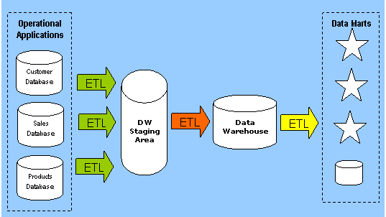
Creating a Data Warehouse Database
Step 3: Create Data staging area (DSA)

Slide 10
Creating a Data Warehouse Database
Step 4: Implementing Dimensions
Define surrogate key type IDENTITY vs sequential numbers
Define SCD attributes
Define lineage and computed columns
Define unknown member
Seed dimensions (DimDate and etc.)

Slide 11
Creating a Data Warehouse Database
Step 5: Implementing Fact Tables
Define partitioning
Define foreign keys
Define lineage and computed columns
Define columns data types

Slide 12
Managing the Performance of a Data Warehouse

Slide 13
Managing the Performance of a Data Warehouse
Step 1: Indexes
Clustered indexes
Nonclustered indexes
Special star join optimization of hash joins for DW queries
Indexed views
Notes:
Clustered indexes are particularly efficient when the clustering key is short. Creating a
clustering index with a long key makes all nonclustered indexes less efficient. In addition, the
clustering key should be unique. If it is not unique, SQL Server makes it unique by adding a
4-byte sequential number called a uniquifier to duplicate keys. This makes keys longer and
all indexes less efficient. Clustering keys should also be ever-increasing. With ever-increasing
keys, minimally logged bulk inserts are possible even if a table already contains data, as long
as the table does not have additional nonclustered indexes.
Data warehouse surrogate keys are ideal for clustered indexes. Because you are the one
who defines them, you can define them as efficiently as possible. Use integers with autonumbering
options. The Primary Key constraint creates a clustered index by default.

Slide 14
Managing the Performance of a Data Warehouse
Step 1: Data Compression
Row compression
Page compression
Unicode compression
Notes:
SQL Server supports data compression. Data compression reduces the size of the database,
which helps improve query performance because queries on compressed data read fewer
pages from disk and thus use less IO. However, data compression requires extra CPU resources
for updates, because data must be decompressed before and compressed after the
update. Data compression is therefore suitable for data warehousing scenarios in which data
is mostly read and only occasionally updated.
SQL Server supports three compression implementations:
■■ Row compression
■■ Page compression
■■ Unicode compression
Row compression reduces metadata overhead by storing fixed data type columns in a
variable-length format. This includes strings and numeric data. Row compression has only a
small impact on CPU resources and is often appropriate for OLTP applications as well.
Page compression includes row compression, but also adds prefix and dictionary compressions.
Prefix compression stores repeated prefixes of values from a single column in a special
compression information (CI) structure that immediately follows the page header, replacing
the repeated prefix values with a reference to the corresponding prefix. Dictionary compression
stores repeated values anywhere in a page in the CI area. Dictionary compression is not
restricted to a single column.
In SQL Server, Unicode characters occupy an average of two bytes. Unicode compression
substitutes single-byte storage for Unicode characters that don’t truly require two bytes. Depending
on collation, Unicode compression can save up to 50 percent of the space otherwise
required for Unicode strings.

Slide 15
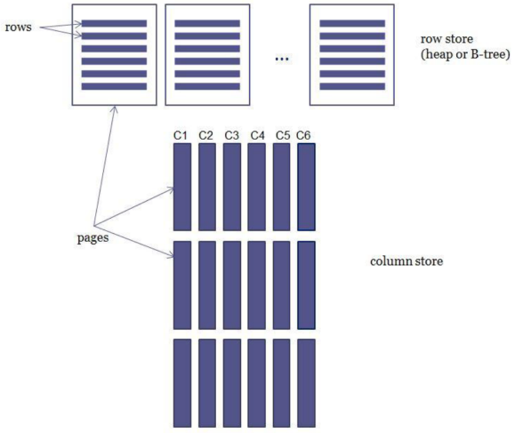
Managing the Performance of a Data Warehouse
Columnstore Indexes and Batch Processing
Notes:
SQL Server supports data compression. Data compression reduces the size of the database,
which helps improve query performance because queries on compressed data read fewer
pages from disk and thus use less IO. However, data compression requires extra CPU resources
for updates, because data must be decompressed before and compressed after the
update. Data compression is therefore suitable for data warehousing scenarios in which data
is mostly read and only occasionally updated.
SQL Server supports three compression implementations:
■■ Row compression
■■ Page compression
■■ Unicode compression
Row compression reduces metadata overhead by storing fixed data type columns in a
variable-length format. This includes strings and numeric data. Row compression has only a
small impact on CPU resources and is often appropriate for OLTP applications as well.
Page compression includes row compression, but also adds prefix and dictionary compressions.
Prefix compression stores repeated prefixes of values from a single column in a special
compression information (CI) structure that immediately follows the page header, replacing
the repeated prefix values with a reference to the corresponding prefix. Dictionary compression
stores repeated values anywhere in a page in the CI area. Dictionary compression is not
restricted to a single column.
In SQL Server, Unicode characters occupy an average of two bytes. Unicode compression
substitutes single-byte storage for Unicode characters that don’t truly require two bytes. Depending
on collation, Unicode compression can save up to 50 percent of the space otherwise
required for Unicode strings.

Slide 16
Managing the Performance of a Data Warehouse
Using Partitions
Minimally logged deletion.
TRUNCATE TABLE command
Minimally logged inserts
table must either be empty
have no indexes
Clustered index only on an ever-increasing (or ever-decreasing) key
Notes:
SQL Server supports data compression. Data compression reduces the size of the database,
which helps improve query performance because queries on compressed data read fewer
pages from disk and thus use less IO. However, data compression requires extra CPU resources
for updates, because data must be decompressed before and compressed after the
update. Data compression is therefore suitable for data warehousing scenarios in which data
is mostly read and only occasionally updated.
SQL Server supports three compression implementations:
■■ Row compression
■■ Page compression
■■ Unicode compression
Row compression reduces metadata overhead by storing fixed data type columns in a
variable-length format. This includes strings and numeric data. Row compression has only a
small impact on CPU resources and is often appropriate for OLTP applications as well.
Page compression includes row compression, but also adds prefix and dictionary compressions.
Prefix compression stores repeated prefixes of values from a single column in a special
compression information (CI) structure that immediately follows the page header, replacing
the repeated prefix values with a reference to the corresponding prefix. Dictionary compression
stores repeated values anywhere in a page in the CI area. Dictionary compression is not
restricted to a single column.
In SQL Server, Unicode characters occupy an average of two bytes. Unicode compression
substitutes single-byte storage for Unicode characters that don’t truly require two bytes. Depending
on collation, Unicode compression can save up to 50 percent of the space otherwise
required for Unicode strings.

Slide 17
Managing the Performance of a Data Warehouse
Using Partitions
Table
Partition 2006 year
Partition 2007 year
Partition 2008 year
Partition 2009 year
Partition 2010 year
Partition 2011 year
Partition 2012 year
Switch partition to table
Truncate or update
Switch table to partition
Insert or update
Notes:
SQL Server supports data compression. Data compression reduces the size of the database,
which helps improve query performance because queries on compressed data read fewer
pages from disk and thus use less IO. However, data compression requires extra CPU resources
for updates, because data must be decompressed before and compressed after the
update. Data compression is therefore suitable for data warehousing scenarios in which data
is mostly read and only occasionally updated.
SQL Server supports three compression implementations:
■■ Row compression
■■ Page compression
■■ Unicode compression
Row compression reduces metadata overhead by storing fixed data type columns in a
variable-length format. This includes strings and numeric data. Row compression has only a
small impact on CPU resources and is often appropriate for OLTP applications as well.
Page compression includes row compression, but also adds prefix and dictionary compressions.
Prefix compression stores repeated prefixes of values from a single column in a special
compression information (CI) structure that immediately follows the page header, replacing
the repeated prefix values with a reference to the corresponding prefix. Dictionary compression
stores repeated values anywhere in a page in the CI area. Dictionary compression is not
restricted to a single column.
In SQL Server, Unicode characters occupy an average of two bytes. Unicode compression
substitutes single-byte storage for Unicode characters that don’t truly require two bytes. Depending
on collation, Unicode compression can save up to 50 percent of the space otherwise
required for Unicode strings.

Slide 18
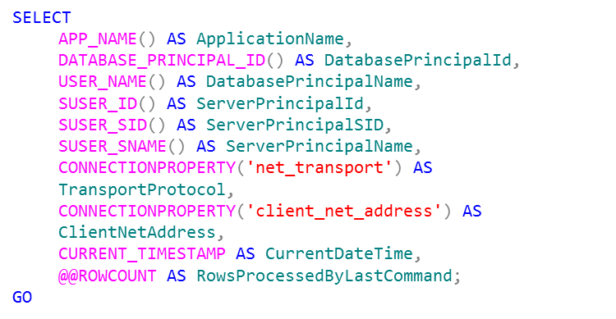
Data Lineage
Data Lineage
Notes:
Auditing by adding data lineage information for your data loads is quite simple. You add appropriate
columns to your dimensions and/or fact tables, and then you insert or update the
values of these columns with each load. If you are using SSIS as your ETL tool, you can use
many of the SSIS system variables to add lineage information to your data flow.
If you are loading data with T-SQL commands and procedures, you can use T-SQL system
functions to get the desired lineage information. The following query uses system functions
that are very useful for capturing lineage information.
Besides lineage information, you might also want to log additional information about the
whole load, not just the row-level information. For example, you might want to add the time
at which the load execution started, when it ended, the number of rows transferred, and so
on. You can create a custom logging table and insert this information at the start and end of
the ETL process. If you are using SSIS as your ETL tool, you can use the SSIS built-in logging
capabilities to store this load-level information

Slide 19
DWH documentation

Slide 20
DWH
Data mapping

Slide 21
DWH
Dimensional model

Slide 22
Developing SSIS
Packages

Slide 23
ETL Developing SSIS Packages
ETL Developing SSIS Packages

Slide 24
ETL Developing SSIS Packages
Extract
Transform
Load

Slide 25
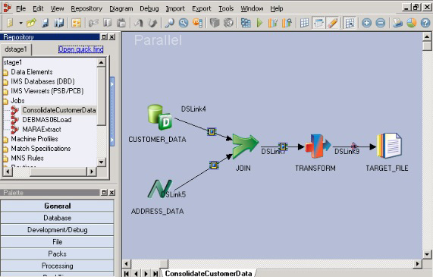
ETL Tools
IBM DATASTAGE

Slide 26
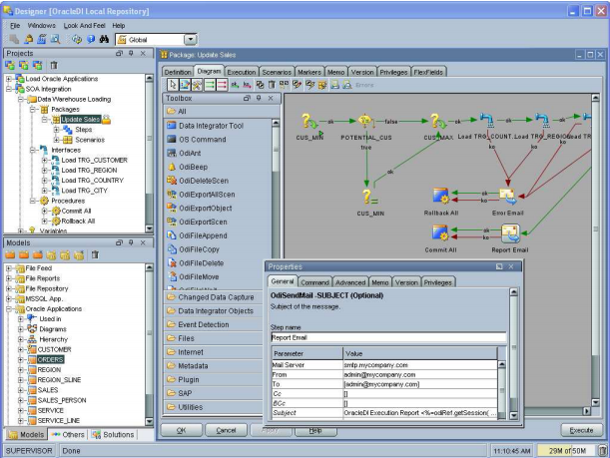
ETL Tools
ORACLE DATA
INTEGRATOR ,
ORACLE
WAREHOUSE BUILDER

Slide 27
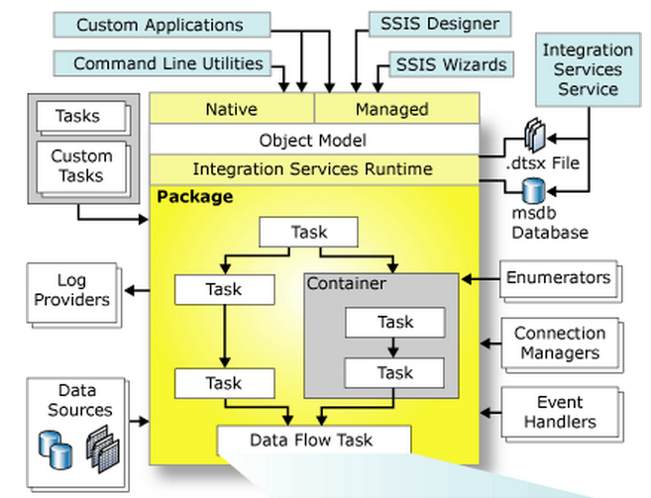
Microsoft SQL Server Integration Services components

Slide 28
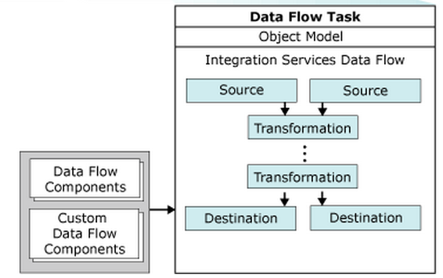
Microsoft SQL Server Integration Services components

Slide 29
Introducing Control Flow, Data Flow, and Connection Managers
Connection managers
Control flow
Data flow

Slide 30
Creating SSIS Packages

Slide 31
Creating SSIS Packages
Using the SQL Server Import and Export Wizard
Developing SSIS Packages in SSDT
Introducing Control Flow, Data Flow, and Connection Managers

Slide 32
UN Statistic Project

Slide 33
UN Statistic Project

