Slide 1

MSBI LAB S21.E01-INTRO
December 14, 2020

Slide 2

Agenda
1
About this course
2
Database evolution
3
MS SQL Server overview
4
Resources
5
Create PoC of a Database

Slide 3
About this course

Slide 4

Business Intelligence
Reporting and analytics
Dashboard development
Data Mining
Predictive Analytics
Performance Management and KPI’s
Metadata presentation and effective usage

Slide 5
MSBI.Dev.S21 : Technologies
MSBI DEVELOPER
MS SQL Server
SSIS
SSAS
Azure
Power BI
OLTP Databases
ETL (Extract – Transform – Load)
Tabular
Storage
Data Warehouse DWH
Data Base Maintenance
DAX
Azure SQL
Administration
Azure Data Factory v2 (ADFv2)
T-SQL
Azure DevOps
C#
PowerShell
Python

Slide 6
MSBI.Dev.S21 : Timeline
December
January
February
March
April
MSBI Developer Course
MS SQL
EXAM
PowerBI
SSIS
Azure
SSAS
Next step

Slide 7
MSBI.Dev.S21 : Workflow
Monday
Tuesday
Wednesday
Thursday
Friday
Saturday
Sunday
Week 1
Lecture 10:00
Lecture 10:00
Homework
Homework
Making
Making
Week 2
Deadline
Deadline
Checking
Checking
Week 3
Result
Result

Slide 8
Database evolution

Slide 9

Database evolution
1
Clay Tablet
2
File Management System
3
Hierarchical database System
4
Network Database System
5
Relational Database System (RDBMS)
6
NoSQL, NewSQL

Slide 10
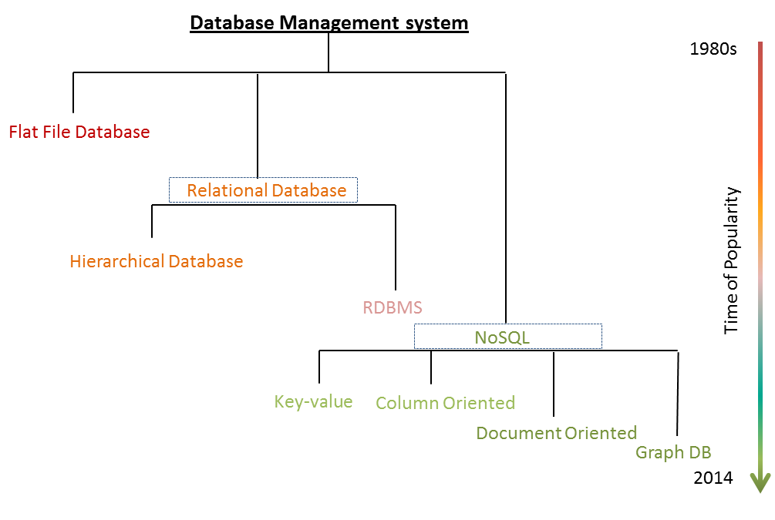
Database evolution

Slide 11
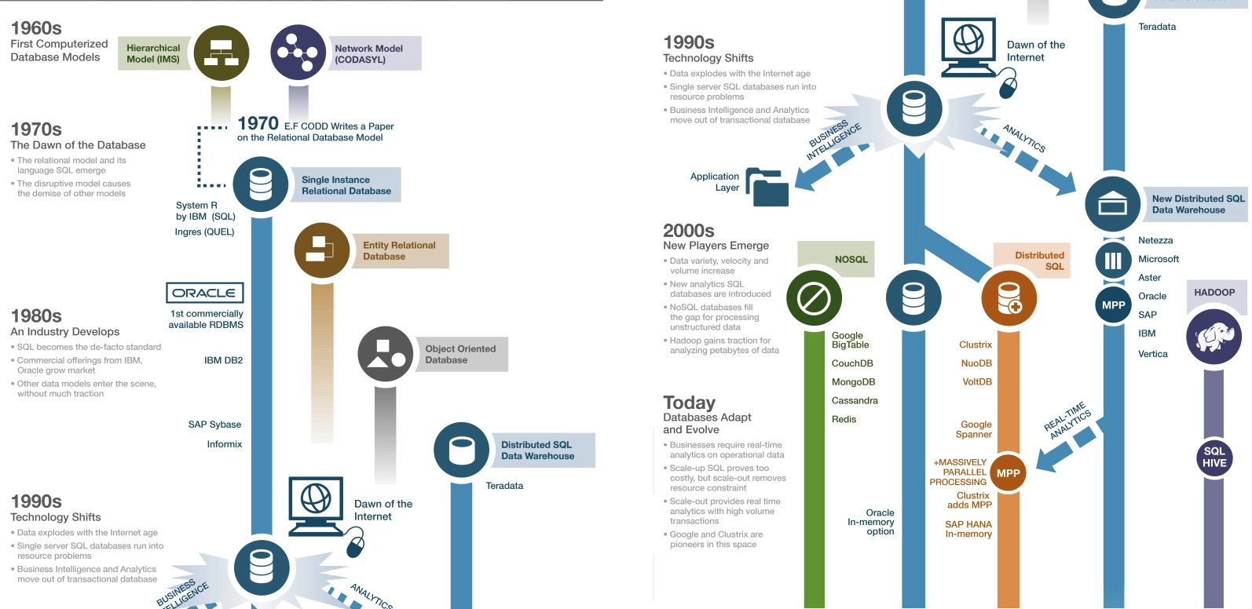
Database evolution

Slide 12

Database evolution
File Management System

Slide 13
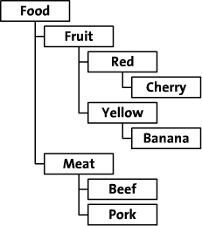
Database evolution
Hierarchical database System

Slide 14
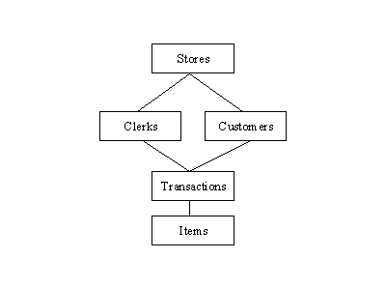
Database evolution
Network Database System

Slide 15
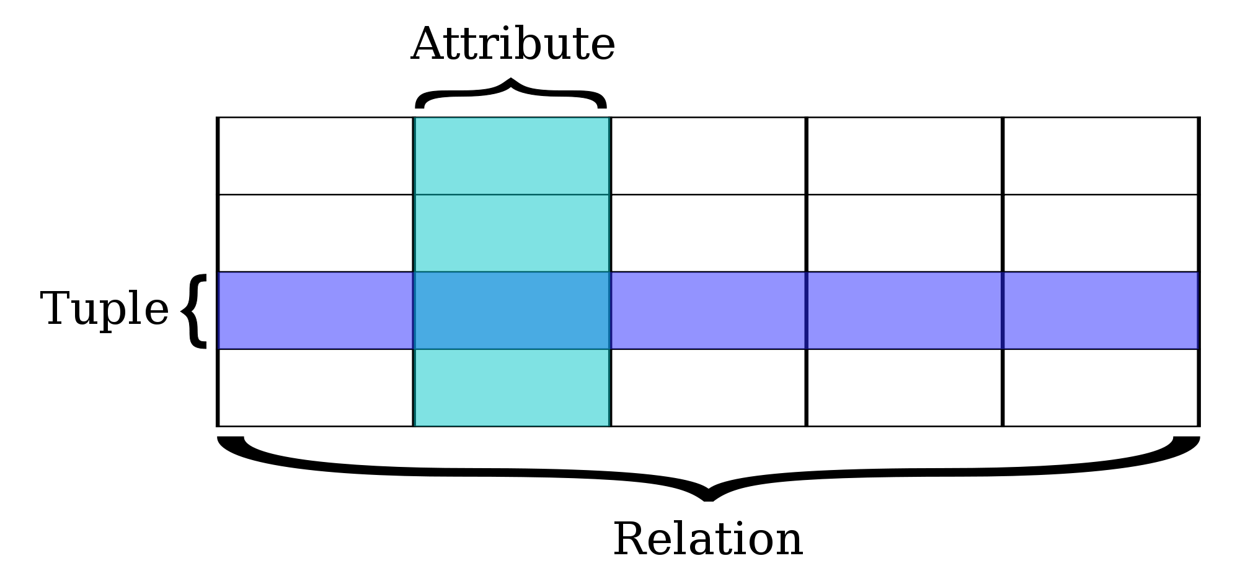
Database evolution
Relational Database System

Slide 16
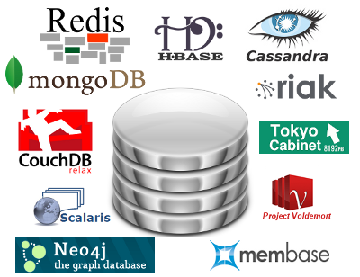
Database evolution
NoSQL

Slide 17
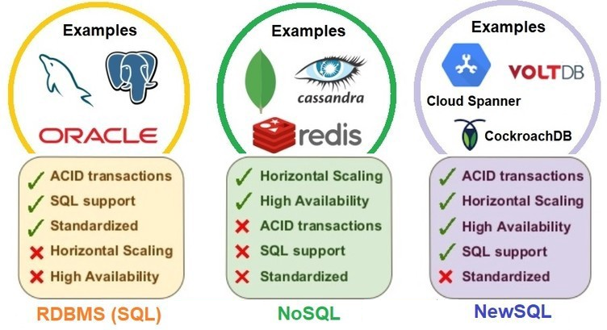
Database evolution
NOSQL, NEWSQL

Slide 18
MS SQL Server overview

Slide 19
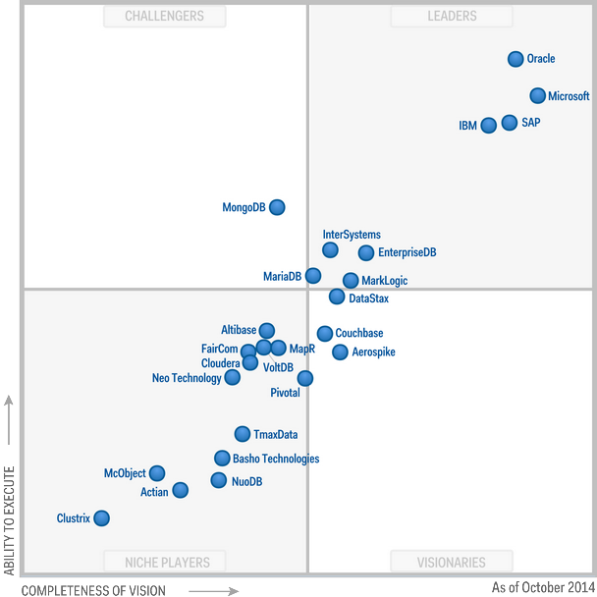
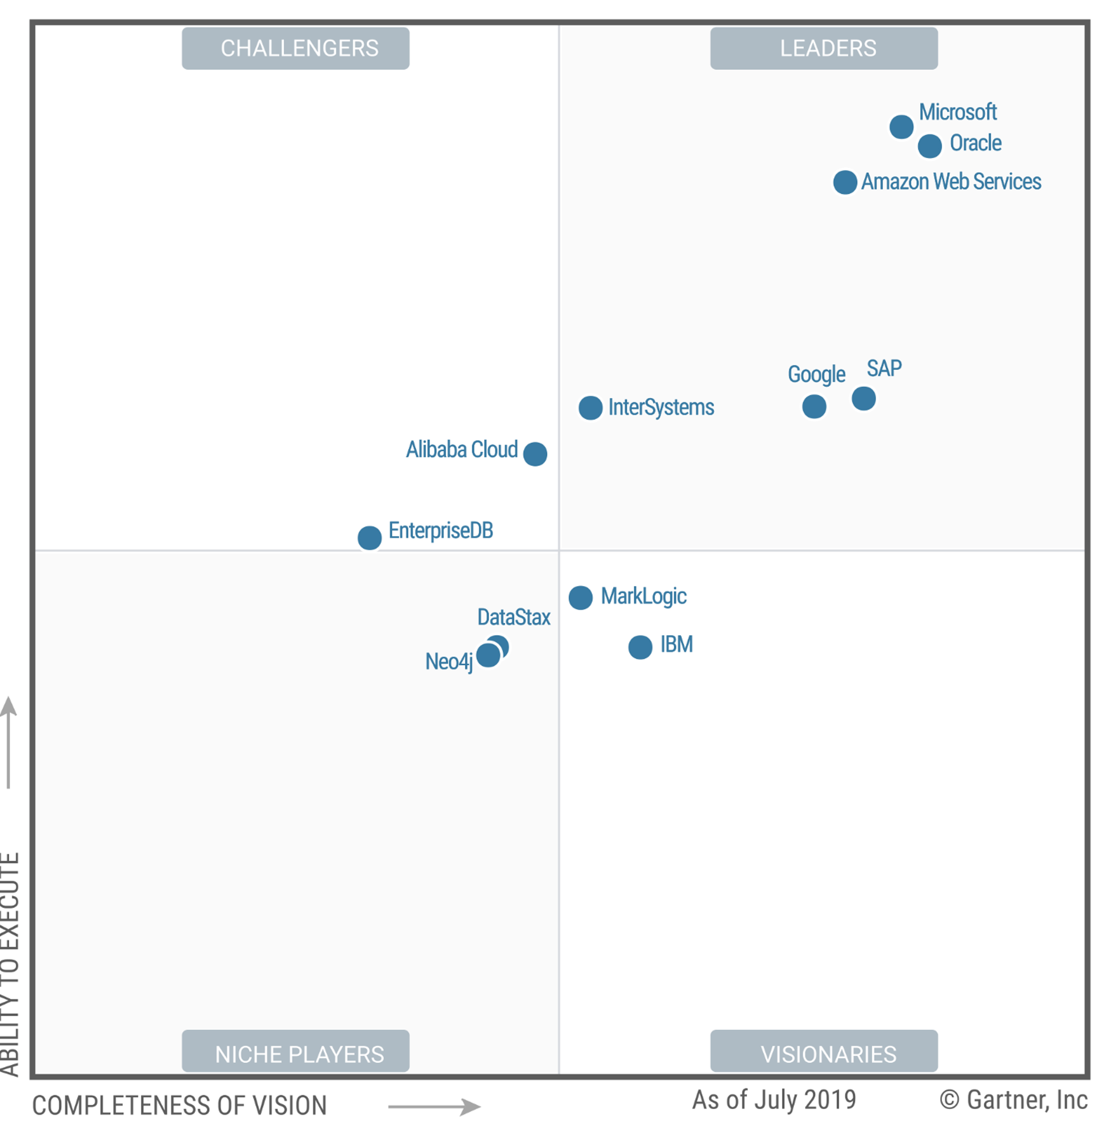
MS SQL Server overview
Magic Quadrant for Operational Database Management Systems
2014
2019

Slide 20
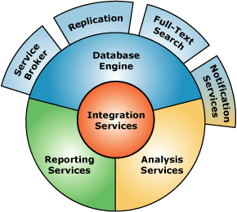
MS SQL Server overview
Key Components
1
Database Engine
2
SQL Server Integration Services (SSIS)
3
SQL Server Analysis Services (SSAS)
4
SQL Server Reporting Services (SSRS)

Slide 21
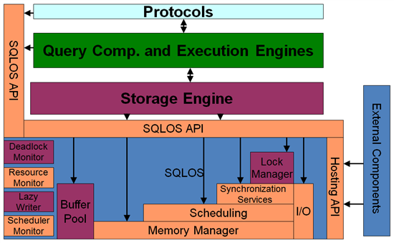
MS SQL Server overview
Database Engine

Slide 22
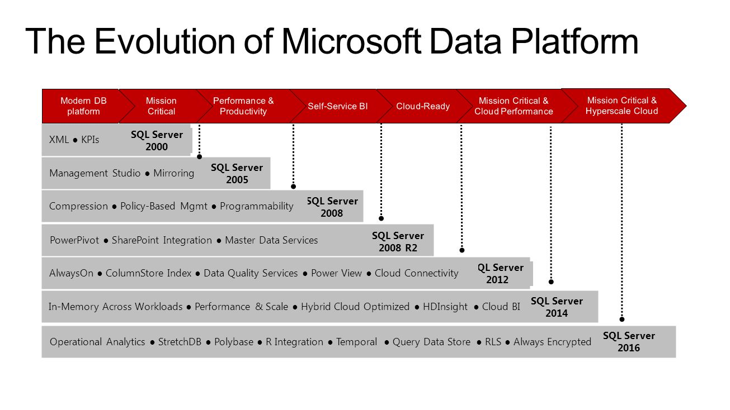
MS SQL Server overview

Slide 23
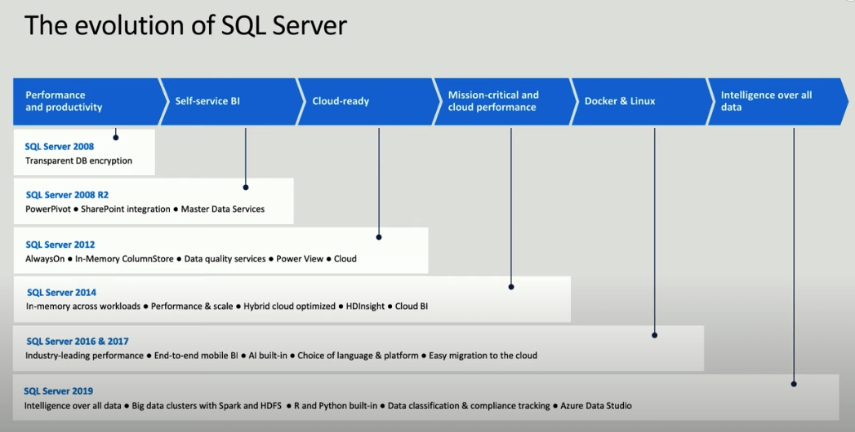
MS SQL Server overview

Slide 24
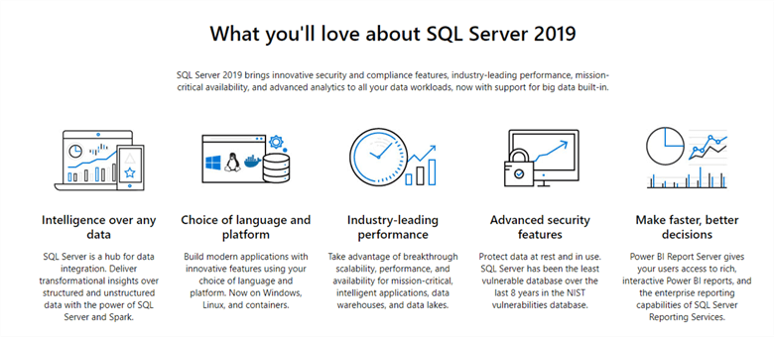
MS SQL Server overview

Slide 25
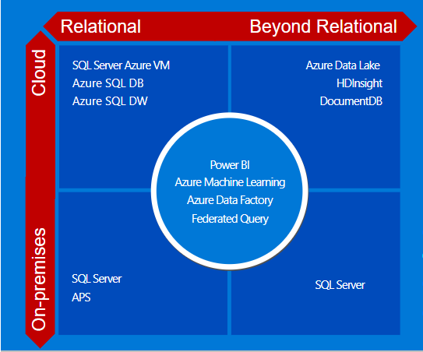
MS SQL Server overview
Trend: Cloud

Slide 26
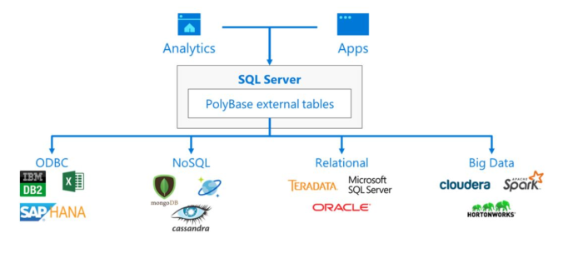
MS SQL Server overview
Trend: Polybase

Slide 27
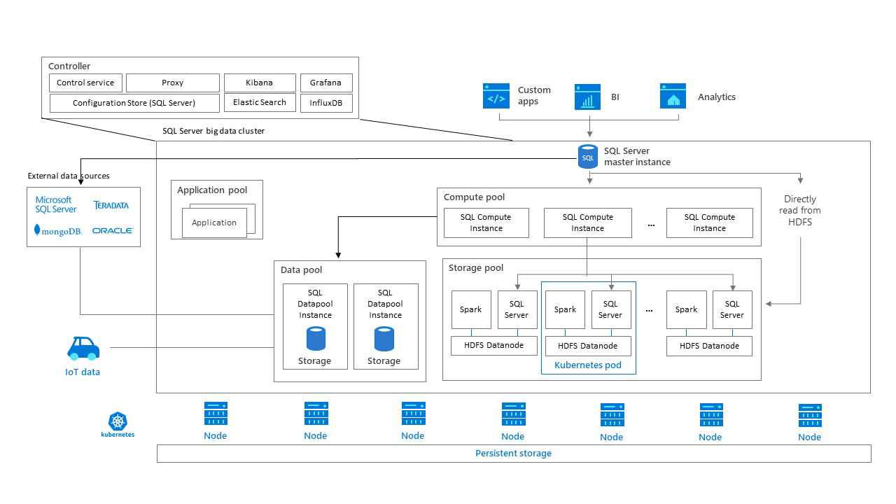
MS SQL Server overview
TREND: Big Data Clusters

Slide 28
Resources

Slide 29
PoC of a Database

Slide 30
PoC of a Database

