Slide 1

MSBI LAB S21.E02-SQL
December 17, 2020

Slide 2

IN THE PREVIOUS PART
1
Database evolution
2
MS SQL Server overview
3
Course workflow and resources
4
POC of a database

Slide 3

S21E02 AGENDA
1
Data Storage Internals
2
Tables and Indexes
3
Foundations of Querying
4
Getting Started with the SELECT Statement
5
Working with Git, Jira, Draw.io
6
Library OLTP Database (Homework assignment)

Slide 4
Data Storage Internals

Slide 5
Data Storage Internals
Databases
Database Files and Filegroups
Data Pages and Data Rows
Large Objects (LOB) Storage
Extents and Allocation Map Pages
Data Modifications

Slide 6
Data Storage Internals
System Database
master Database
resource Database
msdb Database
model Database
tempdb Database

Slide 7
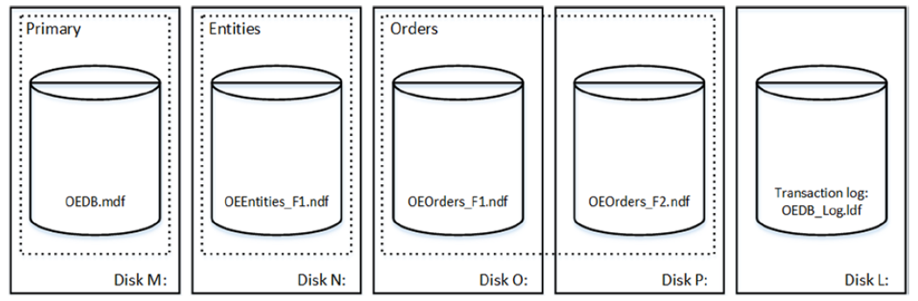
Data Storage Internals
Database Files and Filegroups

Slide 8
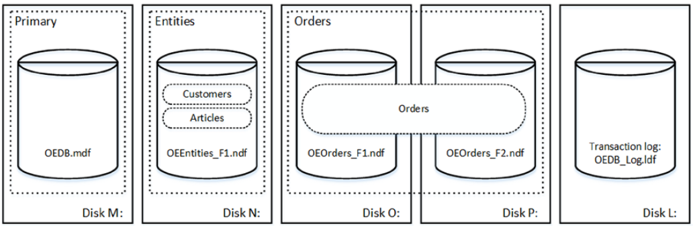
Data Storage Internals
Database Files and Filegroups

Slide 9
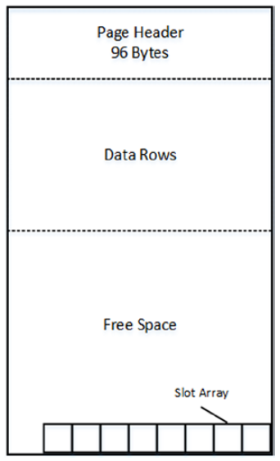
Data Storage Internals
Data Pages and Data Rows
The space in the database is divided into logical 8KB pages

Slide 10
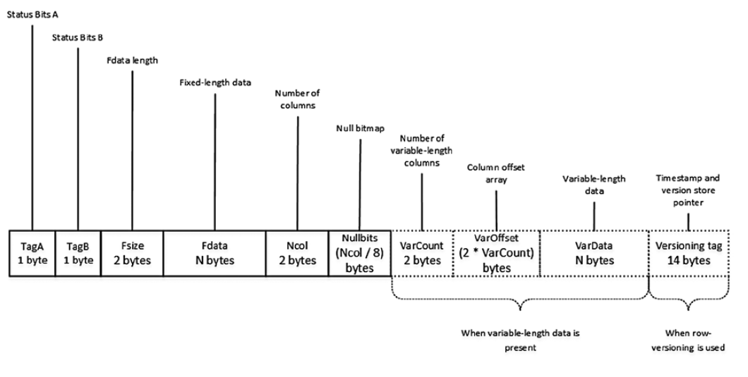
Data Storage Internals
Data Pages and Data Rows

Slide 11
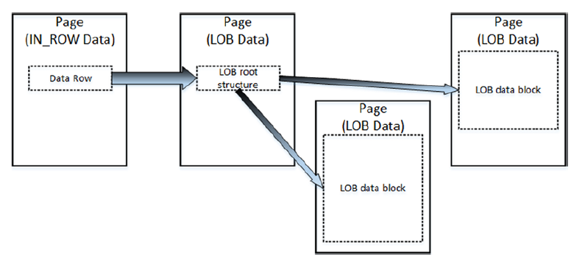
Data Storage Internals
Large Objects Storage
Row-Overflow Storage
LOB Storage

Slide 12
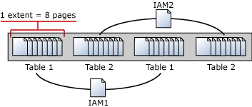
Data Storage Internals
Extents and Allocation Map Pages

Slide 13
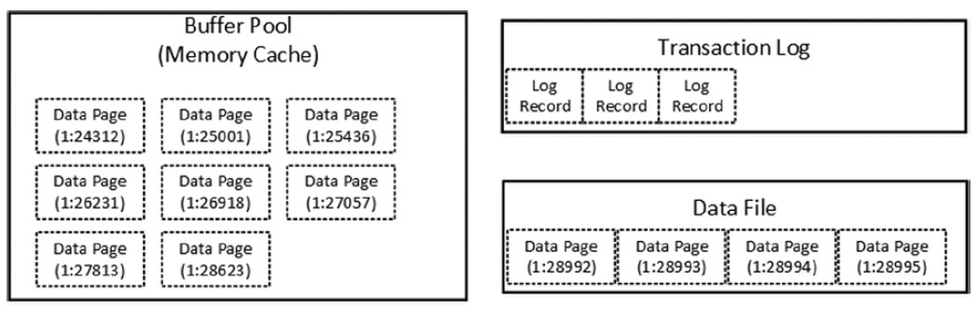
Data Storage Internals
Data Modifications
Initial stage

Slide 14
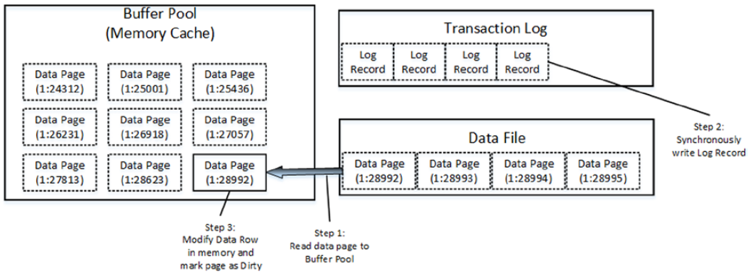
Data Storage Internals
Data Modifications
Modifying data

Slide 15
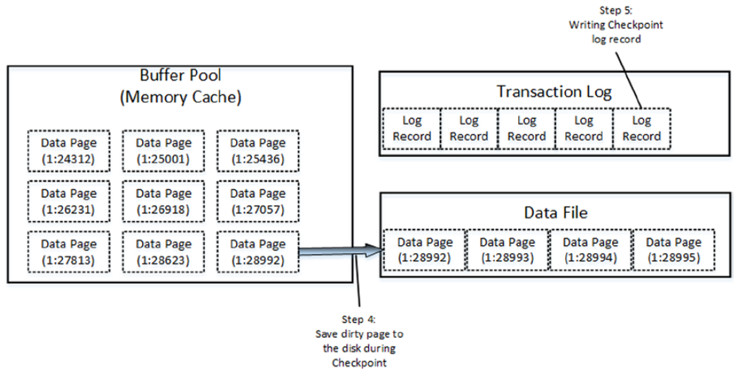
Data Storage Internals
Data Modifications
Checkpoint

Slide 16
Tables and Indexes Internal Structure and Access Methods

Slide 17
Tables and Indexes: Internal Structure and Access Methods
Heap Tables
Clustered Indexes
Composite Indexes
Nonclustered Indexes

Slide 18

Tables and Indexes: Internal Structure and Access Methods
Heap Tables
Heap tables are tables without a clustered index.
The data in heap tables is unsorted.
SQL Server does not guarantee, nor does it maintain, a sorting order of the data in the heap tables.

Slide 19
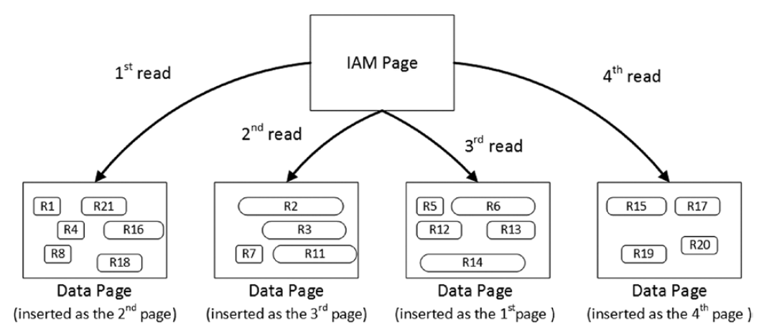
Tables and Indexes: Internal Structure and Access Methods
Heap Tables

Slide 20
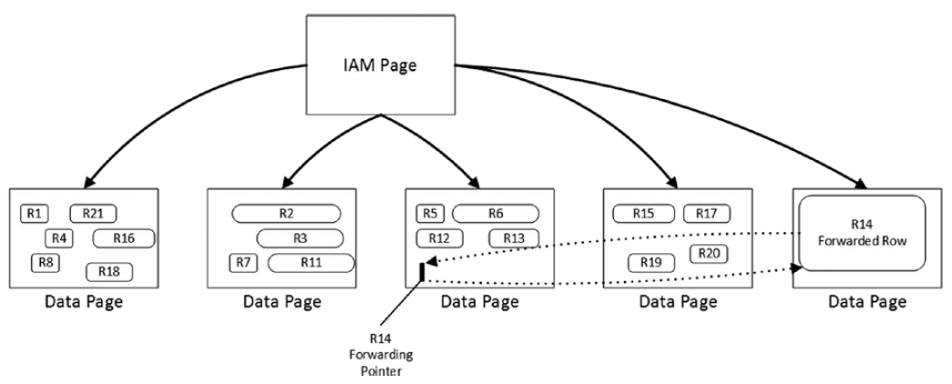
Tables and Indexes: Internal Structure and Access Methods
Heap Tables
Forwarding pointers

Slide 21
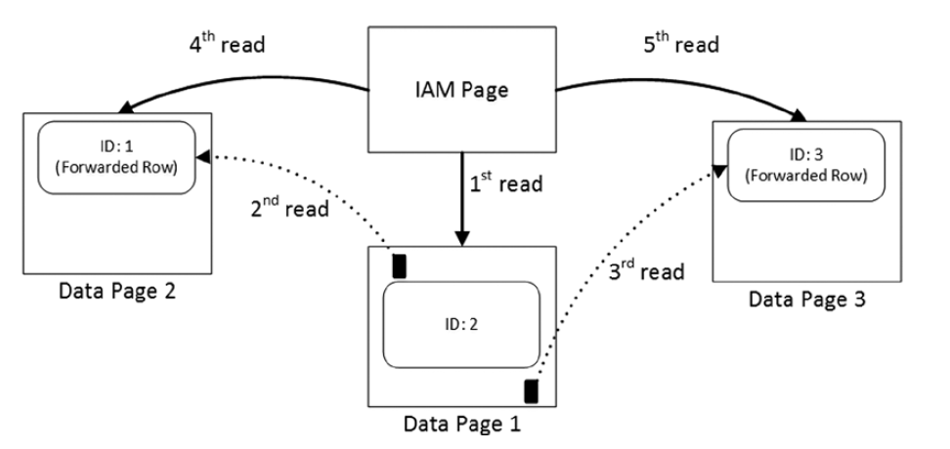
Tables and Indexes: Internal Structure and Access Methods
Heap Tables
Reading data when the forwarding pointers exist

Slide 22

Tables and Indexes: Internal Structure and Access Methods
Clustered Indexes
A clustered index dictates the physical order of the data in a table, which is sorted according to the clustered index key.
The table can have only one clustered index defined.

Slide 23
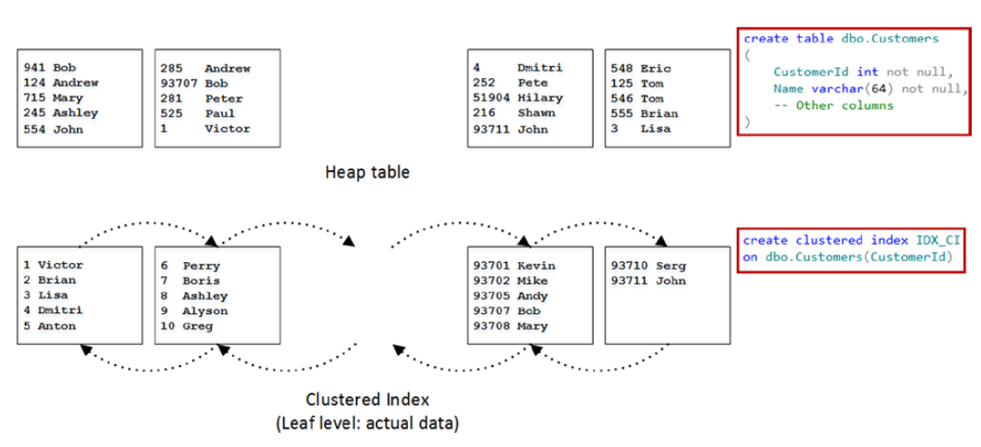
Tables and Indexes: Internal Structure and Access Methods
Clustered Indexes

Slide 24
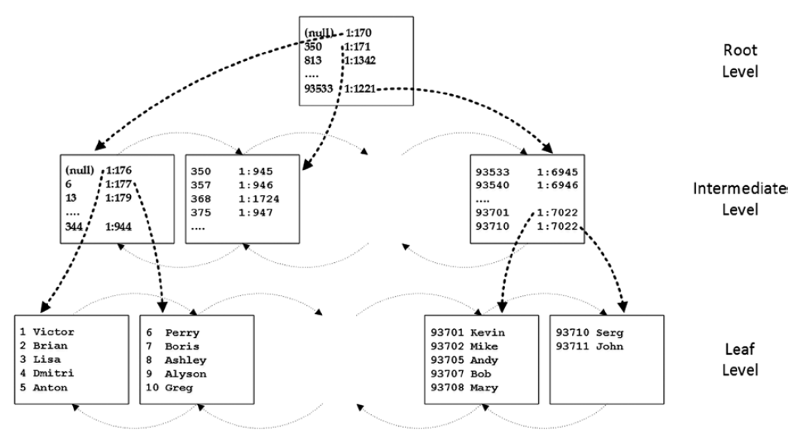
Tables and Indexes: Internal Structure and Access Methods
Clustered Indexes

Slide 25
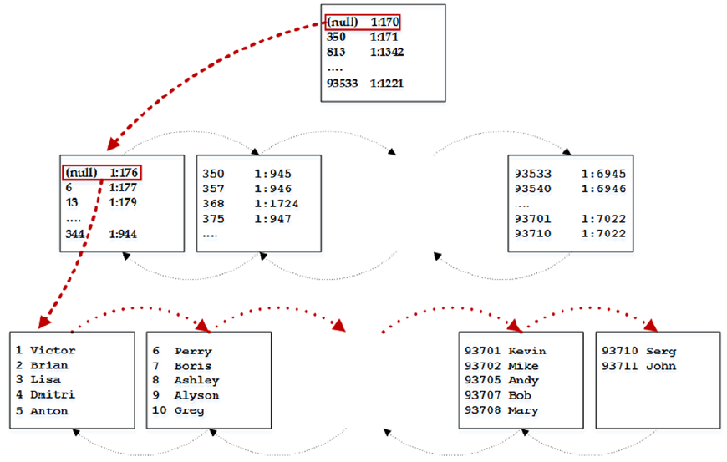
Tables and Indexes: Internal Structure and Access Methods
Clustered Indexes
Ordered index scan

Slide 26
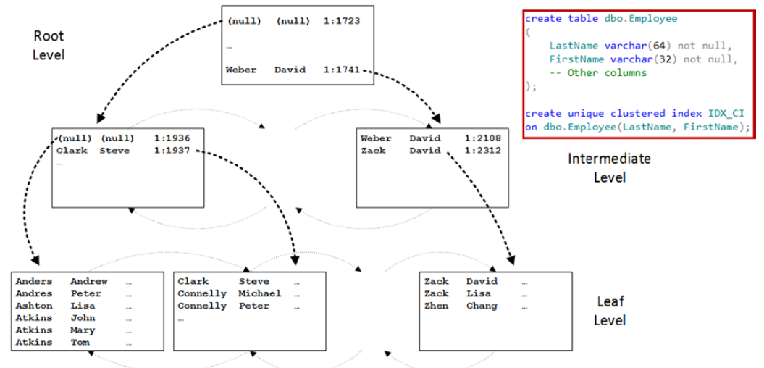
Tables and Indexes: Internal Structure and Access Methods
Composite Indexes

Slide 27
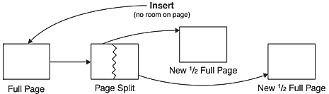
Tables and Indexes: Internal Structure and Access Methods
Page split

Slide 28
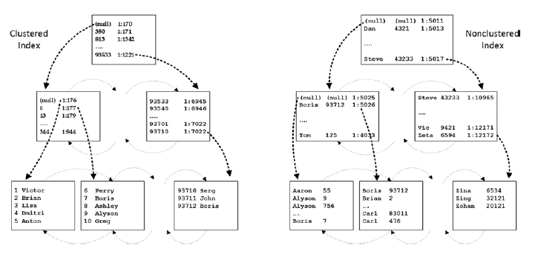
Tables and Indexes: Internal Structure and Access Methods
Nonclustered Indexes

Slide 29
Foundations of T-SQL

Slide 30
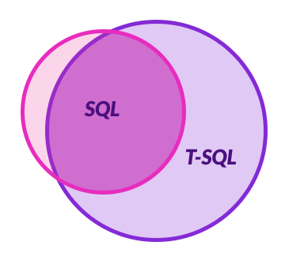
Foundations of T-SQL
SQL
T-SQL
ISO/IEC 9075 standard
International Organization for Standards (ISO)
American National Standards Institute (ANSI)
Dialect of SQL

Slide 31
Foundations of T-SQL
@Variable1 <> @Variable2
@Variable1 != @Variable2
CAST
CONVERT
SELECT TOP 1
Standard (SQL)
Is not a standard (T-SQL only)
Standard (SQL)
Is not a standard (T-SQL only)
Is not a standard (T-SQL only)

Slide 32
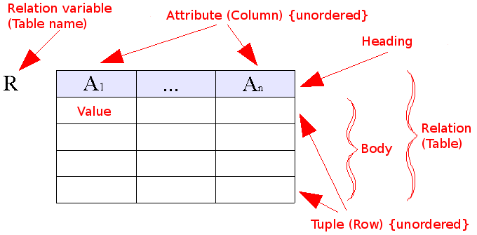
Foundations of T-SQL
Relational model

Slide 33

Foundations of T-SQL
THREE-VALUED PREDICATE LOGIC
True
False,
Unknown
SELECT [empid]
,[lastname]
,[region]
FROM [TSQL2012].[HR].[Employees]
WHERE [region]='WA'
NULL

Slide 34
Foundations of T-SQL
Using T-SQL in a Relational Way
DEMO

Slide 35
Understanding Logical Query Processing
T-SQL As a Declarative English-Like Language
declarative means you define what you want
imperative languages define how to achieve what you want
“Bring me a soda from the refrigerator.”
SELECT shipperid, phone, companyname
FROM Sales.Shippers;
“Go to the refrigerator; open the door; get a soda; bring it to me.”

Slide 36
Understanding Logical Query Processing
T-SQL As a Declarative English-Like Language
For human
For robot
“Bring me a soda from the refrigerator.”
SELECT shipperid, phone, companyname
FROM Sales.Shippers;
DEMO
“Go to the refrigerator; open the door; get a soda; bring it to me.”
FROM Sales.Shippers
SELECT shipperid, phone, companyname;

Slide 37
Understanding Logical Query Processing
Logical Query Processing Phases
In T-SQL Query
1. SELECT
2. FROM
3. WHERE
4. GROUP BY
5. HAVING
6. ORDER BY
Logical query processing order
1. FROM
2. WHERE
3. GROUP BY
4. HAVING
5. SELECT
6. ORDER BY

Slide 38
Getting Started with the SELECT Statement

Slide 39
Getting Started with the SELECT Statement
Using the FROM and SELECT Clauses
DEMO

Slide 40
Getting Started with the SELECT Statement
Working with Data Types and Built-in Functions
DEMO
Data Types (Transact-SQL)” at https://docs.microsoft.com/en-us/sql/t-sql/data-types/data-types-transact-sql
Built-in Functions (Transact-SQL)” at https://docs.microsoft.com/en-us/sql/t-sql/functions/functions

Slide 41
Working with Git, Jira, Draw.io

Slide 42
Working with GIT

Slide 43
Working with Jira

Slide 44
Working with Draw.io

Slide 45
Homework Assignment

Slide 46
Homework Assignment

