Slide 1

MSBI LAB S21.E03-SQL
December 21, 2020

Slide 2

IN THE PREVIOUS PART
1
Data Storage Internals
2
Tables and Indexes
3
Foundations of Querying
4
Getting Started with the SELECT Statement
5
Working with Git, Jira, Draw.io
6
Library OLTP Database (Homework assignment)

Slide 3

S21E03 AGENDA
1
Choosing a Data Type for Keys
2
CASE Expression and Related Functions
3
Filtering and Sorting Data
4
Combining Sets (JOINS)
5
Working with Git
6
Design for OLTP Database (Web Store)

Slide 4
Choosing a Data Type for Keys

Slide 5
Choosing a Data Type for Keys
Choosing a Data Type for Keys
The identity column property
The sequence object
Nonsequential GUIDs
Sequential GUIDs
Custom solutions

Slide 6
CASE Expression and Related Functions

Slide 7
CASE Expression and Related Functions
SELECT
productid,
productname,
unitprice,
discontinued,
CASE discontinued
WHEN 0 THEN 'No'
WHEN 1 THEN 'Yes'
ELSE 'Unknown'
END AS discontinued_desc
FROM Production.Products;
COALESCE
ISNULL
CHOOSE
IIF

Slide 8
Filtering and Sorting Data

Slide 9

Filtering and Sorting Data
Filtering Data with Predicates
Predicates
ON
WHERE
HAVING
Three-Valued Logic and Search Arguments

Slide 10
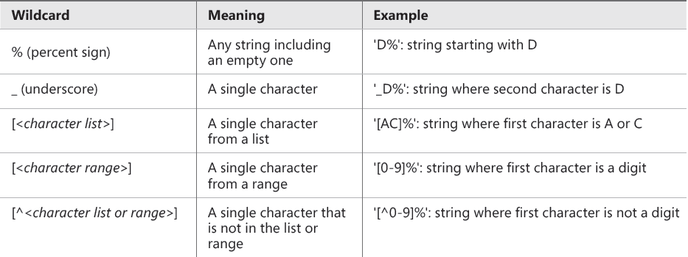
Filtering and Sorting Data
Filtering Character Data
LIKE

Slide 11
Filtering and Sorting Data
Search Arguments

Slide 12
Filtering and Sorting Data
Search Arguments
Non-SARG
SARG
WHERE [Column] - 1 = @var
WHERE ABS([Column]) = 1
WHERE ISNULL([Column], 1) = 1
WHERE DATEADD(DAY, 7, [Column]) > GETDATE()
WHERE SUBSTRING([Column], 1, 4) = 'ABCD'
WHERE [Column] LIKE '%ABC%'
WHERE [Column] = @var + 1
WHERE [Column] IN (-1, 1)
WHERE (([Column] = 1) OR ([Column] IS NULL))
WHERE [Column] > DATEADD(DAY, -7, GETDATE())
WHERE [Column] LIKE 'ABCD%'

Slide 13
Filtering and Sorting Data
Filtering Date and Time Data
Use YYYYMDD format
SELECT orderid, orderdate, empid, custid
FROM Sales.Orders
WHERE orderdate = '02/12/07';
SELECT orderid, orderdate, empid, custid
FROM Sales.Orders
WHERE orderdate = '20070212';

Slide 14
Filtering and Sorting Data
Filtering Data with TOP and OFFSET-FETCH
Filtering Data with TOP
Filtering Data with OFFSET-FETCH
T-SQL only
SQL standard; supports skipping
Deterministic results of sorting

Slide 15
Filtering and Sorting Data
DEMO

Slide 16
Combining Sets (Joins)

Slide 17
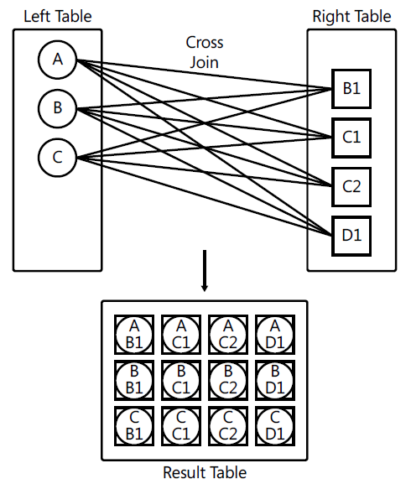
Combining Sets
CROSS Join

Slide 18
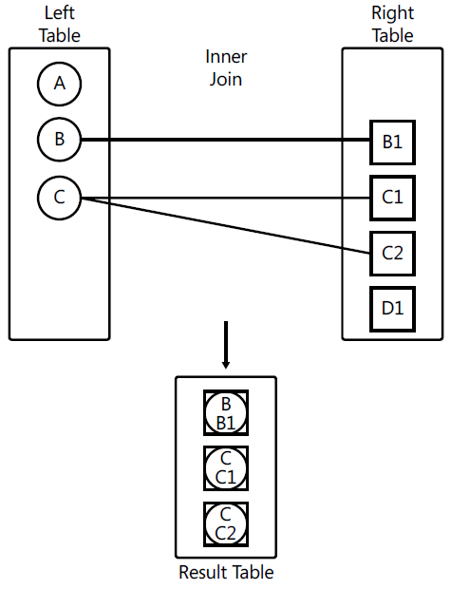
Combining Sets
Inner Join

Slide 19
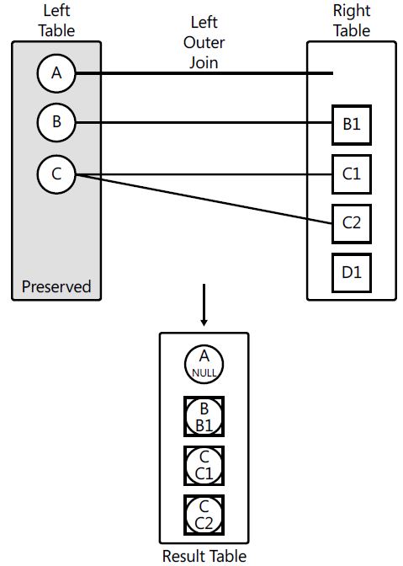
Combining Sets
Outer Joins

Slide 20
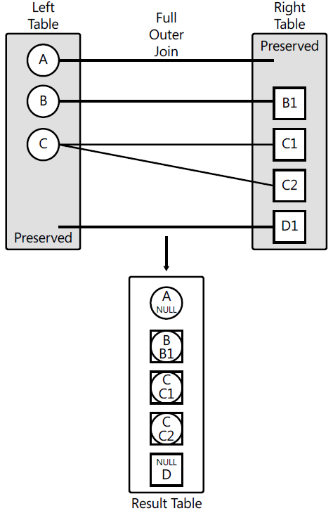
Combining Sets
FULL OUTER JOIN

Slide 21
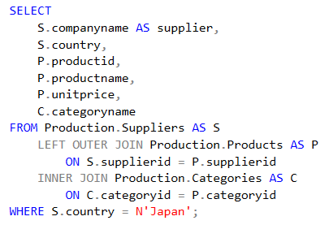
Combining Sets
Multi-Join Queries

Slide 22
Combining Sets
USING JOINS
DEMO

Slide 23
Working with Git

Slide 24
Working with Git
DEMO

Slide 25
Design for OLTP Database

Slide 26
Design for OLTP Database (Web Store)

