Slide 1

MSBI LAB S21.E04-SQL
December 24, 2020

Slide 2

IN THE PREVIOUS PART
1
Choosing a Data Type for Keys
2
CASE Expression and Related Functions
3
Filtering and Sorting Data
4
Combining Sets (JOINS)
5
Working with Git
6
Design for OLTP Database (Web Store)

Slide 3

S21E04 AGENDA
1
Using Set Operators
2
Using Subqueries AND Table Expressions
3
USING APPLY Operator
4
Grouping
5
Pivoting and Unpivoting Data
6
Design for OLTP Database: EAV pattern

Slide 4
Using Set Operators

Slide 5


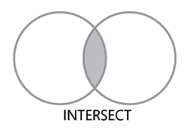
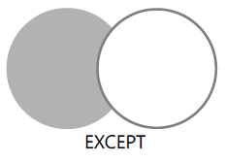
Using Set Operators

Slide 6
Using Set Operators
DEMO

Slide 7
Using Subqueries AND Table Expressions

Slide 8
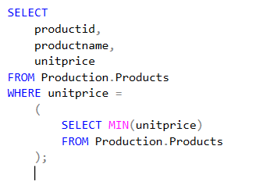
Using Subqueries and Table Expressions
Self-Contained Subqueries
Self-contained subqueries are subqueries that have no dependency on the outer query.
Notes:
Note that if what’s supposed to be a scalar subquery returns in practice more than one
value, the code fails at run time. If the scalar subquery returns an empty set, it is converted to
a NULL.

Slide 9
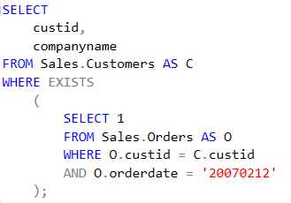
Using Subqueries and Table Expressions
Correlated Subqueries
Correlated subqueries are subqueries where the inner query has a reference to a column from the table in the outer query.

Slide 10
Using Subqueries and Table Expressions
Table Expressions
Table expressions are named queries.
Derived tables
Common table expressions (CTEs)
Views
Inline table-valued functions

Slide 11
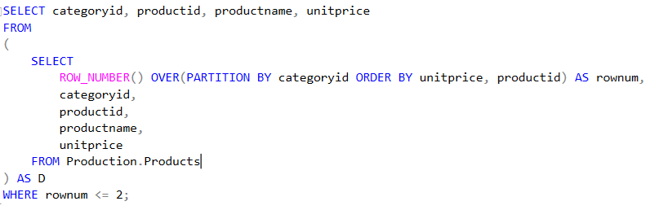
Using Subqueries and Table Expressions
Derived Tables

Slide 12
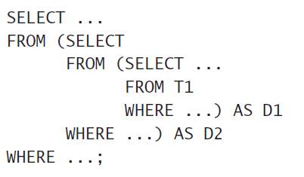
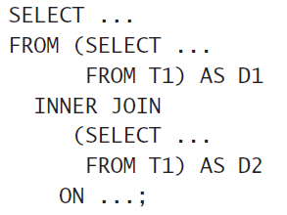
Using Subqueries and Table Expressions
Derived Tables

Slide 13
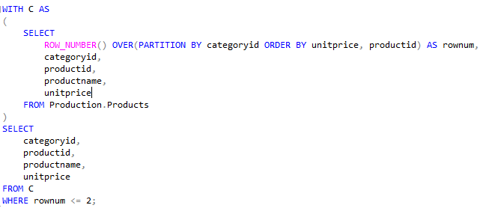
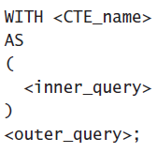
Using Subqueries and Table Expressions
CTE
common table expression (CTE)

Slide 14
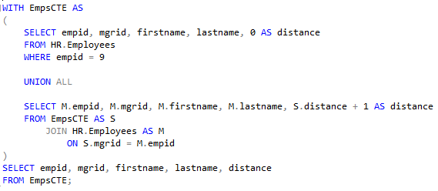
Using Subqueries and Table Expressions
CTE recursive form
common table expression (CTE) recursive form

Slide 15
Using Subqueries and Table Expressions
DEMO

Slide 16
Using APPLY Operator

Slide 17
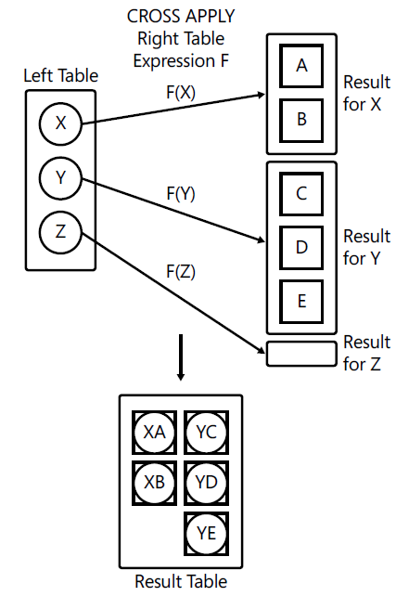
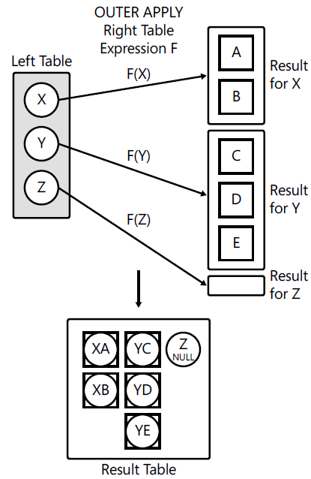
Using APPLY Operator
CROSS APPLY
OUTER APPLY

Slide 18
Using APPLY Operator
DEMO

Slide 19
Grouping

Slide 20
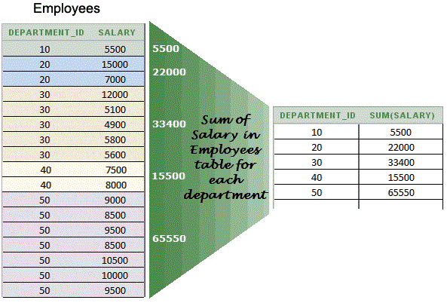
Grouping
SUM, COUNT, AVG, MIN, MAX

Slide 21
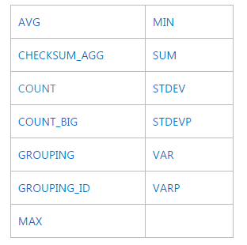
Grouping
Aggregate Functions
https://docs.microsoft.com/en-us/sql/t-sql/functions/aggregate-functions-transact-sql

Slide 22
Grouping
SINGLE Grouping Sets
SELECT
shipperid,
YEAR(shippeddate) AS shippedyear,
COUNT(*) AS numorders
FROM Sales.Orders
GROUP BY shipperid, YEAR(shippeddate)
ORDER BY shipperid;

Slide 23
Grouping
Multiple Grouping Sets
SELECT shipperid, YEAR(shippeddate) AS shipyear, COUNT(*) AS numorders
FROM Sales.Orders
GROUP BY GROUPING SETS
(
( shipperid, YEAR(shippeddate) ),
( YEAR(shippeddate) ),
( )
)

Slide 24
Grouping
DEMO

Slide 25
Pivoting and Unpivoting Data

Slide 26
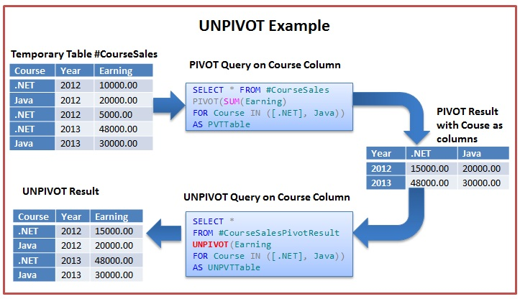
Pivoting and Unpivoting Data
WITH PivotData AS
(
SELECT
< grouping column >,
< spreading column >,
< aggregation column >
FROM < source table >
)
SELECT < select list >
FROM PivotData
PIVOT( < aggregate function >(< aggregation column >)
FOR < spreading column > IN (< distinct spreading values >) ) AS P;
SELECT < column list >, < names column >, < values column >
FROM < source table >
UNPIVOT( < values column > FOR < names column > IN( <source columns> ) ) AS U;

Slide 27
Pivoting and Unpivoting Data
DEMO

Slide 28
EAV Pattern

Slide 29
EAV pattern

