Slide 1



Feb 23, 2019
3
Notes:
Appendix includes recent awards, please visit elements.epam.com for all 2016-2017 awards

Slide 2
IN PREVIOUS PART: S18E07
---
topics:
- topicname: Designing and Implementing Views and Inline Functions
subtopics:
- subtopicname: Views
- subtopicname: Inline Functions
- topicname: Using Synonyms
subtopics:
- subtopicname: Creating a Synonym
- topicname: Hierarchies
subtopics:
- subtopicname: Adjacency List Model
- subtopicname: Nested Set Model of Hierarchies
- subtopicname: HierarchyID
- topicname: Design for OLTP Database
subtopics:
- subtopicname: Remnants
- subtopicname: Fact Tables and Dimensions
- topicname: Team work with GIT
subtopics:
- subtopicname: Git branching model
- subtopicname: Workflow with branches and Pull Requests
---
3
Notes:
Appendix includes recent awards, please visit elements.epam.com for all 2016-2017 awards

Slide 3
Agenda: MSBI.Dev.S19E08
---
topics:
- topicname: Inserting Data
subtopics:
- subtopicname: INSERT VALUES
- subtopicname: INSERT SELECT
- subtopicname: INSERT EXEC
- subtopicname: SELECT INTO
- topicname: Updating Data
subtopics:
- subtopicname: UPDATE Statement
- subtopicname: UPDATE Based on Join
- subtopicname: Nondeterministic UPDATE
- subtopicname: UPDATE and Table Expressions
- subtopicname: UPDATE Based on a Variable
- subtopicname: UPDATE All-at-Once
- topicname: Deleting Data
subtopics:
- subtopicname: DELETE Statement
- subtopicname: TRUNCATE Statement
- subtopicname: DELETE Based on a Join
- subtopicname: DELETE Using Table Expressions
- topicname: Other Data Modification Aspects
subtopics:
- subtopicname: Using the IDENTITY Column Property
keywords: [SCOPE_IDENTITY,IDENTITY,IDENT_CURRENT]
- subtopicname: Using the Sequence Object
---
3
Notes:
Appendix includes recent awards, please visit elements.epam.com for all 2016-2017 awards

Slide 4
Agenda: MSBI.Dev.S19E08
- topicname: Merging Data
subtopics:
- subtopicname: Using the MERGE Statement
- topicname: Using the OUTPUT Option
subtopics:
- subtopicname: Working with the OUTPUT Clause
- subtopicname: INSERT with OUTPUT
- subtopicname: DELETE with OUTPUT
- subtopicname: UPDATE with OUTPUT
- subtopicname: MERGE with OUTPUT
- subtopicname: Composable DML
3
Notes:
Appendix includes recent awards, please visit elements.epam.com for all 2016-2017 awards

Slide 5
Inserting Data

Slide 6
Inserting, Updating, and Deleting Data
Inserting Data
INSERT VALUES
INSERT SELECT
INSERT EXEC
SELECT INTO
Notes:
If you want the target column’s type to be different than the source, you can use the CAST
or CONVERT functions. But remember that in such a case, the target column will be defined
as allowing NULLs even if the source column disallowed NULLs, because you applied manipulation
to the source column. As with the previous examples, you can use the ISNULL function
to make SQL Server define the target column as not allowing NULLs. For example, to convert
the orderdate column from its source type DATETIME to DATE in the target, and disallow
NULLs, use the expression ISNULL(CAST(orderdate AS DATE), '19000101') AS orderdate.

Slide 7
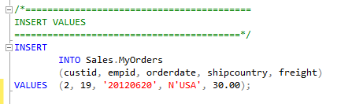
Inserting, Updating, and Deleting Data
Inserting Data
INSERT VALUES
INSERT SELECT
INSERT EXEC
SELECT INTO
Notes:
If you want the target column’s type to be different than the source, you can use the CAST
or CONVERT functions. But remember that in such a case, the target column will be defined
as allowing NULLs even if the source column disallowed NULLs, because you applied manipulation
to the source column. As with the previous examples, you can use the ISNULL function
to make SQL Server define the target column as not allowing NULLs. For example, to convert
the orderdate column from its source type DATETIME to DATE in the target, and disallow
NULLs, use the expression ISNULL(CAST(orderdate AS DATE), '19000101') AS orderdate.

Slide 8
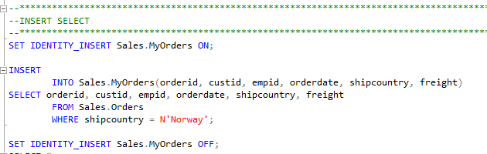
Inserting, Updating, and Deleting Data
Inserting Data
INSERT VALUES
INSERT SELECT
INSERT EXEC
SELECT INTO
Notes:
If you want the target column’s type to be different than the source, you can use the CAST
or CONVERT functions. But remember that in such a case, the target column will be defined
as allowing NULLs even if the source column disallowed NULLs, because you applied manipulation
to the source column. As with the previous examples, you can use the ISNULL function
to make SQL Server define the target column as not allowing NULLs. For example, to convert
the orderdate column from its source type DATETIME to DATE in the target, and disallow
NULLs, use the expression ISNULL(CAST(orderdate AS DATE), '19000101') AS orderdate.

Slide 9
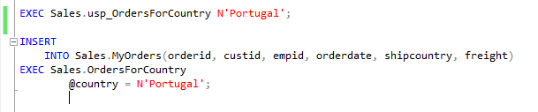
Inserting, Updating, and Deleting Data
Inserting Data
INSERT VALUES
INSERT SELECT
INSERT EXEC
SELECT INTO
Notes:
If you want the target column’s type to be different than the source, you can use the CAST
or CONVERT functions. But remember that in such a case, the target column will be defined
as allowing NULLs even if the source column disallowed NULLs, because you applied manipulation
to the source column. As with the previous examples, you can use the ISNULL function
to make SQL Server define the target column as not allowing NULLs. For example, to convert
the orderdate column from its source type DATETIME to DATE in the target, and disallow
NULLs, use the expression ISNULL(CAST(orderdate AS DATE), '19000101') AS orderdate.

Slide 10
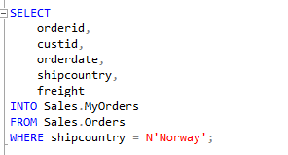
Inserting, Updating, and Deleting Data
Inserting Data
INSERT VALUES
INSERT SELECT
INSERT EXEC
SELECT INTO
Notes:
If you want the target column’s type to be different than the source, you can use the CAST
or CONVERT functions. But remember that in such a case, the target column will be defined
as allowing NULLs even if the source column disallowed NULLs, because you applied manipulation
to the source column. As with the previous examples, you can use the ISNULL function
to make SQL Server define the target column as not allowing NULLs. For example, to convert
the orderdate column from its source type DATETIME to DATE in the target, and disallow
NULLs, use the expression ISNULL(CAST(orderdate AS DATE), '19000101') AS orderdate.

Slide 11
Updating Data

Slide 12

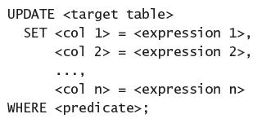
Inserting, Updating, and Deleting Data
Updating Data
UPDATE Statement

Slide 13
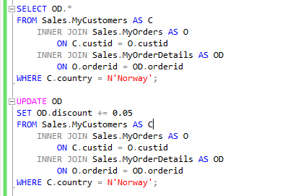
Inserting, Updating, and Deleting Data
Updating Data
UPDATE Based on Join

Slide 14
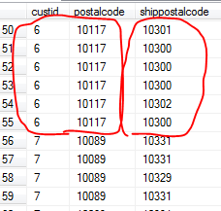
Inserting, Updating, and Deleting Data
Updating Data
Nondeterministic UPDATE

Slide 15
Inserting, Updating, and Deleting Data
Updating Data
UPDATE and Table Expressions
UPDATE All-at-Once

Slide 16
Deleting Data

Slide 17

Inserting, Updating, and Deleting Data
DELETING DATA
DELETE Statement
TRUNCATE Statement
Notes:
The DELETE statement writes significantly more to the transaction log compared to the
TRUNCATE statement. For DELETE, SQL Server records in the log the actual data that
was deleted. For TRUNCATE, SQL Server records information only about which pages
were deallocated. As a result, the TRUNCATE statement tends to be substantially faster.
■■ The DELETE statement doesn’t attempt to reset an identity property if one is associated
with a column in the target table. The TRUNCATE statement does. If you use
TRUNCATE and would prefer not to reset the property, you need to store the current
identity value plus one in a variable (using the IDENT_CURRENT function), and reseed
the property with the stored value after the truncation.
■■ The DELETE statement is supported if there’s a foreign key pointing to the table in
question as long as there are no related rows in the referencing table. TRUNCATE is not
allowed if a foreign key is pointing to the table—even if there are no related rows in
the referencing table, and even if the foreign key is disabled.
■■ The DELETE statement is allowed against a table involved in an indexed view. A TRUNCATE
statement is disallowed in such a case.
■■ The DELETE statement requires DELETE permissions on the target table. The TRUNCATE
statement requires ALTER permissions on the target table.

Slide 18


Inserting, Updating, and Deleting Data
DELETING DATA
DELETE Statement
TRUNCATE Statement
transaction log
Identity
foreign key
indexed view
permissions
Notes:
The DELETE statement writes significantly more to the transaction log compared to the
TRUNCATE statement. For DELETE, SQL Server records in the log the actual data that
was deleted. For TRUNCATE, SQL Server records information only about which pages
were deallocated. As a result, the TRUNCATE statement tends to be substantially faster.
■■ The DELETE statement doesn’t attempt to reset an identity property if one is associated
with a column in the target table. The TRUNCATE statement does. If you use
TRUNCATE and would prefer not to reset the property, you need to store the current
identity value plus one in a variable (using the IDENT_CURRENT function), and reseed
the property with the stored value after the truncation.
■■ The DELETE statement is supported if there’s a foreign key pointing to the table in
question as long as there are no related rows in the referencing table. TRUNCATE is not
allowed if a foreign key is pointing to the table—even if there are no related rows in
the referencing table, and even if the foreign key is disabled.
■■ The DELETE statement is allowed against a table involved in an indexed view. A TRUNCATE
statement is disallowed in such a case.
■■ The DELETE statement requires DELETE permissions on the target table. The TRUNCATE
statement requires ALTER permissions on the target table.

Slide 19
Inserting, Updating, and Deleting Data
DELETING DATA
DELETE Based on a Join
DELETE Using Table Expressions

Slide 20
Other Data Modification Aspects

Slide 21
Other Data Modification Aspects
Using the IDENTITY Column Property
SCOPE_IDENTITY
@@IDENTITY
IDENT_CURRENT
Notes:
Only one column in a table can have an IDE
As for the difference between SCOPE_IDENTITY and @@IDENTITY, suppose that you have
a stored procedure P1 with three statements:
■■ An INSERT that generates a new identity value
■■ A call to a stored procedure P2 that also has an INSERT statement that generates a new
identity value
■■ A statement that queries the functions SCOPE_IDENTITY and @@IDENTITY
The SCOPE_IDENTITY function will return the value generated by P1 (same session and
scope). The @@IDENTITY function will return the value generated by P2 (same session irrespective
of scope).NTITY property.
■■ The SCOPE_IDENTITY function returns the last identity value generated in your session
in the current scope.
■■ The @@IDENTITY function returns the last identity value generated in your session
regardless of scope.
■■ The IDENT_CURRENT function accepts a table as input and returns the last identity
value generated in the input table regardless of session

Slide 22
Other Data Modification Aspects
Using the IDENTITY Column Property
SCOPE_IDENTITY
@@IDENTITY
IDENT_CURRENT
Notes:
Only one column in a table can have an IDE
As for the difference between SCOPE_IDENTITY and @@IDENTITY, suppose that you have
a stored procedure P1 with three statements:
■■ An INSERT that generates a new identity value
■■ A call to a stored procedure P2 that also has an INSERT statement that generates a new
identity value
■■ A statement that queries the functions SCOPE_IDENTITY and @@IDENTITY
The SCOPE_IDENTITY function will return the value generated by P1 (same session and
scope). The @@IDENTITY function will return the value generated by P2 (same session irrespective
of scope).NTITY property.
■■ The SCOPE_IDENTITY function returns the last identity value generated in your session
in the current scope.
■■ The @@IDENTITY function returns the last identity value generated in your session
regardless of scope.
■■ The IDENT_CURRENT function accepts a table as input and returns the last identity
value generated in the input table regardless of session

Slide 23
Other Data Modification Aspects
Using the Sequence Object
CREATE SEQUENCE
INCREMENT BY
MINVALUE
MAXVALUE
CYCLE | NO CYCLE
START WITH

Slide 24
Merging Data

Slide 25
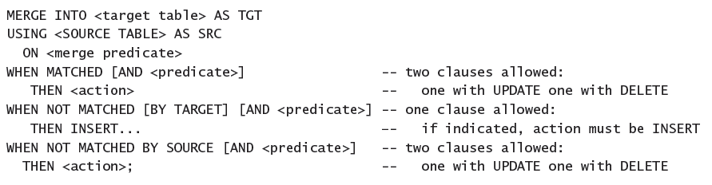
Other Data Modification Aspects
Merging Data
With the MERGE statement, you can merge data from a source table into a target table.

Slide 26
Using the OUTPUT Option

Slide 27
Other Data Modification Aspects
Working with the OUTPUT Clause
INSERT with OUTPUT
DELETE with OUTPUT
UPDATE with OUTPUT
MERGE with OUTPUT

