Slide 1
IN PREVIOUS PART: S18E06
1
Querying and Managing XML Data
-
Returning Results As XML with FOR XML
-
Querying XML Data with XQuery
-
Using the XML Data Type
3
Notes:
Appendix includes recent awards, please visit elements.epam.com for all 2016-2017 awards

Slide 2



Feb 23, 2019
3
Notes:
Appendix includes recent awards, please visit elements.epam.com for all 2016-2017 awards

Slide 3
Agenda: MSBI.Dev.S19E07
---
topics:
- topicname: Designing and Implementing Views and Inline Functions
subtopics:
- subtopicname: Views
- subtopicname: Inline Functions
- topicname: Using Synonyms
subtopics:
- subtopicname: Creating a Synonym
- topicname: Hierarchies
subtopics:
- subtopicname: Adjacency List Model
- subtopicname: Nested Set Model of Hierarchies
- subtopicname: HierarchyID
- topicname: Design for OLTP Database
subtopics:
- subtopicname: Remnants
- subtopicname: Fact Tables and Dimensions
- topicname: Team work with GIT
subtopics:
- subtopicname: Git branching model
- subtopicname: Workflow with branches and Pull Requests
---
3
Notes:
Appendix includes recent awards, please visit elements.epam.com for all 2016-2017 awards

Slide 4
Designing and Implementing Views and Inline Functions

Slide 5
IN PREVIOUS PART: S18E08
Inserting, Updating, and Deleting Data
Inserting Data
Updating Data
Deleting Data
Other Data Modification Aspects
Using the Sequence Object and IDENTITY Column Property

Slide 6
S18E09 AGENDA
Backup and restore, Add user and login
Managing Transactions and Concurrency
Implementing Error Handling
Using Dynamic SQL

Slide 7

Managing Transactions and Concurrency
Transactions
Transaction is a logical unit of work.
All data manipulation language (DML) statements such as INSERT, UPDATE, and DELETE. Technically, even single SELECT statements are a type of transaction in SQL Server
All data definition language (DDL) statements such as CREATE TABLE and CREATE INDEX.

Slide 8
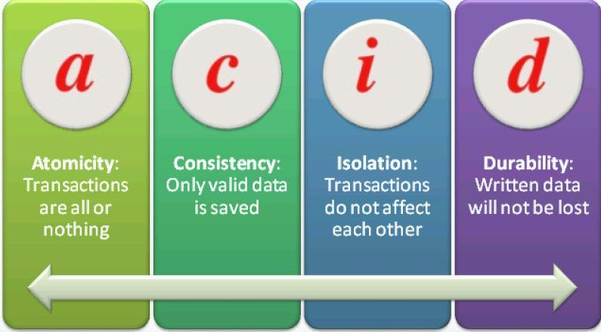
Managing Transactions and Concurrency
ACID Properties of Transactions
Atomicity
Consistency
Isolation
Durability
Notes:
SQL Server ensures all these ACID properties through a variety of mechanisms. To maintain
atomicity, SQL Server treats every data DML or DDL command individually and will not allow
any command to only partially succeed. Consider, for example, an UPDATE statement that
would update 500 rows in a table at the point in time that the transaction begins. The command
will not finish until exactly all those 500 rows are updated. If something prevents that
command from updating all 500 rows, SQL Server will abort the command and roll back the
transaction.
If more than one command is present in a transaction, SQL Server will normally not allow
the entire transaction to be committed unless both statements succeed. (If XACT_ABORT is
OFF, which is the default, you can insert code to decide whether to roll back the transaction
or commit it. See the sections on TRY/CATCH and XACT_ABORT later in this lesson for more
information.)
For consistency, SQL Server ensures that all constraints in the database are enforced. If
your transaction attempts to insert a row that has an invalid foreign key, for example, then
SQL Server will detect that a constraint would be violated, and generate an error message.
You can add logic to decide whether or not to roll back the transaction.
To enforce transactional isolation, SQL Server ensures that when a transaction makes
multiple changes to the database, none of the objects being changed by that transaction are
allowed to be changed by any other transactions. In other words, one transaction's changes
are isolated from any other transaction activities. If two transactions want to change the same
data, one of them must wait until the other transaction is finished

Slide 9
Managing Transactions and Concurrency
Types of Transactions
System transactions
User transactions

Slide 10
Managing Transactions and Concurrency
Transaction Commands
BEGIN TRANSACTION (BEGIN TRAN)
COMMIT TRANSACTION (COMMIT TRAN, COMMIT WORK, or just COMMIT)
ROLLBACK TRAN, ROLLBACK WORK, ROLLBACK.

Slide 11
Managing Transactions and Concurrency
Transaction Levels and States
@@TRANCOUNT
XACT_STATE()
DEMO
Notes:
Transaction Levels and States
You can detect the transaction level or state by using two system functions:
■■ @@TRANCOUNT can be queried to find the level of transaction.
■■ A level of 0 indicates that at this point, the code is not within a transaction.
■■ A level > 0 indicates that there is an active transaction, and a number > 1 indicates
the nesting level of nested transactions.
■■ XACT_STATE() can be queried to find the state of the transaction.
■■ A state of 0 indicates that there is no active transaction.
■■ A state of 1 indicates that there is an uncommitted transaction, and it can be
committed, but the nesting level is not reported.
■■ A state of -1 indicates that there is an uncommitted transaction, but it cannot be
committed due to a prior fatal error

Slide 12
Managing Transactions and Concurrency
Transaction Modes
Autocommit
Implicit transaction
Explicit transaction

Slide 13
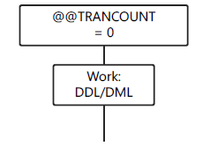
Managing Transactions and Concurrency
Transaction Modes
AUTOCOMMIT (DEFAULT)

Slide 14
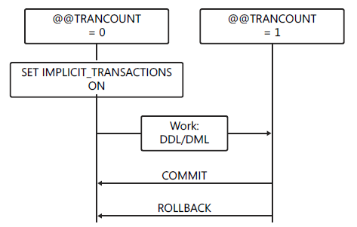
Managing Transactions and Concurrency
Transaction Modes
Implicit transaction

Slide 15
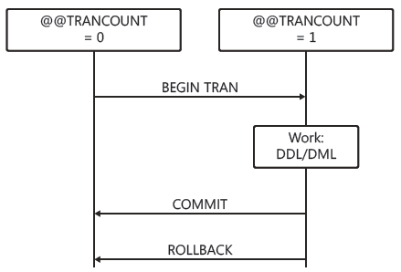
Managing Transactions and Concurrency
Transaction Modes
Explicit transaction

Slide 16
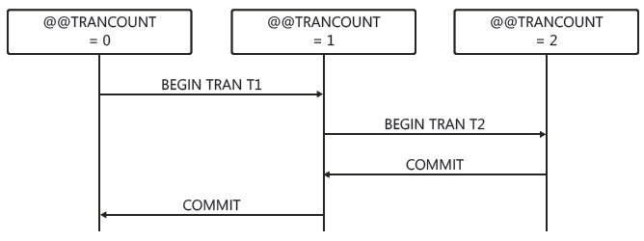
Managing Transactions and Concurrency
Transaction Modes
Nested Transactions

Slide 17
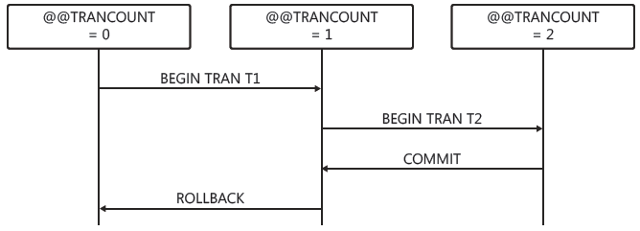
Managing Transactions and Concurrency
Transaction Modes
Nested Transactions Rollback

Slide 18
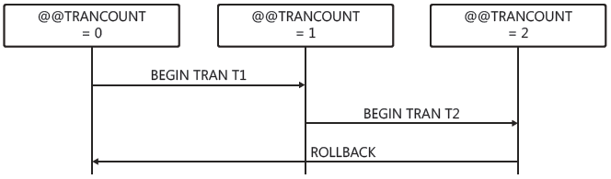
Managing Transactions and Concurrency
Transaction Modes
Nested Transactions Rollback

Slide 19
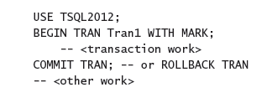
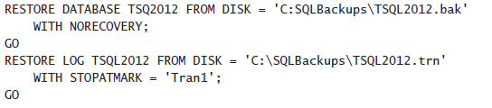
Managing Transactions and Concurrency
Marking a Transaction
Notes:
The transaction name is
displayed in the name column of sys.dm_tran_active_transactions, as shown in the following
example.
Named transactions are used for placing a mark in the transaction log in order to specify
a point to which one or more databases can be restored. When the transaction is recorded in
the database's transaction log, the transaction mark is also recorded, as shown in the following
example.

Slide 20
Managing Transactions and Concurrency
Additional Transaction Options
Savepoints (DEMO)
Cross-database transactions
Distributed transactions

Slide 21
Managing Transactions and Concurrency
Basic Locking
Shared locks
Exclusive locks
Advanced Locking Modes
There are more advanced modes called update, intent, and schema locks used for special purposes

Slide 22
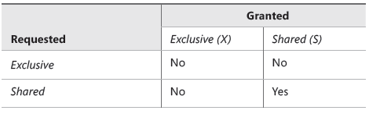
Managing Transactions and Concurrency
Lock Compatibility

Slide 23
Managing Transactions and Concurrency
Blocking
Notes:
Isolation levels are set per session. If you do not set a different isolation level in your session,
all your transactions will execute using the default isolation level, READ COMMITTED.
For on-premise SQL Server instances, this is READ COMMITTED. In Windows Azure SQL
Database, the default isolation level is READ COMMITTED SNAP SHOT.

Slide 24
Managing Transactions and Concurrency
Deadlocking

Slide 25
Managing Transactions and Concurrency
Transaction Isolation Levels
READ COMMITTED
READ COMMITTED SNAPSHOT
READ UNCOMMMITED
REPEATABLE READ
SNAPSHOT
SERIALIZABLE

Slide 26
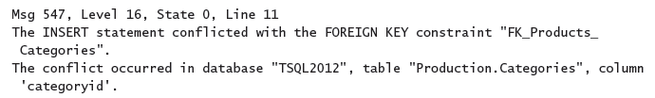
Implementing Error Handling
Detecting and Raising Errors
Error Messages

Slide 27
Implementing Error Handling
Analyzing Error Messages
Error number
SQL Server error messages are numbered from 1 through 49999
Custom error messages are numbered 50001 and higher
The error number 50000 is reserved for a custom message that does not have a custom error number
Severity level (0-25)
errors with a severity of 16 or higher are logged automatically to the SQL Server log and the Windows log
Errors with a severity level from 19 through 25 can be specified only by members of the sysadmin server role.
severity level from 20 through 25 are considered fatal level 0 through 10 are informational only
Errors with severity level 0 through 10 are informational only.

Slide 28
Implementing Error Handling
Analyzing Error Messages
State
This is an integer with a maximum value of 127, used by Microsoft for internal purposes.
Error message
The error message can be up to 255 Unicode characters long
SQL Server error messages are listed in sys.messages
You can add your own custom error messages by using sp_addmessage

Slide 29

Implementing Error Handling
RAISING ERROR
RAISERROR
THROW
Notes:
You cannot issue THROW with a NOWAIT command in order to cause immediate
buffer output.
■■ You cannot issue THROW using a severity level higher than 16 by using the WITH LOG
clause as you can with RAISERROR.

Slide 30

Implementing Error Handling
RAISING ERROR
RAISERROR
THROW
THROW does not use parentheses to delimit parameters.
THROW can be used without parameters, but only in the CATCH block of a TRY/CATCH construct.
When parameters are supplied, error_number, message, and state are all required.
The error_number does not require a matching defined message in sys.messages.
The message parameter does not allow formatting, but you can use FORMATMESSAGE() with a variable to get the same effect.
The state parameter must be an integer that ranges from 0 to 255.
Any parameter can be a variable.
There is no severity parameter; the severity is always set to 16.
THROW always terminates the batch except when it is used in a TRY block
Notes:
You cannot issue THROW with a NOWAIT command in order to cause immediate
buffer output.
■■ You cannot issue THROW using a severity level higher than 16 by using the WITH LOG
clause as you can with RAISERROR.

Slide 31
Implementing Error Handling
Handling Errors After Detection
Unstructured Error Handling
Using @@ERROR
XACT_ABORT with Transactions
SET XACT_ABORT ON
Structured Error Handling
Using TRY/CATCH

Slide 32
Implementing Error Handling
TRY/CATCH
THROW vs. RAISERROR in TRY/CATCH
Using XACT_ABORT with TRY/CATCH

