Slide 1

MSBI LAB S21.E06-SQL
December 30, 2020

Slide 2

IN THE PREVIOUS PART
1
Using Window Functions
2
Creating and Altering Tables
3
Enforcing Data Integrity
4
SSDT: How to manage database as a source code

Slide 3

S21E06 AGENDA
1
Working with Variables
2
Inserting, Updating, Deleting Data
3
Using the IDENTITY Column Property
4
Merging Data
5
Using the OUTPUT Option

Slide 4
Working with Variables

Slide 5
Working with Variables
DEMO
Notes:
If you want the target column’s type to be different than the source, you can use the CAST
or CONVERT functions. But remember that in such a case, the target column will be defined
as allowing NULLs even if the source column disallowed NULLs, because you applied manipulation
to the source column. As with the previous examples, you can use the ISNULL function
to make SQL Server define the target column as not allowing NULLs. For example, to convert
the orderdate column from its source type DATETIME to DATE in the target, and disallow
NULLs, use the expression ISNULL(CAST(orderdate AS DATE), '19000101') AS orderdate.

Slide 6
Inserting Data

Slide 7
Inserting Data
Methods to Insert Data
INSERT VALUES
INSERT SELECT
INSERT EXEC
SELECT INTO
Notes:
If you want the target column’s type to be different than the source, you can use the CAST
or CONVERT functions. But remember that in such a case, the target column will be defined
as allowing NULLs even if the source column disallowed NULLs, because you applied manipulation
to the source column. As with the previous examples, you can use the ISNULL function
to make SQL Server define the target column as not allowing NULLs. For example, to convert
the orderdate column from its source type DATETIME to DATE in the target, and disallow
NULLs, use the expression ISNULL(CAST(orderdate AS DATE), '19000101') AS orderdate.

Slide 8
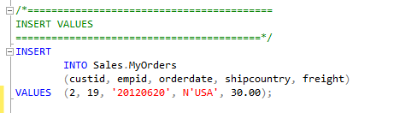
Inserting Data
INSERT VALUES
INSERT SELECT
INSERT EXEC
SELECT INTO
Notes:
If you want the target column’s type to be different than the source, you can use the CAST
or CONVERT functions. But remember that in such a case, the target column will be defined
as allowing NULLs even if the source column disallowed NULLs, because you applied manipulation
to the source column. As with the previous examples, you can use the ISNULL function
to make SQL Server define the target column as not allowing NULLs. For example, to convert
the orderdate column from its source type DATETIME to DATE in the target, and disallow
NULLs, use the expression ISNULL(CAST(orderdate AS DATE), '19000101') AS orderdate.

Slide 9
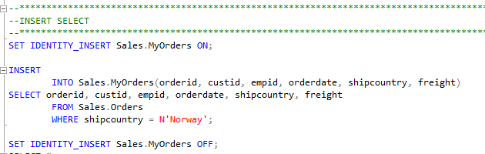
Inserting Data
INSERT VALUES
INSERT SELECT
INSERT EXEC
SELECT INTO
Notes:
If you want the target column’s type to be different than the source, you can use the CAST
or CONVERT functions. But remember that in such a case, the target column will be defined
as allowing NULLs even if the source column disallowed NULLs, because you applied manipulation
to the source column. As with the previous examples, you can use the ISNULL function
to make SQL Server define the target column as not allowing NULLs. For example, to convert
the orderdate column from its source type DATETIME to DATE in the target, and disallow
NULLs, use the expression ISNULL(CAST(orderdate AS DATE), '19000101') AS orderdate.

Slide 10
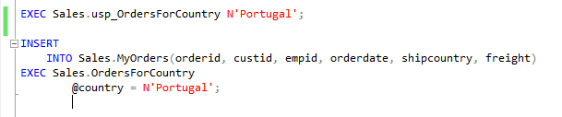
Inserting Data
INSERT VALUES
INSERT SELECT
INSERT EXEC
SELECT INTO
Notes:
If you want the target column’s type to be different than the source, you can use the CAST
or CONVERT functions. But remember that in such a case, the target column will be defined
as allowing NULLs even if the source column disallowed NULLs, because you applied manipulation
to the source column. As with the previous examples, you can use the ISNULL function
to make SQL Server define the target column as not allowing NULLs. For example, to convert
the orderdate column from its source type DATETIME to DATE in the target, and disallow
NULLs, use the expression ISNULL(CAST(orderdate AS DATE), '19000101') AS orderdate.

Slide 11
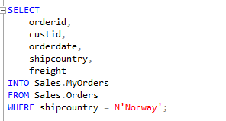
Inserting Data
INSERT VALUES
INSERT SELECT
INSERT EXEC
SELECT INTO
Notes:
If you want the target column’s type to be different than the source, you can use the CAST
or CONVERT functions. But remember that in such a case, the target column will be defined
as allowing NULLs even if the source column disallowed NULLs, because you applied manipulation
to the source column. As with the previous examples, you can use the ISNULL function
to make SQL Server define the target column as not allowing NULLs. For example, to convert
the orderdate column from its source type DATETIME to DATE in the target, and disallow
NULLs, use the expression ISNULL(CAST(orderdate AS DATE), '19000101') AS orderdate.

Slide 12
Inserting Data
DEMO
Notes:
If you want the target column’s type to be different than the source, you can use the CAST
or CONVERT functions. But remember that in such a case, the target column will be defined
as allowing NULLs even if the source column disallowed NULLs, because you applied manipulation
to the source column. As with the previous examples, you can use the ISNULL function
to make SQL Server define the target column as not allowing NULLs. For example, to convert
the orderdate column from its source type DATETIME to DATE in the target, and disallow
NULLs, use the expression ISNULL(CAST(orderdate AS DATE), '19000101') AS orderdate.

Slide 13
Updating Data

Slide 14
Updating Data
UPDATE Statement
UPDATE <object>
SET column_name = expression
[ ,...n ]
WHERE <search_condition>

Slide 15
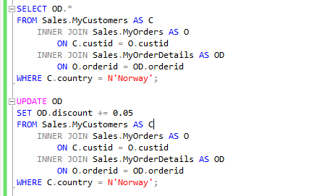

Updating Data
UPDATE Based on Join

Slide 16
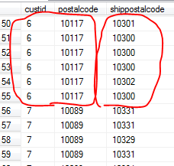
Updating Data
Nondeterministic UPDATE

Slide 17
Updating Data
DEMO

Slide 18
Deleting Data

Slide 19

Deleting Data
Methods to Delete Data
DELETE Statement
TRUNCATE Statement
Notes:
The DELETE statement writes significantly more to the transaction log compared to the
TRUNCATE statement. For DELETE, SQL Server records in the log the actual data that
was deleted. For TRUNCATE, SQL Server records information only about which pages
were deallocated. As a result, the TRUNCATE statement tends to be substantially faster.
■■ The DELETE statement doesn’t attempt to reset an identity property if one is associated
with a column in the target table. The TRUNCATE statement does. If you use
TRUNCATE and would prefer not to reset the property, you need to store the current
identity value plus one in a variable (using the IDENT_CURRENT function), and reseed
the property with the stored value after the truncation.
■■ The DELETE statement is supported if there’s a foreign key pointing to the table in
question as long as there are no related rows in the referencing table. TRUNCATE is not
allowed if a foreign key is pointing to the table—even if there are no related rows in
the referencing table, and even if the foreign key is disabled.
■■ The DELETE statement is allowed against a table involved in an indexed view. A TRUNCATE
statement is disallowed in such a case.
■■ The DELETE statement requires DELETE permissions on the target table. The TRUNCATE
statement requires ALTER permissions on the target table.

Slide 20


Deleting Data
Methods to Delete Data
DELETE Statement
TRUNCATE Statement
transaction log
Identity
foreign key
indexed view
permissions
Notes:
The DELETE statement writes significantly more to the transaction log compared to the
TRUNCATE statement. For DELETE, SQL Server records in the log the actual data that
was deleted. For TRUNCATE, SQL Server records information only about which pages
were deallocated. As a result, the TRUNCATE statement tends to be substantially faster.
■■ The DELETE statement doesn’t attempt to reset an identity property if one is associated
with a column in the target table. The TRUNCATE statement does. If you use
TRUNCATE and would prefer not to reset the property, you need to store the current
identity value plus one in a variable (using the IDENT_CURRENT function), and reseed
the property with the stored value after the truncation.
■■ The DELETE statement is supported if there’s a foreign key pointing to the table in
question as long as there are no related rows in the referencing table. TRUNCATE is not
allowed if a foreign key is pointing to the table—even if there are no related rows in
the referencing table, and even if the foreign key is disabled.
■■ The DELETE statement is allowed against a table involved in an indexed view. A TRUNCATE
statement is disallowed in such a case.
■■ The DELETE statement requires DELETE permissions on the target table. The TRUNCATE
statement requires ALTER permissions on the target table.

Slide 21
Deleting Data
DEMO

Slide 22
Using the IDENTITY Column Property

Slide 23
Using the IDENTITY Column Property
SCOPE_IDENTITY
@@IDENTITY
IDENT_CURRENT
Notes:
Only one column in a table can have an IDE
As for the difference between SCOPE_IDENTITY and @@IDENTITY, suppose that you have
a stored procedure P1 with three statements:
■■ An INSERT that generates a new identity value
■■ A call to a stored procedure P2 that also has an INSERT statement that generates a new
identity value
■■ A statement that queries the functions SCOPE_IDENTITY and @@IDENTITY
The SCOPE_IDENTITY function will return the value generated by P1 (same session and
scope). The @@IDENTITY function will return the value generated by P2 (same session irrespective
of scope).NTITY property.
■■ The SCOPE_IDENTITY function returns the last identity value generated in your session
in the current scope.
■■ The @@IDENTITY function returns the last identity value generated in your session
regardless of scope.
■■ The IDENT_CURRENT function accepts a table as input and returns the last identity
value generated in the input table regardless of session

Slide 24
Using the IDENTITY Column Property
Using the Sequence Object
CREATE SEQUENCE
INCREMENT BY
MINVALUE
MAXVALUE
CYCLE | NO CYCLE
START WITH

Slide 25
Using the IDENTITY Column Property
DEMO
Notes:
Only one column in a table can have an IDE
As for the difference between SCOPE_IDENTITY and @@IDENTITY, suppose that you have
a stored procedure P1 with three statements:
■■ An INSERT that generates a new identity value
■■ A call to a stored procedure P2 that also has an INSERT statement that generates a new
identity value
■■ A statement that queries the functions SCOPE_IDENTITY and @@IDENTITY
The SCOPE_IDENTITY function will return the value generated by P1 (same session and
scope). The @@IDENTITY function will return the value generated by P2 (same session irrespective
of scope).NTITY property.
■■ The SCOPE_IDENTITY function returns the last identity value generated in your session
in the current scope.
■■ The @@IDENTITY function returns the last identity value generated in your session
regardless of scope.
■■ The IDENT_CURRENT function accepts a table as input and returns the last identity
value generated in the input table regardless of session

Slide 26
Merging Data

Slide 27
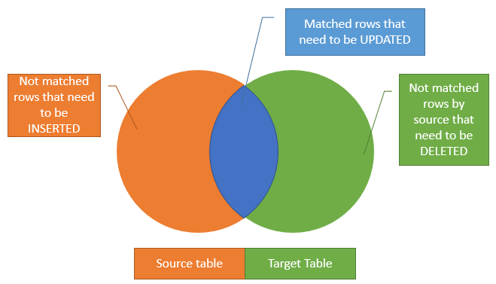
Merging Data

Slide 28
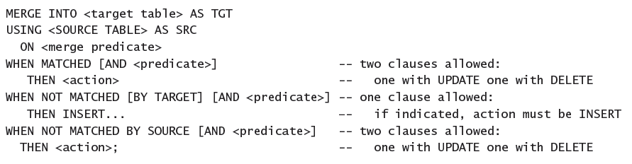
Merging Data

Slide 29
Merging Data
DEMO

Slide 30
Using the OUTPUT Option

Slide 31
Using the OUTPUT Option
INSERT with OUTPUT
DELETE with OUTPUT
UPDATE with OUTPUT
MERGE with OUTPUT

Slide 32
Using the OUTPUT Option
DEMO

