Slide 1



3
Notes:
Appendix includes recent awards, please visit elements.epam.com for all 2016-2017 awards

Slide 2
IN PREVIOUS PART: S18E04
1
Using Subqueries, Table Expressions, and the APPLY Operator
2
Using Set Operators
3
Grouping and Windowing
4
Pivoting and Unpivoting Data
5
Entity-Attribute-Value pattern (EAV) Online shop
3
Notes:
Appendix includes recent awards, please visit elements.epam.com for all 2016-2017 awards

Slide 3
Agenda: MSBI.Dev.S19E05
1
Using Window Functions
2
Creating and Altering Tables
3
Enforcing Data Integrity
4
SSDT How to manage database as a source code
5
Jira
3
Notes:
Appendix includes recent awards, please visit elements.epam.com for all 2016-2017 awards

Slide 4
Using Window Functions

Slide 5
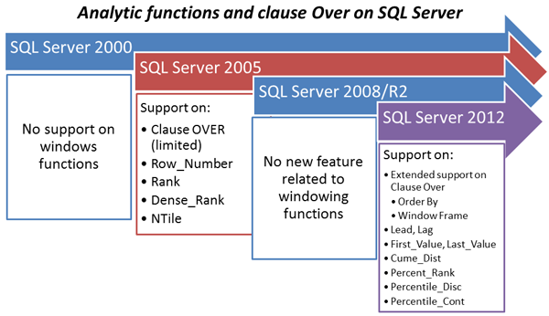
Using Window Functions

Slide 6
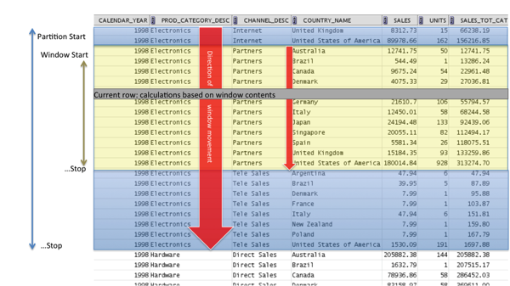
Using Window Functions

Slide 7
Using Window Functions
Window Aggregate Functions
SUM, COUNT, AVG, MIN,

Slide 8
Using Window Functions
UNBOUNDED PRECEDING or FOLLOWING, meaning the beginning or end of the partition, respectively
CURRENT ROW, obviously representing the current row
<n> ROWS PRECEDING or FOLLOWING, meaning n rows before or after the current, respectively
FRAMES

Slide 9
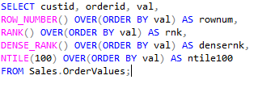
Using Window Functions
Window Ranking Functions

Slide 10
Using Window Functions
Window Offset Functions
LAG
LEAD
FIRST_VALUE
LAST_VALUE

Slide 11
Creating and Altering Tables

Slide 12
Creating and Altering Tables
Creating and Altering Tables
base tables
Temporary tables
Table variables
Views
Indexed views
Derived tables and table expressions

Slide 13
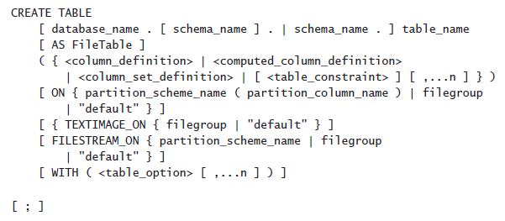
Creating and Altering Tables
Creating and Altering Tables
By using the CREATE TABLE statement
By using the SELECT INTO statement

Slide 14
Creating and Altering Tables
Creating and Altering Tables
Specifying a Database Schema
Naming Tables and Columns
Choosing Column Data Types
NULL and Default Values
Computed Columns
Table Compression

Slide 15
Creating and Altering Tables
Naming Tables and Columns
Regular
Delimited
CREATE TABLE Production.CategoriesTest1
CREATE TABLE Production.[Yesterday's News]
CREATE TABLE Production."Tomorrow's Schedule"

Slide 16
Creating and Altering Tables
Choosing Column Data Types
Size is important
NVARCHAR or VARCHAR vs NCHAR or CHAR
DATE, TIME, and DATETIME2 vs DATETIME and SMALLDATETIME
VARCHAR(MAX), NVARCHAR(MAX), and VARBINARY(MAX) instead of the deprecated TEXT, NTEXT, and IMAGE
Use ROWVERSION instead of the deprecated TIMESTAMP
Use DECIMAL and NUMERIC instead of FLOAT or REAL

Slide 17
Creating and Altering Tables
Column
NULL and Default Values
The Identity Property and Sequence Numbers
Computed Columns (non deterministic function GETDATE() or CURRENT_TIMESTAMP)

Slide 18
Creating and Altering Tables
Table Compression
Row
Page

Slide 19
Enforcing Data Integrity

Slide 20
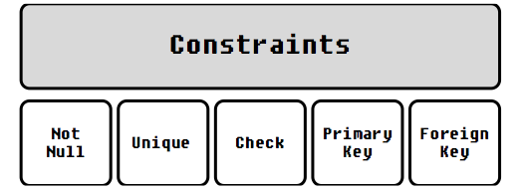
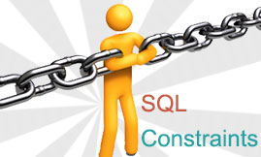
Enforcing Data Integrity
Enforcing Data Integrity
Primary Key Constraints
Unique Constraints
Foreign Key Constraints
Check Constraints
Default Constraints

Slide 21
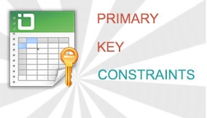
Enforcing Data Integrity
Enforcing Data Integrity
Primary Key Constraints

Slide 22
Enforcing Data Integrity
Enforcing Data Integrity
Unique Constraints

Slide 23
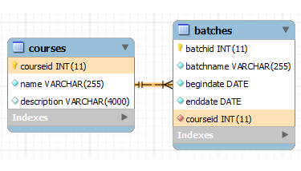

Enforcing Data Integrity
Enforcing Data Integrity
Foreign Key Constraints

Slide 24
Enforcing Data Integrity
Enforcing Data Integrity
Foreign Key Constraints

Slide 25

Enforcing Data Integrity
Enforcing Data Integrity
Check Constraints

Slide 26
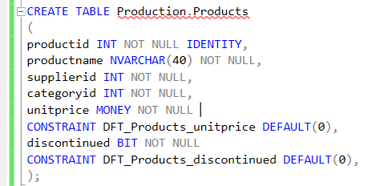
Enforcing Data Integrity
Enforcing Data Integrity
Default Constraints

Slide 27
Enforcing Data Integrity
Specifying a Database Schema

Slide 28
Enforcing Data Integrity
Naming
UQ_<TableName>_<ColNames>
FK_<ReferencingTable>_<ReferencedTable>
DFT_<Table>_<Column>
CHK_<Table>_<Column_Or_Description>

Slide 29
SSDT How to manage database as a source code

Slide 30
SSDT How to manage database as a source code
Create new project.
Sync project to actual state of database
Deploy changes to DEV , TST and PRD
Team work

Slide 31
Jira

Slide 32
Jira
Agile
SCRUM
Kanban

