Slide 1


S19E01
February 1, 2019

Slide 2
AGENDA
1
About this Course
2
Database evolution
3
MS SQL Server overview
4
Resources, Homework assignment workflow
5
Visual Studio, SSMS, SSDT BI
6
Work remotely
7
Homework assignment : Create POC of Library Database

Slide 3
S18E01
About this course

Slide 4

Business Intelligence
Reporting and analytics
Dashboard development
Data Mining
Predictive Analytics
Performance Management and KPI’s
Metadata presentation and effective usage

Slide 5
Business Intelligence

Slide 6
MSBI.Dev.S19 : Technologies
MSBI DEVELOPER
MS SQL Server
SSIS
SSAS
Azure
SSRS
OLTP Databases
ETL (Extract – Transform – Load)
Multidimensional
Storage
Power BI
Data Warehouse DWH
Data Base Maintenance
Tabular
Azure SQL
PowerShell
Administration
MDX
Azure Data Factory v1 (ADFv1)
C#
T-SQL
DAX
Azure Data Factory v2 (ADFv2)
Python
Azure DevOps
A lot of…

Slide 7
MSBI.Dev.S19 : Timeline
February
March
April
May
June
MSBI Developer Course
MS SQL
DWH,SSIS
EXAM
SSAS (mdx,dax)
Azure
SSRS
PowerBI
Next step

Slide 8
S18E01
Database evolution

Slide 9
Database evolution
1
clay tablet
2
File Management System
3
Hierarchical database System
4
Network Database System
5
Relational Database System (RDBMS)
6
NoSQL (Document oriented, Column Store, Graph, Key-Value)

Slide 10
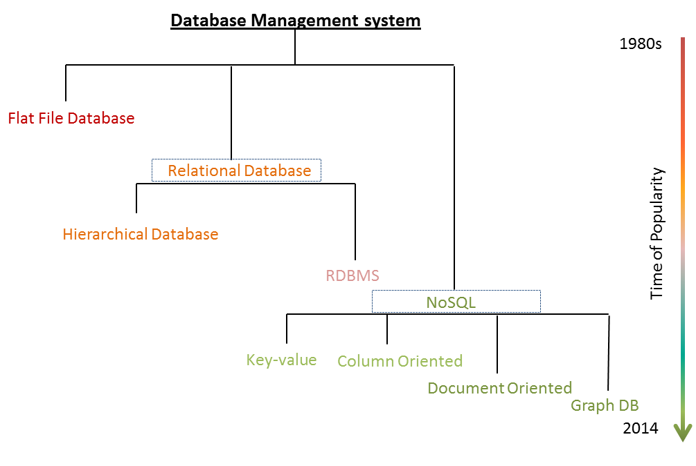
Database evolution

Slide 11
Database evolution:
File Management System

Slide 12

Database evolution
Hierarchical database System

Slide 13
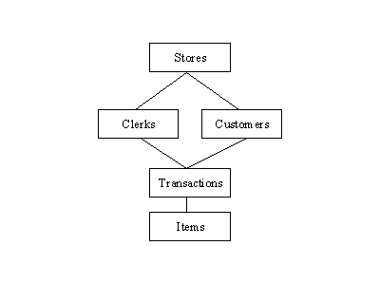
Database evolution:
Network Database System

Slide 14

Database evolution:
Relational Database System

Slide 15
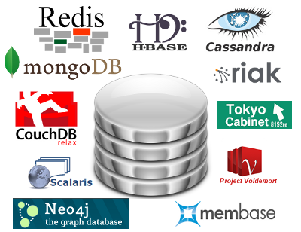
Database evolution:
NoSQL

Slide 16
S18E01
MS SQL Server overview

Slide 17
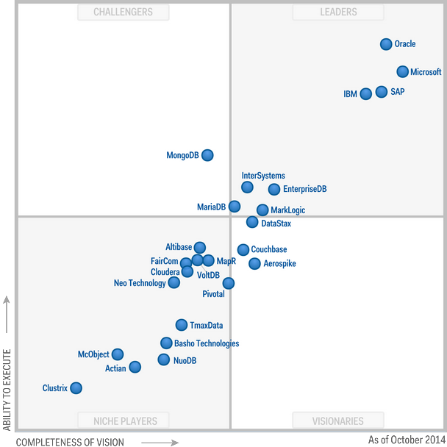
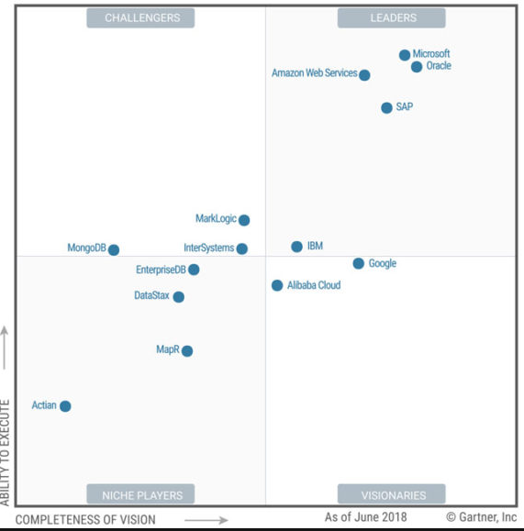
MS SQL Server overview
Magic Quadrant for Operational Database Management Systems
2014
2018

Slide 18
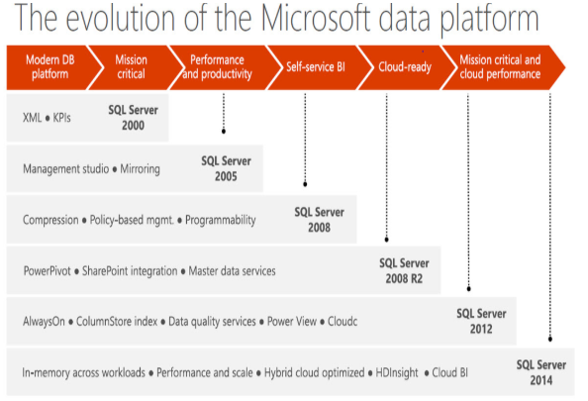
MS SQL Server overview
SQL 2016
SQL 2017

Slide 19
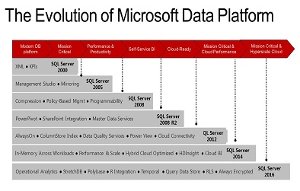
MS SQL Server overview
SQL 2017

Slide 20
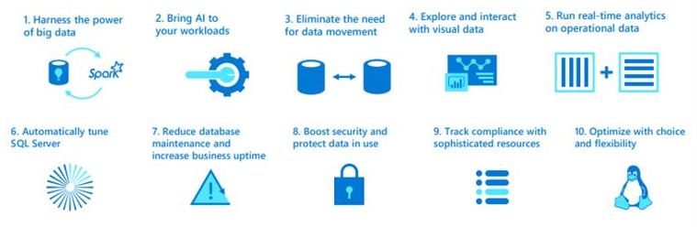
MS SQL Server overview
SQL 2017

Slide 21
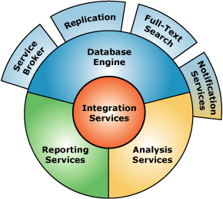
MS SQL Server overview :
Key Components
1
Database Engine
2
SQL Server Analysis Services (SSAS)
3
SQL Server Reporting Services (SSRS)
4
SQL Server Integration Services (SSIS)

Slide 22
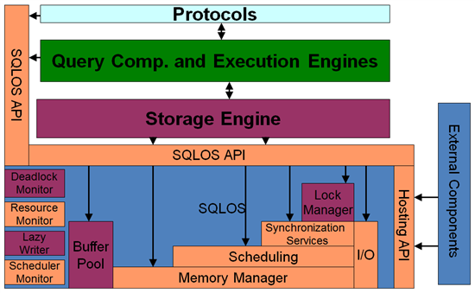
MS SQL Server overview :
Database Engine

Slide 23
MS SQL Server overview :
System Databases
SSMS SQL Server Management Studio
master Database
msdb Database
model Database
Resource Database
tempdb Database
SQL Server Management Studio (SSMS) is an integrated environment for accessing, configuring, managing, administering, and developing all components of SQL Server. SSMS combines a broad group of graphical tools with a number of rich script editors to provide access to SQL Server to developers and administrators of all skill levels.

Slide 24
S19E01
Resources, Homework assignment workflow

Slide 25
S19E01

Slide 26
S19E01
Visual Studio, SSMS, SSDT BI

Slide 27
S18E01
Work remotely

Slide 28
S19E01
POC of Library Database

Slide 29
S19E01

