Slide 1


S19E04
February , 2019

Slide 2
IN PREVIOUS PART: S19E03
Getting Started with the SELECT Statement
Filtering and Sorting Data
Combining Sets
Design for OLTP Database (Web Store)
Library OLTP Database (Homework assignment)
Using Subqueries, Table Expressions, and the APPLY Operator

Slide 3
S19E04 AGENDA
Sorting with NULL
Using Set Operators
Using Subqueries, Table Expressions, and the APPLY Operator
Grouping and Windowing
Writing Grouped Queries
Pivoting and Unpivoting Data
Design for OLTP Database (Web Store) EAV pattern
Using Window Functions

Slide 4
Using Subqueries, Table Expressions, and the APPLY Operator
Using Subqueries, Table Expressions, and the APPLY Operator
Topic

Slide 5
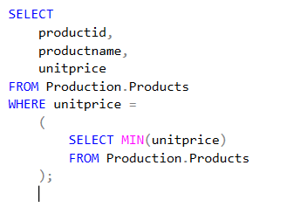
Using Subqueries, Table Expressions, and the APPLY Operator
Self-Contained Subqueries
Self-contained subqueries are subqueries that have no dependency on the outer query.
Notes:
Note that if what’s supposed to be a scalar subquery returns in practice more than one
value, the code fails at run time. If the scalar subquery returns an empty set, it is converted to
a NULL.

Slide 6
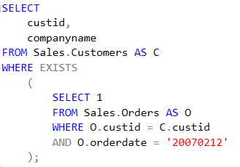
Using Subqueries, Table Expressions, and the APPLY Operator
Correlated Subqueries
Correlated subqueries are subqueries where the inner query has a reference to a column from the table in the outer query.

Slide 7
Using Subqueries, Table Expressions, and the APPLY Operator
Table Expressions
Table expressions are named queries.
Derived tables
Common table expressions (CTEs)
Views
Inline table-valued functions

Slide 8
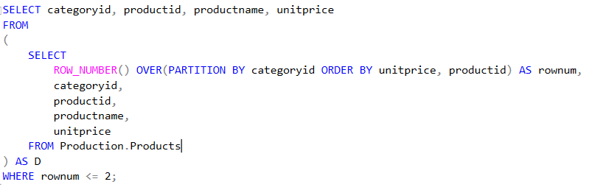
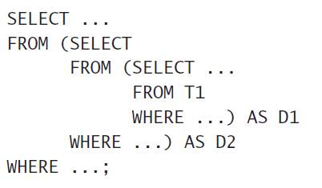
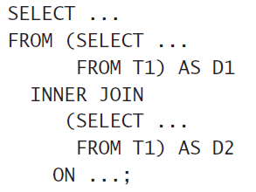
Using Subqueries, Table Expressions, and the APPLY Operator
Derived Tables

Slide 9
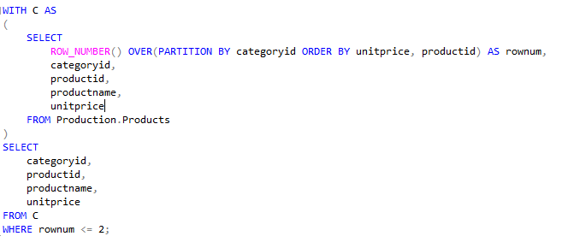
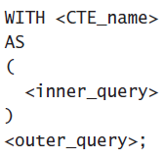
Using Subqueries, Table Expressions, and the APPLY Operator
CTEs
common table expression (CTE)

Slide 10
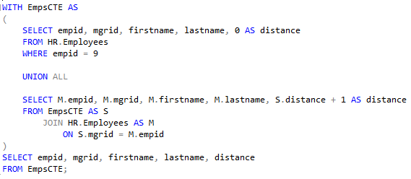
Using Subqueries, Table Expressions, and the APPLY Operator
CTEs recursive form
common table expression (CTE) recursive form

Slide 11
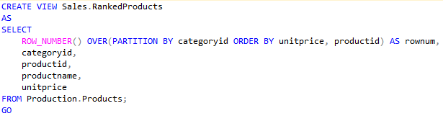
Using Subqueries, Table Expressions, and the APPLY Operator
Views and Inline Table-Valued Functions
View
CREATE VIEW [schema_name ].[view_name]
AS
<SELECT STATEMENT> [;]
GO

Slide 12
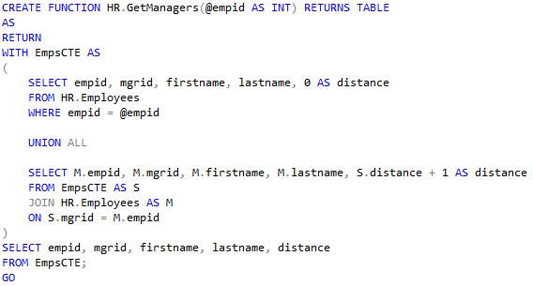
Using Subqueries, Table Expressions, and the APPLY Operator
Table-Valued Function
CREATE FUNCTION [schema_name ].[Function_name]
(@parameter_name [AS] paramenter_data_type)
RETURNS TABLE
AS
RETURN
(<SELECT STATEMENT>) [;]
GO

Slide 13
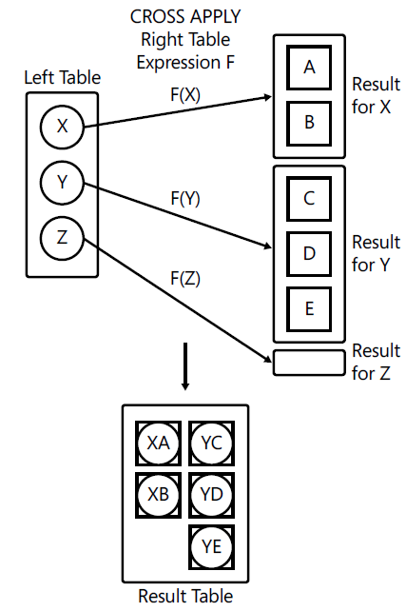
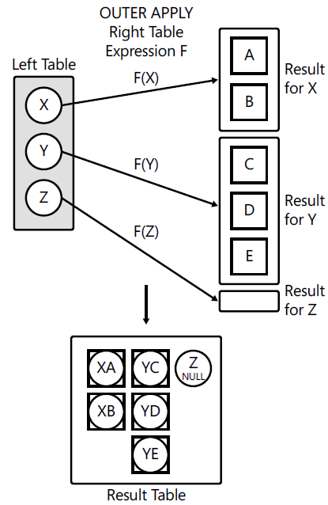
Using Subqueries, Table Expressions, and the APPLY Operator
Apply
CROSS APPLY
OUTER APP LY

Slide 14
Sorting with NULL
DEMO

Slide 15
Using Set Operators
Topic

Slide 16
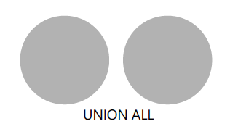

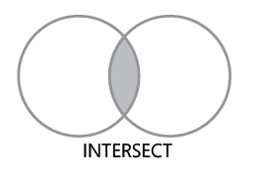
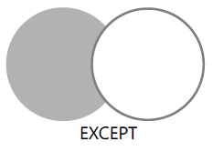
Using Set Operators

Slide 17
Any Some All

Slide 18
Grouping and Windowing
Topic

Slide 19
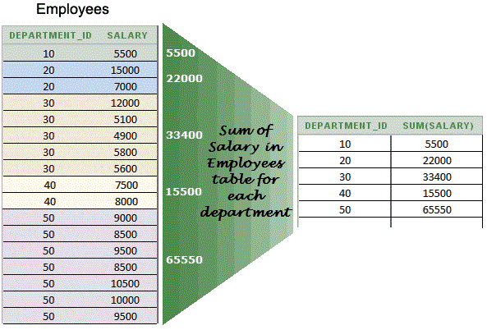
Grouping and Windowing
SUM, COUNT, AVG, MIN, MAX
Aggregate Functions (Transact-SQL)
https://msdn.microsoft.com/en-us/library/ms173454.aspx

Slide 20
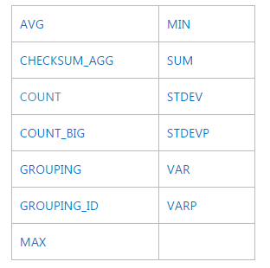
Grouping and Windowing
Aggregate Functions (Transact-SQL)
https://msdn.microsoft.com/en-us/library/ms173454.aspx

Slide 21
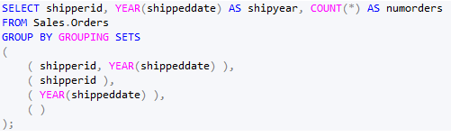
Grouping and Windowing

Slide 22
Pivoting and Unpivoting Data
Topic

Slide 23
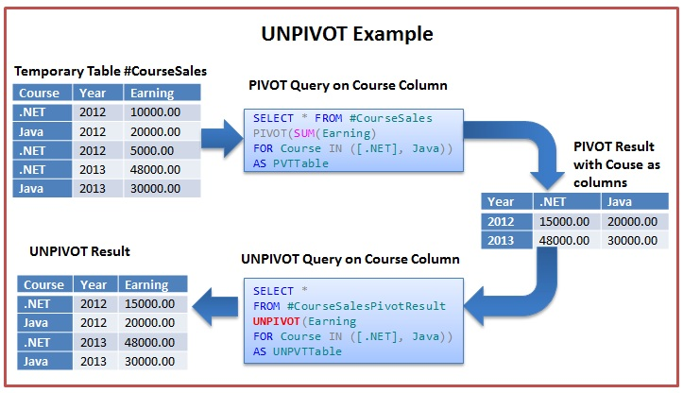
Grouping and Windowing
WITH PivotData AS
(
SELECT
< grouping column >,
< spreading column >,
< aggregation column >
FROM < source table >
)
SELECT < select list >
FROM PivotData
PIVOT( < aggregate function >(< aggregation column >)
FOR < spreading column > IN (< distinct spreading values >) ) AS P;

Slide 24
Grouping and Windowing
SELECT < column list >, < names column >, < values column >
FROM < source table >
UNPIVOT( < values column > FOR < names column > IN( <source columns> ) ) AS U;

Slide 25
EAV pattern
EAV pattern
Topic

Slide 26
EAV pattern

Slide 27
Using Window Functions
Topic

Slide 28
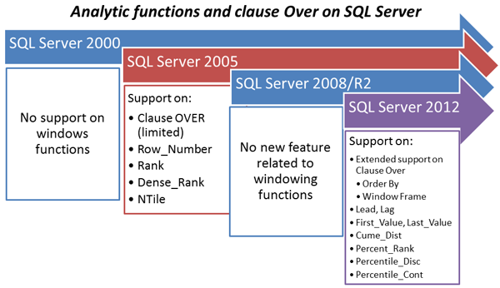
Using Window Functions

Slide 29
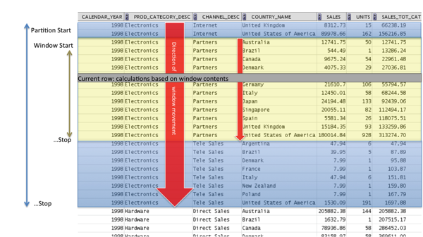
Using Window Functions

Slide 30
Using Window Functions
Window Aggregate Functions
SUM, COUNT, AVG, MIN,

Slide 31
Using Window Functions
UNBOUNDED PRECEDING or FOLLOWING, meaning the beginning or end of the partition, respectively
CURRENT ROW, obviously representing the current row
<n> ROWS PRECEDING or FOLLOWING, meaning n rows before or after the current, respectively
FRAMES

Slide 32
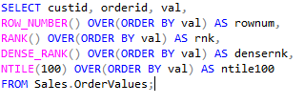
Using Window Functions
Window Ranking Functions

Slide 33
Using Window Functions
Window Offset Functions
LAG
LEAD
FIRST_VALUE
LAST_VALUE

