Slide 1


S19E05
February 10, 2019

Slide 2
IN PREVIOUS PART: S18E04
Grouping and Windowing
Writing Grouped Queries
Pivoting and Unpivoting Data
Using Window Functions

Slide 3
S18E05 AGENDA
Managing and Configuring Databases
Creating Tables and Enforcing Data Integrity
Creating and Altering Tables
Enforcing Data Integrity
Design for OLTP Database :

Slide 4
Managing and Configuring Databases
Demo

Slide 5
Creating Tables and Enforcing Data Integrity
Creating and Altering Tables
base tables
Temporary tables
Table variables
Views
Indexed views
Derived tables and table expressions

Slide 6
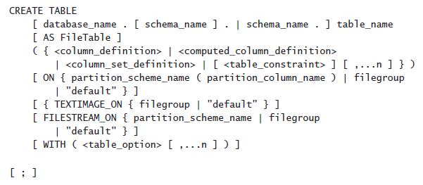
Creating Tables and Enforcing Data Integrity
Creating and Altering Tables
By using the CREATE TABLE statement
By using the SELECT INTO statement

Slide 7
Creating Tables and Enforcing Data Integrity
Creating and Altering Tables
Specifying a Database Schema
Naming Tables and Columns
Choosing Column Data Types
NULL and Default Values
Computed Columns
Table Compression

Slide 8
Creating Tables and Enforcing Data Integrity
Naming Tables and Columns
Regular
Delimited
CREATE TABLE Production.CategoriesTest1
CREATE TABLE Production.[Yesterday's News]
CREATE TABLE Production."Tomorrow's Schedule"

Slide 9
Creating Tables and Enforcing Data Integrity
Choosing Column Data Types
Size is important
NVARCHAR or VARCHAR vs NCHAR or CHAR
DATE, TIME, and DATETIME2 vs DATETIME and SMALLDATETIME
VARCHAR(MAX), NVARCHAR(MAX), and VARBINARY(MAX) instead of the deprecated TEXT, NTEXT, and IMAGE
Use ROWVERSION instead of the deprecated TIMESTAMP
Use DECIMAL and NUMERIC instead of FLOAT or REAL

Slide 10
Creating Tables and Enforcing Data Integrity
Column
NULL and Default Values
The Identity Property and Sequence Numbers
Computed Columns (non deterministic function GETDATE() or CURRENT_TIMESTAMP)

Slide 11
Creating Tables and Enforcing Data Integrity
Table Compression
Row
Page

Slide 12
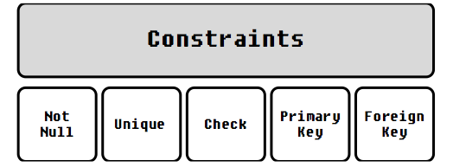

Creating Tables and Enforcing Data Integrity
Enforcing Data Integrity
Primary Key Constraints
Unique Constraints
Foreign Key Constraints
Check Constraints
Default Constraints

Slide 13
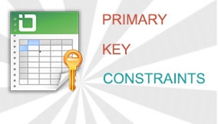
Creating Tables and Enforcing Data Integrity
Enforcing Data Integrity
Primary Key Constraints

Slide 14
Creating Tables and Enforcing Data Integrity
Enforcing Data Integrity
Unique Constraints

Slide 15
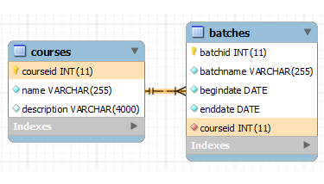

Creating Tables and Enforcing Data Integrity
Enforcing Data Integrity
Foreign Key Constraints

Slide 16
Creating Tables and Enforcing Data Integrity
Enforcing Data Integrity
Foreign Key Constraints

Slide 17

Creating Tables and Enforcing Data Integrity
Enforcing Data Integrity
Check Constraints

Slide 18
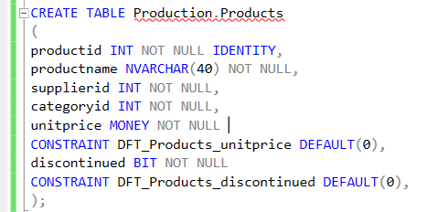
Creating Tables and Enforcing Data Integrity
Enforcing Data Integrity
Default Constraints

Slide 19
Creating Tables and Enforcing Data Integrity
Specifying a Database Schema

Slide 20
Creating Tables and Enforcing Data Integrity
Naming
UQ_<TableName>_<ColNames>
FK_<ReferencingTable>_<ReferencedTable>
DFT_<Table>_<Column>
CHK_<Table>_<Column_Or_Description>

Slide 21
Database design
Operational tables

Slide 22
How to
Queries

