Slide 1

MSBI LAB S21.E11-SQL
January 25, 2021

Slide 2

IN THE PREVIOUS PART
1
Querying and Managing XML Data
2
JSON data in SQL Server
3
Understanding Temporary Tables
4
Passing Table Data to Stored Procedures

Slide 3

S21E10 AGENDA
1
Implementing Indexes and Statistics
2
Query Optimizer
3
Using Tools to Analyze Query Performance
4
Execution Plans

Slide 4
Implementing Indexes and Statistics

Slide 5

Implementing Indexes and Statistics
Heap Tables
Heap tables are tables without a clustered index.
The data in heap tables is unsorted.
SQL Server does not guarantee, nor does it maintain, a sorting order of the data in the heap tables.

Slide 6
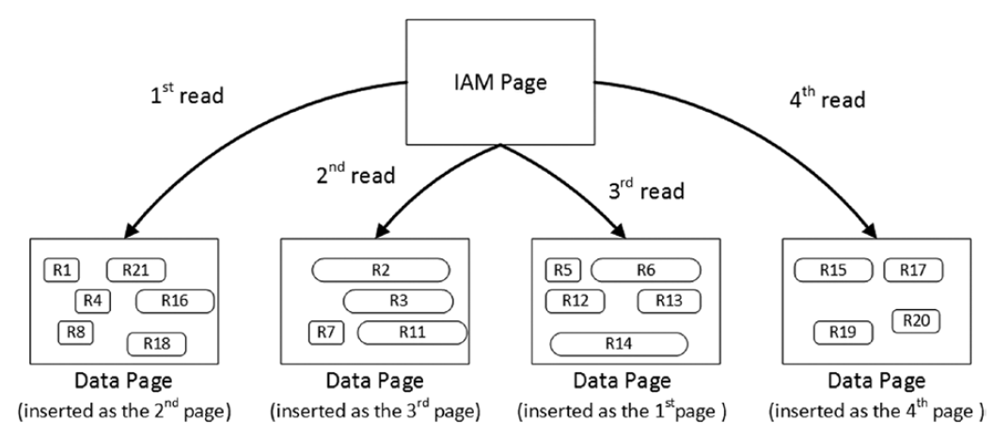
Implementing Indexes and Statistics
Heap Tables

Slide 7
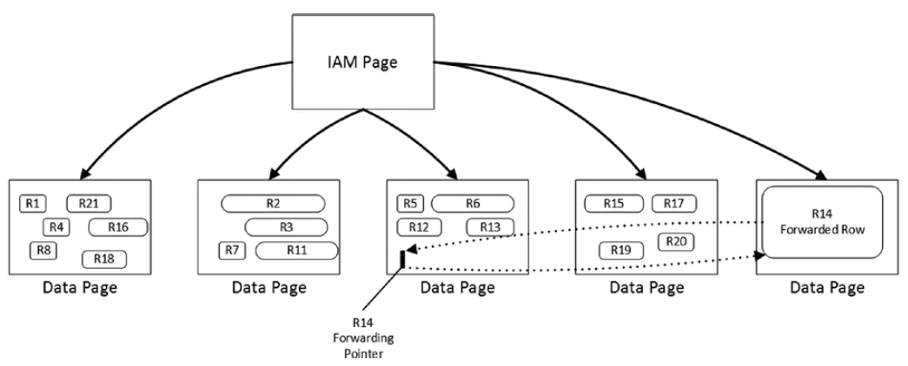
Implementing Indexes and Statistics
Heap Tables
Forwarding pointers

Slide 8
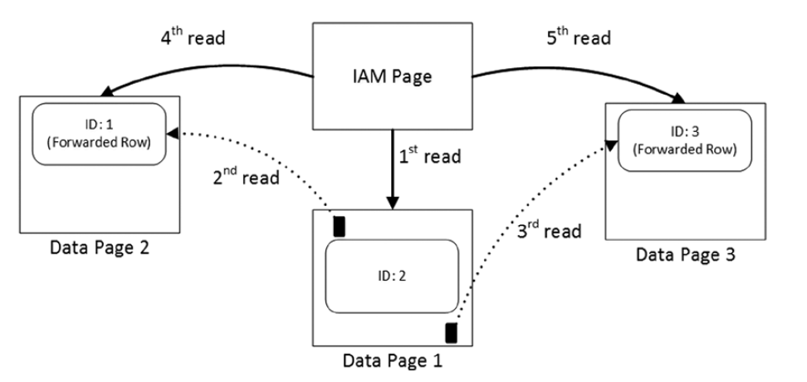
Implementing Indexes and Statistics
Heap Tables
Reading data when the forwarding pointers exist

Slide 9

Implementing Indexes and Statistics
Clustered Indexes
A clustered index dictates the physical order of the data in a table, which is sorted according to the clustered index key.
The table can have only one clustered index defined.

Slide 10
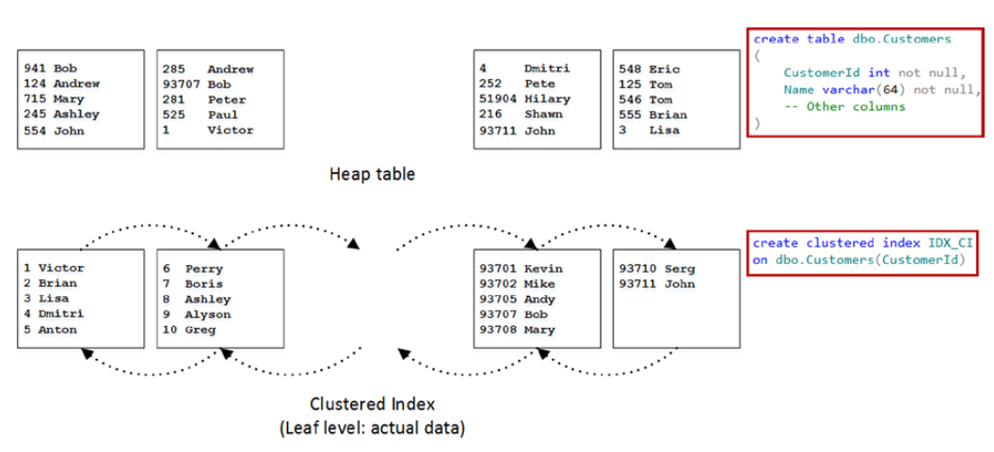
Implementing Indexes and Statistics
Clustered Indexes

Slide 11
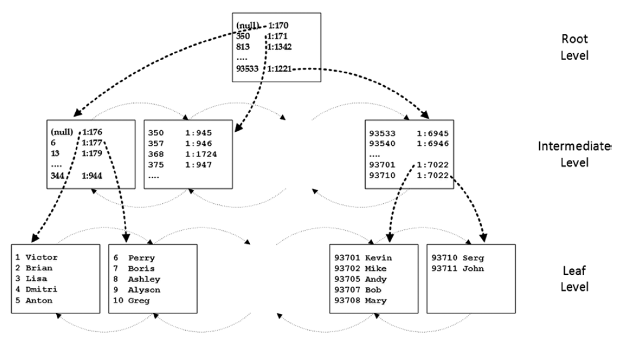
Implementing Indexes and Statistics
Clustered Indexes

Slide 12
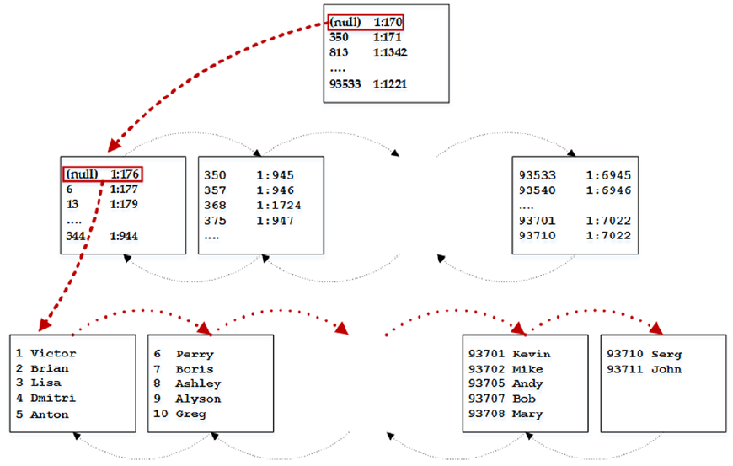
Implementing Indexes and Statistics
Clustered Indexes
Ordered index scan

Slide 13
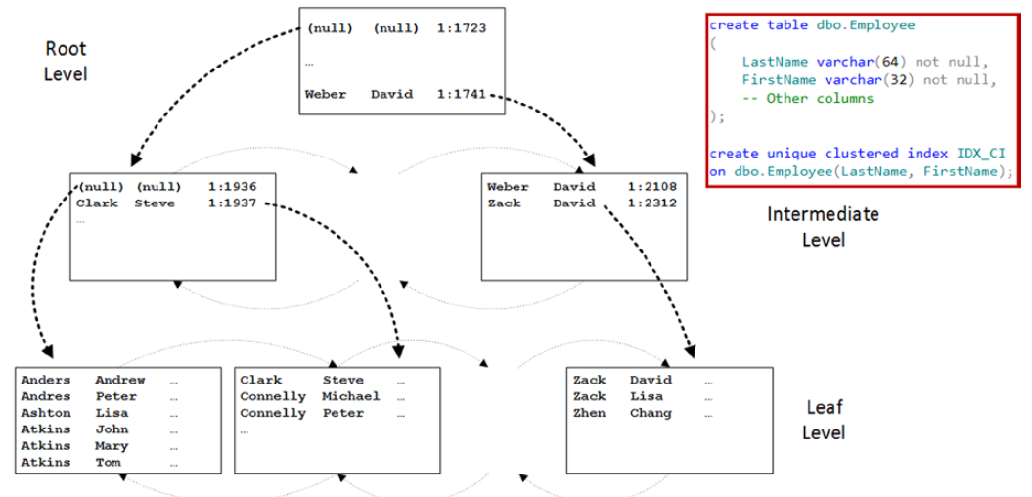
Implementing Indexes and Statistics
Composite Indexes

Slide 14
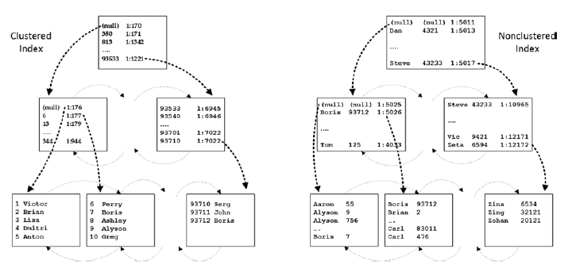
Implementing Indexes and Statistics
Nonclustered Indexes

Slide 15
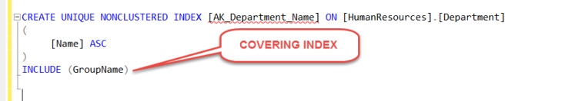
Implementing Indexes and Statistics
Covering Indexes

Slide 16


Implementing Indexes and Statistics
Filtered Indexes

Slide 17

Implementing Indexes and Statistics
Supporting Queries with Indexes
WHERE
JOIN
ORDER BY
GROUP BY
SARG

Slide 18
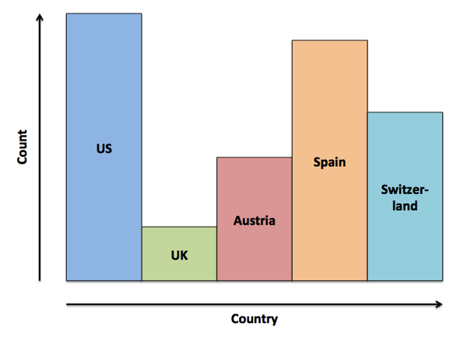
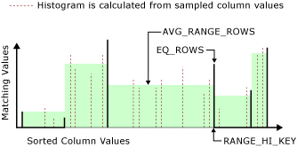
Implementing Indexes and Statistics
Statistics

Slide 19
Implementing Indexes and Statistics
DEMO

Slide 20
Query Optimizer

Slide 21
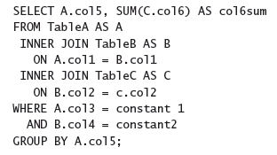
Query Optimizer
Query Optimization Problems

Slide 22
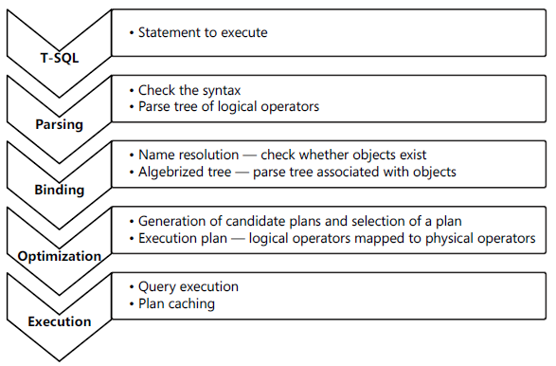
Query Optimizer
Query execution phases

Slide 23
Query Optimizer
Parameter Sniffing
DEMO

Slide 24
Using Tools to Analyze Query Performance

Slide 25
Using Tools to Analyze Query Performance
SQL Server Extended Events
Events These are your points of interest for monitoring. You can use events for monitoring or to trigger synchronous or asynchronous actions.
Targets These are event consumers. You can use targets that write to a file, store event data in a memory buffer, or aggregate event data. Targets can process data synchronously or asynchronously.
Actions These are responses to an event. They are bound to an event. Actions can capture a stack dump and inspect data, store information in a local variable, aggregate event data, or even append data to event data. For example, in SQL Server, you can use the execution plan detection action to detect execution plans.
Predicates These are sets of logical rules to filter captured events. In order to minimize the impact of a monitoring session on your system, it is important that you capture only events you need.
Types These help interpret the data collected. The data is actually a collection of bytes, and types give this data context. A type is provided for events, actions, targets, predicates, and types themselves.
Maps These are SQL Server internal tables that map internal numeric values to meaningful strings.

Slide 26
Using Tools to Analyze Query Performance
SQL Server Profiler
Event An event is an action within SQL Server. For example, an action can be a logon failure, T-SQL batch, start of a stored procedure, and more.
EventClass This is the type of an event. The event class defines the data that an event can report.
EventCategory Event categories define groupings of events
DataColumn A data column is an attribute of an event. If you save a trace to a table, an event is represented by a row in the table, and attributes of events are columns in the table.
Template A template is a saved trace definition. SQL Server Profiler comes with a couple of predefined templates that can speed up the creation of a trace.
Filter Filters limit the events traced. You can put a filter on any event column. In order to minimize the impact of monitoring on your SQL Server instance, you should filter out any event you do not need in your current trace.
Trace A trace is a collection of events, columns, filters, and data returned

Slide 27
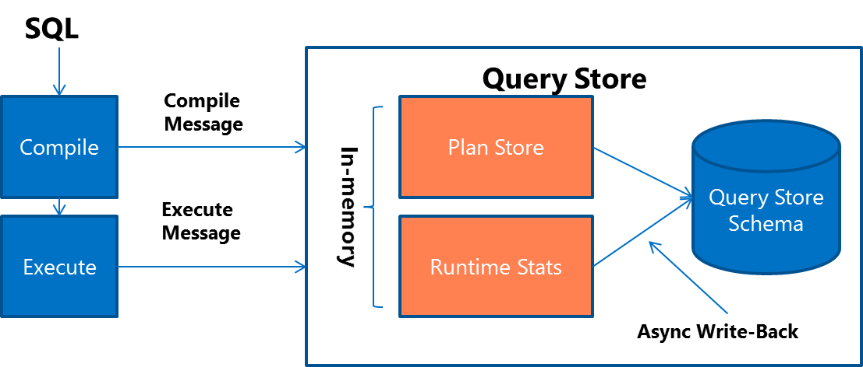
Using Tools to Analyze Query Performance
Query Store

Slide 28
Using Tools to Analyze Query Performance
SET STATISTICS IO ON;
Scan count
Logical reads
Physical reads
Read-ahead reads
Lob logical reads
Lob physical reads
Lob read-ahead reads

Slide 29
Using Tools to Analyze Query Performance
SET STATISTICS TIME ON;
Parse and compile time
Execution time

Slide 30
Using Tools to Analyze Query Performance
Dynamic Management Objects (DMO)
SQL Server Operating System (SQLOS)–related DMOs
sys.dm_os_waiting_tasks
sys.dm_exec_sessions
Execution-related DMOs
sys.dm_exec_requests
sys.dm_exec_sql_text
sys.dm_exec_query_stats
Index-related DMOs
sys.dm_db_missing_index_details

Slide 31
Using Tools to Analyze Query Performance
DEMO

Slide 32
Execution Plans

Slide 33
Execution Plans
Execution Plan Types
Estimated plans
Actual plans

Slide 34
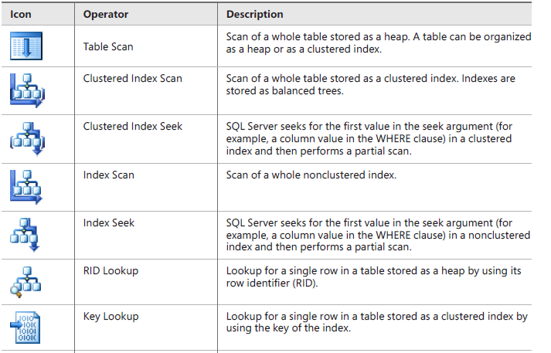
Execution Plans
Operators

Slide 35
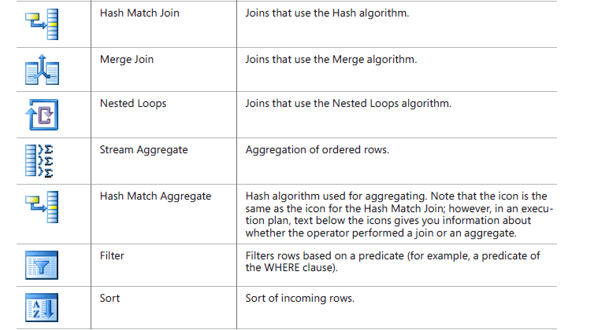
Execution Plans
Operators

Slide 36
Execution Plans
Physical Join Types
Nested Loops
Merge
Hash
Bitmap Filtering Optimized Hash (also called Star join optimization)
Adaptive join (SQL 2017)

Slide 37
Execution Plans
DEMO

