Slide 1


November, 25 2019

Slide 2
IN PREVIOUS PART: S20E03
Getting Started with the SELECT Statement
Filtering and Sorting Data
Combining Sets
Design for OLTP Database (Web Store)
Working with Git

Slide 3
S20E04 AGENDA
Sorting with NULL
Using Set Operators
Using Subqueries, Table Expressions, and the APPLY Operator
Grouping and Windowing
Writing Grouped Queries
Pivoting and Unpivoting Data
Design for OLTP Database (Web Store) EAV pattern

Slide 4
Using Set Operators
Topic

Slide 5
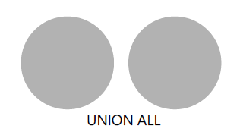

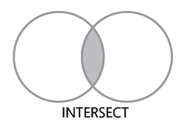
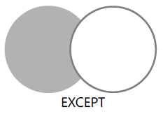
Using Set Operators

Slide 6
Using Subqueries, Table Expressions, and the APPLY Operator
Using Subqueries, Table Expressions, and the APPLY Operator
Topic

Slide 7
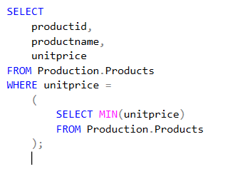
Using Subqueries, Table Expressions, and the APPLY Operator
Self-Contained Subqueries
Self-contained subqueries are subqueries that have no dependency on the outer query.
Notes:
Note that if what’s supposed to be a scalar subquery returns in practice more than one
value, the code fails at run time. If the scalar subquery returns an empty set, it is converted to
a NULL.

Slide 8
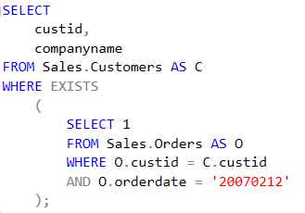
Using Subqueries, Table Expressions, and the APPLY Operator
Correlated Subqueries
Correlated subqueries are subqueries where the inner query has a reference to a column from the table in the outer query.

Slide 9
Using Subqueries, Table Expressions, and the APPLY Operator
Table Expressions
Table expressions are named queries.
Derived tables
Common table expressions (CTEs)
Views
Inline table-valued functions

Slide 10
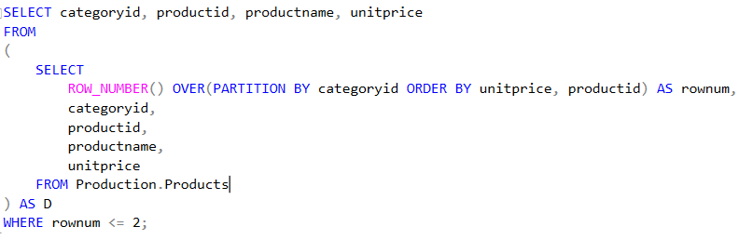
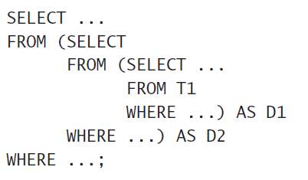
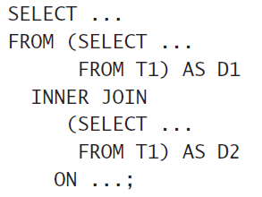
Using Subqueries, Table Expressions, and the APPLY Operator
Derived Tables

Slide 11
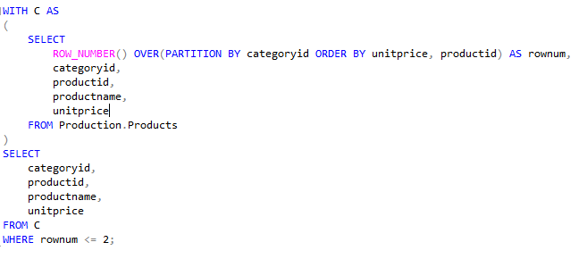
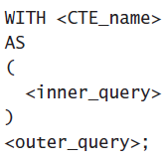
Using Subqueries, Table Expressions, and the APPLY Operator
CTEs
common table expression (CTE)

Slide 12
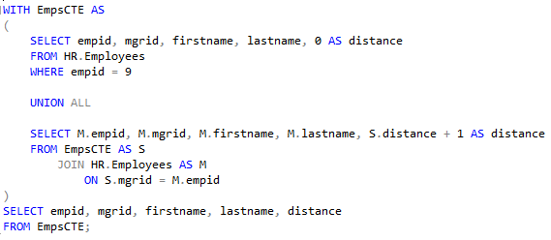
Using Subqueries, Table Expressions, and the APPLY Operator
CTEs recursive form
common table expression (CTE) recursive form

Slide 13
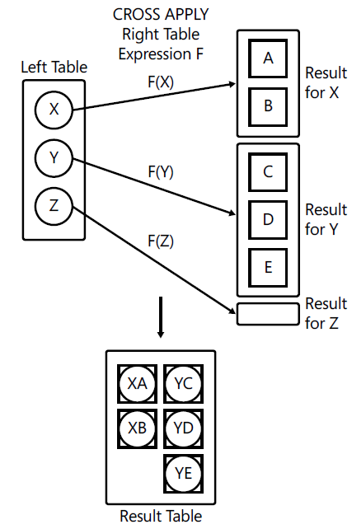
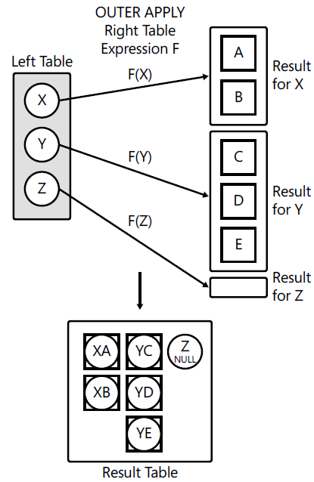
Using Subqueries, Table Expressions, and the APPLY Operator
Apply
CROSS APPLY
OUTER APP LY

Slide 14
Grouping and Windowing
Topic

Slide 15
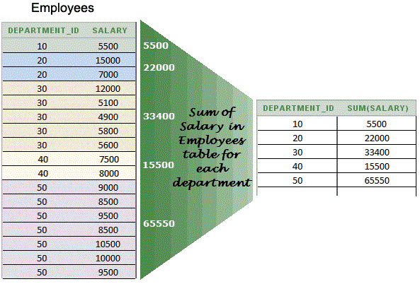
Grouping and Windowing
SUM, COUNT, AVG, MIN, MAX
Aggregate Functions (Transact-SQL)
https://msdn.microsoft.com/en-us/library/ms173454.aspx

Slide 16
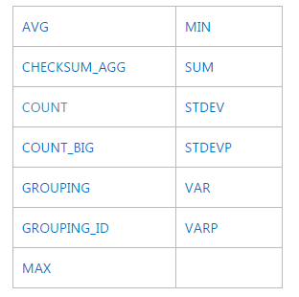
Grouping and Windowing
Aggregate Functions (Transact-SQL)
https://msdn.microsoft.com/en-us/library/ms173454.aspx

Slide 17
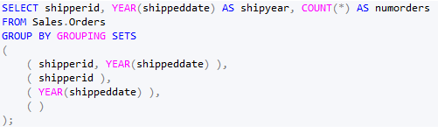
Grouping and Windowing

Slide 18
Pivoting and Unpivoting Data
Topic

Slide 19
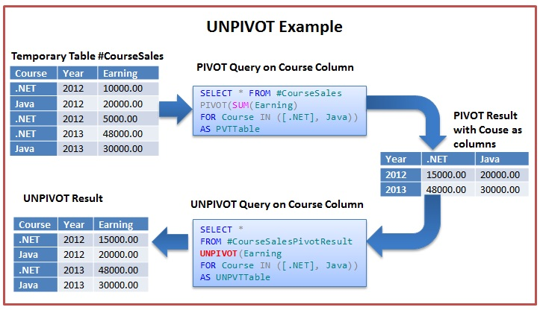
Grouping and Windowing
WITH PivotData AS
(
SELECT
< grouping column >,
< spreading column >,
< aggregation column >
FROM < source table >
)
SELECT < select list >
FROM PivotData
PIVOT( < aggregate function >(< aggregation column >)
FOR < spreading column > IN (< distinct spreading values >) ) AS P;
SELECT < column list >, < names column >, < values column >
FROM < source table >
UNPIVOT( < values column > FOR < names column > IN( <source columns> ) ) AS U;

Slide 20
EAV pattern
EAV pattern
Topic

Slide 21
EAV pattern

