Slide 1




April 29, 2019
3

Slide 2
Agenda: MSBI.Dev.PowerBI.S19E01
1. Power BI Desktop Data Transformations
Transforming Data using Power BI Desktop
· Introduction to Power BI Desktop
· Changing Locale
· Connecting to a Database
· Basic Transformations
· Managing Query Groups
· Splitting Columns
· Changing Data Types
· Working with Dates
· Removing and Reordering Columns
· Conditional Columns
· Connecting to Files in a Folder
· Merge Queries
· Query Dependency View
· Transforming Less Structured Data
· Enter Data
· Query Parameters
3

Slide 3
Workshop plan: MSBI.Dev.PowerBI.S19E01
Introduction (15min)
Power BI desktop introduction
Configuring Power BI desktop
Demonstrating sandbox result
Main part (45min)
(Fact)Scrapping data from web site with power query
Editing dataset – show popular filters/fuctions
Creating function based on scrapping data
Creating a new table with years data (= {2014..2019})
Using invoke custom function (GetDataByYear)
Transforming data (unpivot, replace)
Creating column by example (type index)
(Dimensions) Entering data (TypeIndex)
Using blank query(Date) (= Table.Distinct(FactLifeQualityIndex,"CityFull") as table
Creating a table based on distinct another table)
Splitting columns
Getting data from MS SQL
Changing type, renaming
3. Summary (5min)
3
Notes:
Creating function based on scrapping data:
= (year as number) as table =>
let
Source = Web.Page(Web.Contents("https://www.xxx?title="&Number.ToText(year)&"")),
Data0 = Source{0}[Data]
in
Data0
Quality of Life Index
Purchasing Power Index
Safety Index
Health Care Index
Cost of living Index
Property Price to Income Index
Traffic Commute Time Index
Pollution Index
Climate Index

Slide 4
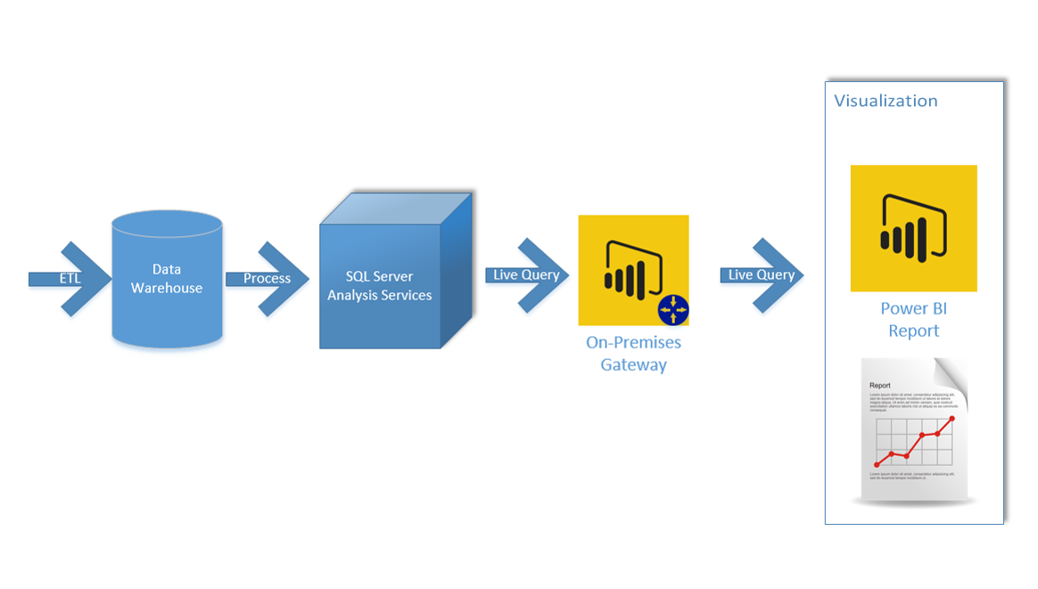
Enterprise Architecture for Power BI
3

Slide 5
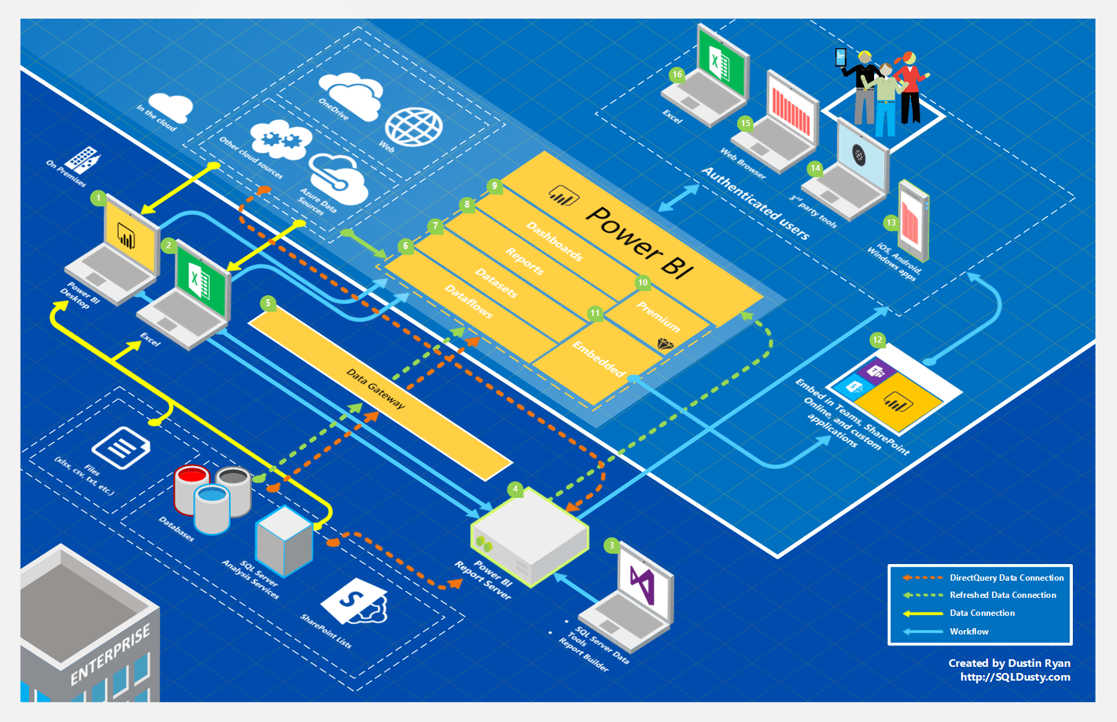
Global Architecture for Power BI
3

