Slide 1



Feb 28, 2019
3
Notes:
Appendix includes recent awards, please visit elements.epam.com for all 2016-2017 awards

Slide 2
IN PREVIOUS PART: S18E08
---
topics:
- topicname: Inserting Data
subtopics:
- subtopicname: INSERT VALUES
- subtopicname: INSERT SELECT
- subtopicname: INSERT EXEC
- subtopicname: SELECT INTO
- topicname: Updating Data
subtopics:
- subtopicname: UPDATE Statement
- subtopicname: UPDATE Based on Join
- subtopicname: Nondeterministic UPDATE
- subtopicname: UPDATE and Table Expressions
- subtopicname: UPDATE Based on a Variable
- subtopicname: UPDATE All-at-Once
- topicname: Deleting Data
subtopics:
- subtopicname: DELETE Statement
- subtopicname: TRUNCATE Statement
- subtopicname: DELETE Based on a Join
- subtopicname: DELETE Using Table Expressions
- topicname: Other Data Modification Aspects
subtopics:
- subtopicname: Using the IDENTITY Column Property
keywords: [SCOPE_IDENTITY,IDENTITY,IDENT_CURRENT]
- subtopicname: Using the Sequence Object
---
3
Notes:
Appendix includes recent awards, please visit elements.epam.com for all 2016-2017 awards

Slide 3
IN PREVIOUS PART: S18E08
- topicname: Merging Data
subtopics:
- subtopicname: Using the MERGE Statement
- topicname: Using the OUTPUT Option
subtopics:
- subtopicname: Working with the OUTPUT Clause
- subtopicname: INSERT with OUTPUT
- subtopicname: DELETE with OUTPUT
- subtopicname: UPDATE with OUTPUT
- subtopicname: MERGE with OUTPUT
- subtopicname: Composable DML
3
Notes:
Appendix includes recent awards, please visit elements.epam.com for all 2016-2017 awards

Slide 4
Agenda: MSBI.Dev.S19E09
---
topics:
- topicname: Implementing Transactions
subtopics:
- subtopicname: Understanding Transactions
- subtopicname: Types of Transactions
- subtopicname: Transaction Commands
- subtopicname: Transaction Levels and States
- subtopicname: Transaction Modes
- subtopicname: Additional Transaction Options
- topicname: Basic Locking
subtopics:
- subtopicname: Lock Compatibility
- subtopicname: Blocking
- subtopicname: Deadlocking
- topicname: Transaction Isolation Levels
subtopics:
- subtopicname: READ COMMITTED
- subtopicname: READ UNCOMMMITED
- subtopicname: READ COMMITTED SNAPSHOT
- subtopicname: REPEATABLE READ
- subtopicname: SNAPSHOT
- subtopicname: SERIALIZABLE
- topicname: Detecting and Raising Errors
subtopics:
- subtopicname: Analyzing Error Messages
- subtopicname: RAISERROR
- subtopicname: THROW
- subtopicname: TRY_CONVERT and TRY_PARSE
3
Notes:
Appendix includes recent awards, please visit elements.epam.com for all 2016-2017 awards

Slide 5
Implementing Transactions

Slide 6

Managing Transactions and Concurrency
Transactions
Transaction is a logical unit of work.
All data manipulation language (DML) statements such as INSERT, UPDATE, and DELETE. Technically, even single SELECT statements are a type of transaction in SQL Server
All data definition language (DDL) statements such as CREATE TABLE and CREATE INDEX.

Slide 7
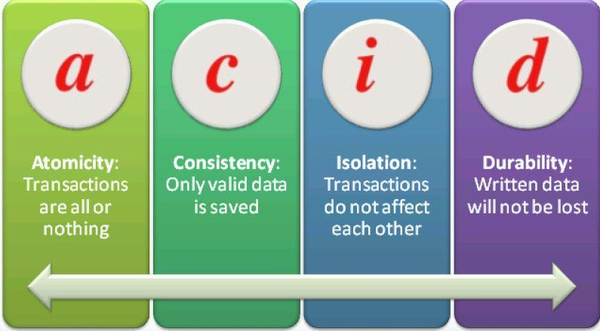
Managing Transactions and Concurrency
ACID Properties of Transactions
Atomicity
Consistency
Isolation
Durability
Notes:
SQL Server ensures all these ACID properties through a variety of mechanisms. To maintain
atomicity, SQL Server treats every data DML or DDL command individually and will not allow
any command to only partially succeed. Consider, for example, an UPDATE statement that
would update 500 rows in a table at the point in time that the transaction begins. The command
will not finish until exactly all those 500 rows are updated. If something prevents that
command from updating all 500 rows, SQL Server will abort the command and roll back the
transaction.
If more than one command is present in a transaction, SQL Server will normally not allow
the entire transaction to be committed unless both statements succeed. (If XACT_ABORT is
OFF, which is the default, you can insert code to decide whether to roll back the transaction
or commit it. See the sections on TRY/CATCH and XACT_ABORT later in this lesson for more
information.)
For consistency, SQL Server ensures that all constraints in the database are enforced. If
your transaction attempts to insert a row that has an invalid foreign key, for example, then
SQL Server will detect that a constraint would be violated, and generate an error message.
You can add logic to decide whether or not to roll back the transaction.
To enforce transactional isolation, SQL Server ensures that when a transaction makes
multiple changes to the database, none of the objects being changed by that transaction are
allowed to be changed by any other transactions. In other words, one transaction's changes
are isolated from any other transaction activities. If two transactions want to change the same
data, one of them must wait until the other transaction is finished

Slide 8
Managing Transactions and Concurrency
Types of Transactions
System transactions
User transactions

Slide 9
Managing Transactions and Concurrency
Transaction Commands
BEGIN TRANSACTION (BEGIN TRAN)
COMMIT TRANSACTION (COMMIT TRAN, COMMIT WORK, or just COMMIT)
ROLLBACK TRAN, ROLLBACK WORK, ROLLBACK.
DEMO

Slide 10
Managing Transactions and Concurrency
Transaction Levels and States
@@TRANCOUNT
XACT_STATE()
Notes:
Transaction Levels and States
You can detect the transaction level or state by using two system functions:
■■ @@TRANCOUNT can be queried to find the level of transaction.
■■ A level of 0 indicates that at this point, the code is not within a transaction.
■■ A level > 0 indicates that there is an active transaction, and a number > 1 indicates
the nesting level of nested transactions.
■■ XACT_STATE() can be queried to find the state of the transaction.
■■ A state of 0 indicates that there is no active transaction.
■■ A state of 1 indicates that there is an uncommitted transaction, and it can be
committed, but the nesting level is not reported.
■■ A state of -1 indicates that there is an uncommitted transaction, but it cannot be
committed due to a prior fatal error

Slide 11
Managing Transactions and Concurrency
Transaction Modes
Autocommit
Implicit transaction
Explicit transaction

Slide 12
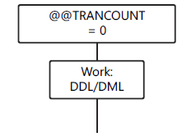
Managing Transactions and Concurrency
Transaction Modes
AUTOCOMMIT (DEFAULT)

Slide 13
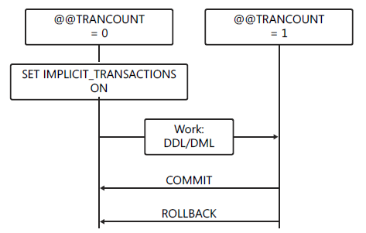
Managing Transactions and Concurrency
Transaction Modes
Implicit transaction

Slide 14
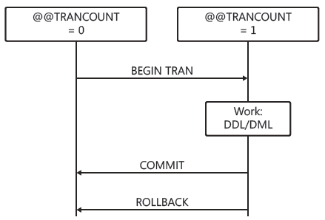
Managing Transactions and Concurrency
Transaction Modes
Explicit transaction

Slide 15
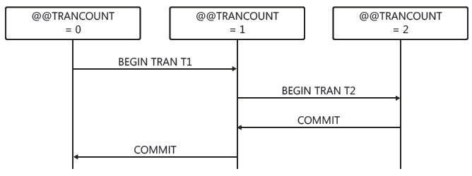
Managing Transactions and Concurrency
Transaction Modes
Nested Transactions

Slide 16
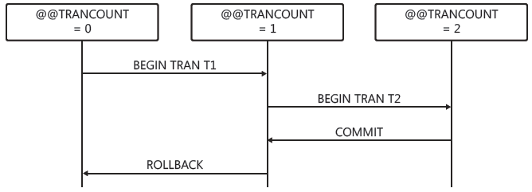
Managing Transactions and Concurrency
Transaction Modes
Nested Transactions Rollback

Slide 17
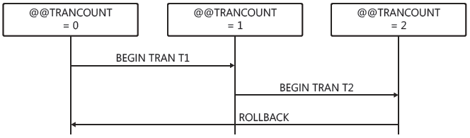
Managing Transactions and Concurrency
Transaction Modes
Nested Transactions Rollback

Slide 18
Managing Transactions and Concurrency
Transaction Modes
DEMO

Slide 19
Managing Transactions and Concurrency
Additional Transaction Options
Savepoints (DEMO)
Cross-database transactions
Distributed transactions

Slide 20
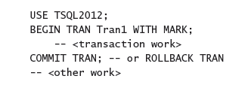
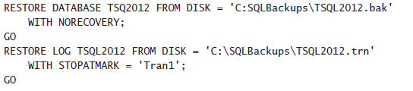
Managing Transactions and Concurrency
Marking a Transaction
Notes:
The transaction name is
displayed in the name column of sys.dm_tran_active_transactions, as shown in the following
example.
Named transactions are used for placing a mark in the transaction log in order to specify
a point to which one or more databases can be restored. When the transaction is recorded in
the database's transaction log, the transaction mark is also recorded, as shown in the following
example.

Slide 21
Basic locking

Slide 22
Managing Transactions and Concurrency
Basic Locking
Shared locks
Exclusive locks
Advanced Locking Modes
There are more advanced modes called update, intent, and schema locks used for special purposes

Slide 23
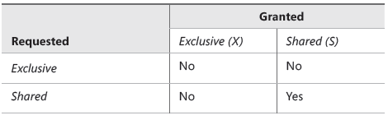
Managing Transactions and Concurrency
Lock Compatibility

Slide 24
Managing Transactions and Concurrency
Blocking
Notes:
Isolation levels are set per session. If you do not set a different isolation level in your session,
all your transactions will execute using the default isolation level, READ COMMITTED.
For on-premise SQL Server instances, this is READ COMMITTED. In Windows Azure SQL
Database, the default isolation level is READ COMMITTED SNAP SHOT.

Slide 25
Managing Transactions and Concurrency
Deadlocking
DEMO

Slide 26
Transaction Isolation Levels

Slide 27
Managing Transactions and Concurrency
Transaction Isolation Levels
Pessimistic
READ UNCOMMITTED
READ COMMITED
REPEATABLE READ
SERIALIZABLE
Optimistic
READ COMMITTED SNAPSHOT
SNAPSHOT
DEMO
SET TRANSACTION ISOLATION LEVEL

Slide 28
Detecting and Raising Errors

Slide 29
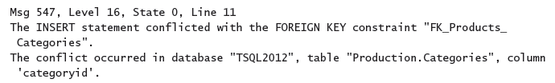
Implementing Error Handling
Detecting and Raising Errors
Error Messages

Slide 30
Implementing Error Handling
Analyzing Error Messages
Error number
SQL Server error messages are numbered from 1 through 49999
Custom error messages are numbered 50001 and higher
The error number 50000 is reserved for a custom message that does not have a custom error number
Severity level (0-25)
errors with a severity of 16 or higher are logged automatically to the SQL Server log and the Windows log
errors with a severity level from 19 through 25 can be specified only by members of the sysadmin server role.
severity level from 20 through 25 are considered fatal
errors with severity level 0 through 10 are informational only.

Slide 31
Implementing Error Handling
Analyzing Error Messages
State
This is an integer with a maximum value of 127, used by Microsoft for internal purposes.
Error message
The error message can be up to 255 Unicode characters long
SQL Server error messages are listed in sys.messages
You can add your own custom error messages by using sp_addmessage

Slide 32

Implementing Error Handling
RAISING ERROR
RAISERROR
THROW
Notes:
You cannot issue THROW with a NOWAIT command in order to cause immediate
buffer output.
■■ You cannot issue THROW using a severity level higher than 16 by using the WITH LOG
clause as you can with RAISERROR.

Slide 33

Implementing Error Handling
RAISING ERROR
RAISERROR
THROW
THROW does not use parentheses to delimit parameters.
THROW can be used without parameters, but only in the CATCH block of a TRY/CATCH construct.
When parameters are supplied, error_number, message, and state are all required.
The error_number does not require a matching defined message in sys.messages.
The message parameter does not allow formatting, but you can use FORMATMESSAGE() with a variable to get the same effect.
The state parameter must be an integer that ranges from 0 to 255.
Any parameter can be a variable.
There is no severity parameter; the severity is always set to 16.
THROW always terminates the batch except when it is used in a TRY block
Notes:
You cannot issue THROW with a NOWAIT command in order to cause immediate
buffer output.
■■ You cannot issue THROW using a severity level higher than 16 by using the WITH LOG
clause as you can with RAISERROR.

Slide 34
Implementing Error Handling
Handling Errors After Detection
Unstructured Error Handling
Using @@ERROR
XACT_ABORT with Transactions
SET XACT_ABORT ON
Structured Error Handling
Using TRY/CATCH
DEMO

