Slide 1



March 3, 2019
3
Notes:
Appendix includes recent awards, please visit elements.epam.com for all 2016-2017 awards

Slide 2
IN PREVIOUS PART: MSBI.Dev.S19E09
---
topics:
- topicname: Implementing Transactions
subtopics:
- subtopicname: Understanding Transactions
- subtopicname: Types of Transactions
- subtopicname: Transaction Commands
- subtopicname: Transaction Levels and States
- subtopicname: Transaction Modes
- subtopicname: Additional Transaction Options
- topicname: Basic Locking
subtopics:
- subtopicname: Lock Compatibility
- subtopicname: Blocking
- subtopicname: Deadlocking
- topicname: Transaction Isolation Levels
subtopics:
- subtopicname: READ COMMITTED
- subtopicname: READ UNCOMMMITED
- subtopicname: READ COMMITTED SNAPSHOT
- subtopicname: REPEATABLE READ
- subtopicname: SNAPSHOT
- subtopicname: SERIALIZABLE
- topicname: Detecting and Raising Errors
subtopics:
- subtopicname: Analyzing Error Messages
- subtopicname: RAISERROR
- subtopicname: THROW
- subtopicname: TRY_CONVERT and TRY_PARSE
3
Notes:
Appendix includes recent awards, please visit elements.epam.com for all 2016-2017 awards

Slide 3
Agenda: MSBI.Dev.S19E10
- topicname: Using Dynamic SQL
subtopics:
- subtopicname: Dynamic SQL Overview
- subtopicname: Uses for Dynamic SQL
- subtopicname: The EXECUTE Command
- subtopicname: SQL Injection
- subtopicname: Using sp_executesql
- subtopicname: Use case scenarios
- topicname: Designing and Implementing Stored Procedures
subtopics:
- subtopicname: Understanding Stored Procedures
keywords: [SET NOCOUNT ON, RETURN and Return Codes,Input Parameters,Output Parameters]
- subtopicname: Branching Logic
keywords: [IF/ELSE, WHILE,WAITFOR,GOTO]
- subtopicname: Developing Stored Procedures
keywords: [Stored Procedures and Error Handling, Dynamic SQL in Stored Procedures]
3
Notes:
Appendix includes recent awards, please visit elements.epam.com for all 2016-2017 awards

Slide 4
Agenda: MSBI.Dev.S19E10
- topicname: Implementing Triggers
subtopics:
- subtopicname: DML Triggers
- subtopicname: AFTER Triggers
keywords: [Nested AFTER Triggers]
- subtopicname: INSTEAD OF Triggers
- subtopicname: DML Trigger Functions
keywords: [UP DATE (),COLUMNS _UPDATED()]
- topicname: Implementing User-Defined Functions
subtopics:
- subtopicname: Scalar UDFs
- subtopicname: Inline Table-Valued UDF
- subtopicname: Multistatement Table-Valued UDF
- subtopicname: Limitations on UDFs
3
Notes:
Appendix includes recent awards, please visit elements.epam.com for all 2016-2017 awards

Slide 5
Using Dynamic SQL

Slide 6
Using Dynamic SQL
Dynamic SQL Overview
Generating T-SQL Strings
The EXECUTE Command
SQL Injection
Using sp_executesql
PRINT N'SELECT custid, companyname, contactname, contacttitle, address
FROM [Sales].[Customers]
WHERE address = N''5678 rue de l''''Abbaye'';';
Notes:
■■ Executing stored procedures
■■ Impersonating users or logins
■■ Querying a linked server
■■ Executing dynamic SQL generated strings

Slide 7
Using Dynamic SQL
Dynamic SQL Overview
Executing stored procedures
Impersonating users or logins
Querying a linked server
Executing dynamic SQL generated strings
Generating T-SQL Strings
The EXECUTE Command
SQL Injection
Using sp_executesql
Notes:
■■ Executing stored procedures
■■ Impersonating users or logins
■■ Querying a linked server
■■ Executing dynamic SQL generated strings

Slide 8

Using Dynamic SQL
Dynamic SQL Overview
Generating T-SQL Strings
The EXECUTE Command
SQL Injection!
Using sp_executesql
Notes:
■■ Executing stored procedures
■■ Impersonating users or logins
■■ Querying a linked server
■■ Executing dynamic SQL generated strings

Slide 9
Using Dynamic SQL
Dynamic SQL Overview
Generating T-SQL Strings
The EXECUTE Command
SQL Injection
Using sp_executesql
Notes:
■■ Executing stored procedures
■■ Impersonating users or logins
■■ Querying a linked server
■■ Executing dynamic SQL generated strings

Slide 10
Designing and Implementing Stored Procedures

Slide 11
Designing and Implementing Stored Procedures
Understanding Stored Procedures
Stored procedures are routines that reside in a database and encapsulate code. SQL Server permits several types of stored procedures, such as the following:
T-SQL stored procedures written in T-SQL code
CLR stored procedures stored as Microsoft .NET assemblies in the database
Extended stored procedures, which make calls to externally compiled data definition languages (DLLs)
Natively Compiled Stored Procedure (NEW)

Slide 12
Designing and Implementing Stored Procedures
Understanding Stored Procedures
Stored procedures important features:
Can be called from T-SQL code by using the EXECUTE command
You can pass data to them through input parameters, and receive data back through output parameters
They can return result sets of queries to the client application
They can modify data in tables.
They can create, alter, and drop tables and indexes.

Slide 13
Designing and Implementing Stored Procedures
Understanding Stored Procedures
advantages:
To encapsulate T-SQL code
To make a database more secure
To present a more versatile data access layer to users and applications
To help improve performance by creating execution plans that can be reused

Slide 14
Designing and Implementing Stored Procedures
Understanding Stored Procedures
Let’s create and execute SP:
Input parameters
Output Parameters
Notes:
A stored procedure ends when the T-SQL batch ends, but you can cause the procedure to exit
at any point by using the RETURN command. You can use more than one RETURN command
in a procedure. RETURN stops the execution of the procedure and returns control back to the
caller. Statements after the RETURN statement are not executed.
RETURN by itself causes SQL Server to send a status code back to the caller. The statuses
are 0 for successful and a negative number if there is an error. However, the error numbers
are not reliable, so you should not rely on them. Use the SQL Server error numbers from
@@ERROR or from ERROR_NUMBER() in a CATCH block instead.
You can send your own return codes back to the caller by inserting an integer value after
the RETURN statement. However, if you want to send information back to the caller, it is considered
a better practice to use an OUTPUT parameter instead.

Slide 15
Designing and Implementing Stored Procedures
Understanding Stored Procedures
Branching Logic:
IF/ELSE
WHILE (with BREAK and CONTINUE)
WAITFOR
GOTO
RETURN (normally inside T-SQL routines)

Slide 16
Implementing Triggers

Slide 17
Implementing Triggers
Triggers
DML Triggers
AFTER
INSTEAD OF

Slide 18
Implementing Triggers
Triggers
Nested AFTER Triggers
EXEC sp_configure 'nested triggers';
32 (not 42)

Slide 19
Implementing Triggers
INSTEAD OF Triggers

Slide 20

Implementing Triggers
DML Trigger Functions
UPDATE ()
COLUMNS _UPDATED()

Slide 21
Implementing User-Defined Functions

Slide 22
Implementing User-Defined Functions
Understanding User-Defined Functions
Can
accept parameters
embedded in T-SQL statements
access SQL Server data
Cannot
be executed by using the EXECUTE command
perform any DDL
Scalar
table-valued
inline table-valued UDF
multistatement table-valued UDF

Slide 23
Implementing User-Defined Functions
Understanding User-Defined Functions
OBJECT_ID()
FN = SQL scalar function
IF = SQL inline table-valued function
TF = SQL table-valued-function

Slide 24
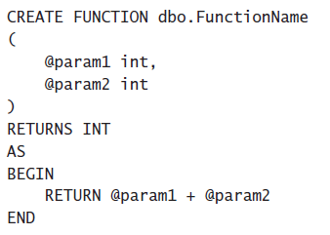
Implementing User-Defined Functions
Understanding User-Defined Functions
Scalar UDFs

Slide 25
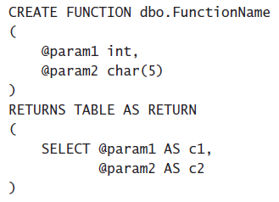
Implementing User-Defined Functions
Understanding User-Defined Functions
Table-Valued UDFs
Inline Table-Valued UDF

Slide 26
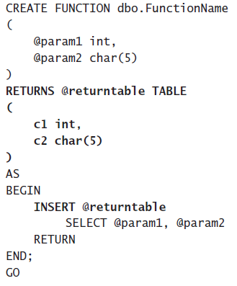
Implementing User-Defined Functions
Understanding User-Defined Functions
Table-Valued UDFs
Multistatement Table-Valued UDF

Slide 27
Implementing User-Defined Functions
Limitations on UDFs
UDFs cannot do the following:
Apply any schema or data changes in the database.
Change the state of a database or SQL Server instance.
Create or access temporary tables.
Call stored procedures.
Execute dynamic SQL.
Produce side effects. For example, both the RAND() and NEWID()

Slide 28
Implementing User-Defined Functions
UDF Options
You can specify five options with UDFs:
ENCRYPTION
SCHEMABINDING
RETURN NULL ON NULL INPUT
CALLED ON NULL INPUT
EXECUTE AS

Slide 29
Implementing User-Defined Functions
UDF Performance Considerations

