Slide 1


MSBI.DEV
Course
S18E11
March 31, 2018

Slide 2
IN PREVIOUS PART: S18E10
Using Dynamic SQL
Designing and Implementing Stored Procedures
Implementing Triggers
Implementing User-Defined Functions

Slide 3
S18E11 AGENDA
Using Tools to Analyze Query Performance
Implementing Indexes and Statistics
Understanding Cursors, Sets, and Temporary Tables

Slide 4
S18E11 AGENDA
Using Tools to Analyze Query Performance
Implementing Indexes and Statistics
Understanding Cursors, Sets, and Temporary Tables

Slide 5
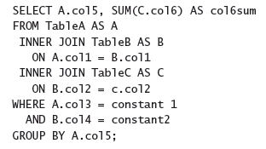
Using Tools to Analyze Query Performance
Query Optimization Problems and the Query Optimizer

Slide 6
Using Tools to Analyze Query Performance
Query Optimization Problems and the Query Optimizer
Nested Loops
Merge
Hash
Bitmap Filtering Optimized Hash (also called Star join optimization)

Slide 7
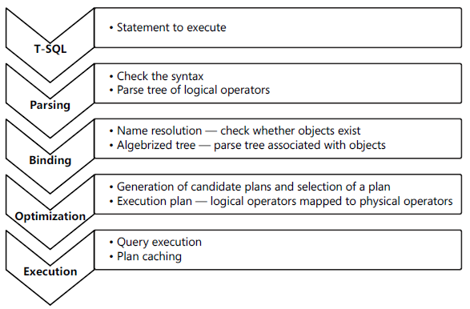
Using Tools to Analyze Query Performance
Query execution phases

Slide 8
Using Tools to Analyze Query Performance
parameter sniffing

Slide 9
Using Tools to Analyze Query Performance
SQL Server Extended Events
■ Events These are your points of interest for monitoring. You can use events for monitoring
or to trigger synchronous or asynchronous actions.
■ Targets These are event consumers. You can use targets that write to a file, store
event data in a memory buffer, or aggregate event data. Targets can process data
synchronously or asynchronously.
■ Actions These are responses to an event. They are bound to an event. Actions can
capture a stack dump and inspect data, store information in a local variable, aggregate
event data, or even append data to event data. For example, in SQL Server, you can use
the execution plan detection action to detect execution plans.
■ Predicates These are sets of logical rules to filter captured events. In order to
minimize the impact of a monitoring session on your system, it is important that you
capture only events you need.
■ Types These help interpret the data collected. The data is actually a collection of
bytes, and types give this data context. A type is provided for events, actions, targets,
predicates, and types themselves.
■ Maps These are SQL Server internal tables that map internal numeric values to
meaningful strings.

Slide 10
Using Tools to Analyze Query Performance
SQL Server Profiler
Event An event is an action within SQL Server. For example, an action can be a logon
failure, T-SQL batch, start of a stored procedure, and more.
EventClass This is the type of an event. The event class defines the data that an event
can report.
EventCategory Event categories define groupings of events
DataColumn A data column is an attribute of an event. If you save a trace to a table,
an event is represented by a row in the table, and attributes of events are columns in
the table.
Template A template is a saved trace definition. SQL Server Profiler comes with a
couple of predefined templates that can speed up the creation of a trace.
Filter Filters limit the events traced. You can put a filter on any event column. In
order to minimize the impact of monitoring on your SQL Server instance, you should
filter out any event you do not need in your current trace.
Trace A trace is a collection of events, columns, filters, and data returned

Slide 11
Using Tools to Analyze Query Performance
SQL Trace
Notes:
SQL Trace is an internal SQL Server mechanism for capturing events. SQL Trace is deprecated
in future versions. This means that it will still be available in the life cycle of SQL Server
2012 and the next version of SQL Server; however, after the next version, SQL Trace might be
discontinued.

Slide 12
Using Tools to Analyze Query Performance
SET STATISTICS IO ON;
Scan count
Logical reads
Physical reads
Read-ahead reads
Lob logical reads
Lob physical reads
Lob read-ahead reads

Slide 13
Using Tools to Analyze Query Performance
SET STATISTICS TIME ON;
Parse and compile time
Execution Times

Slide 14
Designing and Implementing Stored Procedures
Execution Plans
SET SHOWPLAN_TEXT and SET SHOWPLAN_ALL for estimated plans
SET STATISTICS PROFILE for actual plans
SET SHOWPLAN_XML for estimated plans
SET STATISTICS XML for actual plan

Slide 15
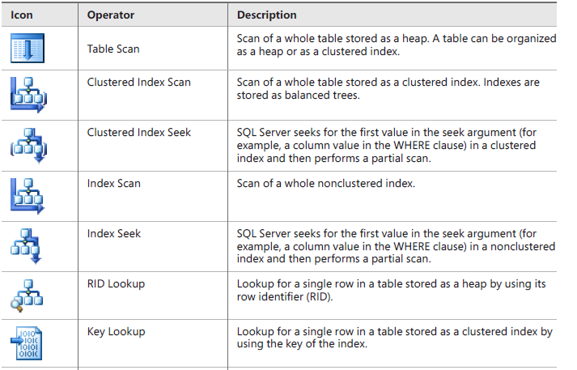
Designing and Implementing Stored Procedures
Execution Plans

Slide 16
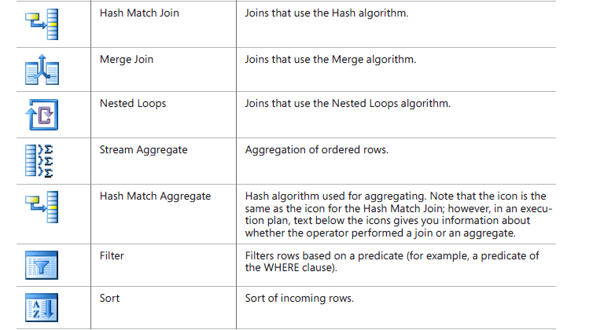
Designing and Implementing Stored Procedures
Execution Plans

Slide 17
Using Dynamic Management Objects
The Most Important DMOs for Query Tuning
SQL Server Operating System (SQLOS)–related DMOs
sys.dm_os_waiting_tasks
sys.dm_exec_sessions
Execution-related DMOs
sys.dm_exec_requests
sys.dm_exec_sql_text
sys.dm_exec_query_stats
Index-related DMOs
sys.dm_db_missing_index_details

Slide 18
S18E11 AGENDA
Using Tools to Analyze Query Performance
Implementing Indexes and Statistics
Understanding Cursors, Sets, and Temporary Tables

Slide 19

Tables and Indexes: Internal Structure and Access Methods
Heap Tables
Heap tables are tables without a clustered index.
The data in heap tables is unsorted.
SQL Server does not guarantee, nor does it maintain, a sorting order of the data in the heap tables.

Slide 20
Tables and Indexes: Internal Structure and Access Methods
Heap Tables

Slide 21
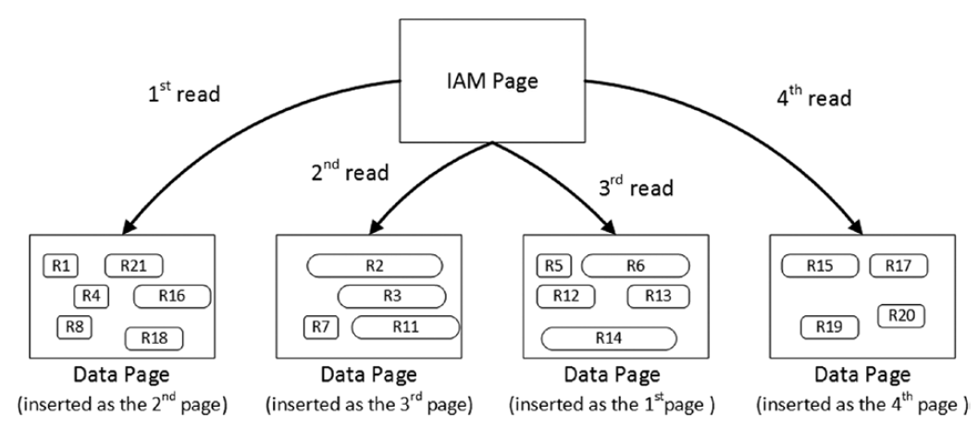
Tables and Indexes: Internal Structure and Access Methods
Heap Tables
Heap tables are tables without a clustered index.
The data in heap tables is unsorted.
SQL Server does not guarantee,nor does it maintain, a sorting order of the data in the heap tables.

Slide 22
Tables and Indexes: Internal Structure and Access Methods
Heap Tables
Heap tables are tables without a clustered index.
The data in heap tables is unsorted.
SQL Server does not guarantee,nor does it maintain, a sorting order of the data in the heap tables.

Slide 23
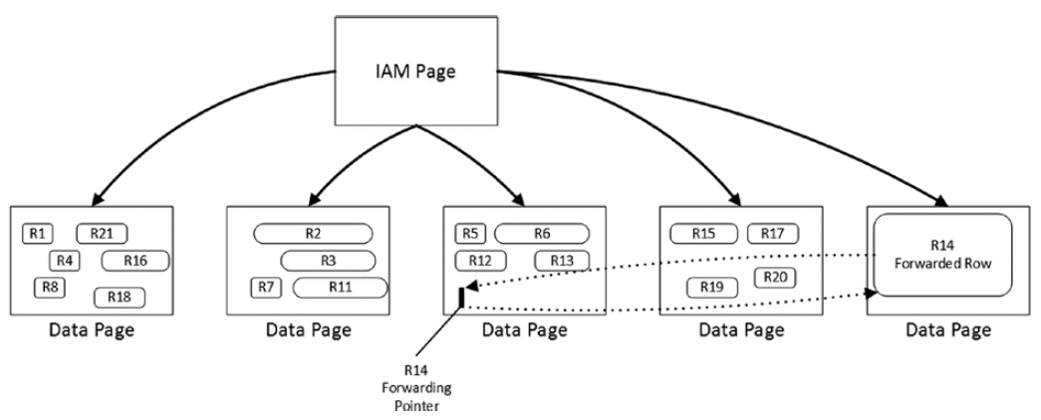
Tables and Indexes: Internal Structure and Access Methods
Heap Tables
Forwarding pointers

Slide 24
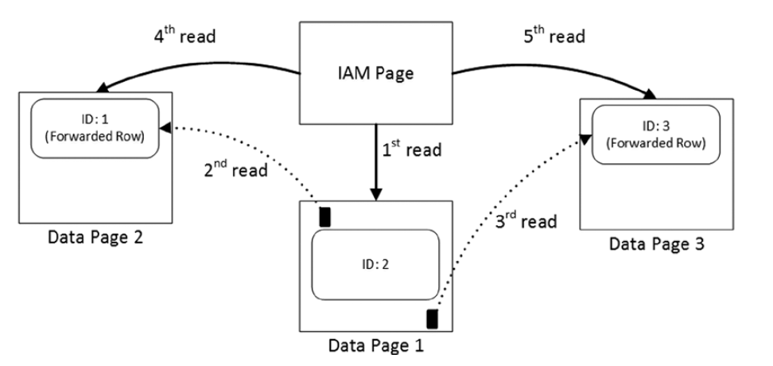
Tables and Indexes: Internal Structure and Access Methods
Heap Tables
Reading data when the forwarding pointers exist

Slide 25

Tables and Indexes: Internal Structure and Access Methods
Clustered Indexes
A clustered index dictates the physical order of the data in a table, which is sorted according to the clustered index key.
The table can have only one clustered index defined.

Slide 26
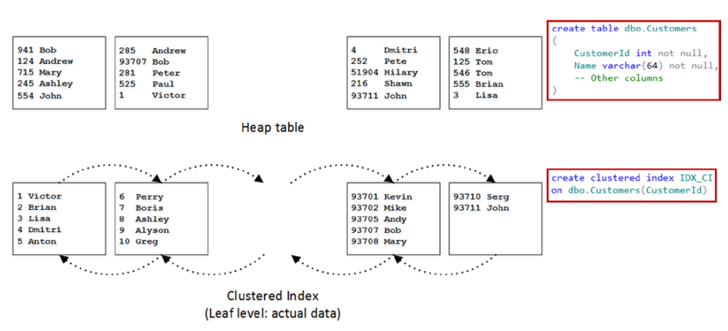
Tables and Indexes: Internal Structure and Access Methods
Clustered Indexes

Slide 27
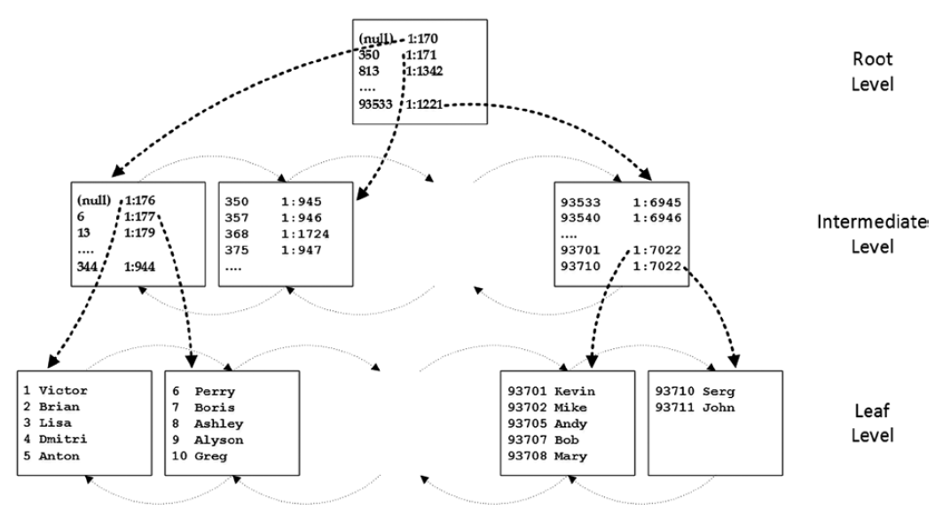
Tables and Indexes: Internal Structure and Access Methods
Clustered Indexes

Slide 28
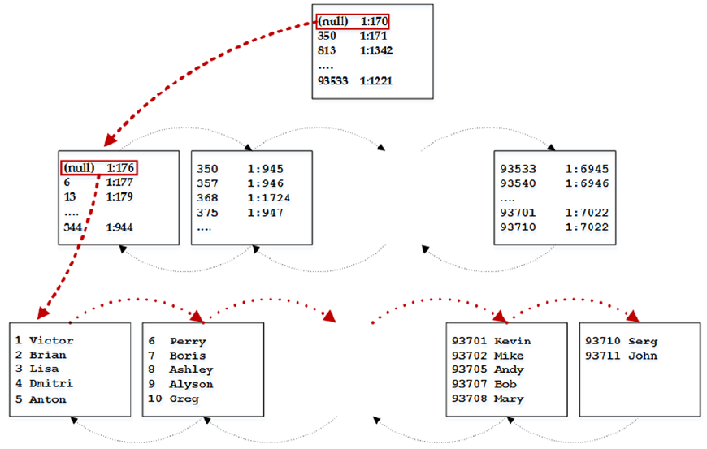
Tables and Indexes: Internal Structure and Access Methods
Clustered Indexes
Ordered index scan

Slide 29
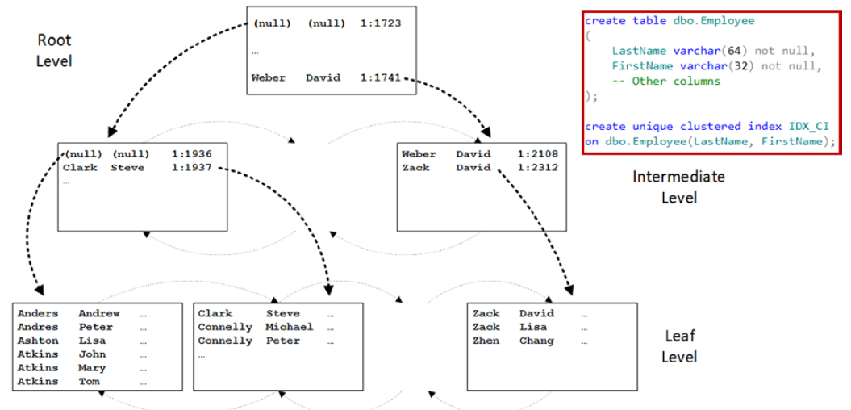
Tables and Indexes: Internal Structure and Access Methods
Composite Indexes

Slide 30
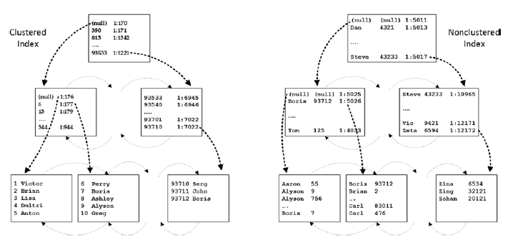
Tables and Indexes: Internal Structure and Access Methods
Nonclustered Indexes

Slide 31
Tables and Indexes: Internal Structure and Access Methods
Nonclustered Indexes

Slide 32
Tables and Indexes: Internal Structure and Access Methods
Supporting Queries with Indexes
JOIN
WHERE (Search Arguments)
ORDER

Slide 33


Tables and Indexes: Internal Structure and Access Methods
Indexes with Included Columns
Filtered Indexes

Slide 34
S18E11 AGENDA
Using Tools to Analyze Query Performance
Implementing Indexes and Statistics
Understanding Cursors, Sets, and Temporary Tables

Slide 35
Cursors
DEMO

Slide 36
using temporary tables vs. table variables
DEMO

