Slide 1


MSBI.DEV
Course
S18E13
April 8, 2018

Slide 2
IN PREVIOUS PART: S18E12
BI. Business Intelligence
Designing and Implementing a Data Warehouse
Introducing Star and Snowflake Schemas
Designing Dimensions
Designing Fact Tables

Slide 3
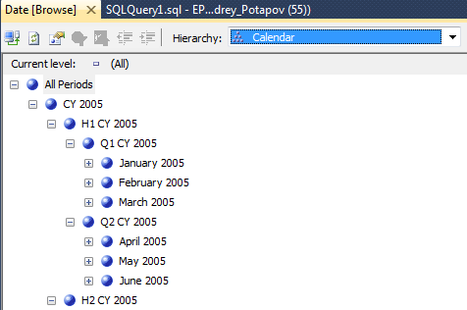
Hierarchies

Slide 4


Slowly Changing Dimensions
SCD Type 1

Slide 5
Slowly Changing Dimensions
SCD Type 1

Slide 6
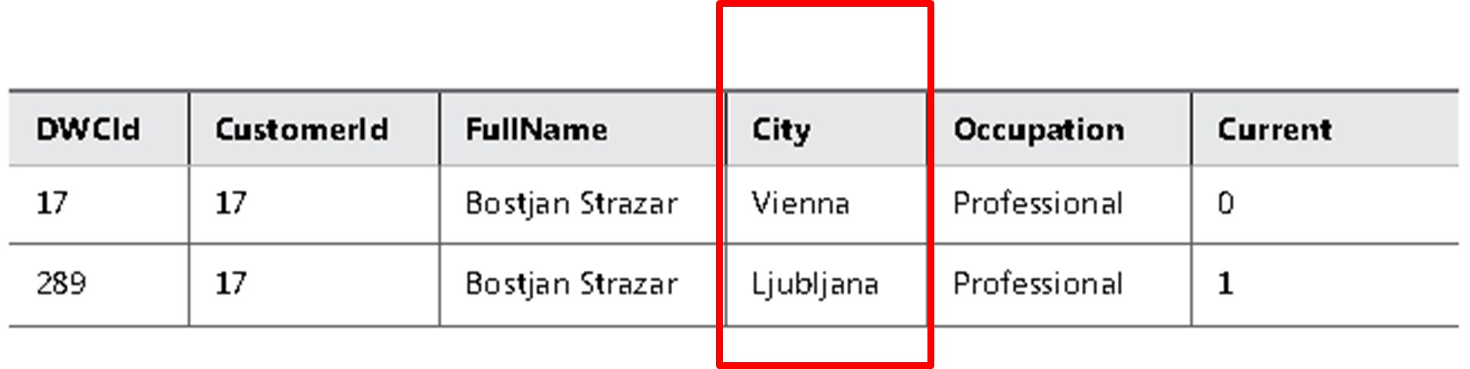
Slowly Changing Dimensions
SCD Type 2

Slide 7
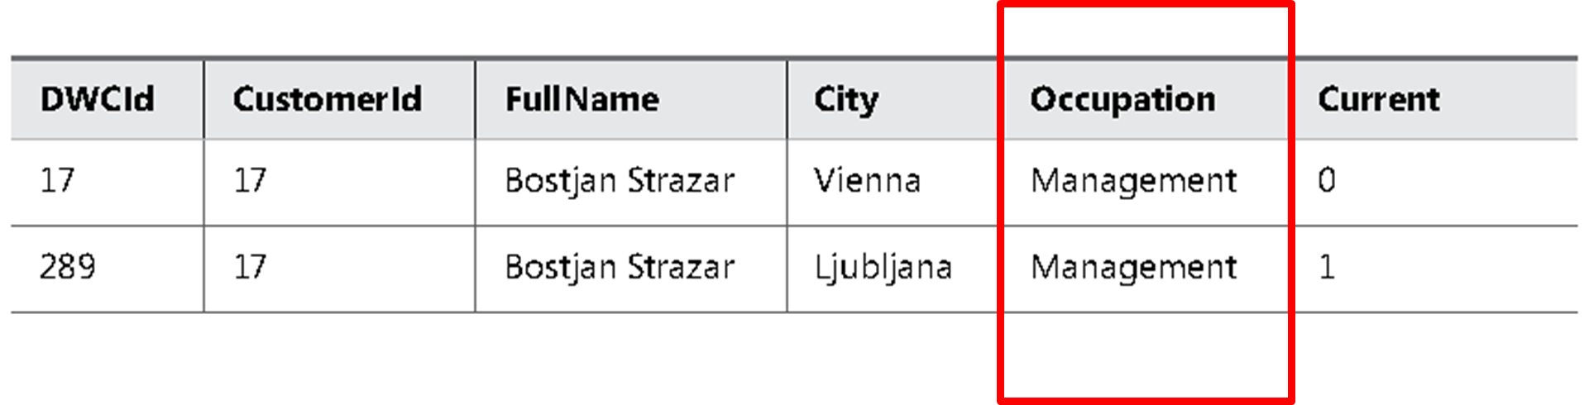
Slowly Changing Dimensions
An SCD Type 1 and Type 2 Mixture, Updating All Rows

Slide 8
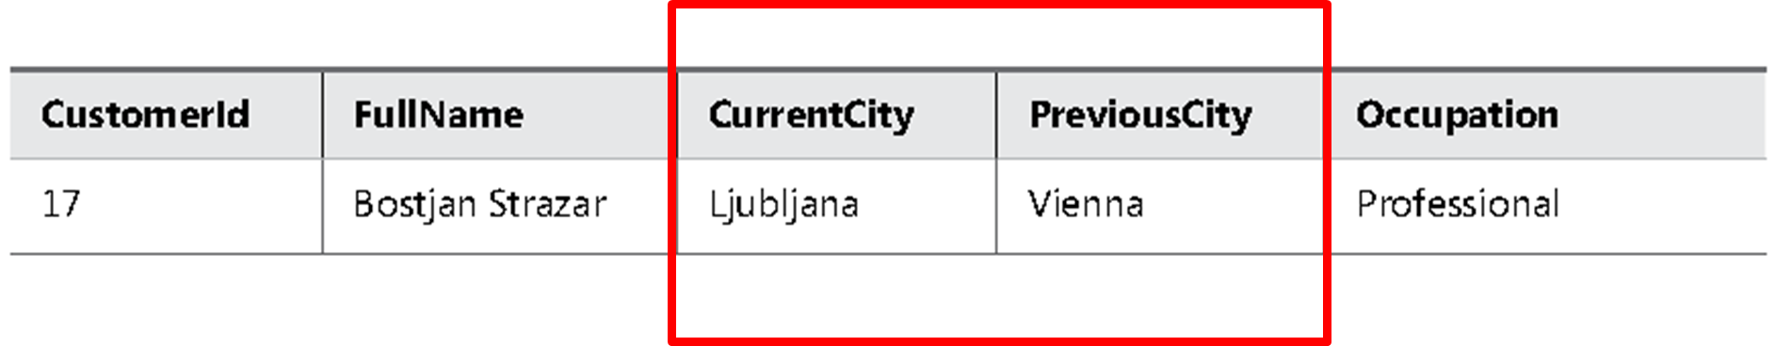
Slowly Changing Dimensions
SCD Type 3

Slide 9
Designing Fact Tables
Designing Fact Tables

Slide 10
Fact Table Column Types

Slide 11
Fact Table Column Types
Foreign keys
Measures
Lineage columns (optional)
Business key columns from the primary source table (optional)

Slide 12
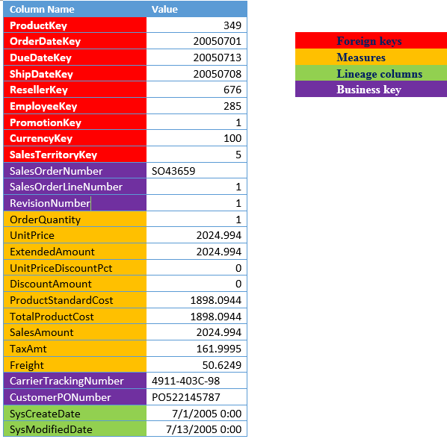
Fact Table Column Types
FactResellerSales

Slide 13
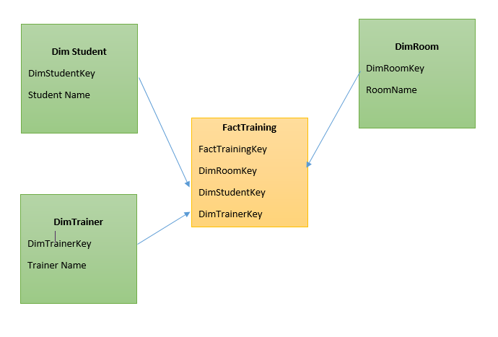
Fact Table Types
Factless Fact Table

Slide 14
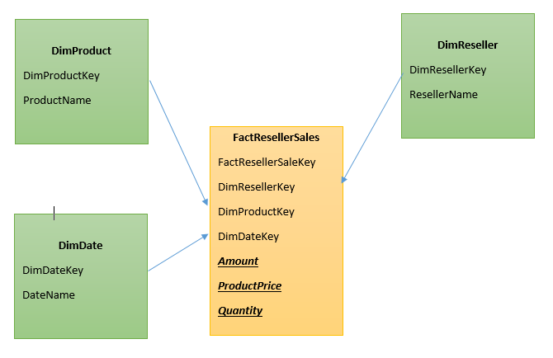
Fact Table Types
Transaction Fact Tables

Slide 15
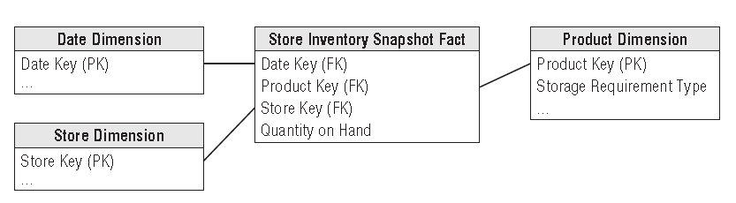
Fact Table Types
Periodic Snapshot Fact Tables

Slide 16
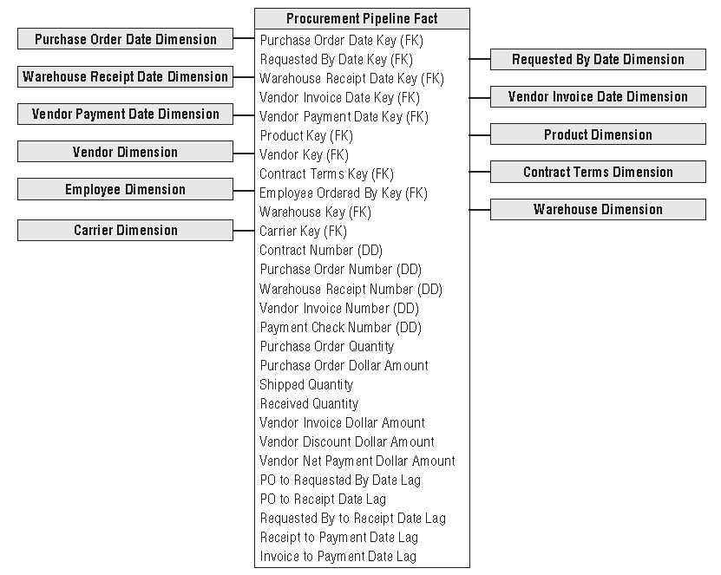
Fact Table Types
Accumulating
Snapshot Fact Tables

Slide 17
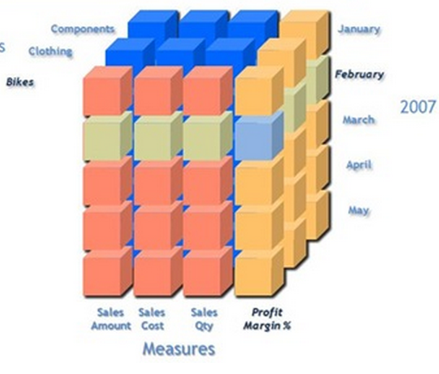
Additivity of Measures
Additive measures
Transaction amount
Semi-Additive measures
Account balance
Non-additive measures
Price
Notes:
Let us begin with the definition of each which will be followed by examples: 1. Additive measures: These are those specific class of fact measures which can be aggreagated across all dimension and their hieracchy 2. Semi-Additive measures: These are those specific class of fact measures which can be aggreagated across all dimension and their hieracchy except the time dimension 3. Non-additive measures: These are those specific class of fact measures which cannot be aggreagated across all/any dimension and their hieracchy
A good example of a non aggregatable measure might be 'Price' on a sales record. For example: A) We have sales figures...one may tend to add sales across all quareters to avail the yearly sales..hence this is an example of Additive measure B) We have stock levels say 1000(qty of Item A) on Monday...I sell 200(qty of Item A) on Tuesday I further sell 300(qty of Item A) on Wednesday...going by basic math On Thursday I should be left with 500(qty of Item A, assuming no inventory has flown in) to obtain current stock level I cannot aggregate the Stock sales across time dimension hierarchy...If done I will have inappropriate outcomes C) Aggregation of percentage or dates is an Ideal example of non-additive measures.
Additivity of measures is not exactly a data warehouse design problem. However, you should
consider which aggregate functions you will use in reports for which measures, and which aggregate
functions you will use when aggregating over which dimension.
The simplest types of measures are those that can be aggregated with the SUM aggregate
function across all dimensions, such as amounts or quantities. For example, if sales for product
A were $200.00 and sales for product B were $150.00, then the total of the sales was $350.00.
If yesterday’s sales were $100.00 and sales for the day before yesterday were $130.00, then
the total sales amounted to $230.00. Measures that can be summarized across all dimensions
are called additive measures.
Some measures are not additive over any dimension. Examples include prices and percentages,
such as a discount percentage. Typically, you use the AVERAGE aggregate function for
such measures, or you do not aggregate them at all. Such measures are called non-additive
measures. Often, you can sum additive measures and then calculate non-additive measures
from the additive aggregations. For example, you can calculate the sum of sales amount and
then divide that value by the sum of the order quantity to get the average price. On higher

Slide 18
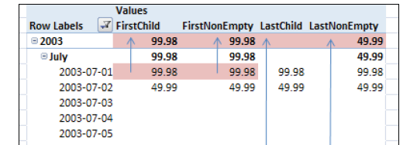
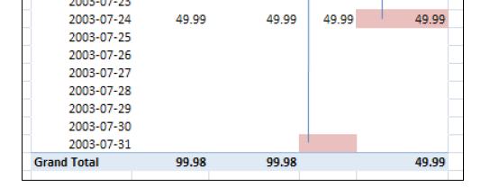
Additivity of Measures in SSAS
AverageOfChildren
FirstChild
LastChild
FirstNonEmpty
LastNonEmpty

Slide 19
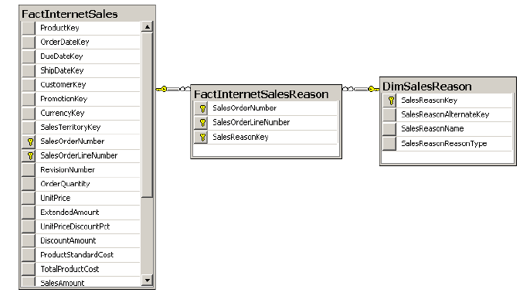
Many-to-Many Relationships
A classic many-to-many relationship

Slide 20
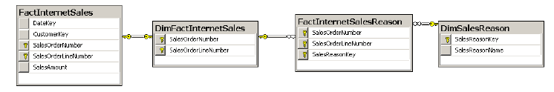
Many-to-Many Relationships
A many-to-many relationship with two intermediate tables

Slide 21
S18E13 AGENDA
Implementing Dimensions and Fact Tables
Managing the Performance of a Data Warehouse
ETL Developing SSIS Packages
UN statistics DWH

Slide 22
Introducing Star and Snowflake Schemas
Implementing Dimensions and Fact Tables
Notes:
Implementing a data warehouse means creating the data warehouse (DW) database and
database objects. The main database objects, as you saw in Chapter 1, “Data Warehouse
Logical Design,” are dimensions and fact tables. To expedite your extract-transform-load (ETL)
process, you can have additional objects in your DW, including sequences, stored procedures,
and staging tables. After you create the objects, you should test them by loading test data.
After this lesson, you will be able to:
■■ Create a data warehouse database.
■■ Create sequences.
■■ Implement dimensions.
■■ Implement fact tables.
Estimated lesson time: 50 minutes

Slide 23


Implementing Dimensions and Fact Tables
Step 1 Database Settings
Recovery models:
Full recovery model
Bulk Logged recovery model
Simple recovery model
Is Read Committed SnapShot
Miscellaneous:

Slide 24
Creating a Data Warehouse Database
Step 2 Database Settings
data and log files:
Automatic shrinking
Automatic growing
Calculate and monitor
Files size
File Groups

Slide 25
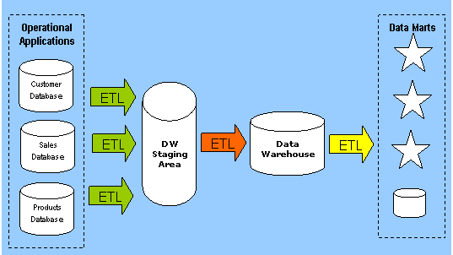
Creating a Data Warehouse Database
Step 3: Create Data staging area (DSA)

Slide 26
Creating a Data Warehouse Database
Step 4: Implementing Dimensions
Define surrogate key type IDENTITY vs sequential numbers
Define SCD attributes
Define lineage and computed columns
Define unknown member
Seed dimensions (DimDate and etc.)

Slide 27
Creating a Data Warehouse Database
Step 5: Implementing Fact Tables
Define partitioning
Define foreign keys
Define lineage and computed columns
Define columns data types

Slide 28
Managing the Performance of a Data Warehouse
Managing the Performance of a
Data Warehouse
Notes:
Implementing a Star schema by creating tables is quite simple. However, when a data warehouse
is in production, more complex problems appear. Data warehouses are often very
large, so you are likely to have to deal with performance problems. In this lesson, you will
learn how to index DW tables appropriately, use data compression, and create columnstore
indexes. In addition, this lesson briefly tackles some T-SQL queries typical for a data warehousing
environment.
After this lesson, you will be able to:
■■ Use clustered and nonclustered indexes on a dimension and on a fact table.
■■ Use data compression.
■■ Use appropriate T-SQL queries.
■■ Use indexed views.
Estimated lesson time: 60 minutes

Slide 29
Managing the Performance of a Data Warehouse
Step 1: Indexes
Clustered indexes
Nonclustered indexes
Special star join optimization of hash joins for DW queries
Indexed views
Notes:
Clustered indexes are particularly efficient when the clustering key is short. Creating a
clustering index with a long key makes all nonclustered indexes less efficient. In addition, the
clustering key should be unique. If it is not unique, SQL Server makes it unique by adding a
4-byte sequential number called a uniquifier to duplicate keys. This makes keys longer and
all indexes less efficient. Clustering keys should also be ever-increasing. With ever-increasing
keys, minimally logged bulk inserts are possible even if a table already contains data, as long
as the table does not have additional nonclustered indexes.
Data warehouse surrogate keys are ideal for clustered indexes. Because you are the one
who defines them, you can define them as efficiently as possible. Use integers with autonumbering
options. The Primary Key constraint creates a clustered index by default.

Slide 30
Managing the Performance of a Data Warehouse
Step 1: Data Compression
Row compression
Page compression
Unicode compression
Notes:
SQL Server supports data compression. Data compression reduces the size of the database,
which helps improve query performance because queries on compressed data read fewer
pages from disk and thus use less IO. However, data compression requires extra CPU resources
for updates, because data must be decompressed before and compressed after the
update. Data compression is therefore suitable for data warehousing scenarios in which data
is mostly read and only occasionally updated.
SQL Server supports three compression implementations:
■■ Row compression
■■ Page compression
■■ Unicode compression
Row compression reduces metadata overhead by storing fixed data type columns in a
variable-length format. This includes strings and numeric data. Row compression has only a
small impact on CPU resources and is often appropriate for OLTP applications as well.
Page compression includes row compression, but also adds prefix and dictionary compressions.
Prefix compression stores repeated prefixes of values from a single column in a special
compression information (CI) structure that immediately follows the page header, replacing
the repeated prefix values with a reference to the corresponding prefix. Dictionary compression
stores repeated values anywhere in a page in the CI area. Dictionary compression is not
restricted to a single column.
In SQL Server, Unicode characters occupy an average of two bytes. Unicode compression
substitutes single-byte storage for Unicode characters that don’t truly require two bytes. Depending
on collation, Unicode compression can save up to 50 percent of the space otherwise
required for Unicode strings.

Slide 31
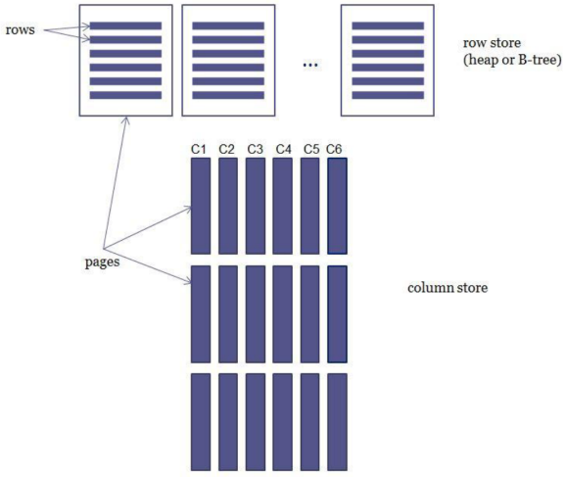
Managing the Performance of a Data Warehouse
Columnstore Indexes and Batch Processing
Notes:
SQL Server supports data compression. Data compression reduces the size of the database,
which helps improve query performance because queries on compressed data read fewer
pages from disk and thus use less IO. However, data compression requires extra CPU resources
for updates, because data must be decompressed before and compressed after the
update. Data compression is therefore suitable for data warehousing scenarios in which data
is mostly read and only occasionally updated.
SQL Server supports three compression implementations:
■■ Row compression
■■ Page compression
■■ Unicode compression
Row compression reduces metadata overhead by storing fixed data type columns in a
variable-length format. This includes strings and numeric data. Row compression has only a
small impact on CPU resources and is often appropriate for OLTP applications as well.
Page compression includes row compression, but also adds prefix and dictionary compressions.
Prefix compression stores repeated prefixes of values from a single column in a special
compression information (CI) structure that immediately follows the page header, replacing
the repeated prefix values with a reference to the corresponding prefix. Dictionary compression
stores repeated values anywhere in a page in the CI area. Dictionary compression is not
restricted to a single column.
In SQL Server, Unicode characters occupy an average of two bytes. Unicode compression
substitutes single-byte storage for Unicode characters that don’t truly require two bytes. Depending
on collation, Unicode compression can save up to 50 percent of the space otherwise
required for Unicode strings.

Slide 32
Managing the Performance of a Data Warehouse
Using Partitions
Minimally logged deletion.
TRUNCATE TABLE command
Minimally logged inserts
table must either be empty
have no indexes
Clustered index only on an ever-increasing (or ever-decreasing) key
Notes:
SQL Server supports data compression. Data compression reduces the size of the database,
which helps improve query performance because queries on compressed data read fewer
pages from disk and thus use less IO. However, data compression requires extra CPU resources
for updates, because data must be decompressed before and compressed after the
update. Data compression is therefore suitable for data warehousing scenarios in which data
is mostly read and only occasionally updated.
SQL Server supports three compression implementations:
■■ Row compression
■■ Page compression
■■ Unicode compression
Row compression reduces metadata overhead by storing fixed data type columns in a
variable-length format. This includes strings and numeric data. Row compression has only a
small impact on CPU resources and is often appropriate for OLTP applications as well.
Page compression includes row compression, but also adds prefix and dictionary compressions.
Prefix compression stores repeated prefixes of values from a single column in a special
compression information (CI) structure that immediately follows the page header, replacing
the repeated prefix values with a reference to the corresponding prefix. Dictionary compression
stores repeated values anywhere in a page in the CI area. Dictionary compression is not
restricted to a single column.
In SQL Server, Unicode characters occupy an average of two bytes. Unicode compression
substitutes single-byte storage for Unicode characters that don’t truly require two bytes. Depending
on collation, Unicode compression can save up to 50 percent of the space otherwise
required for Unicode strings.

Slide 33
Managing the Performance of a Data Warehouse
Using Partitions
Table
Partition 2006 year
Partition 2007 year
Partition 2008 year
Partition 2009 year
Partition 2010 year
Partition 2011 year
Partition 2012 year
Switch partition to table
Truncate or update
Switch table to partition
Insert or update
Notes:
SQL Server supports data compression. Data compression reduces the size of the database,
which helps improve query performance because queries on compressed data read fewer
pages from disk and thus use less IO. However, data compression requires extra CPU resources
for updates, because data must be decompressed before and compressed after the
update. Data compression is therefore suitable for data warehousing scenarios in which data
is mostly read and only occasionally updated.
SQL Server supports three compression implementations:
■■ Row compression
■■ Page compression
■■ Unicode compression
Row compression reduces metadata overhead by storing fixed data type columns in a
variable-length format. This includes strings and numeric data. Row compression has only a
small impact on CPU resources and is often appropriate for OLTP applications as well.
Page compression includes row compression, but also adds prefix and dictionary compressions.
Prefix compression stores repeated prefixes of values from a single column in a special
compression information (CI) structure that immediately follows the page header, replacing
the repeated prefix values with a reference to the corresponding prefix. Dictionary compression
stores repeated values anywhere in a page in the CI area. Dictionary compression is not
restricted to a single column.
In SQL Server, Unicode characters occupy an average of two bytes. Unicode compression
substitutes single-byte storage for Unicode characters that don’t truly require two bytes. Depending
on collation, Unicode compression can save up to 50 percent of the space otherwise
required for Unicode strings.

Slide 34
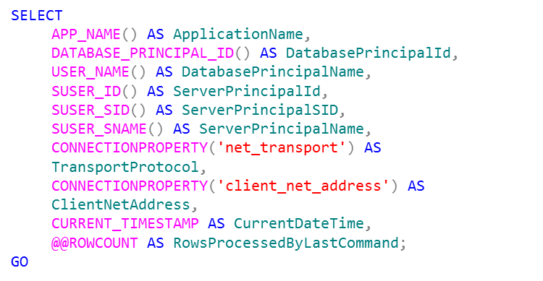
Data Lineage
Data Lineage
Notes:
Auditing by adding data lineage information for your data loads is quite simple. You add appropriate
columns to your dimensions and/or fact tables, and then you insert or update the
values of these columns with each load. If you are using SSIS as your ETL tool, you can use
many of the SSIS system variables to add lineage information to your data flow.
If you are loading data with T-SQL commands and procedures, you can use T-SQL system
functions to get the desired lineage information. The following query uses system functions
that are very useful for capturing lineage information.
Besides lineage information, you might also want to log additional information about the
whole load, not just the row-level information. For example, you might want to add the time
at which the load execution started, when it ended, the number of rows transferred, and so
on. You can create a custom logging table and insert this information at the start and end of
the ETL process. If you are using SSIS as your ETL tool, you can use the SSIS built-in logging
capabilities to store this load-level information

Slide 35
DWH
UN Statistics DWH

Slide 36
DWH
Dimensional model
Data mapping

