Slide 1


MSBI.DEV
Course
S18E14
April 8, 2016

Slide 2
IN PREVIOUS PART: S18E13 AGENDA
Implementing Dimensions and Fact Tables
Managing the Performance of a Data Warehouse
UN Statistic DWH

Slide 3
S18E14 AGENDA
Creating SSIS Packages
Designing and Implementing Control Flow
Designing and Implementing Data Flow
DWH Design
UN Statistics BI solution case scenario

Slide 4
ETL Developing SSIS Packages
ETL Developing SSIS Packages

Slide 5
ETL Developing SSIS Packages
Extract
Transform
Load

Slide 6
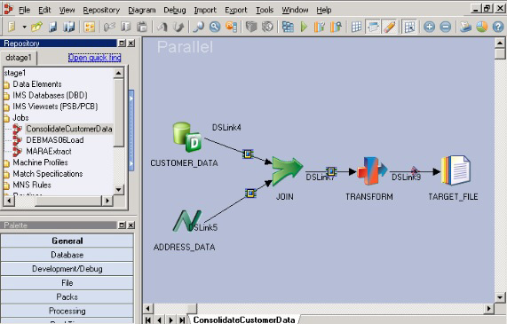
ETL Tools
IBM DATASTAGE

Slide 7
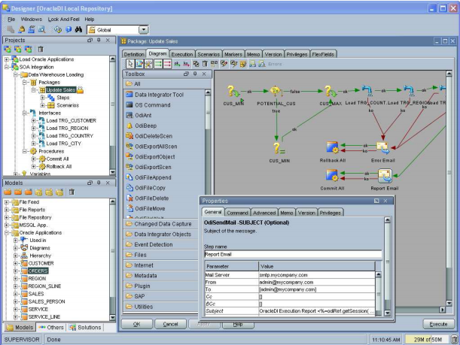
ETL Tools
ORACLE DATA
INTEGRATOR ,
ORACLE
WAREHOUSE BUILDER

Slide 8
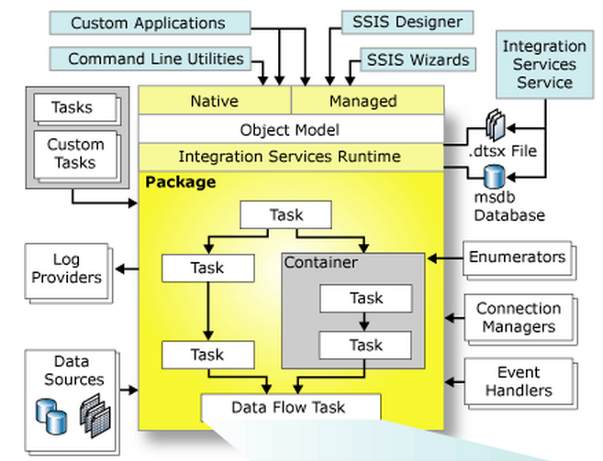
Microsoft SQL Server Integration Services components

Slide 9
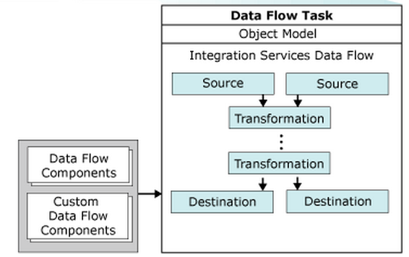
Microsoft SQL Server Integration Services components

Slide 10
Introducing Control Flow, Data Flow, and Connection Managers
Connection managers
Control flow
Data flow

Slide 11
Creating SSIS Packages
Creating SSIS Packages

Slide 12
Creating SSIS Packages
Using the SQL Server Import and Export Wizard
Developing SSIS Packages in SSDT
Introducing Control Flow, Data Flow, and Connection Managers

Slide 13
Designing and Implementing Control Flow
Designing and Implementing Control Flow

Slide 14
Designing and Implementing Control Flow
Connection
Managers
Type | Description
ADO | Connects to ActiveX Data Objects (ADO) objects.
ADO.NET | Connects to a data source by using a .NET provider.
CACHE | Reads data from the data flow or from a cache file (.caw), and can save data to the cache file.
DQS | Connects to a Data Quality Services server and a Data Quality Services database on the server.
EXCEL | Connects to an Excel workbook file.
FILE | Connects to a file or a folder.
FLATFILE | Connect to data in a single flat file.
FTP | Connect to an FTP server.
HTTP | Connects to a webserver.
MSMQ | Connects to a message queue.
MSOLAP100 | Connects to an instance of SQL Server Analysis Services or an Analysis Services project.
MULTIFILE | Connects to multiple files and folders.
MULTIFLATFILE | Connects to multiple data files and folders.
OLEDB | Connects to a data source by using an OLE DB provider.
ODBC | Connects to a data source by using ODBC.
SMOServer | Connects to a SQL Server Management Objects (SMO) server.
SMTP | Connects to an SMTP mail server.
WMI | Connects to a server and specifies the scope of Windows Management Instrumentation (WMI) management on the server.
https://msdn.microsoft.com/en-us/ms140203.aspx

Slide 15
Designing and Implementing Control Flow
Connection Managers
ADO.NET
OLE DB
ODBC
https://datatellblog.wordpress.com/2015/01/13/ssis-data-flows-ado-net-vs-ole-db-vs-odbc/

Slide 16
Designing and Implementing Control Flow
Connection Manager Scope
Package-scoped connection managers
Project-scoped connection managers
https://msdn.microsoft.com/en-us/ms140203.aspx

Slide 17
Designing and Implementing Control Flow
32-Bit and 64-Bit Data Providers
SSIS development environment is a 32-bit environment
SSIS execution environment is dictated by the underlying operating system
https://msdn.microsoft.com/en-us/ms140203.aspx

Slide 18
Designing and Implementing Control Flow
Creating a Connection Manager DEMO
https://msdn.microsoft.com/en-us/ms140203.aspx

Slide 19
Designing and Implementing Control Flow
STOP HERE
https://msdn.microsoft.com/en-us/ms140203.aspx

Slide 20
Designing and Implementing Control Flow
Planning a Complex Data Movement
Data cleansing
Data normalization
Data type conversion
Data translation
Data validation
Data calculation and data aggregation
Data pivoting and data unpivoting

Slide 21
Designing and Implementing Control Flow
Tasks
Data Preparation Tasks
Web Service task, XML task, File System task etc.
Workflow Tasks
Execute Package task, Send Mail task etc.
Data Movement Tasks
Bulk Insert task, Execute SQL task, Data flow task
SQL Server Administration Tasks
SQL Server Maintenance Tasks
Analysis Services Tasks
Script Task

Slide 22
Designing and Implementing Control Flow
Containers
For Loop container
Foreach Loop container
Sequence container

Slide 23
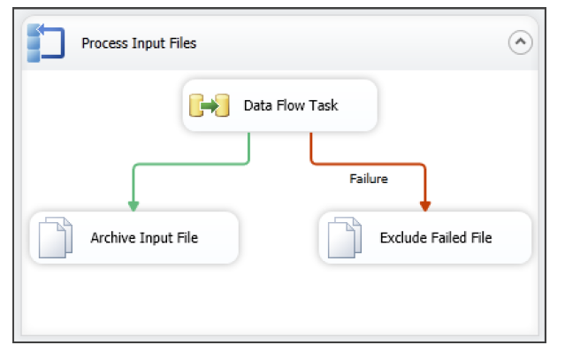
Designing and Implementing Control Flow
Precedence Constraints

Slide 24
Designing and Implementing Data Flow
Designing and Implementing Data Flow

Slide 25
Designing and Implementing Data Flow
Defining Data Sources and Destinations
Creating a Data Flow Task
Defining Data Flow Source Adapters
Defining Data Flow Destination Adapters
SSIS Data Types

Slide 26
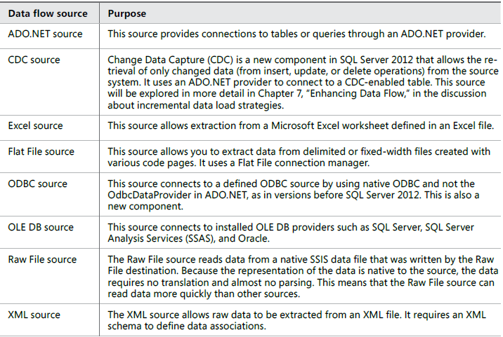
Designing and Implementing Data Flow
Defining Data Flow Source Adapters

Slide 27
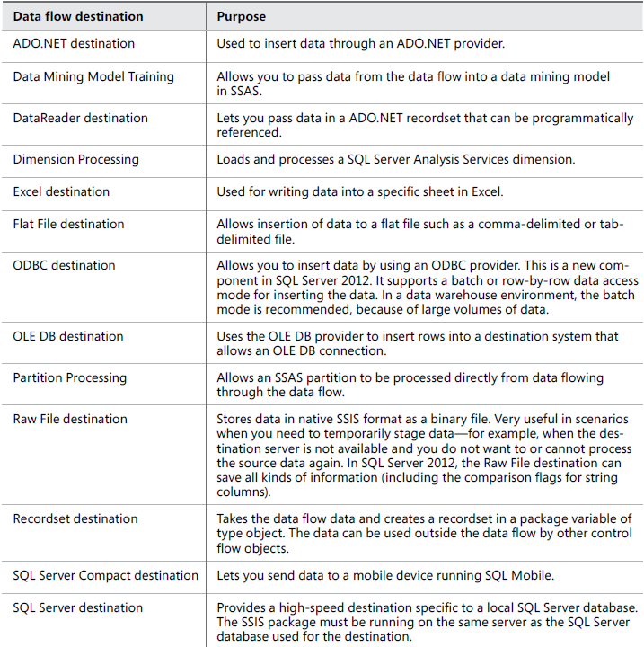
Designing and Implementing Data Flow
Defining Data Flow Destination Adapters

Slide 28
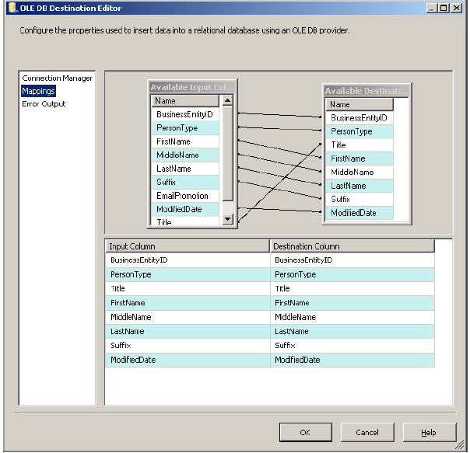
Designing and Implementing Data Flow
Columns mapping

Slide 29
Designing and Implementing Data Flow
Defining Data Sources and Destinations
Creating a Data Flow Task
Defining Data Flow Source Adapters
Defining Data Flow Destination Adapters
SSIS Data Types

