Slide 1



April 24, 2019
3

Slide 2
In Previous part: S19E22 AGENDA
---
topics:
- topicname: CrimeStat.SSIS
subtopics:
- subtopicname: Incremental loading
- subtopicname: change data capture
- subtopicname: Executing Stored Procedures with parameters
- subtopicname: Slowly Changed Dimensions (SDC)
- subtopicname: Master Package
---

Slide 3
Agenda: MSBI.Dev.S19E23
---
topics:
- topicname: SSAS Tabular
subtopics:
- subtopicname: Tabular
- subtopicname: Multidimensional vs Tabular
- subtopicname: Architecture
- topicname: Create CrimeStat.SSAS.Tab project
subtopics:
- subtopicname: Hierarchies
- subtopicname: Using DAX
---
3
Notes:
Appendix includes recent awards, please visit elements.epam.com for all 2016-2017 awards

Slide 4
Tabular

Slide 5
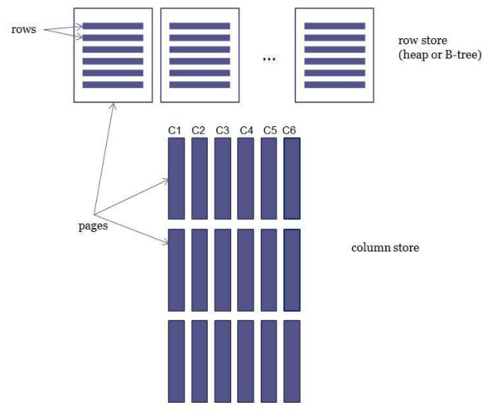
SSAS Tabular
Why Have Two Models?

Slide 6
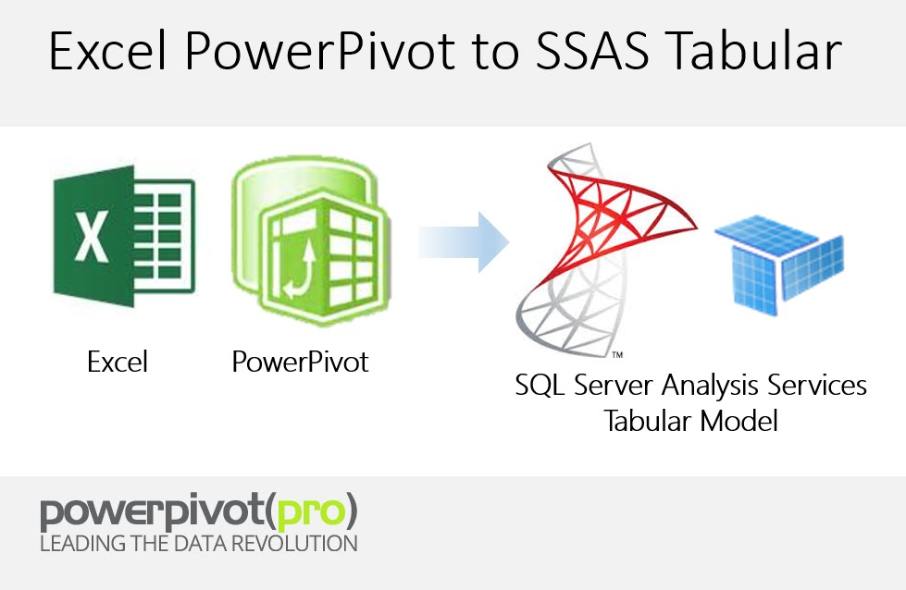
SSAS Tabular
Why Have Two Models?
Modern hardware
a new generation of memory-based, columnar databases
Multidimensional is difficult to learn
PowerPivot
Tabular approach allows…

Slide 7
SSAS Tabular
Multidimensional
vs
Tabular

Slide 8
SSAS Tabular
Why Have Two Models? Tabular pros and cons
In memory
PowerView
Distinct
Tabular approach allows…
Self-Service BI
In memory
PowerView
Hierarchies
Volume of data

Slide 9
SSAS Tabular
Why Have Two Models? MOLAP pros and cons
Hierarchies
Translation
Many-To-Many
Aggregation
Volume, Security
MDX
Writeback
MDX
Visualization
Data retrieval

Slide 10
SSAS Tabular
BI Semantic Model

Slide 11
SSAS Tabular
Architecture

Slide 12
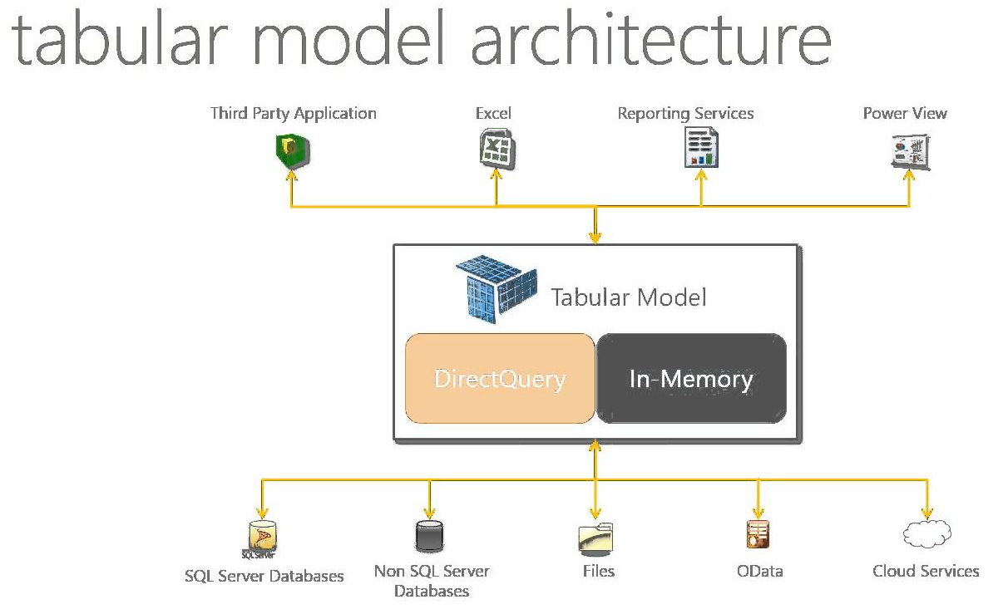
SSAS Tabular
ArchitectureHave Two Models?

Slide 13
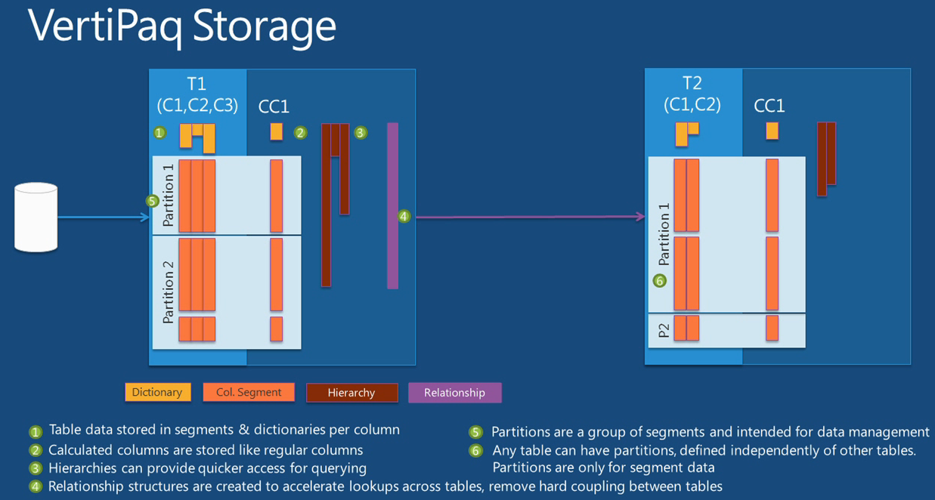
SSAS Tabular
Architecture

Slide 14
SSAS Tabular
Create UN statistic Tabular SSAS project

Slide 15
SSAS Tabular
Power View

Slide 16
SSAS Tabular
Power BI

Slide 17
S16E26
Thank You!

