Slide 1

MSBI LAB S21.E07-SQL
January 11, 2021

Slide 2

IN THE PREVIOUS PART
1
Working with Variables
2
Inserting, Updating, Deleting Data
3
Using the IDENTITY Column Property
4
Merging Data
5
Using the OUTPUT Option

Slide 3

S21E07 AGENDA
1
Designing and Implementing Views
2
Implementing User-Defined Functions
3
Hierarchies
4
Git Branching Model
5
Introduction to Power BI

Slide 4
Designing and Implementing Views

Slide 5
Designing and Implementing Views
Views case scenario
Notes:
Restrictions on Views
Views have a number of restrictions, such as the following:
■■ You cannot add an ORDER BY to the SELECT statement in a view. A view must appear
just like a table, and tables in a relational database contain sets of rows. Sets by themselves
are not ordered, although you can apply an order to a result set using ORDER
BY. Similarly, tables and views in SQL Server do not have a logical order to their rows,
though you can apply one by adding an ORDER BY to the outermost SELECT statement
when you access the view.
■■ You cannot pass parameters to views.
■■ Similarly, a view cannot reference a variable inside the SELECT statement. See the
section “Inline Functions” for information on how to use functions to simulate passing
parameters to a view.
■■ A view cannot create a table, whether permanent or temporary. In other words, you
cannot use the SELECT/INTO syntax in a view.
■■ A view can reference only permanent tables; a view cannot reference a temporary
table.

Slide 6

Designing and Implementing Views
Creating Views
WITH ENCRYPTION
WITH SCHEMABINDING
WITH VIEW_METADATA
WITH CHECK OPTION
Notes:
Restrictions on Views
Views have a number of restrictions, such as the following:
■■ You cannot add an ORDER BY to the SELECT statement in a view. A view must appear
just like a table, and tables in a relational database contain sets of rows. Sets by themselves
are not ordered, although you can apply an order to a result set using ORDER
BY. Similarly, tables and views in SQL Server do not have a logical order to their rows,
though you can apply one by adding an ORDER BY to the outermost SELECT statement
when you access the view.
■■ You cannot pass parameters to views.
■■ Similarly, a view cannot reference a variable inside the SELECT statement. See the
section “Inline Functions” for information on how to use functions to simulate passing
parameters to a view.
■■ A view cannot create a table, whether permanent or temporary. In other words, you
cannot use the SELECT/INTO syntax in a view.
■■ A view can reference only permanent tables; a view cannot reference a temporary
table.

Slide 7
Designing and Implementing Views
Views Restrictions
NO ORDER BY (unless there is also a TOP clause)
NO PARAMETERS
NO DDL (CREATE, ALTER etc)
NO TEMP TABLE
Notes:
However, it is possible to create a unique clustered index on a view and materialize the
data. In that case, more than the view definition is stored. The actual results of the view query
are stored on disk, in the clustered index structure. To be indexed, a view must satisfy a number
of important restrictions. For more information about indexed views, see "Implementing
Indexed Views" in Chapter 15, “Implementing Indexes and Statistics.”

Slide 8
Designing and Implementing Views
Indexed Views
Notes:
However, it is possible to create a unique clustered index on a view and materialize the
data. In that case, more than the view definition is stored. The actual results of the view query
are stored on disk, in the clustered index structure. To be indexed, a view must satisfy a number
of important restrictions. For more information about indexed views, see "Implementing
Indexed Views" in Chapter 15, “Implementing Indexes and Statistics.”

Slide 9
Designing and Implementing Views
Partitioned Views
Notes:
However, it is possible to create a unique clustered index on a view and materialize the
data. In that case, more than the view definition is stored. The actual results of the view query
are stored on disk, in the clustered index structure. To be indexed, a view must satisfy a number
of important restrictions. For more information about indexed views, see "Implementing
Indexed Views" in Chapter 15, “Implementing Indexes and Statistics.”

Slide 10
Designing and Implementing Views
Modifying Data Through a View
Only with direct reference to column
WITH CHECK OPTION
Notes:
However, it is possible to create a unique clustered index on a view and materialize the
data. In that case, more than the view definition is stored. The actual results of the view query
are stored on disk, in the clustered index structure. To be indexed, a view must satisfy a number
of important restrictions. For more information about indexed views, see "Implementing
Indexed Views" in Chapter 15, “Implementing Indexes and Statistics.”

Slide 11
Designing and Implementing Views
DEMO

Slide 12
Implementing User-Defined Functions

Slide 13
Implementing User-Defined Functions
User-Defined Function Types
Scalar
inline (starting with SQL Server 2019)
Table-valued
inline table-valued UDF
multistatement table-valued UDF

Slide 14
Implementing User-Defined Functions
Understanding User-Defined Functions
Can
accept parameters
embedded in T-SQL statements
access SQL Server data

Slide 15
Implementing User-Defined Functions
OBJECT_ID()
FN = SQL scalar function
IF = SQL inline table-valued function
TF = SQL multistatement table-valued function

Slide 16
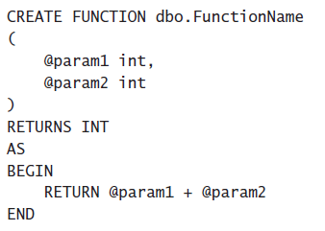
Implementing User-Defined Functions
Scalar UDFs

Slide 17
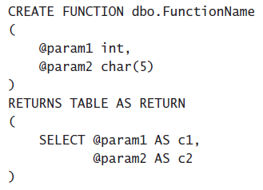
Implementing User-Defined Functions
Inline Table-Valued UDF

Slide 18
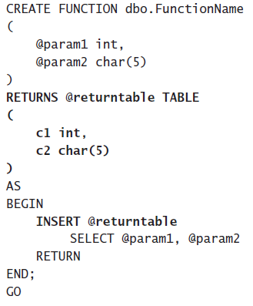
Implementing User-Defined Functions
Multistatement Table-Valued UDF

Slide 19
Implementing User-Defined Functions
DEMO

Slide 20
Implementing User-Defined Functions
UDF Options
You can specify five options with UDFs:
ENCRYPTION
SCHEMABINDING
RETURN NULL ON NULL INPUT / CALLED ON NULL INPUT
EXECUTE AS
INLINE = ON / OFF (Starting with SQL Server 2019)

Slide 21
Implementing User-Defined Functions
Limitations on UDFs
UDFs cannot do the following:
Apply any schema or data changes in the database.
Change the state of a database or SQL Server instance.
Create or access temporary tables.
Call stored procedures.
Execute dynamic SQL.
Produce side effects. For example, both the RAND() and NEWID()

Slide 22
Implementing User-Defined Functions
UDF Performance Considerations

Slide 23
Hierarchies

Slide 24
Hierarchies
Adjacency List Model
Nested Set Model of Hierarchies
Materialized Path (HierarchyID)
CREATE TABLE dbo.ManagersDirectory
(
ManagerID INT
,EmployeeID INT
,CONSTRAINT md_pk1 PRIMARY KEY (ManagerID, EmployeeID)
);
GO
https://www.simple-talk.com/sql/performance/the-performance-of-traversing-a-sql-hierarchy-/

Slide 25
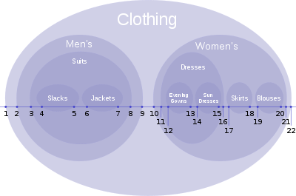
Hierarchies
Adjacency List Model
Nested Set Model of Hierarchies
Materialized Path (HierarchyID)
Joe Celko’s Trees and Hierarchies in SQL for Smarties

Slide 26
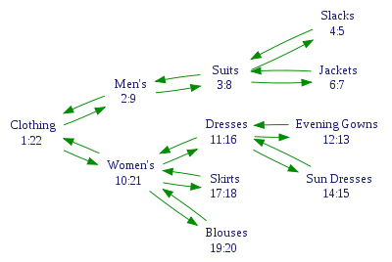
Hierarchies
Adjacency List Model
Nested Set Model of Hierarchies
Materialized Path (HierarchyID)
Joe Celko’s Trees and Hierarchies in SQL for Smarties

Slide 27
Hierarchies
Adjacency List Model
Nested Set Model of Hierarchies
Materialized Path (HierarchyID)
https://docs.microsoft.com/en-us/sql/t-sql/data-types/hierarchyid-data-type-method-reference

Slide 28
GIT Teamwork

Slide 29
Git Branching Model
Notes:
Appendix includes recent awards, please visit elements.epam.com for all 2016-2017 awards

Slide 30
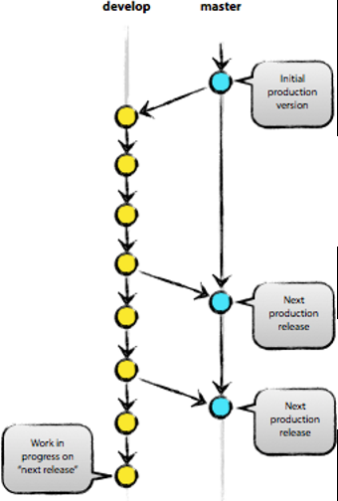
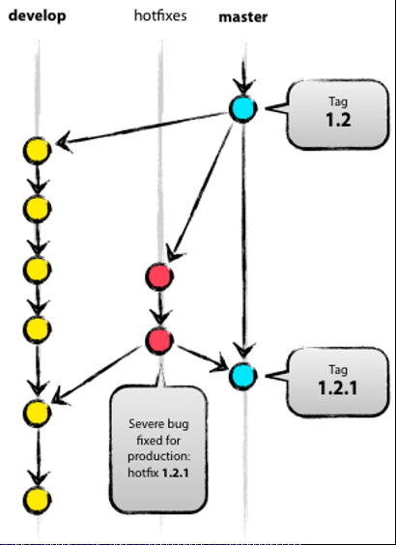
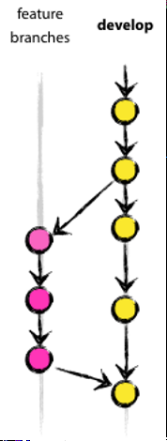
Git Branching Model
Notes:
Appendix includes recent awards, please visit elements.epam.com for all 2016-2017 awards

Slide 31
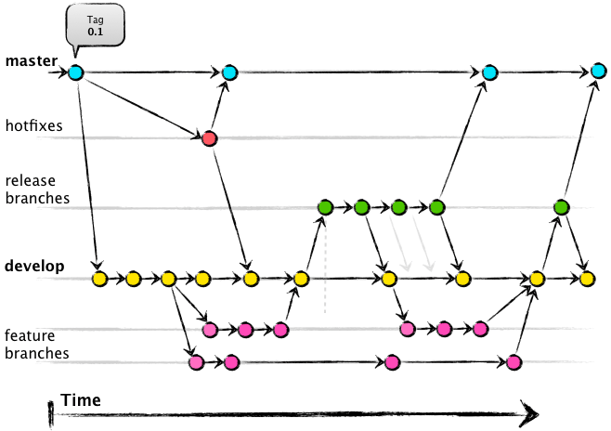
Git Branching Model
Notes:
Appendix includes recent awards, please visit elements.epam.com for all 2016-2017 awards

Slide 32
Introduction to Power BI

Slide 33
Introduction to Power BI
DEMO

