Slide 1

November 14, 2021
CONFIDENTIAL | © 2021 EPAM Systems, Inc.

Slide 2

Agenda
1
Foundations of T-SQL
2
Getting Started with the SELECT Statement
3
Filtering and Sorting Data
4
Combining Sets (Joins)
5
Using Set Operators

Slide 3
Foundations of T-SQL

Slide 4
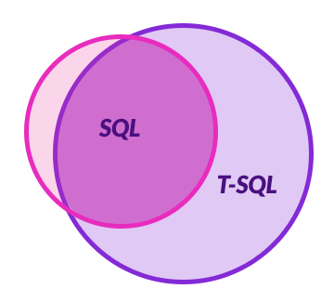
Foundations of T-SQL
SQL
T-SQL
ISO/IEC 9075 standard
International Organization for Standards (ISO)
American National Standards Institute (ANSI)
Dialect of SQL

Slide 5
Foundations of T-SQL
@Variable1 <> @Variable2
@Variable1 != @Variable2
CAST
CONVERT
SELECT TOP 1
Standard (SQL)
Is not a standard (T-SQL only)
Standard (SQL)
Is not a standard (T-SQL only)
Is not a standard (T-SQL only)

Slide 6
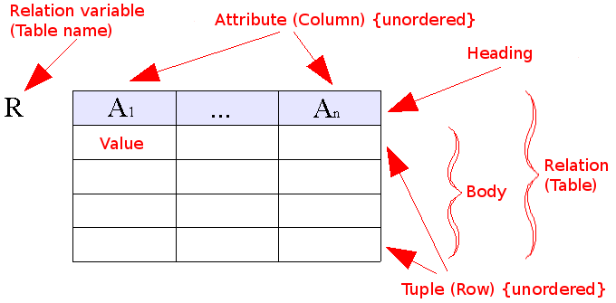
Foundations of T-SQL
Relational model

Slide 7
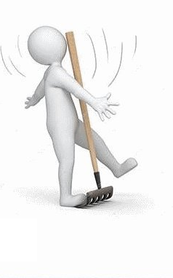
Foundations of T-SQL
THREE-VALUED PREDICATE LOGIC
True
False
Unknown
NULL

Slide 8
Foundations of T-SQL
Using T-SQL in a Relational Way
DEMO

Slide 9
Foundations of T-SQL
T-SQL As a Declarative English-Like Language
declarative means you define what you want
imperative languages define how to achieve what you want
“Bring me a soda from the refrigerator.”
SELECT shipperid, phone, companyname
FROM Sales.Shippers;
“Go to the refrigerator; open the door; get a soda; bring it to me.”

Slide 10
Foundations of T-SQL
T-SQL As a Declarative English-Like Language
For human
For robot
“Bring me a soda from the refrigerator.”
SELECT shipperid, phone, companyname
FROM Sales.Shippers;
DEMO
“Go to the refrigerator; open the door; get a soda; bring it to me.”
FROM Sales.Shippers
SELECT shipperid, phone, companyname;

Slide 11
Foundations of T-SQL
Logical Query Processing Phases
In T-SQL Query
1. SELECT
2. FROM
3. WHERE
4. GROUP BY
5. HAVING
6. ORDER BY
Logical query processing order
1. FROM
2. WHERE
3. GROUP BY
4. HAVING
5. SELECT
6. ORDER BY

Slide 12
Getting Started with the SELECT Statement

Slide 13
Getting Started with the SELECT Statement
Using the FROM and SELECT Clauses
DEMO

Slide 14
Getting Started with the SELECT Statement
Working with Data Types and Built-in Functions
DEMO
Data Types (Transact-SQL)” at https://docs.microsoft.com/en-us/sql/t-sql/data-types/data-types-transact-sql
Built-in Functions (Transact-SQL)” at https://docs.microsoft.com/en-us/sql/t-sql/functions/functions

Slide 15
Getting Started with the SELECT Statement
CASE Expression and Related Functions
CASE
COALESCE
ISNULL
CHOOSE
IIF
DEMO

Slide 16
Filtering and Sorting Data

Slide 17

Filtering and Sorting Data
Filtering Data with Predicates
Predicates
ON
WHERE
HAVING
Three-Valued Logic and Search Arguments

Slide 18
Filtering and Sorting Data
Filtering Date and Time Data
Use YYYYMMDD format
SELECT orderid, orderdate, empid, custid
FROM Sales.Orders
WHERE orderdate = '02/12/07';
SELECT orderid, orderdate, empid, custid
FROM Sales.Orders
WHERE orderdate = '20070212';

Slide 19
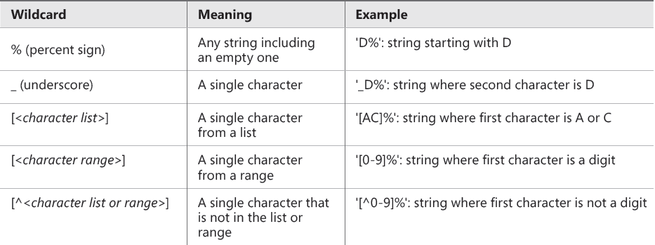
Filtering and Sorting Data
Filtering Character Data
LIKE

Slide 20
Filtering and Sorting Data
Search Arguments

Slide 21
Filtering and Sorting Data
Search Arguments
Non-SARGable
SARGable
WHERE [Column] - 1 = @var
WHERE ABS([Column]) = 1
WHERE ISNULL([Column], 1) = 1
WHERE DATEADD(DAY, 7, [Column]) > GETDATE()
WHERE SUBSTRING([Column], 1, 4) = 'ABCD'
WHERE [Column] LIKE '%ABC%'
WHERE [Column] = @var + 1
WHERE [Column] IN (-1, 1)
WHERE (([Column] = 1) OR ([Column] IS NULL))
WHERE [Column] > DATEADD(DAY, -7, GETDATE())
WHERE [Column] LIKE 'ABCD%'

Slide 22
Filtering and Sorting Data
Filtering Data with TOP and OFFSET-FETCH
Filtering Data with TOP
Filtering Data with OFFSET-FETCH
T-SQL only
SQL standard; supports skipping
Deterministic results of sorting

Slide 23
Filtering and Sorting Data
DEMO

Slide 24
Combining Sets (Joins)

Slide 25
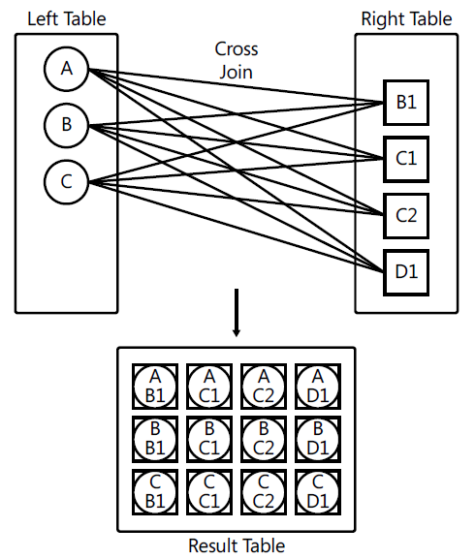
Combining Sets
CROSS Join

Slide 26
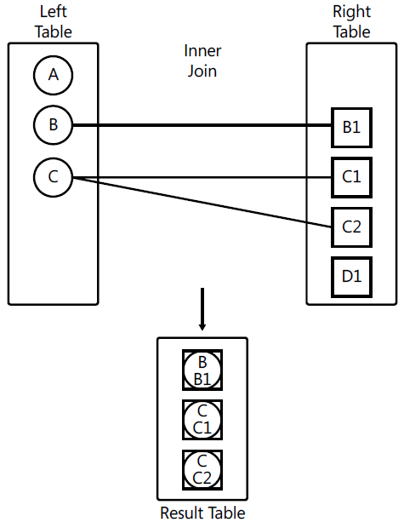
Combining Sets
Inner Join

Slide 27
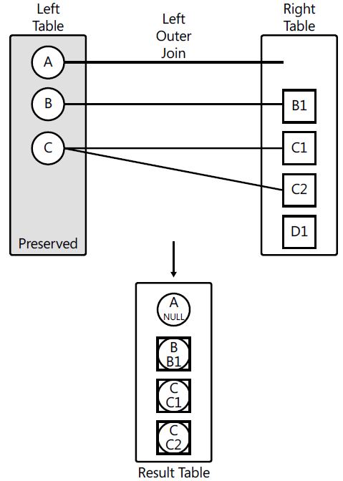
Combining Sets
Outer Joins

Slide 28
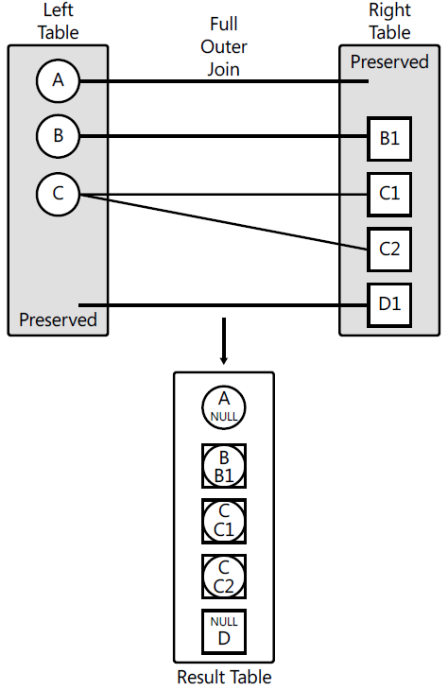
Combining Sets
FULL OUTER JOIN

Slide 29
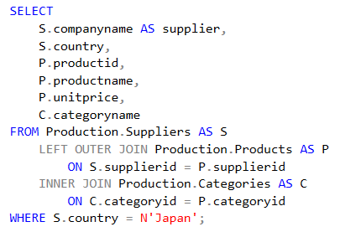
Combining Sets
Multi-Join Queries

Slide 30
Combining Sets
USING JOINS
DEMO

Slide 31
Using Set Operators

Slide 32
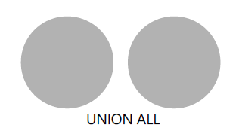

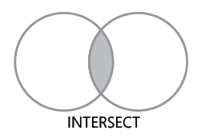
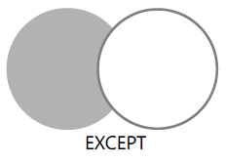
Using Set Operators

Slide 33
Using Set Operators
DEMO

Slide 34
Q&A Session

