Slide 1

November 14, 2021
CONFIDENTIAL | © 2021 EPAM Systems, Inc.

Slide 2

Agenda
1
Working with Variables
2
Inserting, Updating, Deleting Data
3
Using the IDENTITY Column Property
4
Merging Data
5
Using the OUTPUT Option
6
Managing Transactions

Slide 3
Working with Variables

Slide 4
Working with Variables
DEMO

Slide 5
Inserting Data

Slide 6
Inserting Data
Methods to Insert Data
INSERT VALUES
INSERT SELECT
INSERT EXEC
SELECT INTO
Notes:
If you want the target column’s type to be different than the source, you can use the CAST
or CONVERT functions. But remember that in such a case, the target column will be defined
as allowing NULLs even if the source column disallowed NULLs, because you applied manipulation
to the source column. As with the previous examples, you can use the ISNULL function
to make SQL Server define the target column as not allowing NULLs. For example, to convert
the orderdate column from its source type DATETIME to DATE in the target, and disallow
NULLs, use the expression ISNULL(CAST(orderdate AS DATE), '19000101') AS orderdate.

Slide 7
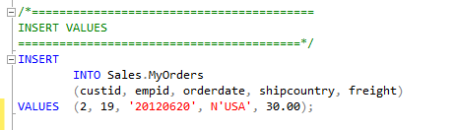
Inserting Data
INSERT VALUES
INSERT SELECT
INSERT EXEC
SELECT INTO
Notes:
If you want the target column’s type to be different than the source, you can use the CAST
or CONVERT functions. But remember that in such a case, the target column will be defined
as allowing NULLs even if the source column disallowed NULLs, because you applied manipulation
to the source column. As with the previous examples, you can use the ISNULL function
to make SQL Server define the target column as not allowing NULLs. For example, to convert
the orderdate column from its source type DATETIME to DATE in the target, and disallow
NULLs, use the expression ISNULL(CAST(orderdate AS DATE), '19000101') AS orderdate.

Slide 8
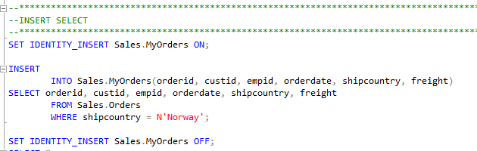
Inserting Data
INSERT VALUES
INSERT SELECT
INSERT EXEC
SELECT INTO
Notes:
If you want the target column’s type to be different than the source, you can use the CAST
or CONVERT functions. But remember that in such a case, the target column will be defined
as allowing NULLs even if the source column disallowed NULLs, because you applied manipulation
to the source column. As with the previous examples, you can use the ISNULL function
to make SQL Server define the target column as not allowing NULLs. For example, to convert
the orderdate column from its source type DATETIME to DATE in the target, and disallow
NULLs, use the expression ISNULL(CAST(orderdate AS DATE), '19000101') AS orderdate.

Slide 9
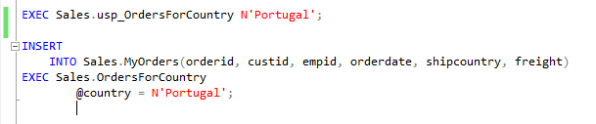
Inserting Data
INSERT VALUES
INSERT SELECT
INSERT EXEC
SELECT INTO
Notes:
If you want the target column’s type to be different than the source, you can use the CAST
or CONVERT functions. But remember that in such a case, the target column will be defined
as allowing NULLs even if the source column disallowed NULLs, because you applied manipulation
to the source column. As with the previous examples, you can use the ISNULL function
to make SQL Server define the target column as not allowing NULLs. For example, to convert
the orderdate column from its source type DATETIME to DATE in the target, and disallow
NULLs, use the expression ISNULL(CAST(orderdate AS DATE), '19000101') AS orderdate.

Slide 10
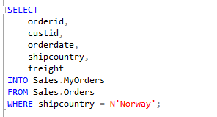
Inserting Data
INSERT VALUES
INSERT SELECT
INSERT EXEC
SELECT INTO
Notes:
If you want the target column’s type to be different than the source, you can use the CAST
or CONVERT functions. But remember that in such a case, the target column will be defined
as allowing NULLs even if the source column disallowed NULLs, because you applied manipulation
to the source column. As with the previous examples, you can use the ISNULL function
to make SQL Server define the target column as not allowing NULLs. For example, to convert
the orderdate column from its source type DATETIME to DATE in the target, and disallow
NULLs, use the expression ISNULL(CAST(orderdate AS DATE), '19000101') AS orderdate.

Slide 11
Inserting Data
DEMO
Notes:
If you want the target column’s type to be different than the source, you can use the CAST
or CONVERT functions. But remember that in such a case, the target column will be defined
as allowing NULLs even if the source column disallowed NULLs, because you applied manipulation
to the source column. As with the previous examples, you can use the ISNULL function
to make SQL Server define the target column as not allowing NULLs. For example, to convert
the orderdate column from its source type DATETIME to DATE in the target, and disallow
NULLs, use the expression ISNULL(CAST(orderdate AS DATE), '19000101') AS orderdate.

Slide 12
Updating Data

Slide 13
Updating Data
UPDATE Statement
UPDATE <object>
SET column_name = expression
[ ,...n ]
WHERE <search_condition>

Slide 14
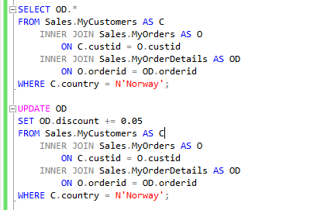

Updating Data
UPDATE Based on Join

Slide 15
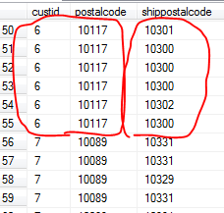
Updating Data
Nondeterministic UPDATE

Slide 16
Updating Data
DEMO

Slide 17
Deleting Data

Slide 18

Deleting Data
Methods to Delete Data
DELETE Statement
TRUNCATE Statement
Notes:
The DELETE statement writes significantly more to the transaction log compared to the
TRUNCATE statement. For DELETE, SQL Server records in the log the actual data that
was deleted. For TRUNCATE, SQL Server records information only about which pages
were deallocated. As a result, the TRUNCATE statement tends to be substantially faster.
■■ The DELETE statement doesn’t attempt to reset an identity property if one is associated
with a column in the target table. The TRUNCATE statement does. If you use
TRUNCATE and would prefer not to reset the property, you need to store the current
identity value plus one in a variable (using the IDENT_CURRENT function), and reseed
the property with the stored value after the truncation.
■■ The DELETE statement is supported if there’s a foreign key pointing to the table in
question as long as there are no related rows in the referencing table. TRUNCATE is not
allowed if a foreign key is pointing to the table—even if there are no related rows in
the referencing table, and even if the foreign key is disabled.
■■ The DELETE statement is allowed against a table involved in an indexed view. A TRUNCATE
statement is disallowed in such a case.
■■ The DELETE statement requires DELETE permissions on the target table. The TRUNCATE
statement requires ALTER permissions on the target table.

Slide 19


Deleting Data
Methods to Delete Data
DELETE Statement
TRUNCATE Statement
transaction log
Identity
foreign key
indexed view
permissions
Notes:
The DELETE statement writes significantly more to the transaction log compared to the
TRUNCATE statement. For DELETE, SQL Server records in the log the actual data that
was deleted. For TRUNCATE, SQL Server records information only about which pages
were deallocated. As a result, the TRUNCATE statement tends to be substantially faster.
■■ The DELETE statement doesn’t attempt to reset an identity property if one is associated
with a column in the target table. The TRUNCATE statement does. If you use
TRUNCATE and would prefer not to reset the property, you need to store the current
identity value plus one in a variable (using the IDENT_CURRENT function), and reseed
the property with the stored value after the truncation.
■■ The DELETE statement is supported if there’s a foreign key pointing to the table in
question as long as there are no related rows in the referencing table. TRUNCATE is not
allowed if a foreign key is pointing to the table—even if there are no related rows in
the referencing table, and even if the foreign key is disabled.
■■ The DELETE statement is allowed against a table involved in an indexed view. A TRUNCATE
statement is disallowed in such a case.
■■ The DELETE statement requires DELETE permissions on the target table. The TRUNCATE
statement requires ALTER permissions on the target table.

Slide 20
Deleting Data
DEMO

Slide 21
Using the IDENTITY Column Property

Slide 22
Using the IDENTITY Column Property
SCOPE_IDENTITY
@@IDENTITY
IDENT_CURRENT
Notes:
Only one column in a table can have an IDE
As for the difference between SCOPE_IDENTITY and @@IDENTITY, suppose that you have
a stored procedure P1 with three statements:
■■ An INSERT that generates a new identity value
■■ A call to a stored procedure P2 that also has an INSERT statement that generates a new
identity value
■■ A statement that queries the functions SCOPE_IDENTITY and @@IDENTITY
The SCOPE_IDENTITY function will return the value generated by P1 (same session and
scope). The @@IDENTITY function will return the value generated by P2 (same session irrespective
of scope).NTITY property.
■■ The SCOPE_IDENTITY function returns the last identity value generated in your session
in the current scope.
■■ The @@IDENTITY function returns the last identity value generated in your session
regardless of scope.
■■ The IDENT_CURRENT function accepts a table as input and returns the last identity
value generated in the input table regardless of session

Slide 23
Using the IDENTITY Column Property
Using the Sequence Object
CREATE SEQUENCE
INCREMENT BY
MINVALUE
MAXVALUE
CYCLE | NO CYCLE
START WITH

Slide 24
Using the IDENTITY Column Property
DEMO
Notes:
Only one column in a table can have an IDE
As for the difference between SCOPE_IDENTITY and @@IDENTITY, suppose that you have
a stored procedure P1 with three statements:
■■ An INSERT that generates a new identity value
■■ A call to a stored procedure P2 that also has an INSERT statement that generates a new
identity value
■■ A statement that queries the functions SCOPE_IDENTITY and @@IDENTITY
The SCOPE_IDENTITY function will return the value generated by P1 (same session and
scope). The @@IDENTITY function will return the value generated by P2 (same session irrespective
of scope).NTITY property.
■■ The SCOPE_IDENTITY function returns the last identity value generated in your session
in the current scope.
■■ The @@IDENTITY function returns the last identity value generated in your session
regardless of scope.
■■ The IDENT_CURRENT function accepts a table as input and returns the last identity
value generated in the input table regardless of session

Slide 25
Merging Data

Slide 26
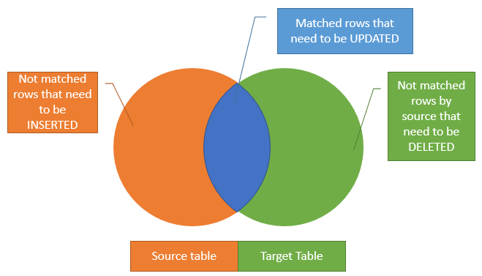
Merging Data

Slide 27
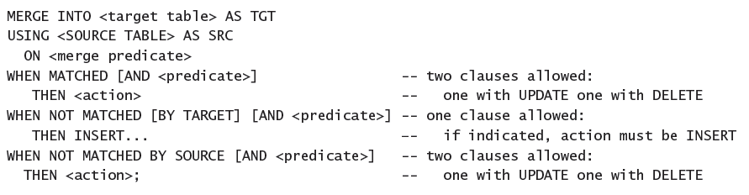
Merging Data

Slide 28
Merging Data
DEMO

Slide 29
Using the OUTPUT Option

Slide 30
Using the OUTPUT Option
INSERT with OUTPUT
DELETE with OUTPUT
UPDATE with OUTPUT
MERGE with OUTPUT

Slide 31
Using the OUTPUT Option
DEMO

Slide 32
Managing Transactions

Slide 33

Managing Transactions
Understanding Transactions
Transaction is a logical unit of work.
All data manipulation language (DML) statements such as INSERT, UPDATE, and DELETE. Technically, even single SELECT statements are a type of transaction in SQL Server
All data definition language (DDL) statements such as CREATE TABLE and CREATE INDEX.

Slide 34
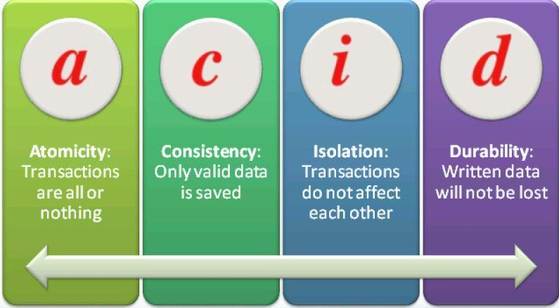
Managing Transactions
ACID Properties of Transactions
Atomicity
Consistency
Isolation
Durability
Notes:
SQL Server ensures all these ACID properties through a variety of mechanisms. To maintain
atomicity, SQL Server treats every data DML or DDL command individually and will not allow
any command to only partially succeed. Consider, for example, an UPDATE statement that
would update 500 rows in a table at the point in time that the transaction begins. The command
will not finish until exactly all those 500 rows are updated. If something prevents that
command from updating all 500 rows, SQL Server will abort the command and roll back the
transaction.
If more than one command is present in a transaction, SQL Server will normally not allow
the entire transaction to be committed unless both statements succeed. (If XACT_ABORT is
OFF, which is the default, you can insert code to decide whether to roll back the transaction
or commit it. See the sections on TRY/CATCH and XACT_ABORT later in this lesson for more
information.)
For consistency, SQL Server ensures that all constraints in the database are enforced. If
your transaction attempts to insert a row that has an invalid foreign key, for example, then
SQL Server will detect that a constraint would be violated, and generate an error message.
You can add logic to decide whether or not to roll back the transaction.
To enforce transactional isolation, SQL Server ensures that when a transaction makes
multiple changes to the database, none of the objects being changed by that transaction are
allowed to be changed by any other transactions. In other words, one transaction's changes
are isolated from any other transaction activities. If two transactions want to change the same
data, one of them must wait until the other transaction is finished

Slide 35
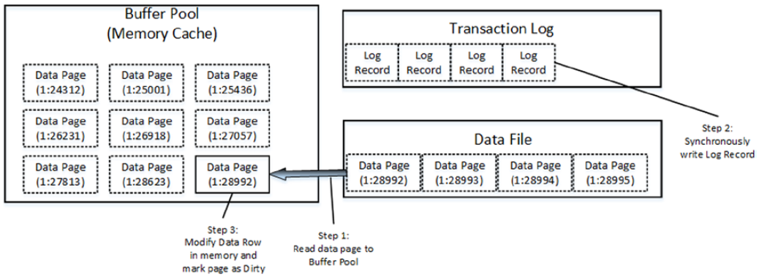
Managing Transactions
Transaction Log

Slide 36
Managing Transactions
Minimally Logged Operations
TRUNCATE
SELECT INTO
INSERT SELECT (only in non-indexed or empty table)
BULK INSERT (only in non-indexed or empty table)

Slide 37
Managing Transactions
Types of Transactions
System transactions
User transactions

Slide 38
Managing Transactions
Transaction Commands
BEGIN TRANSACTION (BEGIN TRAN)
COMMIT TRANSACTION (COMMIT TRAN, COMMIT WORK, or just COMMIT)
ROLLBACK TRAN, ROLLBACK WORK, ROLLBACK.
DEMO

Slide 39
Managing Transactions
Transaction Levels and States
@@TRANCOUNT
XACT_STATE()
Notes:
Transaction Levels and States
You can detect the transaction level or state by using two system functions:
■■ @@TRANCOUNT can be queried to find the level of transaction.
■■ A level of 0 indicates that at this point, the code is not within a transaction.
■■ A level > 0 indicates that there is an active transaction, and a number > 1 indicates
the nesting level of nested transactions.
■■ XACT_STATE() can be queried to find the state of the transaction.
■■ A state of 0 indicates that there is no active transaction.
■■ A state of 1 indicates that there is an uncommitted transaction, and it can be
committed, but the nesting level is not reported.
■■ A state of -1 indicates that there is an uncommitted transaction, but it cannot be
committed due to a prior fatal error

Slide 40
Managing Transactions
Transaction Modes
Autocommit (Default)
Implicit transaction
Explicit transaction

Slide 41
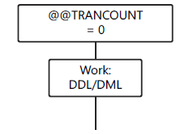
Managing Transactions
Transaction Modes: AUTOCOMMIT

Slide 42
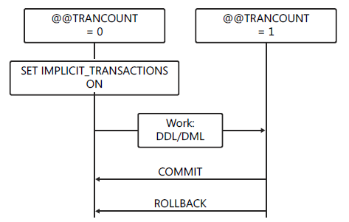
Managing Transactions
Transaction Modes: Implicit transaction

Slide 43
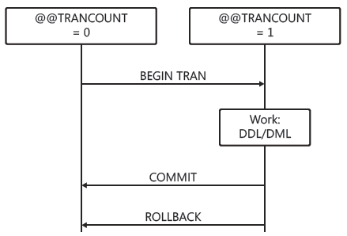
Managing Transactions
Transaction Modes: Explicit transaction

Slide 44
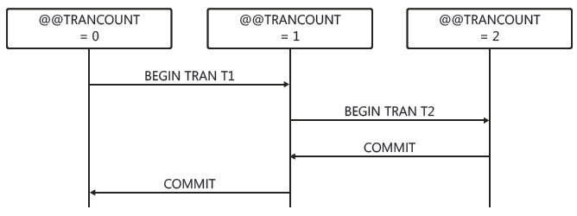
Managing Transactions
Nested Transactions

Slide 45
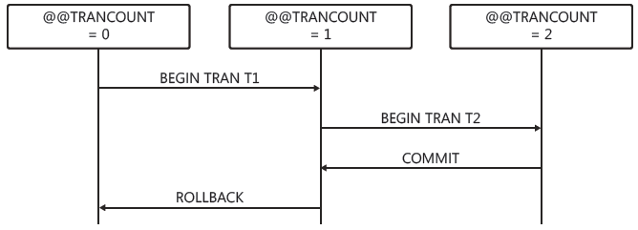
Managing Transactions
Nested Transactions: Rollback

Slide 46
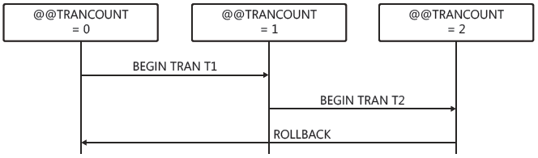
Managing Transactions
Nested Transactions: Rollback

Slide 47
Managing Transactions
DEMO

Slide 48
Managing Transactions
Additional Transaction Options
Cross-database transactions
Distributed transactions

Slide 49
Q&A Session

