Slide 1


November 15, 2019

Slide 2
AGENDA
1
About this Course
2
Database evolution
3
MS SQL Server overview
4
Resources
5
Work remotely
6
Create PoC of a Database

Slide 3
S20E01
About this course

Slide 4

Business Intelligence
Reporting and analytics
Dashboard development
Data Mining
Predictive Analytics
Performance Management and KPI’s
Metadata presentation and effective usage

Slide 5
Business Intelligence

Slide 6
MSBI.Dev.S20 : Technologies
MSBI DEVELOPER
MS SQL Server
SSIS
SSAS
Azure
Power BI
OLTP Databases
ETL (Extract – Transform – Load)
Tabular
Storage
SSRS
Data Warehouse DWH
Data Base Maintenance
DAX
Azure SQL
Administration
Multidimensional
Azure Data Factory v2 (ADFv2)
T-SQL
MDX
Azure DevOps
A lot of…
C#
PowerShell
Python

Slide 7
MSBI.Dev.S20 : Timeline
November
December
January
February
March
MSBI Developer Course
MS SQL
EXAM
DWH,SSIS
SSAS
Azure
PowerBI
Next step

Slide 8
MSBI.Dev.S20 : Workflow
Monday
Tuesday
Wednesday
Thursday
Friday
Saturday
Sunday
Week 1
Lecture 10:00
Lecture 10:00
Homework
Homework
Making
Making
Week 2
Deadline
Deadline
Checking
Checking
Week 3
Result
Result

Slide 9
S20E01
Database evolution

Slide 10
Database evolution
1
Clay Tablet
2
File Management System
3
Hierarchical database System
4
Network Database System
5
Relational Database System (RDBMS)
6
NoSQL (Document oriented, Column Store, Graph, Key-Value)

Slide 11
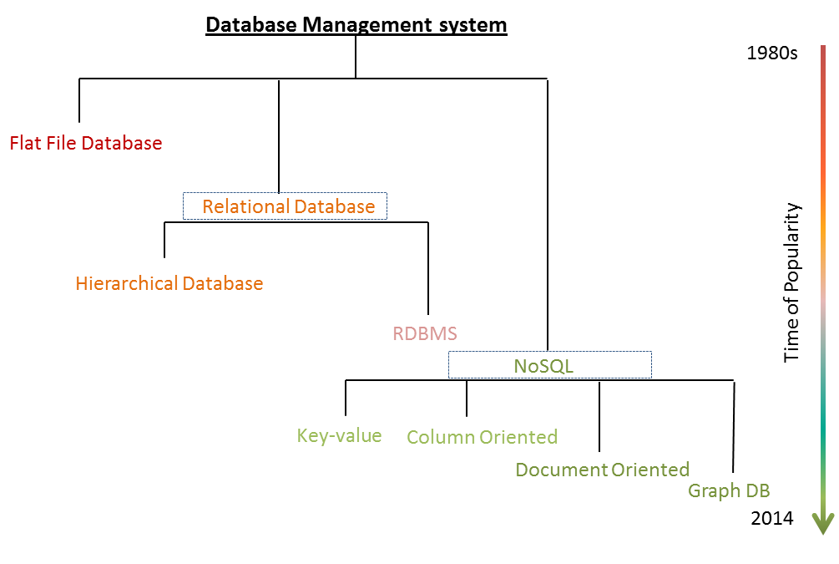
Database evolution

Slide 12
Database evolution:
File Management System

Slide 13

Database evolution
Hierarchical database System

Slide 14
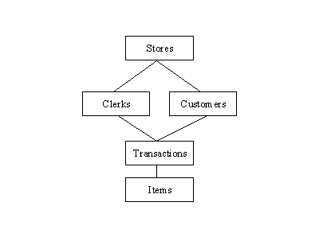
Database evolution:
Network Database System

Slide 15

Database evolution:
Relational Database System

Slide 16
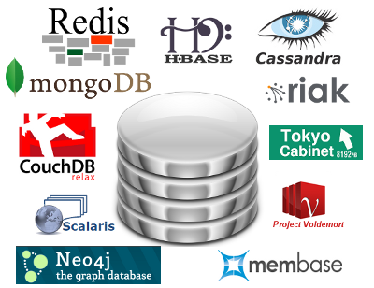
Database evolution:
NoSQL

Slide 17
S20E01
MS SQL Server overview

Slide 18
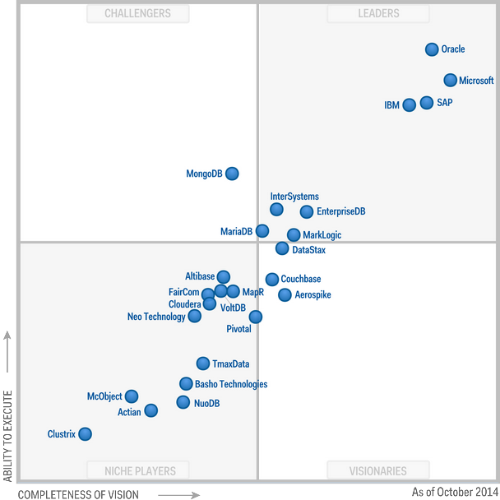
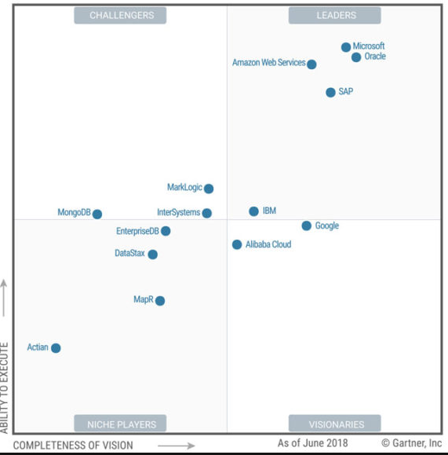
MS SQL Server overview
Magic Quadrant for Operational Database Management Systems
2014
2018

Slide 19
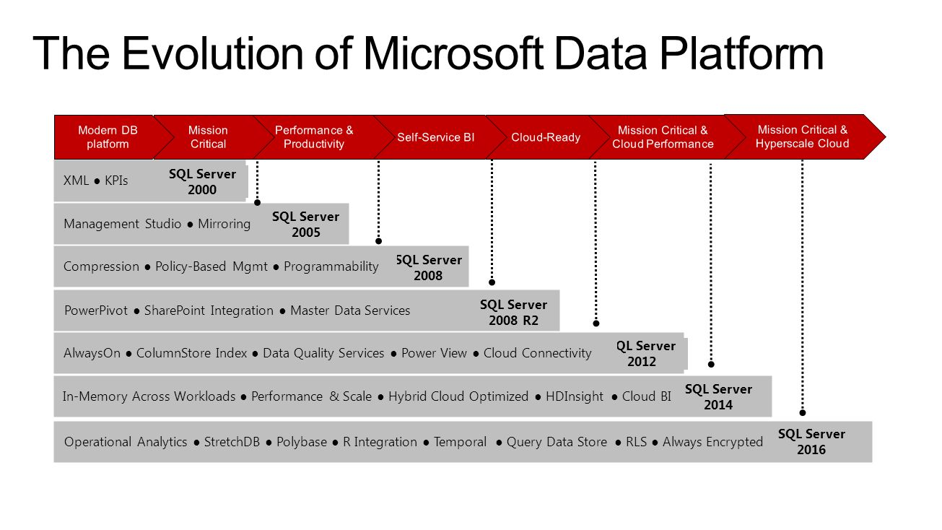
MS SQL Server overview
SQL 2017

Slide 20
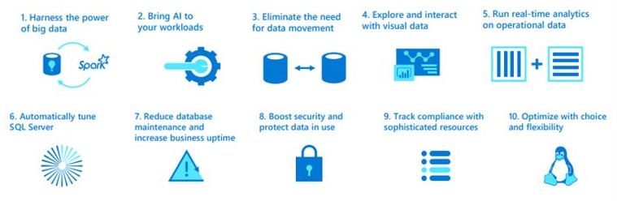
MS SQL Server overview
SQL 2017

Slide 21
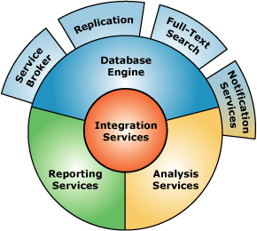
MS SQL Server overview :
Key Components
1
Database Engine
2
SQL Server Analysis Services (SSAS)
3
SQL Server Reporting Services (SSRS)
4
SQL Server Integration Services (SSIS)

Slide 22
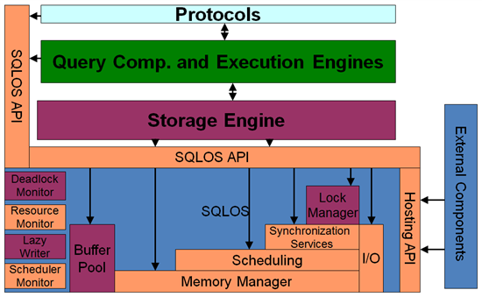
MS SQL Server overview :
Database Engine

Slide 23
MS SQL Server overview :
System Databases
SSMS SQL Server Management Studio
master Database
resource Database
msdb Database
model Database
tempdb Database
SQL Server Management Studio (SSMS) is an integrated environment for accessing, configuring, managing, administering, and developing all components of SQL Server. SSMS combines a broad group of graphical tools with a number of rich script editors to provide access to SQL Server to developers and administrators of all skill levels.

Slide 24
S20E01
Resources

Slide 25
S20E01
Work remotely

Slide 26
S20E01
PoC of a Database

Slide 27
S20E01

