Slide 1



April 24, 2019
3

Slide 2


MSBI DEVELOPER
Course
S16E17
April 3, 2016

Slide 3
IN PREVIOUS PART: S16E16 AGENDA
Designing and Implementing Data Flow
Working with Data Flow Transformations
Determining Appropriate ETL Strategy and Tools
Enhancing SSIS Packages
SSIS Variables
Connection Managers, Tasks, and Precedence Constraint Expressions
Using a Master Package for Advanced Control Flow

Slide 4
S16E17 AGENDA
Developing SSAS cubes (UN Statistic prototype)
Creating and modifying SSAS Cubes
Creating and modifying dimensions
Creating Measure Groups and Measures
First glance at hierarchies
Using Cubes for Ad Hoc (Power BI, Excel)

Slide 5
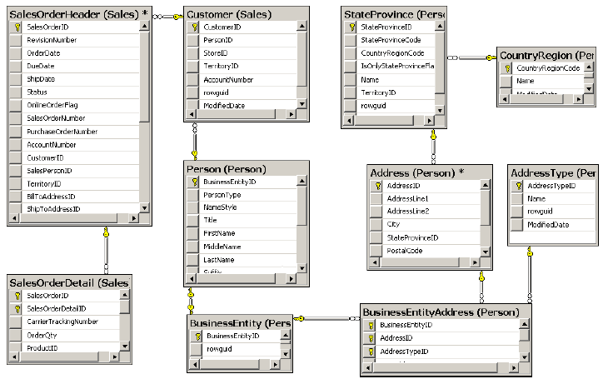
Reporting Problems with a Normalized Schema

Slide 6
Reporting Problems with a Normalized Schema
Comprehensive schema
Performance issues
Concurrency issues
LookUp table for Dates
Data Quality problem

Slide 7
Introducing Star and Snowflake Schemas
Introducing Star
and
Snowflake Schemas

Slide 8
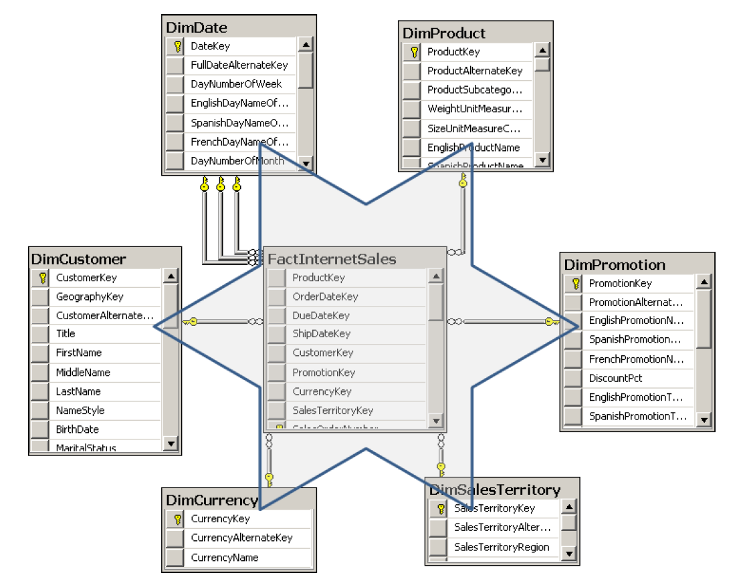
Star Schema
Dimension
Dimension
Dimension
Dimension
Fact Table
Dimension
Dimension

Slide 9
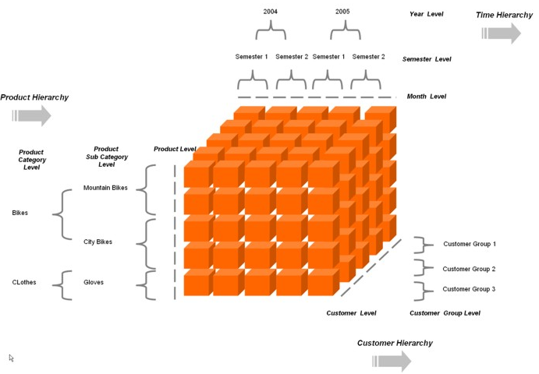
Star Schema – represent Multidimensional cube

Slide 10
S16E17
Developing SSAS cubes

Slide 11
Developing SSAS cubes
Terms
Unified Dimensional Mode (UDM) Cube
Ad hoc reporting

Slide 12
Developing SSAS cubes
UDM (SSAS cube) components
Data source
Data source view (DSV)
Dimensional model
Calculations (optional)
End-user model (optional)
KPI, translations, actions, perspectives
Management settings

Slide 13
Developing SSAS cubes
STEP 1: Creating Data Sources AND Data Source Views​
Defining a New Data Source
Selecting Object for DSV
Creating DSV Keys and Table Relationships
Defining DSV Named Calculations and Named Queries​

Slide 14
Developing SSAS cubes
STEP 2: Creating and modifying SSAS Cubes​
Using the Cube Wizard
Modifying Cube with the Cube Designer

Slide 15
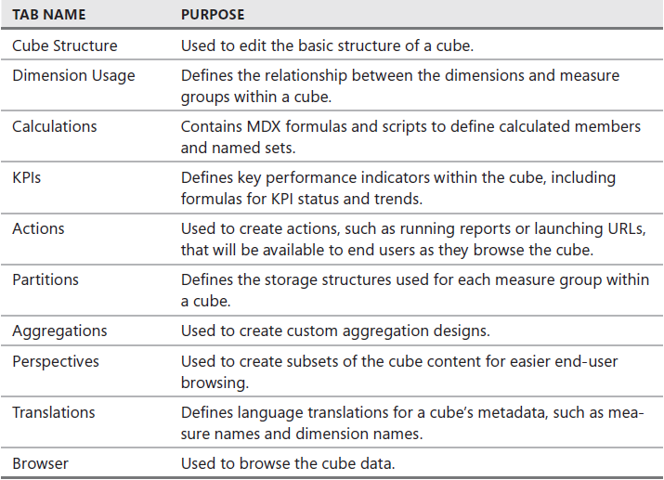
Developing SSAS cubes
STEP 2: Creating and modifying SSAS Cubes​

Slide 16
Developing SSAS cubes
STEP 3: Creating and modifying dimensions
Creating a dimension
Modifying Dimension Attributes Properties
Assigning Dimensions to Cubes​

Slide 17
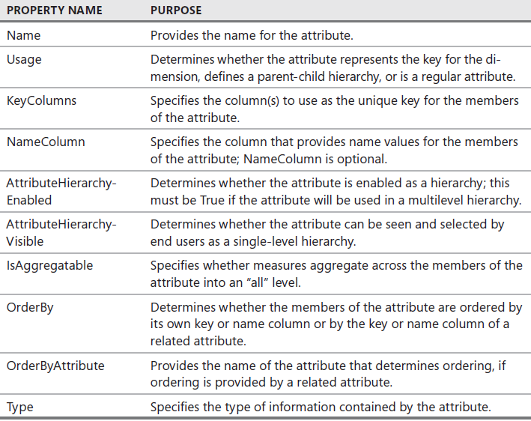
Developing SSAS cubes
STEP 3: Creating and modifying dimensions

Slide 18
Developing SSAS cubes
STEP 4: Creating Measure Groups and Measures
Creating Measure Group
Adding and Configuring Measures​

Slide 19
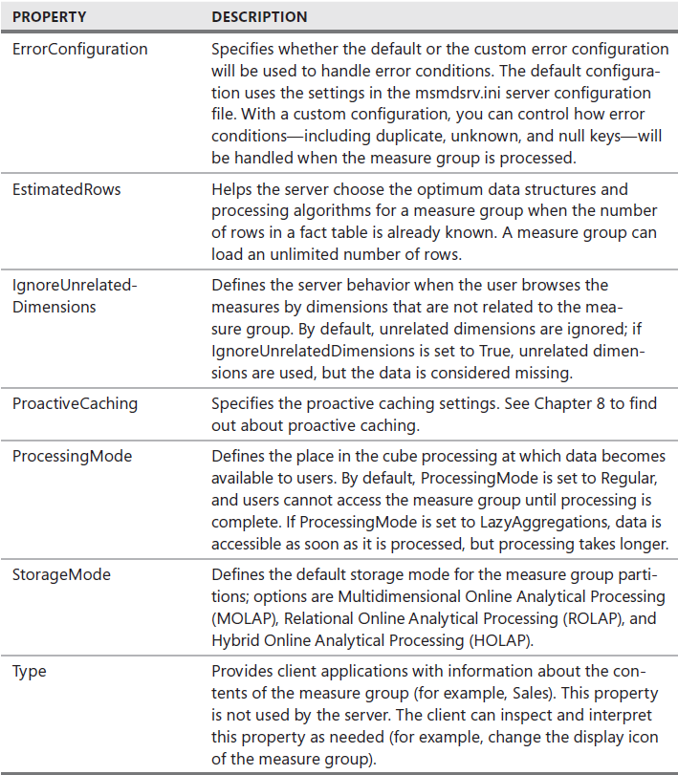
Developing SSAS cubes
STEP 4: Creating Measure Groups and Measures
Measure Group Properties

Slide 20
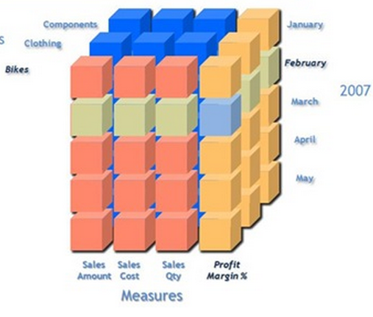
Additivity of Measures
Additive measures
Transaction amount
Semi-Additive measures
Account balance
Non-additive measures
Price
Notes:
Let us begin with the definition of each which will be followed by examples: 1. Additive measures: These are those specific class of fact measures which can be aggreagated across all dimension and their hieracchy 2. Semi-Additive measures: These are those specific class of fact measures which can be aggreagated across all dimension and their hieracchy except the time dimension 3. Non-additive measures: These are those specific class of fact measures which cannot be aggreagated across all/any dimension and their hieracchy
A good example of a non aggregatable measure might be 'Price' on a sales record. For example: A) We have sales figures...one may tend to add sales across all quareters to avail the yearly sales..hence this is an example of Additive measure B) We have stock levels say 1000(qty of Item A) on Monday...I sell 200(qty of Item A) on Tuesday I further sell 300(qty of Item A) on Wednesday...going by basic math On Thursday I should be left with 500(qty of Item A, assuming no inventory has flown in) to obtain current stock level I cannot aggregate the Stock sales across time dimension hierarchy...If done I will have inappropriate outcomes C) Aggregation of percentage or dates is an Ideal example of non-additive measures.
Additivity of measures is not exactly a data warehouse design problem. However, you should
consider which aggregate functions you will use in reports for which measures, and which aggregate
functions you will use when aggregating over which dimension.
The simplest types of measures are those that can be aggregated with the SUM aggregate
function across all dimensions, such as amounts or quantities. For example, if sales for product
A were $200.00 and sales for product B were $150.00, then the total of the sales was $350.00.
If yesterday’s sales were $100.00 and sales for the day before yesterday were $130.00, then
the total sales amounted to $230.00. Measures that can be summarized across all dimensions
are called additive measures.
Some measures are not additive over any dimension. Examples include prices and percentages,
such as a discount percentage. Typically, you use the AVERAGE aggregate function for
such measures, or you do not aggregate them at all. Such measures are called non-additive
measures. Often, you can sum additive measures and then calculate non-additive measures
from the additive aggregations. For example, you can calculate the sum of sales amount and
then divide that value by the sum of the order quantity to get the average price. On higher

Slide 21
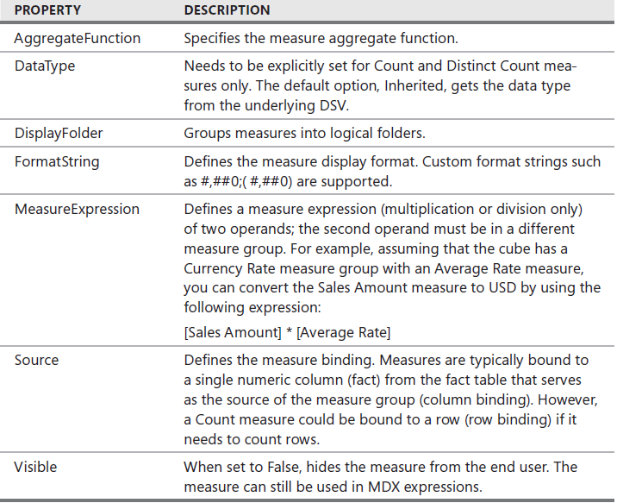
Developing SSAS cubes
STEP 4: Creating Measure Groups and Measures
Measure Properties

Slide 22
Developing SSAS cubes
STEP 5: First glance at hierarchies and calculation
Geography
Rate

Slide 23
Developing SSAS cubes
Ad hoc
SSMS
Power BI
Excel
etc

