Slide 1

MSBI LAB S21.E08-SQL
January 14, 2021

Slide 2

IN THE PREVIOUS PART
1
Designing and Implementing Views
2
Implementing User-Defined Functions
3
Hierarchies
4
Introduction to Power BI
5
Git Teamwork

Slide 3

S21E08 AGENDA
1
Managing Transactions
2
Basic Locking
3
Transaction Isolation Levels
4
Error Handling

Slide 4
Implementing Transactions

Slide 5

Managing Transactions
Understanding Transactions
Transaction is a logical unit of work.
All data manipulation language (DML) statements such as INSERT, UPDATE, and DELETE. Technically, even single SELECT statements are a type of transaction in SQL Server
All data definition language (DDL) statements such as CREATE TABLE and CREATE INDEX.

Slide 6
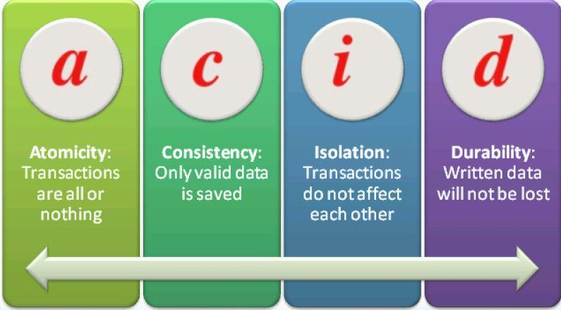
Managing Transactions
ACID Properties of Transactions
Atomicity
Consistency
Isolation
Durability
Notes:
SQL Server ensures all these ACID properties through a variety of mechanisms. To maintain
atomicity, SQL Server treats every data DML or DDL command individually and will not allow
any command to only partially succeed. Consider, for example, an UPDATE statement that
would update 500 rows in a table at the point in time that the transaction begins. The command
will not finish until exactly all those 500 rows are updated. If something prevents that
command from updating all 500 rows, SQL Server will abort the command and roll back the
transaction.
If more than one command is present in a transaction, SQL Server will normally not allow
the entire transaction to be committed unless both statements succeed. (If XACT_ABORT is
OFF, which is the default, you can insert code to decide whether to roll back the transaction
or commit it. See the sections on TRY/CATCH and XACT_ABORT later in this lesson for more
information.)
For consistency, SQL Server ensures that all constraints in the database are enforced. If
your transaction attempts to insert a row that has an invalid foreign key, for example, then
SQL Server will detect that a constraint would be violated, and generate an error message.
You can add logic to decide whether or not to roll back the transaction.
To enforce transactional isolation, SQL Server ensures that when a transaction makes
multiple changes to the database, none of the objects being changed by that transaction are
allowed to be changed by any other transactions. In other words, one transaction's changes
are isolated from any other transaction activities. If two transactions want to change the same
data, one of them must wait until the other transaction is finished

Slide 7
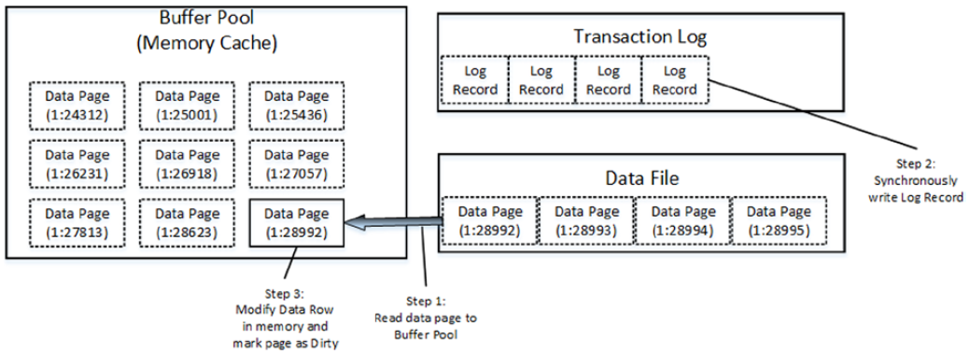
Managing Transactions
Transaction Log

Slide 8
Managing Transactions
Minimally Logged Operations
TRUNCATE
SELECT INTO
INSERT SELECT (only in non-indexed or empty table)
BULK INSERT (only in non-indexed or empty table)

Slide 9
Managing Transactions
Types of Transactions
System transactions
User transactions

Slide 10
Managing Transactions
Transaction Commands
BEGIN TRANSACTION (BEGIN TRAN)
COMMIT TRANSACTION (COMMIT TRAN, COMMIT WORK, or just COMMIT)
ROLLBACK TRAN, ROLLBACK WORK, ROLLBACK.
DEMO

Slide 11
Managing Transactions
Transaction Levels and States
@@TRANCOUNT
XACT_STATE()
Notes:
Transaction Levels and States
You can detect the transaction level or state by using two system functions:
■■ @@TRANCOUNT can be queried to find the level of transaction.
■■ A level of 0 indicates that at this point, the code is not within a transaction.
■■ A level > 0 indicates that there is an active transaction, and a number > 1 indicates
the nesting level of nested transactions.
■■ XACT_STATE() can be queried to find the state of the transaction.
■■ A state of 0 indicates that there is no active transaction.
■■ A state of 1 indicates that there is an uncommitted transaction, and it can be
committed, but the nesting level is not reported.
■■ A state of -1 indicates that there is an uncommitted transaction, but it cannot be
committed due to a prior fatal error

Slide 12
Managing Transactions
Transaction Modes
Autocommit (Default)
Implicit transaction
Explicit transaction

Slide 13
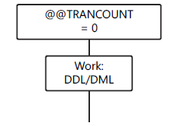
Managing Transactions
Transaction Modes: AUTOCOMMIT

Slide 14
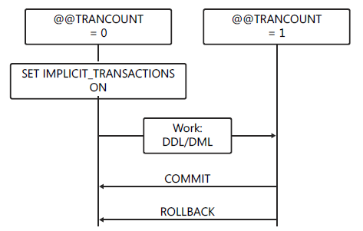
Managing Transactions
Transaction Modes: Implicit transaction

Slide 15
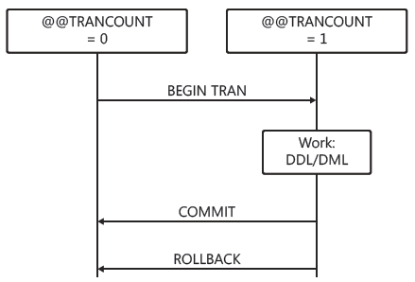
Managing Transactions
Transaction Modes: Explicit transaction

Slide 16
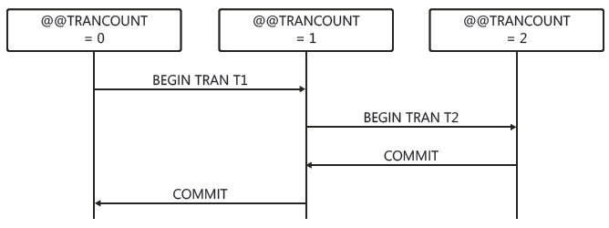
Managing Transactions
Nested Transactions

Slide 17
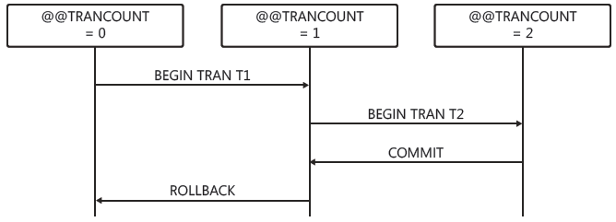
Managing Transactions
Nested Transactions: Rollback

Slide 18
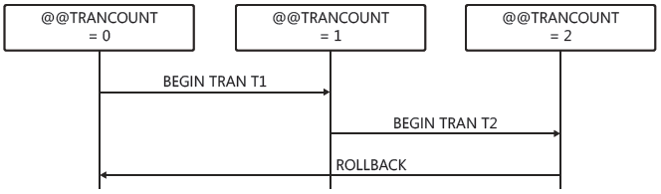
Managing Transactions
Nested Transactions: Rollback

Slide 19
Managing Transactions
DEMO

Slide 20
Managing Transactions
Additional Transaction Options
Cross-database transactions
Distributed transactions

Slide 21
Basic locking

Slide 22
Basic Locking
Lock Types
Shared locks
Exclusive locks
Advanced Locking Modes
There are more advanced modes called update, intent, and schema locks used for special purposes

Slide 23
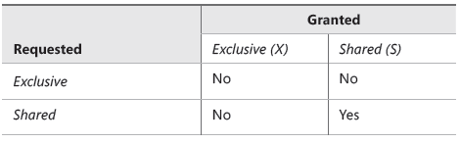
Basic Locking
Lock Compatibility

Slide 24
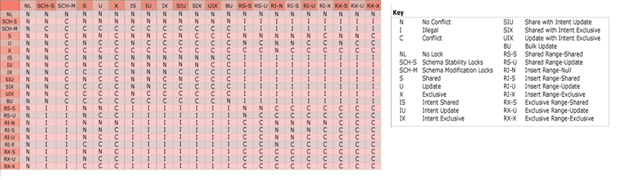
Basic Locking
Lock Compatibility (Full Version)

Slide 25
Basic Locking
Blocking

Slide 26
Managing Transactions
Dead locking
DEMO

Slide 27
Transaction Isolation Levels

Slide 28
Transaction Isolation Levels
Pessimistic
READ UNCOMMITTED
READ COMMITED
REPEATABLE READ
SERIALIZABLE
Optimistic
READ COMMITTED SNAPSHOT
SNAPSHOT
SET TRANSACTION ISOLATION LEVEL

Slide 29
Transaction Isolation Levels
DEMO

Slide 30
Error Handling

Slide 31
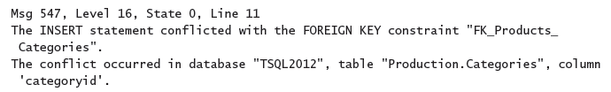
Error Handling
Error Messages

Slide 32
Error Handling
Analyzing Error Messages
Error number
SQL Server error messages are numbered from 1 through 49999
Custom error messages are numbered 50001 and higher
The error number 50000 is reserved for a custom message that does not have a custom error number

Slide 33
Error Handling
Analyzing Error Messages
Severity level (0-25)
errors with a severity of 16 or higher are logged automatically to the SQL Server log and the Windows log
errors with a severity level from 19 through 25 can be specified only by members of the sysadmin server role.
severity level from 20 through 25 are considered fatal
errors with severity level 0 through 10 are informational only.

Slide 34
Error Handling
Analyzing Error Messages
State
This is an integer with a maximum value of 127, used by Microsoft for internal purposes.

Slide 35
Error Handling
Analyzing Error Messages
Error message
The error message can be up to 255 Unicode characters long
SQL Server error messages are listed in sys.messages
You can add your own custom error messages by using sp_addmessage

Slide 36


Error Handling
RAISING ERROR
RAISERROR
THROW
Notes:
You cannot issue THROW with a NOWAIT command in order to cause immediate
buffer output.
■■ You cannot issue THROW using a severity level higher than 16 by using the WITH LOG
clause as you can with RAISERROR.

Slide 37
Error Handling
RAISING ERROR with THROW
THROW does not use parentheses to delimit parameters.
THROW can be used without parameters, but only in the CATCH block of a TRY/CATCH construct.
When parameters are supplied, error_number, message, and state are all required.
The error_number does not require a matching defined message in sys.messages.
The message parameter does not allow formatting, but you can use FORMATMESSAGE() with a variable to get the same effect.
The state parameter must be an integer that ranges from 0 to 255.
Any parameter can be a variable.
There is no severity parameter; the severity is always set to 16.
THROW always terminates the batch except when it is used in a TRY block
Notes:
You cannot issue THROW with a NOWAIT command in order to cause immediate
buffer output.
■■ You cannot issue THROW using a severity level higher than 16 by using the WITH LOG
clause as you can with RAISERROR.

Slide 38
Error Handling
Error Handling Approaches
Unstructured Error Handling
Using @@ERROR
XACT_ABORT with Transactions
SET XACT_ABORT ON
Structured Error Handling
Using TRY/CATCH

Slide 39
Error Handling
DEMO

