Slide 1



3
Notes:
Appendix includes recent awards, please visit elements.epam.com for all 2016-2017 awards

Slide 2
IN PREVIOUS PART: S20E06
1
Querying and Managing XML Data
-
Returning Results As XML with FOR XML
-
Querying XML Data with XQuery
-
Using the XML Data Type
3
Notes:
Appendix includes recent awards, please visit elements.epam.com for all 2016-2017 awards

Slide 3
IN PREVIOUS PART: S20E06
2
JSON data in SQL Server
-
Key JSON capabilities of SQL Server and SQL Database
-
Extract values from JSON text and use them in queries
-
Change JSON values
-
Convert JSON collections to a rowset
-
Convert SQL Server data to JSON or export JSON
3
Notes:
Appendix includes recent awards, please visit elements.epam.com for all 2016-2017 awards

Slide 4
Agenda: MSBI.Dev.S20E07
---
topics:
topicname: Designing and Implementing Views
subtopics:
- subtopicname: Views
- topicname: Implementing User-Defined Functions
subtopics:
- subtopicname: Scalar UDFs
- subtopicname: Inline Table-Valued UDF
- subtopicname: Multistatement Table-Valued UDF
- subtopicname: Limitations on UDFs
- topicname: Using Synonyms
subtopics:
- subtopicname: Creating a Synonym
- topicname: Hierarchies
subtopics:
- subtopicname: Adjacency List Model
- subtopicname: Nested Set Model of Hierarchies
- subtopicname: HierarchyID
- topicname: Introduction in Power BI
- topicname: Team work with GIT
subtopics:
- subtopicname: Git branching model
- subtopicname: Workflow with branches and Pull Requests
---
3
Notes:
Appendix includes recent awards, please visit elements.epam.com for all 2016-2017 awards

Slide 5
Designing and Implementing Views and Inline Functions

Slide 6
Designing and Creating Views, Inline Functions, and Synonyms
Views case scenario
Notes:
Restrictions on Views
Views have a number of restrictions, such as the following:
■■ You cannot add an ORDER BY to the SELECT statement in a view. A view must appear
just like a table, and tables in a relational database contain sets of rows. Sets by themselves
are not ordered, although you can apply an order to a result set using ORDER
BY. Similarly, tables and views in SQL Server do not have a logical order to their rows,
though you can apply one by adding an ORDER BY to the outermost SELECT statement
when you access the view.
■■ You cannot pass parameters to views.
■■ Similarly, a view cannot reference a variable inside the SELECT statement. See the
section “Inline Functions” for information on how to use functions to simulate passing
parameters to a view.
■■ A view cannot create a table, whether permanent or temporary. In other words, you
cannot use the SELECT/INTO syntax in a view.
■■ A view can reference only permanent tables; a view cannot reference a temporary
table.

Slide 7

Designing and Creating Views, Inline Functions, and Synonyms
Views
WITH ENCRYPTION
WITH SCHEMABINDING
WITH VIEW_METADATA
WITH CHECK OPTION
Notes:
Restrictions on Views
Views have a number of restrictions, such as the following:
■■ You cannot add an ORDER BY to the SELECT statement in a view. A view must appear
just like a table, and tables in a relational database contain sets of rows. Sets by themselves
are not ordered, although you can apply an order to a result set using ORDER
BY. Similarly, tables and views in SQL Server do not have a logical order to their rows,
though you can apply one by adding an ORDER BY to the outermost SELECT statement
when you access the view.
■■ You cannot pass parameters to views.
■■ Similarly, a view cannot reference a variable inside the SELECT statement. See the
section “Inline Functions” for information on how to use functions to simulate passing
parameters to a view.
■■ A view cannot create a table, whether permanent or temporary. In other words, you
cannot use the SELECT/INTO syntax in a view.
■■ A view can reference only permanent tables; a view cannot reference a temporary
table.

Slide 8
Designing and Creating Views, Inline Functions, and Synonyms
Views Restriction
NO ORDER BY
NO PARAMETERS
NO DDL (CREATE, ALTER ETC)
NO TEMP TABLE
Notes:
However, it is possible to create a unique clustered index on a view and materialize the
data. In that case, more than the view definition is stored. The actual results of the view query
are stored on disk, in the clustered index structure. To be indexed, a view must satisfy a number
of important restrictions. For more information about indexed views, see "Implementing
Indexed Views" in Chapter 15, “Implementing Indexes and Statistics.”

Slide 9
Designing and Creating Views, Inline Functions, and Synonyms
Views
Indexed Views
Notes:
However, it is possible to create a unique clustered index on a view and materialize the
data. In that case, more than the view definition is stored. The actual results of the view query
are stored on disk, in the clustered index structure. To be indexed, a view must satisfy a number
of important restrictions. For more information about indexed views, see "Implementing
Indexed Views" in Chapter 15, “Implementing Indexes and Statistics.”

Slide 10
Designing and Creating Views, Inline Functions, and Synonyms
Views
Modifying Data Through a View
Only with direct reference with column
Notes:
However, it is possible to create a unique clustered index on a view and materialize the
data. In that case, more than the view definition is stored. The actual results of the view query
are stored on disk, in the clustered index structure. To be indexed, a view must satisfy a number
of important restrictions. For more information about indexed views, see "Implementing
Indexed Views" in Chapter 15, “Implementing Indexes and Statistics.”
■■ DML statements (INSERT, UPDATE, and DELETE) must reference exactly one table at a
time, no matter how many tables the view references.
■■ The view columns must directly reference table columns, and not be expressions or
functions surrounding the column value.
■■ Accordingly, you cannot modify a view column that has an aggregate function, such
as SUM(), MAX(), or MIN(), applied to the table's column.
■■ You cannot modify a view column that is computed from a UNION/UNION ALL, CROSS
JOIN, EXCEPT, or INTERSECT.
■■ You cannot modify a view column whose values result from grouping, such as
DISTINCT, or the GROUP BY and HAVING clause.
■■ You cannot modify a view that has a TOP operator or OFFSET FETCH in the SELECT
statement along with the WITH CHECK OPTION clause.
If you really must update tables through a view, and the view does not meet all the requirements
for updatability, you can create an INSTEAD OF trigger on the view and use the
trigger to update the underlying tables. For more information on INSTEAD OF triggers, see
"INSTEAD OF Triggers" in Chapter 13, “Designing and Implementing T-SQL Routines.”

Slide 11
Designing and Creating Views, Inline Functions, and Synonyms
Views
Partitioned Views
Notes:
Partitioned Views

Slide 12
Designing and Creating Views, Inline Functions, and Synonyms
Views
Views and Metadata

Slide 13
Designing and Creating Views, Inline Functions, and Synonyms
Inline Functions
the body of the function can only be a SELECT statement
WITH ENCRYPTION
WITH SCHEMABINDING

Slide 14
Implementing User-Defined Functions

Slide 15
Implementing User-Defined Functions
Understanding User-Defined Functions
Can
accept parameters
embedded in T-SQL statements
access SQL Server data
Cannot
be executed by using the EXECUTE command
perform any DDL
Scalar
Table-valued
inline table-valued UDF
multistatement table-valued UDF

Slide 16
Implementing User-Defined Functions
Understanding User-Defined Functions
OBJECT_ID()
FN = SQL scalar function
IF = SQL inline table-valued function
TF = SQL multistatement table-valued-function

Slide 17
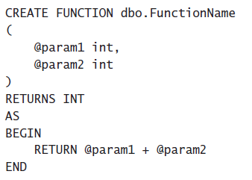
Implementing User-Defined Functions
Understanding User-Defined Functions
Scalar UDFs

Slide 18
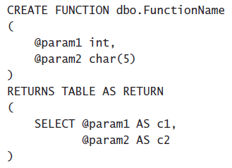
Implementing User-Defined Functions
Understanding User-Defined Functions
Table-Valued UDFs
Inline Table-Valued UDF

Slide 19
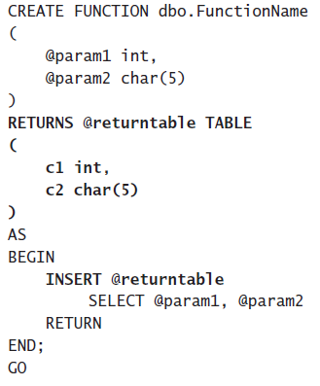
Implementing User-Defined Functions
Understanding User-Defined Functions
Table-Valued UDFs
Multistatement Table-Valued UDF

Slide 20
Implementing User-Defined Functions
UDF Options
You can specify five options with UDFs:
ENCRYPTION
SCHEMABINDING
RETURN NULL ON NULL INPUT / CALLED ON NULL INPUT
EXECUTE AS

Slide 21
Implementing User-Defined Functions
Limitations on UDFs
UDFs cannot do the following:
Apply any schema or data changes in the database.
Change the state of a database or SQL Server instance.
Create or access temporary tables.
Call stored procedures.
Execute dynamic SQL.
Produce side effects. For example, both the RAND() and NEWID()

Slide 22
Implementing User-Defined Functions
UDF Performance Considerations

Slide 23
Using Synonyms

Slide 24
Designing and Creating Views, Inline Functions, and Synonyms
Using Synonyms
Synonyms are names stored in a database that can be used as substitutes for other object names

Slide 25
Hierarchies

Slide 26
Design for OLTP Database
Hierarchies
CREATE TABLE dbo.ManagersDirectory
(
ManagerID INT
,EmployeeID INT
,CONSTRAINT md_pk1 PRIMARY KEY (ManagerID, EmployeeID)
);
GO
Adjacency List Model
Nested Set Model of Hierarchies
HierarchyID
https://www.simple-talk.com/sql/performance/the-performance-of-traversing-a-sql-hierarchy-/
Joe Celko’s Trees and Hierarchies in SQL for Smarties

Slide 27
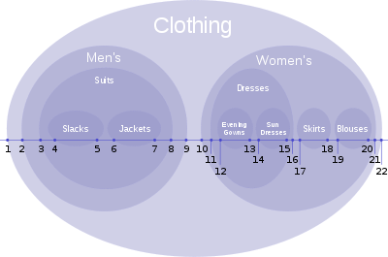
Design for OLTP Database
Hierarchies
Adjacency List Model
Nested Set Model of Hierarchies
HierarchyID
Joe Celko’s Trees and Hierarchies in SQL for Smarties

Slide 28
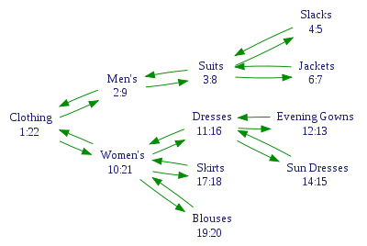
Design for OLTP Database
Hierarchies
Adjacency List Model
Nested Set Model of Hierarchies
HierarchyID
Joe Celko’s Trees and Hierarchies in SQL for Smarties

Slide 29
Design for OLTP Database
Hierarchies
Adjacency List Model
Nested Set Model of Hierarchies
HierarchyID
https://technet.microsoft.com/ru-ru/library/bb677290(v=sql.105).aspx

Slide 30
Introduction in Power BI

Slide 31
GIT Team Work

Slide 32
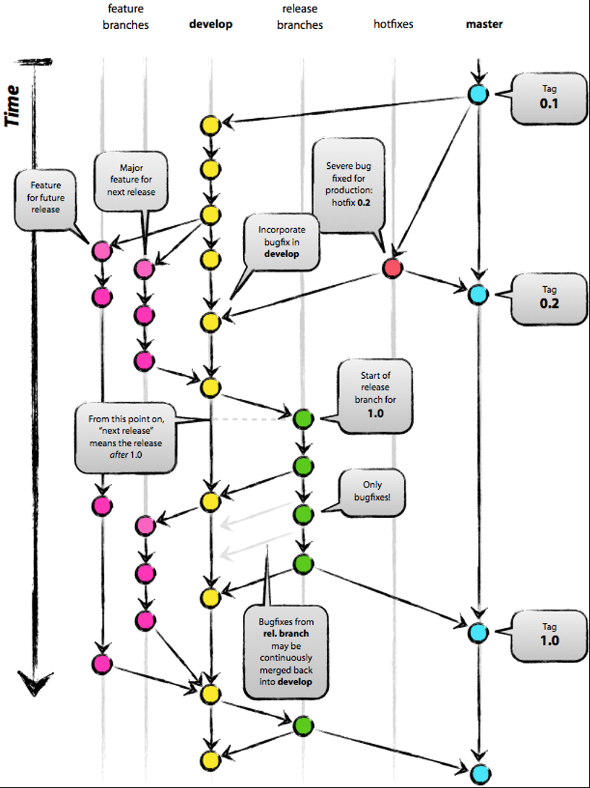
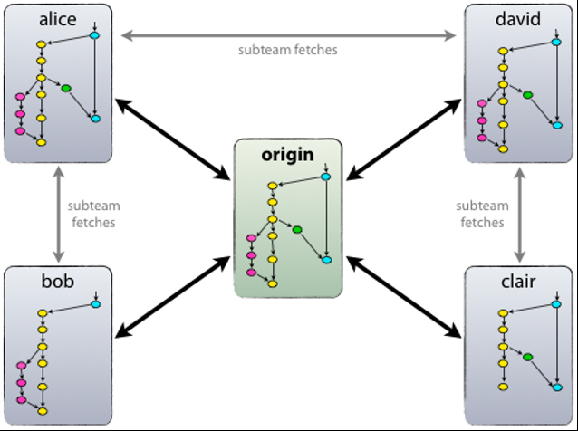
Git branching model
3
Notes:
Appendix includes recent awards, please visit elements.epam.com for all 2016-2017 awards

Slide 33
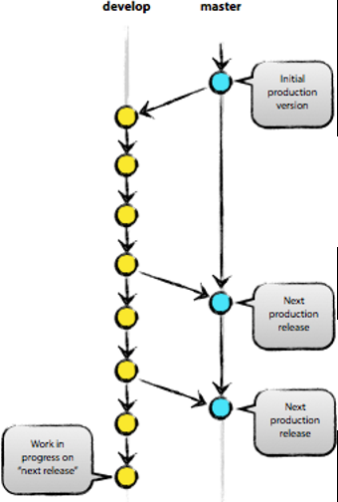
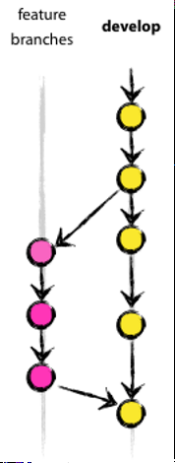
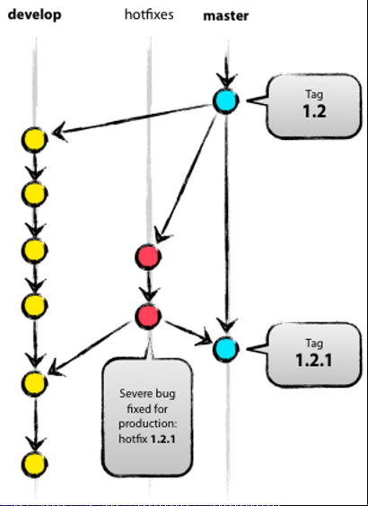
Git branching model
3
Notes:
Appendix includes recent awards, please visit elements.epam.com for all 2016-2017 awards

