Slide 1

MSBI LAB S21.E10-SQL
January 21, 2021

Slide 2

IN THE PREVIOUS PART
1
Using Dynamic SQL
2
Designing and Implementing Stored Procedures
3
Implementing Triggers
4
Using Cursors

Slide 3

S21E10 AGENDA
1
Querying and Managing XML Data
2
JSON data in SQL Server
3
Understanding Temporary Tables
4
Passing Table Data to Stored Procedures

Slide 4
Querying and Managing XML Data

Slide 5
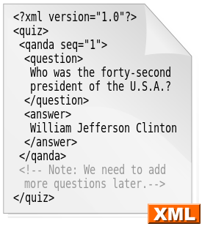
Querying and Managing XML Data
Extensible Markup Language (XML)
is a markup language that defines a set of rules for encoding documents in a format which is both human-readable and machine-readable

Slide 6
Querying and Managing XML Data
MS SQL SERVER XML FEATURES
Creating XML from relational data
Shredding XML into relational tabular format
Native XML data type
XML Query Language (XQuery)

Slide 7
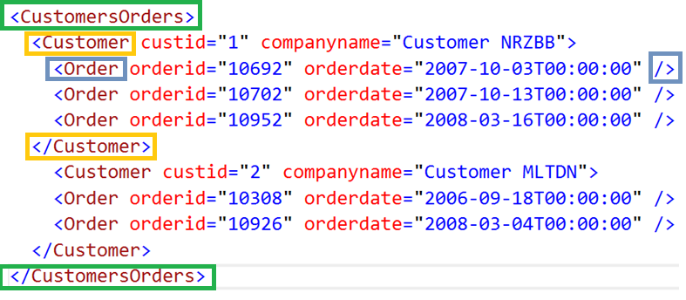
Querying and Managing XML Data
Introduction to XML

Slide 8
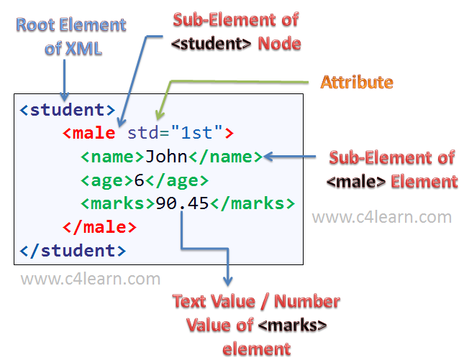
Querying and Managing XML Data
XML Structure

Slide 9
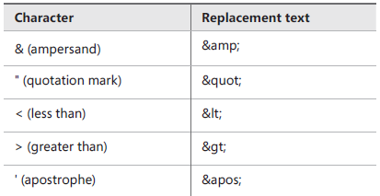
Querying and Managing XML Data
Characters with special values in XML documents

Slide 10
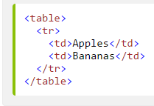
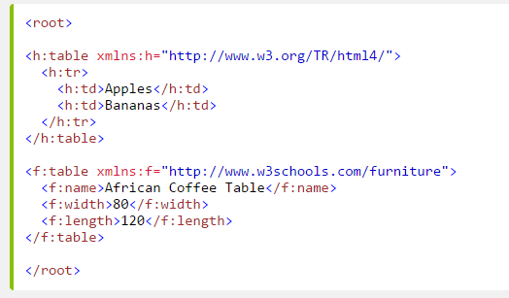
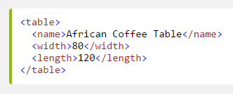
Querying and Managing XML Data
Namespaces
Name Conflicts

Slide 11
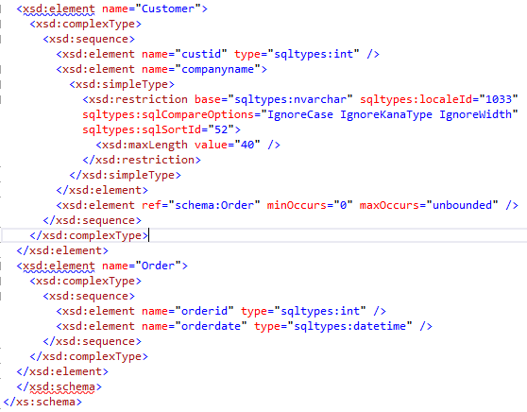
Querying and Managing XML Data
XML Schema Description (XSD)

Slide 12
Querying and Managing XML Data
Producing XML from Relational Data
FOR XML RAW
FOR XML AUTO
FOR XML PATH
FOR XML EXPLICIT

Slide 13
Querying and Managing XML Data
Shredding XML to Tables
OPENXML

Slide 14
Querying and Managing XML Data
DEMO

Slide 15
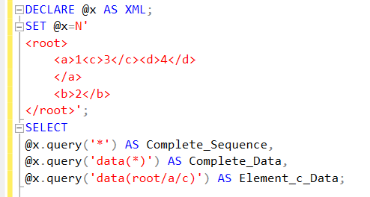
Querying and Managing XML Data
Querying XML Data with XQuery

Slide 16
Querying and Managing XML Data
XQuery Functions
Numeric functions: ceiling(), floor(), and round()
String functions: concat(), contains(), substring(), string-length(), lower-case(), and upper-case()
Boolean and Boolean constructor functions: not(), true(), and false()
Nodes functions: local-name() and namespace-uri()
Aggregate functions: count(), min(), max(), avg(), and sum()
Data accessor functions: data() and string()
SQL Server extension functions: sql:column() and sql:variable()

Slide 17
Querying and Managing XML Data
Xquery: Navigation
node-name/child::element-name[@attribute-name=value]
Axis Specifies the direction of travel. In the example, the axis is child::, which specifies child nodes of the node from the previous step.
Predicate Further narrows down the search. In the example, there is one predicate: [@attribute-name=value], which selects only nodes that have an attribute named attribute-name with value value, such as [@orderid=10952].

Slide 18
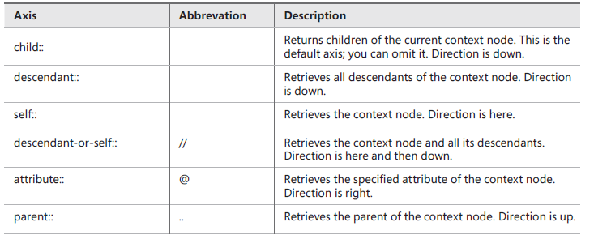
Querying and Managing XML Data
Xquery: Supported Axises

Slide 19
Querying and Managing XML Data
DEMO

Slide 20
JSON data in SQL Server

Slide 21

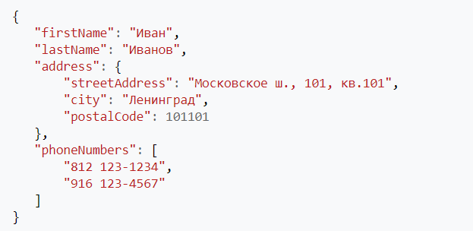
JSON data in SQL Server
JavaScript Object Notation

Slide 22
JSON data in SQL Server
JSON vs XML
{
"firstName": "Иван",
"lastName": "Иванов",
"address": {
"city": "Ленинград",
"postalCode": "101101"
},
"phoneNumbers": [
"812 123-1234",
"916 123-4567"
]
}
<person>
<firstName>Иван</firstName>
<lastName>Иванов</lastName>
<address>
<city>Ленинград</city>
<postalCode>101101</postalCode>
</address>
<phoneNumbers>
<phoneNumber>812 123-1234</phoneNumber>
<phoneNumber>916 123-4567</phoneNumber>
</phoneNumbers>
</person>

Slide 23
JSON data in SQL Server
JSON's basic data types
Number: a signed decimal number that may contain a fractional
String: a sequence of zero or more Unicode characters
Boolean : true or false
Array: an ordered list of zero or more values, each of which may be of any type.
Object: an unordered collection of name–value pairs where the names (also called keys) are strings.
Null: An empty value, using the word null

Slide 24
JSON data in SQL Server
{
"firstName": "John",
"lastName": "Smith",
"isAlive": true,
"age": 27,
"address": {
"streetAddress": "21 2nd Street",
"city": "New York",
"state": "NY"
},
"phoneNumbers": [
{
"type": "home",
"number": "212 555-1234"
},
{
"type": "office",
"number": "646 555-4567"
}
],
"children": [],
"spouse": null
}
JSON's basic data types

Slide 25
JSON data in SQL Server
Array of objects
"phoneNumbers": [
{
"type": "home",
"number": "212 555-1234"
},
{
"type": "office",
"number": "646 555-4567"
}
]
Array of values
"phoneNumbers": [
"212 555-1234",
"646 555-4567"
]

Slide 26
JSON data in SQL Server
Base operation
Convert SQL Server data to JSON or export JSON
FOR JSON
Convert JSON collections to a rowset
OPENJSON.
Extract values from JSON text and use them in queries
JSON_VALUE extracts a scalar value from a JSON string.
JSON_QUERY extracts an object or an array from a JSON string.
ISJSON tests whether a string contains valid JSON.
Modify JSON
JSON_MODIFY

Slide 27
JSON data in SQL Server
DEMO

Slide 28
Understanding Temporary Tables

Slide 29
Understanding Temporary Tables
Global temporary table
DROP TABLE IF EXISTS ##GlobalTable;
CREATE TABLE ##GlobalTable
(
[Id] INT NOT NULL
IDENTITY(1, 1)
CONSTRAINT [PK_temp_GlobalTable] PRIMARY KEY,
[SomeString] NVARCHAR(255) COLLATE DATABASE_DEFAULT NOT NULL
);
Notes:
■■ Executing stored procedures
■■ Impersonating users or logins
■■ Querying a linked server
■■ Executing dynamic SQL generated strings

Slide 30
Understanding Temporary Tables
Local temporary table
DROP TABLE IF EXISTS #LocalTable;
CREATE TABLE #LocalTable
(
[Id] INT NOT NULL
IDENTITY(1, 1)
CONSTRAINT [PK_temp_LocalTable] PRIMARY KEY,
[SomeString] NVARCHAR(255) COLLATE DATABASE_DEFAULT NOT NULL
);
Notes:
■■ Executing stored procedures
■■ Impersonating users or logins
■■ Querying a linked server
■■ Executing dynamic SQL generated strings

Slide 31
Understanding Temporary Tables
Table variable
DECLARE @TalbeVar TABLE
(
[Id] INT NOT NULL
IDENTITY(1, 1)
PRIMARY KEY,
[SomeString] NVARCHAR(255) NOT NULL
);
Notes:
■■ Executing stored procedures
■■ Impersonating users or logins
■■ Querying a linked server
■■ Executing dynamic SQL generated strings

Slide 32
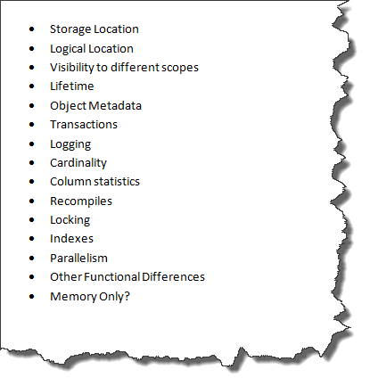
Understanding Temporary Tables
Temporary tables vs table variables
https://dba.stackexchange.com/questions/16385/whats-the-difference-between-a-temp-table-and-table-variable-in-sql-server
Notes:
■■ Executing stored procedures
■■ Impersonating users or logins
■■ Querying a linked server
■■ Executing dynamic SQL generated strings

Slide 33
Understanding Temporary Tables
DEMO

