Slide 1

MSBI LAB S21.E05-SQL
December 28, 2020

Slide 2

IN THE PREVIOUS PART
1
Using Set Operators
2
Using Subqueries AND Table Expressions
3
USING APPLY Operator
4
Grouping
5
Pivoting and Unpivoting Data
6
Design for OLTP Database: EAV pattern

Slide 3

S21E05 AGENDA
1
Using Window Functions
2
Creating and Altering Tables
3
Enforcing Data Integrity
4
SSDT: How to manage database as a source code

Slide 4
Using Window Functions

Slide 5
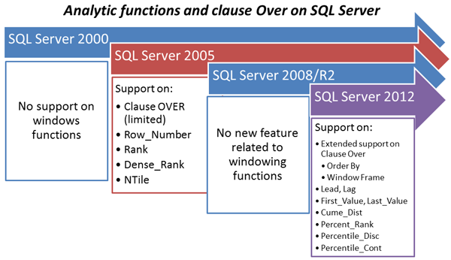
Using Window Functions

Slide 6
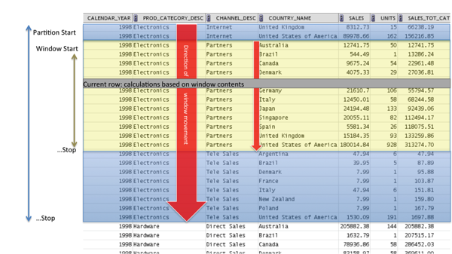
Using Window Functions
<window function>
OVER (
[PARTITION BY … ]
[ORDER BY…]
[{ ROWS | RANGE } ]
)

Slide 7
Using Window Functions
Window Aggregate Functions
APPROX_COUNT_DISTINCT
AVG
CHECKSUM_AGG
COUNT
COUNT_BIG
GROUPING
GROUPING_ID
MAX
MIN
STDEV
STDEVP
STRING_AGG
SUM
VAR
VARP
https://docs.microsoft.com/en-us/sql/t-sql/functions/aggregate-functions-transact-sql

Slide 8
Using Window Functions
Window Ranking Functions
RANK
DENSE_RANK
NTILE
ROW_NUMBER
https://docs.microsoft.com/en-us/sql/t-sql/functions/ranking-functions-transact-sql

Slide 9
Using Window Functions
Window Analytic Functions
CUME_DIST
FIRST_VALUE
LAG
LAST_VALUE
LEAD
PERCENT_RANK
PERCENTILE_CONT
PERCENTILE_DISC
https://docs.microsoft.com/en-us/sql/t-sql/functions/analytic-functions-transact-sql

Slide 10
Using Window Functions
Window Frames
{ ROWS | RANGE }
UNBOUNDED PRECEDING or FOLLOWING, meaning the beginning or end of the partition, respectively
CURRENT ROW, obviously representing the current row
<n> ROWS PRECEDING or FOLLOWING, meaning n rows before or after the current, respectively
RANGE UNBOUNDED PRECEDING AND CURRENT ROW is used as default for window frame

Slide 11
Using Window Functions
DEMO

Slide 12
Creating and Altering Tables

Slide 13
Creating and Altering Tables
Creating and Altering Tables
Base tables
Temporary tables
Table variables
Views
Indexed views
Derived tables and table expressions

Slide 14
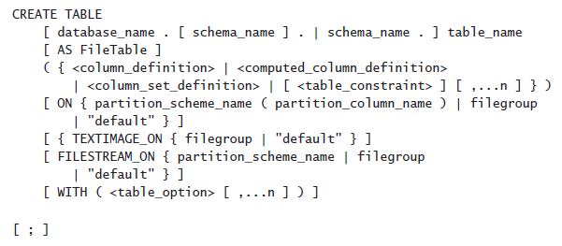
Creating and Altering Tables
Creating and Altering Tables
CREATE TABLE statement
SELECT INTO statement

Slide 15
Creating and Altering Tables
Creating and Altering Tables
Specifying a Database Schema
Naming Tables and Columns
Sys (Lineage) Columns
Choosing Column Data Types
NULL and Default Values
Computed Columns
Table Compression

Slide 16
Creating and Altering Tables
Naming Tables and Columns
Regular
Delimited
CREATE TABLE Production.CategoriesTest1
CREATE TABLE Production.[Yesterday's News]
CREATE TABLE Production."Tomorrow's Schedule"

Slide 17
Creating and Altering Tables
Choosing Column Data Types
Size is important
NVARCHAR or VARCHAR vs NCHAR or CHAR
DATE, TIME, and DATETIME2 vs DATETIME and SMALLDATETIME
VARCHAR(MAX), NVARCHAR(MAX), and VARBINARY(MAX) instead of the deprecated TEXT, NTEXT, and IMAGE
Use DECIMAL and NUMERIC instead of FLOAT or REAL

Slide 18
Choosing a Data Type for Keys
Choosing a Data Type for Keys
The identity column property
The sequence object
Nonsequential GUIDs
Sequential GUIDs
Custom solutions

Slide 19
Creating and Altering Tables
Column
NULL and Default Values
The Identity Property and Sequence Numbers
Computed Columns (non deterministic function GETDATE() or CURRENT_TIMESTAMP)

Slide 20
Creating and Altering Tables
Table Compression
Row
Page

Slide 21
Creating and Altering Tables
DEMO

Slide 22
Enforcing Data Integrity

Slide 23
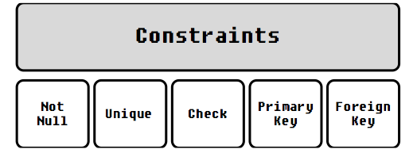

Enforcing Data Integrity
Constraints
NOT NULL
Primary Key Constraint
Unique Constraint
Foreign Key Constraint
Check Constraint
Default Constraint

Slide 24
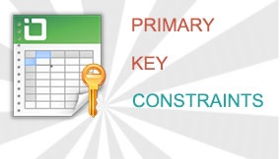
Enforcing Data Integrity
Primary Key Constraints

Slide 25
Enforcing Data Integrity
Unique Constraints

Slide 26
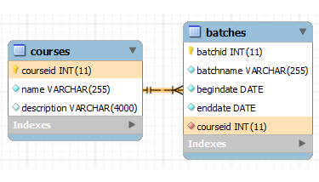

Enforcing Data Integrity
Foreign Key Constraints

Slide 27

Enforcing Data Integrity
Check Constraints

Slide 28
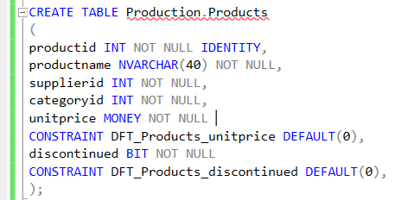
Enforcing Data Integrity
Default Constraints

Slide 29
Enforcing Data Integrity
Naming
PK_<TableName>_<ColNames>
UQ_<TableName>_<ColNames>
FK_<ReferencingTable>_<ReferencedTable>_<ColNames>
DF_<Table>_<Column>
CK_<Table>_<Column_Or_Description>

Slide 30
SSDT: How to manage database as a source code

Slide 31
SSDT How to manage database as a source code
Create new project.
Sync project to actual state of database
Deploy changes to DEV , TST and PRD
Teamwork

