Slide 1



Jan 29, 2019
3

Slide 2
In previous episode: MSBI.Dev.S20E13 MSBI.SSIS.Part01
topics:
- topic: About this sub course
subtopics:
- subtopic: Goals and approach
- subtopic: Expected Result
- subtopic: Tools and Technologies
- topic: Data Warehousing Concepts
subtopics:
- subtopic: What is Data Warehousing?
- subtopic: Conventional data warehouses
- subtopic: Conventional data warehouse Systems
- subtopic: Modern data warehouse
- subtopic: Modern Data Warehouse Systems
- topic: Installation of tools for Visual Studio
subtopics:
- subtopic: SSIS
- subtopic: SSRS
- subtopic: SSAS
3
Notes:
Appendix includes recent awards, please visit elements.epam.com for all 2016-2017 awards

Slide 3
In previous episode: MSBI.Dev.S20E13 MSBI.SSIS.Part01
- topic: ETL
subtopics:
- subtopic: ETL Tools
- subtopic: SSIS architecture
- topic: Creating SSIS Packages
subtopics:
- subtopic: Using the SQL Server Import and Export Wizard
- subtopic: Developing SSIS Packages in SSDT
- subtopic: Introducing Control Flow, Data Flow, and Connection Managers
- topic: UN Statistic Project
subtopics:
- subtopic: Review
- subtopic: First step
- subtopic: Solution Diagram
- subtopic: Data transformation workflow
- subtopic: Dimensional Model
- subtopic: Homework
3
Notes:
Appendix includes recent awards, please visit elements.epam.com for all 2016-2017 awards

Slide 4
Agenda: MSBI.Dev.S20E14 (MSBI.SSIS.E02)
---
topics:
- topic: Create SSIS Project with different Deployment Model
subtopics:
- subtopic: Project deployment model
- subtopic: Package deployment model
- subtopic: Different version of SQL
- topic: Connection Managers
subtopics:
- subtopic: Package-scoped connection managers
- subtopic: Project-scoped connection managers
- subtopic: 32-Bit and 64-Bit Data Providers
- topic: Designing and Implementing Control Flow
subtopics:
- subtopic: Control Flow Tasks
- subtopic: Containers
- subtopic: Precedence Constraints
3
Notes:
Appendix includes recent awards, please visit elements.epam.com for all 2016-2017 awards

Slide 5
Agenda: MSBI.Dev.S20E14 (MSBI.SSIS.E02)
- topic: Designing and Implementing Data Flow
subtopics:
- subtopic: Creating a Data Flow Task
- subtopic: Defining Data Flow Source Adapters
- subtopic: Defining Data Flow Destination Adapters
- subtopic: SSIS Data Types
- topic: UN Statistic Project
subtopics:
- subtopic: Create a Project and Repo
- subtopic: Create DB and SSIS project
- subtopic: Solution Diagram
- subtopic: Data transformation workflow
- subtopic: Dimensional Model
- subtopic: Homework
---
3
Notes:
Appendix includes recent awards, please visit elements.epam.com for all 2016-2017 awards

Slide 6
Create SSIS Project with different Deployment Model

Slide 7
Create SSIS Project with different Deployment Model
Project deployment model
Package deployment model
Different version of SQL

Slide 8
Connection Managers

Slide 9
Connection Managers
Package-scoped connection managers
Project-scoped connection managers
32-Bit and 64-Bit Data Providers

Slide 10
Connection Managers
Connection
Managers
Type | Description
ADO | Connects to ActiveX Data Objects (ADO) objects.
ADO.NET | Connects to a data source by using a .NET provider.
CACHE | Reads data from the data flow or from a cache file (.caw), and can save data to the cache file.
DQS | Connects to a Data Quality Services server and a Data Quality Services database on the server.
EXCEL | Connects to an Excel workbook file.
FILE | Connects to a file or a folder.
FLATFILE | Connect to data in a single flat file.
FTP | Connect to an FTP server.
HTTP | Connects to a webserver.
MSMQ | Connects to a message queue.
MSOLAP100 | Connects to an instance of SQL Server Analysis Services or an Analysis Services project.
MULTIFILE | Connects to multiple files and folders.
MULTIFLATFILE | Connects to multiple data files and folders.
OLEDB | Connects to a data source by using an OLE DB provider.
ODBC | Connects to a data source by using ODBC.
SMOServer | Connects to a SQL Server Management Objects (SMO) server.
SMTP | Connects to an SMTP mail server.
WMI | Connects to a server and specifies the scope of Windows Management Instrumentation (WMI) management on the server.
https://msdn.microsoft.com/en-us/ms140203.aspx

Slide 11
Connection Managers
32-Bit and 64-Bit Data Providers
SSIS development environment is a 32-bit environment
SSIS execution environment is dictated by the underlying operating system
https://msdn.microsoft.com/en-us/ms140203.aspx

Slide 12
Connection Managers
Connection Managers
ADO.NET
OLE DB
ODBC
https://datatellblog.wordpress.com/2015/01/13/ssis-data-flows-ado-net-vs-ole-db-vs-odbc/

Slide 13
Designing and Implementing Control Flow

Slide 14
Designing and Implementing Control Flow
Containers
For Loop container
Foreach Loop container
Sequence container

Slide 15
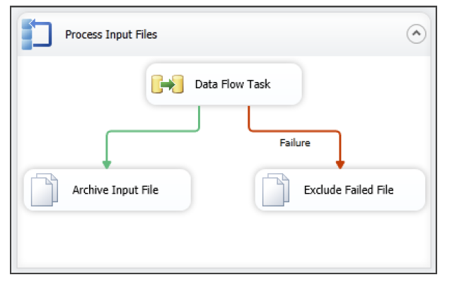
Designing and Implementing Control Flow
Precedence Constraints

Slide 16
Designing and Implementing Data Flow

Slide 17
Designing and Implementing Data Flow
Creating a Data Flow Task
Defining Data Flow Source Adapters
Defining Data Flow Destination Adapters
SSIS Data Types
Data Flow Transformations

Slide 18
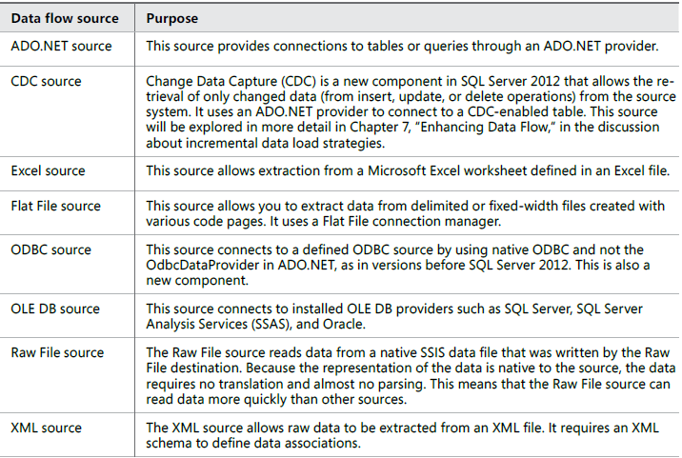
Designing and Implementing Data Flow
Defining Data Flow Source Adapters

Slide 19
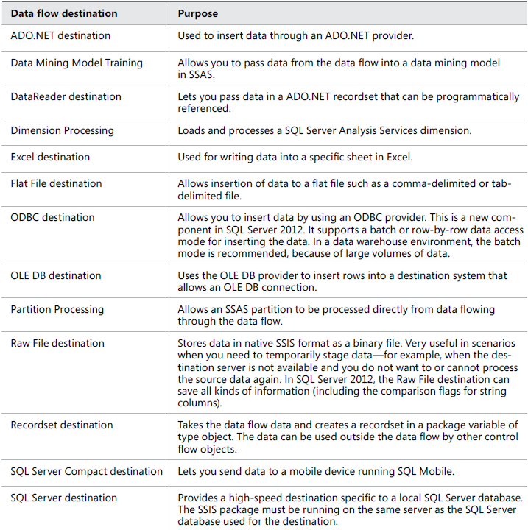
Designing and Implementing Data Flow
Defining Data Flow Destination Adapters

Slide 20
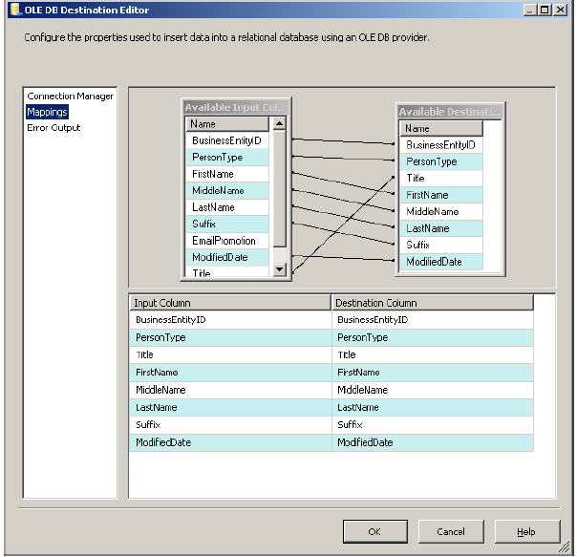
Designing and Implementing Data Flow
Columns mapping

Slide 21
UN Statistic Project

Slide 22
UN Statistic Project
UN Statistic Project
Create a Project and Repo
Create DB and SSIS project
Solution Diagram
Data transformation workflow
Dimensional Model
Homework

