Slide 1



Jan 29, 2019
3

Slide 2
In previous episode: MSBI.Dev.S20E14 MSBI.SSIS.Part.02
---
topics:
- topic: Create SSIS Project with different Deployment Model
subtopics:
- subtopic: Project deployment model
- subtopic: Package deployment model
- subtopic: Different version of SQL
- topic: UN Statistic Project
subtopics:
- subtopic: Create a Project and Repo
- subtopic: Create DB and SSIS project
- subtopic: Solution Diagram
- subtopic: Data transformation workflow
- subtopic: Dimensional Model
- subtopic: Homework
---
3
Notes:
Appendix includes recent awards, please visit elements.epam.com for all 2016-2017 awards

Slide 3
Agenda: MSBI.Dev.S20E15 (MSBI.SSIS.E03)
topics:
- topic: Connection Managers
subtopics:
- subtopic: Package-scoped connection managers
- subtopic: Project-scoped connection managers
- subtopic: 32-Bit and 64-Bit Data Providers
- topic: Designing and Implementing Control Flow
subtopics:
- subtopic: Control Flow Tasks
- subtopic: Containers
- subtopic: Precedence Constraints
- topic: Designing and Implementing Data Flow
subtopics:
- subtopic: Creating a Data Flow Task
- subtopic: Defining Data Flow Source Adapters
- subtopic: Defining Data Flow Destination Adapters
- subtopic: SSIS Data Types
- topic: UN Statistic Project
subtopics:
- subtopic: DWH structure
- subtopic: Azure DevOps Sprint, WorkItem - User Story, Tasks
- subtopic: WorkItem workflow
- subtopic: Load from file to staging
- subtopic: Homework
3
Notes:
Appendix includes recent awards, please visit elements.epam.com for all 2016-2017 awards

Slide 4
Connection Managers

Slide 5
Connection Managers
Package-scoped connection managers
Project-scoped connection managers
32-Bit and 64-Bit Data Providers

Slide 6
Connection Managers
Connection
Managers
Type | Description
ADO | Connects to ActiveX Data Objects (ADO) objects.
ADO.NET | Connects to a data source by using a .NET provider.
CACHE | Reads data from the data flow or from a cache file (.caw), and can save data to the cache file.
DQS | Connects to a Data Quality Services server and a Data Quality Services database on the server.
EXCEL | Connects to an Excel workbook file.
FILE | Connects to a file or a folder.
FLATFILE | Connect to data in a single flat file.
FTP | Connect to an FTP server.
HTTP | Connects to a webserver.
MSMQ | Connects to a message queue.
MSOLAP100 | Connects to an instance of SQL Server Analysis Services or an Analysis Services project.
MULTIFILE | Connects to multiple files and folders.
MULTIFLATFILE | Connects to multiple data files and folders.
OLEDB | Connects to a data source by using an OLE DB provider.
ODBC | Connects to a data source by using ODBC.
SMOServer | Connects to a SQL Server Management Objects (SMO) server.
SMTP | Connects to an SMTP mail server.
WMI | Connects to a server and specifies the scope of Windows Management Instrumentation (WMI) management on the server.
https://msdn.microsoft.com/en-us/ms140203.aspx

Slide 7
Connection Managers
32-Bit and 64-Bit Data Providers
SSIS development environment is a 32-bit environment
SSIS execution environment is dictated by the underlying operating system
https://msdn.microsoft.com/en-us/ms140203.aspx

Slide 8
Connection Managers
Connection Managers
ADO.NET
OLE DB
ODBC
https://datatellblog.wordpress.com/2015/01/13/ssis-data-flows-ado-net-vs-ole-db-vs-odbc/

Slide 9
Designing and Implementing Control Flow

Slide 10
Designing and Implementing Control Flow
Containers
For Loop container
Foreach Loop container
Sequence container

Slide 11
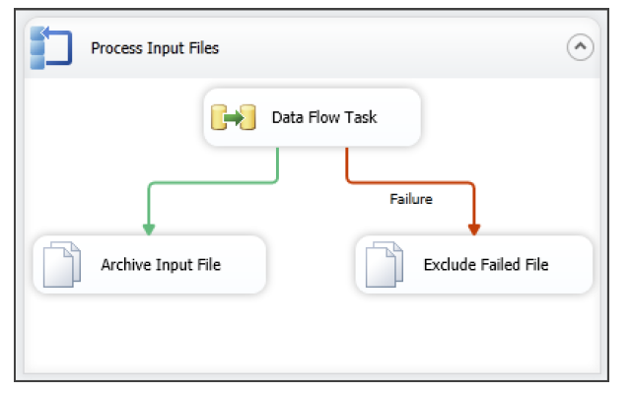
Designing and Implementing Control Flow
Precedence Constraints

Slide 12
Designing and Implementing Data Flow

Slide 13
Designing and Implementing Data Flow
Creating a Data Flow Task
Defining Data Flow Source Adapters
Defining Data Flow Destination Adapters
SSIS Data Types
Data Flow Transformations

Slide 14
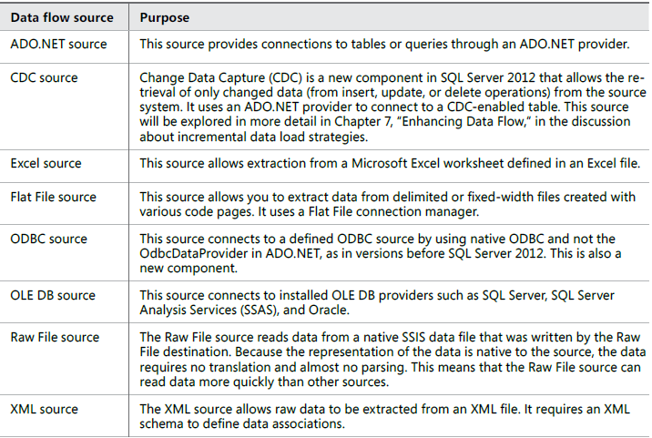
Designing and Implementing Data Flow
Defining Data Flow Source Adapters

Slide 15
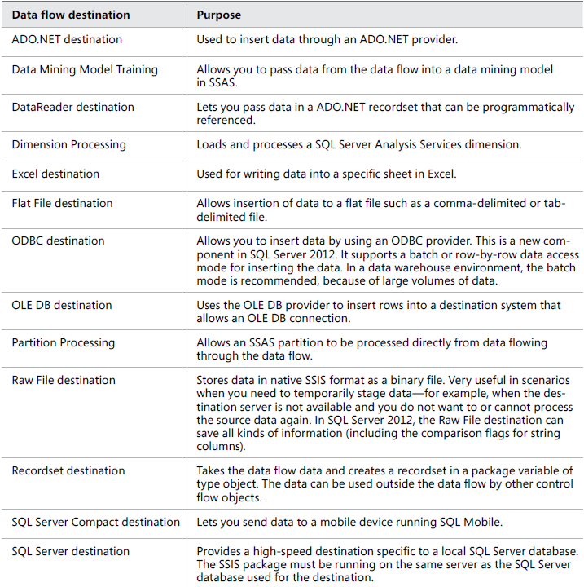
Designing and Implementing Data Flow
Defining Data Flow Destination Adapters

Slide 16
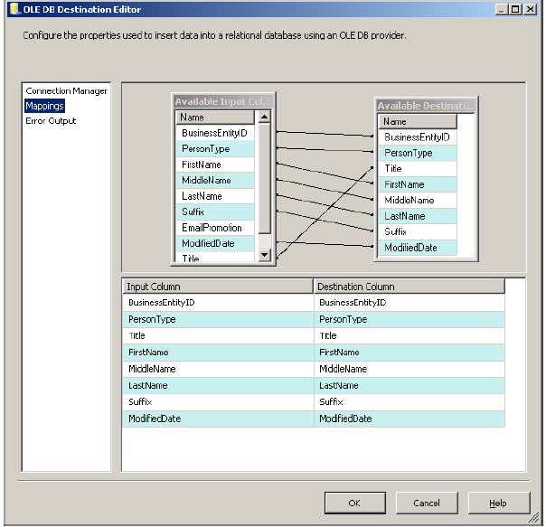
Designing and Implementing Data Flow
Columns mapping

Slide 17
UN Statistic Project

Slide 18
UN Statistic Project
UN Statistic Project
Azure DevOps
DWH structure
Sprint, WorkItem - User Story, Tasks
WorkItem workflow
Load from file to staging
Homework

