Slide 1



Feb 05, 2020
3

Slide 2
In previous episode: MSBI.Dev.S20E15 MSBI.SSIS.Part.03
topics:
- topic: Connection Managers
subtopics:
- subtopic: Package-scoped connection managers
- subtopic: Project-scoped connection managers
- subtopic: 32-Bit and 64-Bit Data Providers
- topic: Designing and Implementing Control Flow
subtopics:
- subtopic: Control Flow Tasks
- subtopic: Containers
- subtopic: Precedence Constraints
- topic: Designing and Implementing Data Flow
subtopics:
- subtopic: Creating a Data Flow Task
- subtopic: Defining Data Flow Source Adapters
- subtopic: Defining Data Flow Destination Adapters
- subtopic: SSIS Data Types
- topic: UN Statistic Project
subtopics:
- subtopic: DWH structure
- subtopic: Azure DevOps Sprint, WorkItem - User Story, Tasks
- subtopic: WorkItem workflow
- subtopic: Load from file to staging
- subtopic: Homework
3
Notes:
Appendix includes recent awards, please visit elements.epam.com for all 2016-2017 awards

Slide 3
Agenda: MSBI.Dev.S20E16 (MSBI.SSIS.E04)
---
topics:
- topic: UN Statistic Project
subtopics:
- subtopic: WorkItem workflow
- subtopic: DWH structure - staging
- subtopic: SSIS Load from files to staging area
- topic: Designing and Implementing Control Flow
subtopics:
- subtopic: Transformations
3
Notes:
Appendix includes recent awards, please visit elements.epam.com for all 2016-2017 awards

Slide 4
UN Statistic Project

Slide 5
UN Statistic Project
UN Statistic Project
    Sprint, WorkItem - User Story, Tasks
    WorkItem workflow
    DWH structure - staging
    SSIS Load from files to staging area

Slide 6
Transformations

Slide 7
Designing and Implementing Data Flow
Designing and Implementing Data Flow

Slide 8
Designing and Implementing Data Flow
Defining Data Sources and Destinations
    Creating a Data Flow Task
    Defining Data Flow Source Adapters
    Defining Data Flow Destination Adapters
    SSIS Data Types

Slide 9

Designing and Implementing Data Flow
Using a Lookup Transformation
Lookup Transformation Case Sensitivity and others

Slide 10
Designing and Implementing Data Flow
Using the Cache Transform Transformation with the Lookup
Transformation

Slide 11
Designing and Implementing Data Flow
Sorting the Data
Set based update

Slide 12
Designing and Implementing Data Flow
Working with Data Flow Transformations
    Selecting Transformations
      non-blocking transformations
      partial-blocking transformation
      blocking transformation

Slide 13
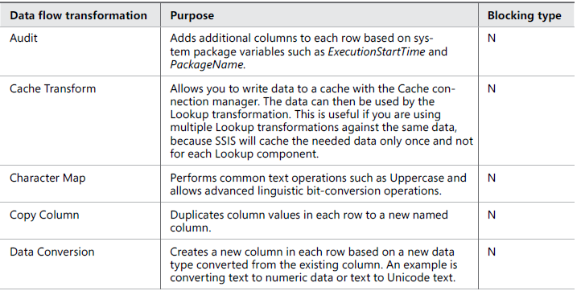
Designing and Implementing Data Flow
Logical Row-Level Transformations

Slide 14
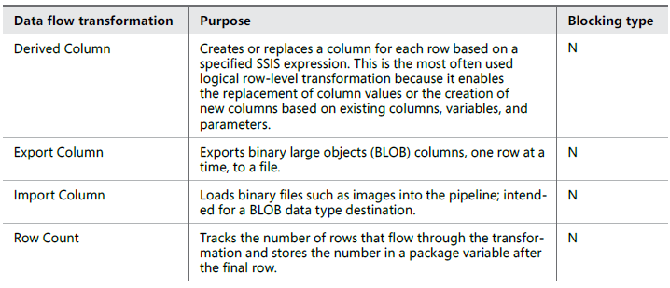
Designing and Implementing Data Flow
Logical Row-Level Transformations

Slide 15
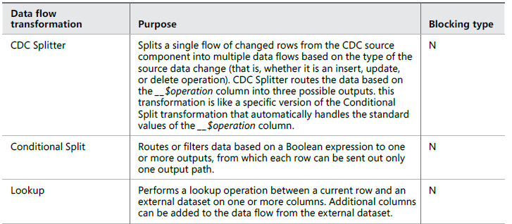
Designing and Implementing Data Flow
Multi-Input and Multi-Output Transformations

Slide 16
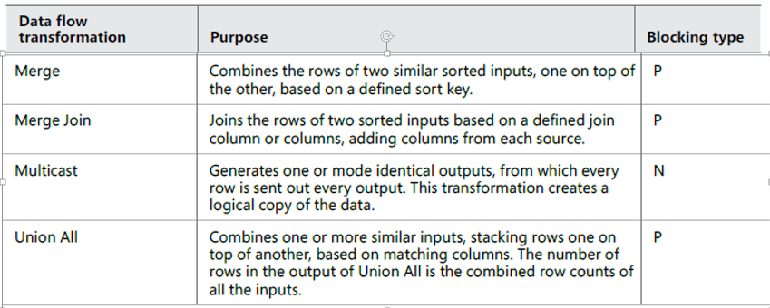
Designing and Implementing Data Flow
Multi-Input and Multi-Output Transformations

Slide 17
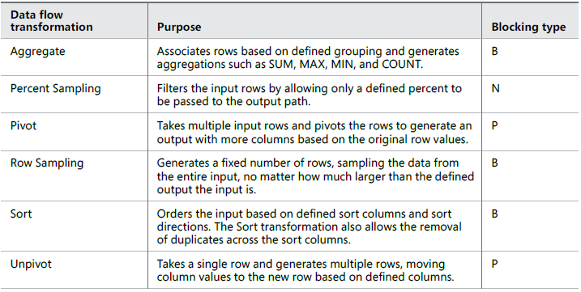
Designing and Implementing Data Flow
Multi-Row Transformations

Slide 18
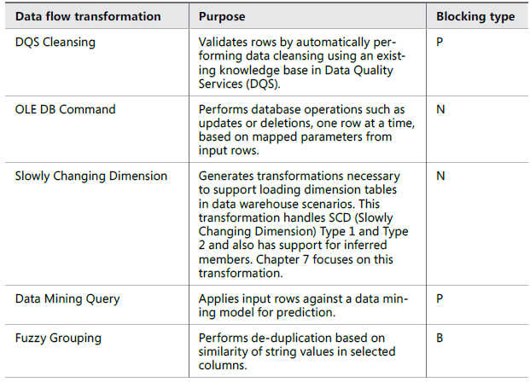
Designing and Implementing Data Flow
Advanced Data-Preparation Transformations

Slide 19
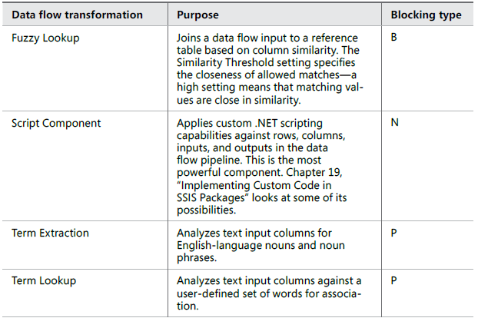
Designing and Implementing Data Flow
Advanced Data-Preparation Transformations

