Slide 1
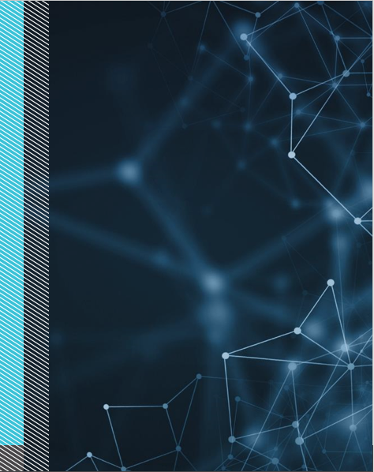


Jan 26, 2019
3
Notes:
Appendix includes recent awards, please visit elements.epam.com for all 2016-2017 awards

Slide 2
Agenda: MSBI.Dev.S20E13 MSBI.SSIS.Part01
topics:
- topic: About this sub course
subtopics:
- subtopic: Goals and approach
- subtopic: Expected Result
- subtopic: Tools and Technologies
- topic: Data Warehousing Concepts
subtopics:
- subtopic: What is Data Warehousing?
- subtopic: Conventional data warehouses
- subtopic: Conventional data warehouse Systems
- subtopic: Modern data warehouse
- subtopic: Modern Data Warehouse Systems
- topic: Installation of tools for Visual Studio
subtopics:
- subtopic: SSIS
- subtopic: SSRS
- subtopic: SSAS
3
Notes:
Appendix includes recent awards, please visit elements.epam.com for all 2016-2017 awards

Slide 3
Agenda: MSBI.Dev.S20E13 MSBI.SSIS.Part01
- topic: ETL
subtopics:
- subtopic: ETL Tools
- subtopic: SSIS architecture
- topic: Creating SSIS Packages
subtopics:
- subtopic: Using the SQL Server Import and Export Wizard
- subtopic: Developing SSIS Packages in SSDT
- subtopic: Introducing Control Flow, Data Flow, and Connection Managers
- topic: UN Statistic Project
subtopics:
- subtopic: Review
- subtopic: First step
- subtopic: Solution Diagram
- subtopic: Data transformation workflow
- subtopic: Dimensional Model
- subtopic: Homework
3
Notes:
Appendix includes recent awards, please visit elements.epam.com for all 2016-2017 awards

Slide 4
About this sub course

Slide 5
About this sub course
Goals and approach
Improve theoretical knowledge of DWH and ETL
Get practical experience in development of ETL and DWH using SSIS and SQL server
Approach
Repeat after trainer

Slide 6
About this sub course
Expected result
UN Statistic project
Working with requirement and documentation
Development of DWH
Development of SSIS
Development and testing of solution
CI/CD

Slide 7
About this sub course
Tools and Technologies
SQL Server
Visual Studio (SSDT, SSIS, SSAS)
Visual Studio Code
Git
Azure DevOps
PowerBI

Slide 8
Data Warehousing Concepts

Slide 9
What is Data Warehousing?
A Data Warehousing (DW) is process for collecting and managing data from varied sources to provide meaningful business insights. A Data warehouse is typically used to connect and analyze business data from heterogeneous sources. The data warehouse is the core of the BI system which is built for data analysis and reporting.
It is a blend of technologies and components which aids the strategic use of data. It is electronic storage of a large amount of information by a business which is designed for query and analysis instead of transaction processing. It is a process of transforming data into information and making it available to users in a timely manner to make a difference.

Slide 10
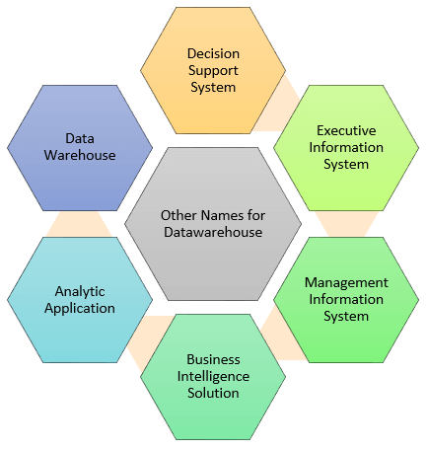
What is Data Warehousing?
Data warehouse system is also known by the following name:
Decision Support System (DSS)
Executive Information System
Management Information System
Business Intelligence Solution
Analytic Application
Data Warehouse

Slide 11
Data Warehousing Concepts
Conventional data warehouses
Data sources
Infrastructure
Applications
Analytics

Slide 12
Data Warehousing Concepts
Conventional data warehouse Systems
Operational Systems: CRM, ERM, financial, and billing
Extract Transform and Load (ETL) Systems: Decision analysis model and data
Enterprise Data Warehouse: Operational, customers and IT data marts
BI Platform: Knowledge Performance Index (KPI) summary systems
Customer Value Analysis: Interactive data queries, OLAP, and static data analysis
BI Collaboration Portal: wholesale, OEM, sales, employees and external

Slide 13
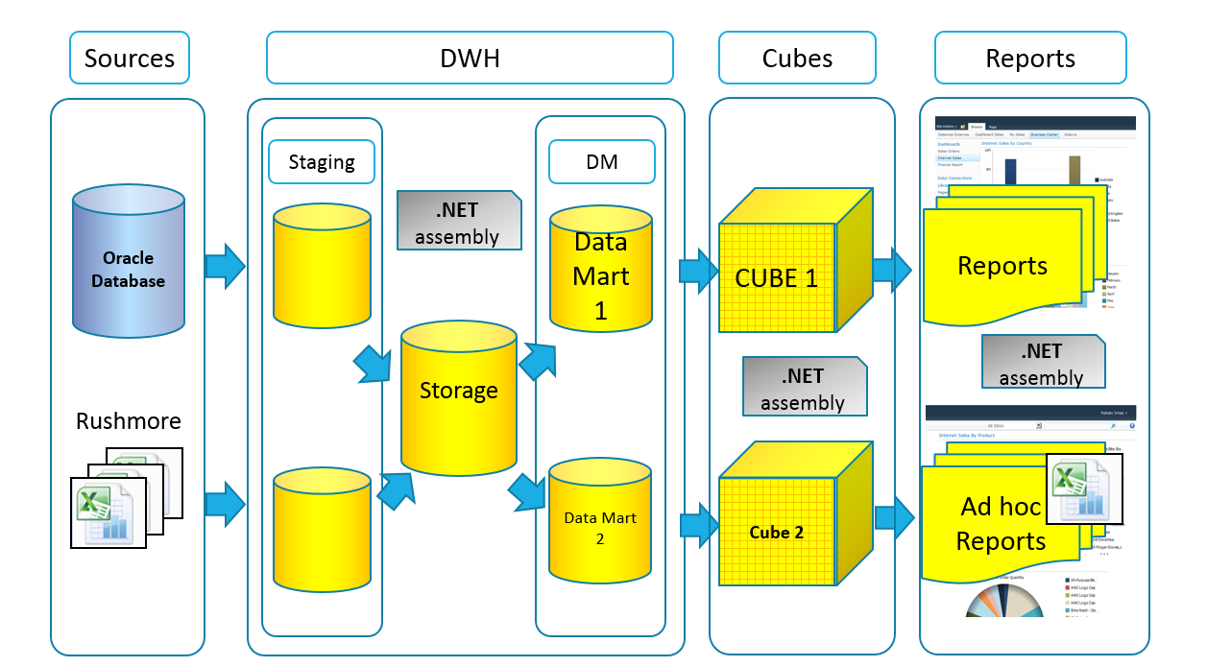
Data Warehousing Concepts
Conventional data warehouse Systems

Slide 14
Data Warehousing Concepts
Modern data warehouse
Object Storage
Table Storage
Computation and Processing
Programming Languages

Slide 15
Data Warehousing Concepts
Modern Data Warehouse Systems
HDFS: Hadoop Distributed File System
HCatalog: Metadata, table, and storage management layer system
HBase: Key-value database and columnar storage
MapReduce: Scalable data processing framework for huge data sets
Oozie: A MapReduce job scheduler
ZooKeeper: Hierarchical key-value store for synchronization
Hadoop: Open-source software framework for storage and processing of big data sets
Hive: A high-level language built on top of MapReduce for analyzing large data sets.
Pig: A high-level language factored into MapReduce for parallel data processing

Slide 16
Data Warehousing Concepts
Modern Data Warehouse Systems
HDFS: Hadoop Distributed File System
HCatalog: Metadata, table, and storage management layer system
HBase: Key-value database and columnar storage
MapReduce: Scalable data processing framework for huge data sets
Oozie: A MapReduce job scheduler
ZooKeeper: Hierarchical key-value store for synchronization
Hadoop: Open-source software framework for storage and processing of big data sets
Hive: A high-level language built on top of MapReduce for analyzing large data sets.
Pig: A high-level language factored into MapReduce for parallel data processing

Slide 17
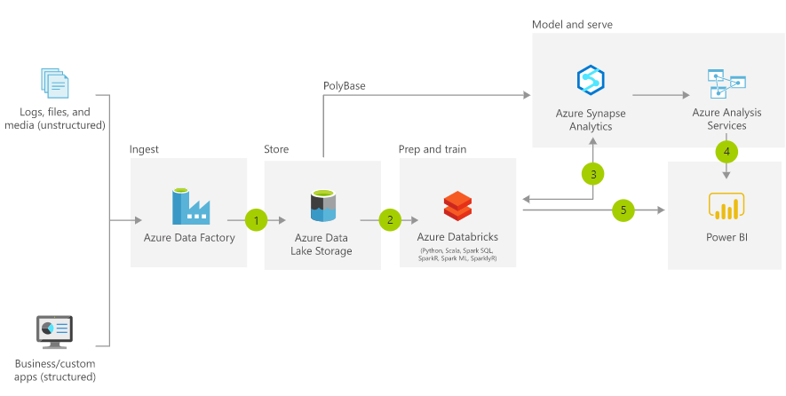
Data Warehousing Concepts
Modern Data Warehouse Systems

Slide 18
ETL

Slide 19
ETL
Extract
Transform
Load

Slide 20
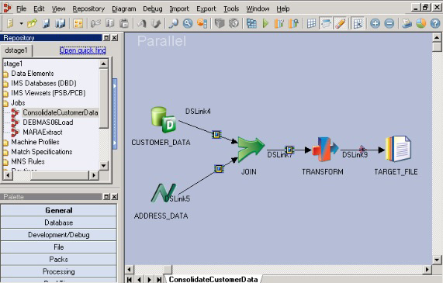
ETL Tools
IBM DATASTAGE

Slide 21
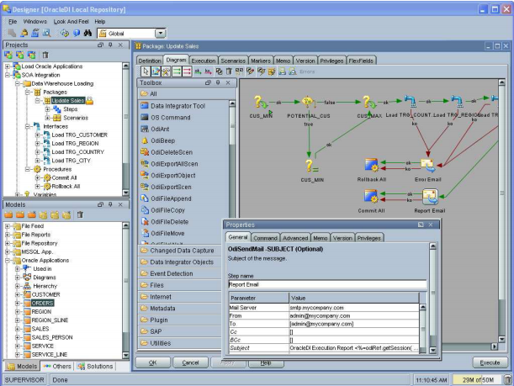
ETL Tools
ORACLE DATA
INTEGRATOR ,
ORACLE
WAREHOUSE BUILDER

Slide 22
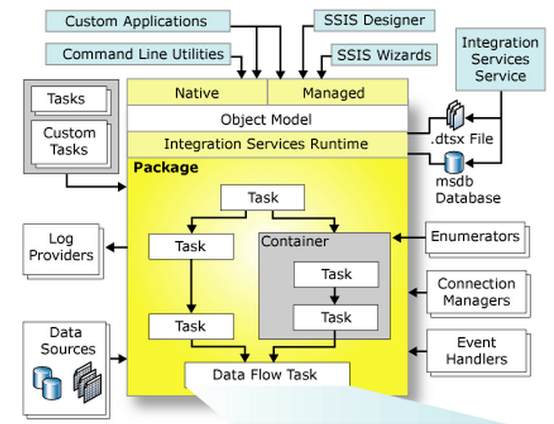
SSIS architecture

Slide 23
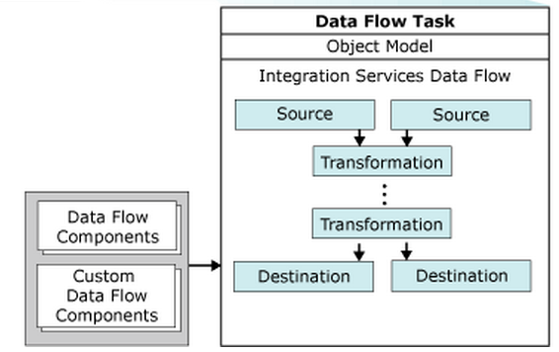
SSIS architecture

Slide 24
Introducing Control Flow, Data Flow, and Connection Managers
Connection managers
Control flow
Data flow

Slide 25
Installation of tools for Visual Studio

Slide 26
Installation of tools for Visual Studio
SSIS
SSRS
SSAS

Slide 27
Creating SSIS Packages

Slide 28
Creating SSIS Packages
Using the SQL Server Import and Export Wizard
Developing SSIS Packages in SSDT
Introducing Control Flow, Data Flow, and Connection Managers

Slide 29
UN Statistic Project

Slide 30
UN Statistic Project
UN Statistic Project
Goal
Solution Diagram
Data transformation workflow
Dimensional Model
Homework

Slide 31
UN Statistic Project

