Slide 1
НИС «Компонентно-ориентированное программирование» From NAND to Tetris Project 1: Boolean Logic
Берюхов Андрей, Урнышев Евгений
БПИ 142

Slide 2
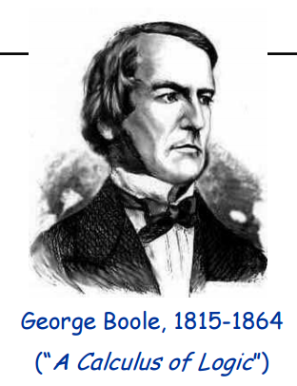
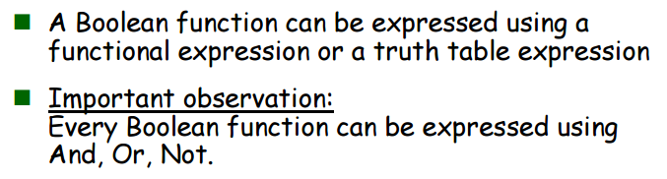
Boolean algebra

Slide 3

Все эти понятия и свойства были подробно изучены в курсе Дискретная математика

Slide 4
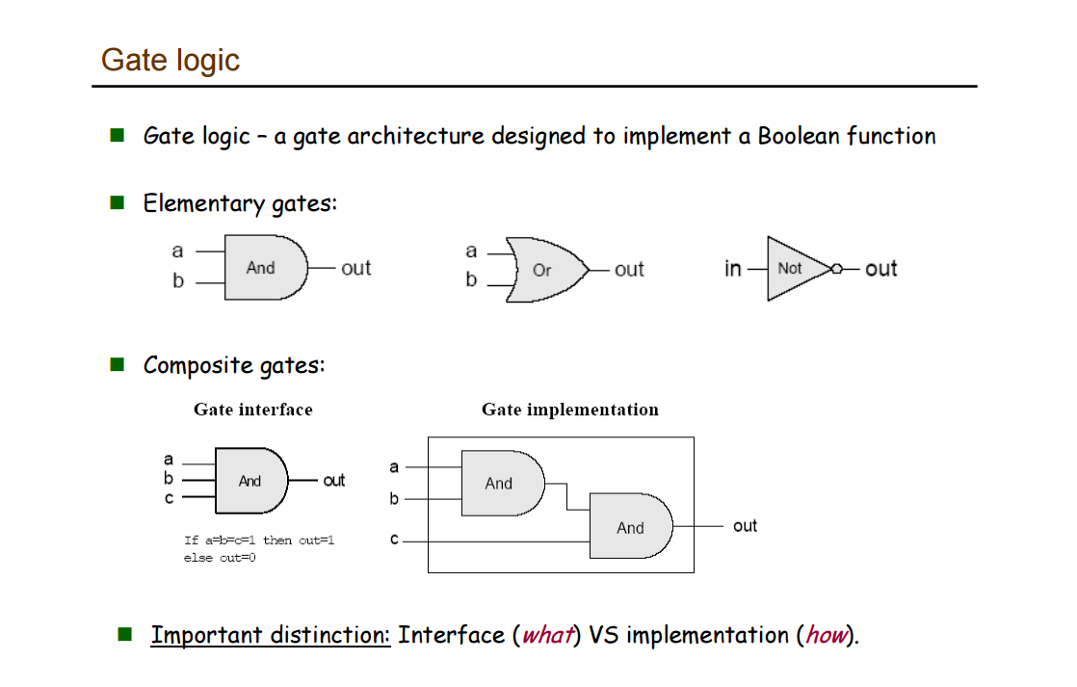

Slide 5
Given: Nand(a,b), false Build: Not(a), And(a,b), Or(a,b),
Then: Mux(a,b,sel), Dmux(in,sel), Not16(in[16]), And16(in[16]), Or16(in[16]), Mux16(in[16]), Or8Way(in[8]), Mux4Way16(a[16], b[16], c[16], d[16], sel[2]), Mux8Way16(a[16]…h[16], sel[3]), DMux4Way(in, sel[2]), DMux8Way(in, sel[3]).

Slide 6
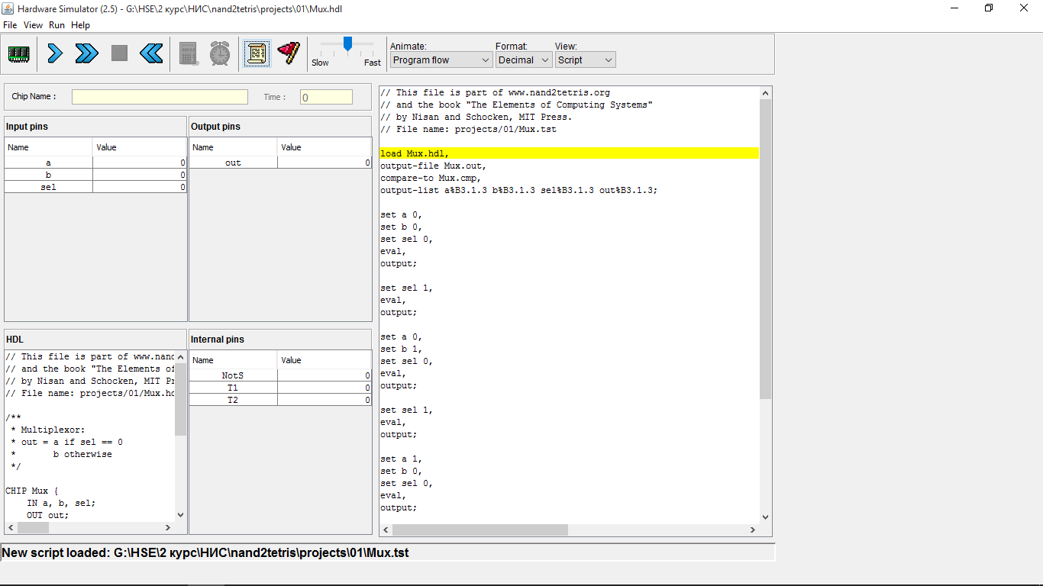

Slide 7
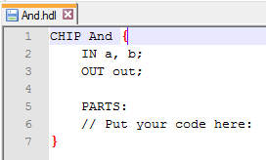
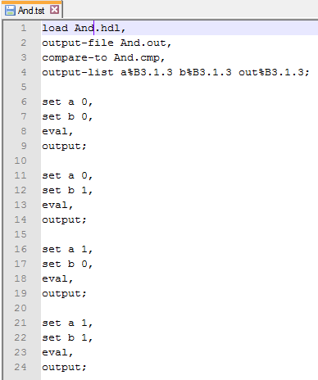
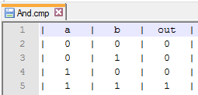
Имеется
Шаблон And.hdl
And.tst
And.cmp
Сделаем
Реализацию And.hdl
And.out
Сравнивая .out и .cmp, Hardware Simulator
определяет правильность реализации

Slide 8
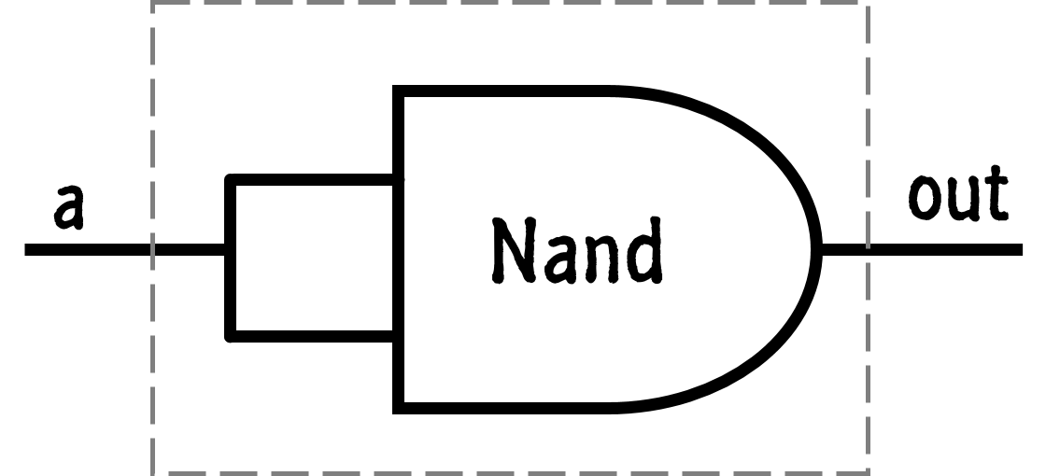
Not(a)=out
CHIP Not {
IN in;
OUT out;
PARTS:
Nand(a=in,
b=in,
out=out);
}
Nand
a
out

Slide 9
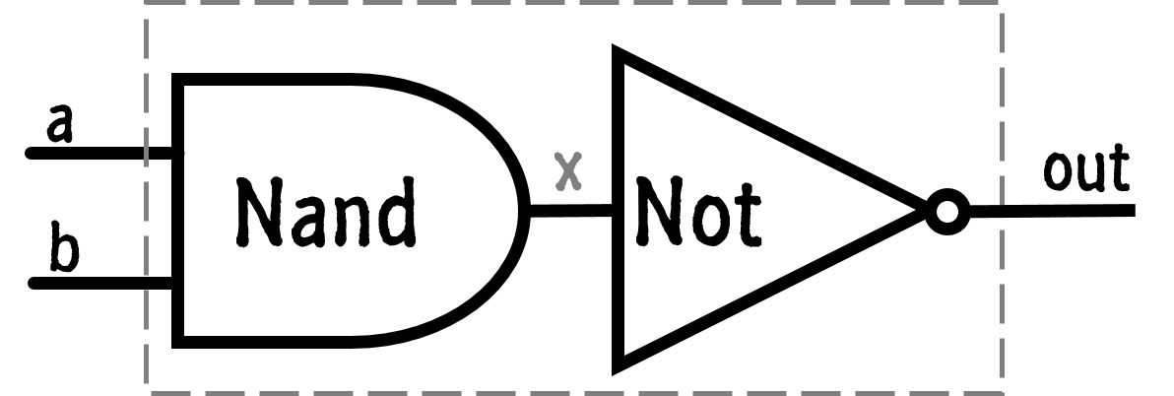
And(a,b)=out
CHIP And {
IN a, b;
OUT out;
PARTS:
Nand(a=a,
b=b,
out=x);
Not(in=x,
out=out);
}
a
Not
Nand
x
out
b

Slide 10
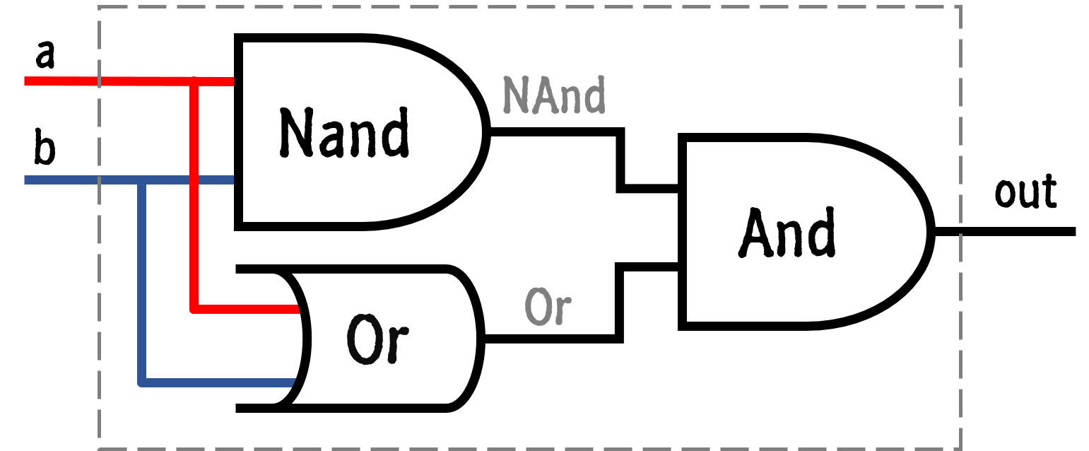
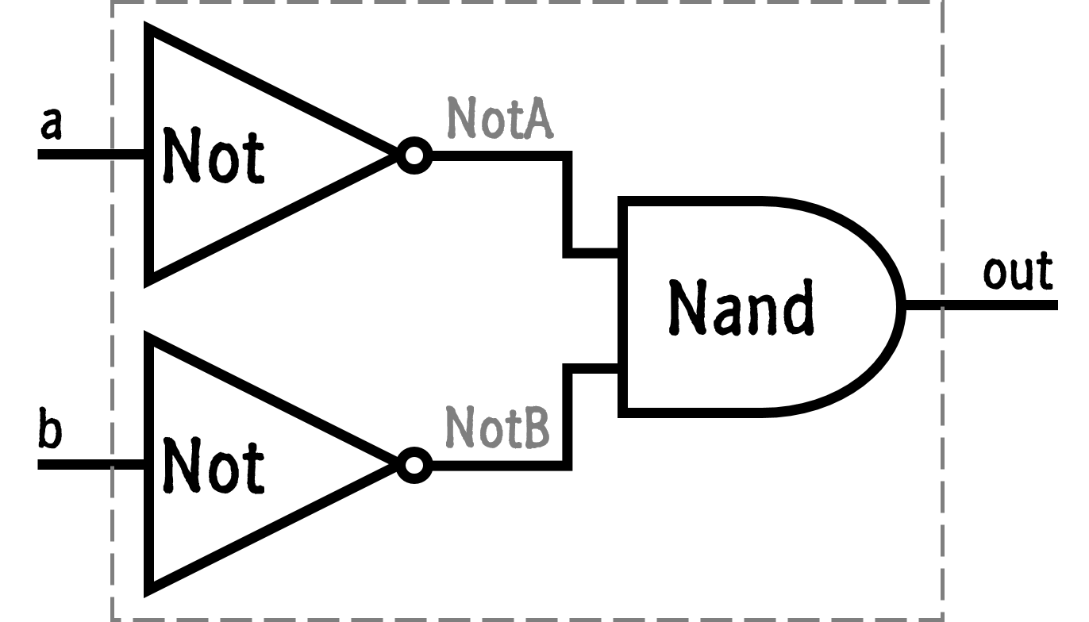
Or(a,b)=out
Not
a
NotA
a
Nand
NAnd
b
Nand
And
out
out
Xor(a,b)=out
Not
Or
Or
b
NotB

Slide 11
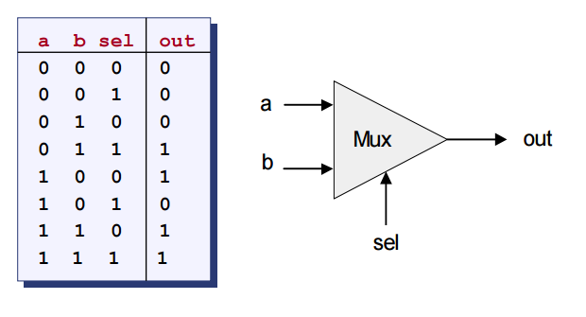
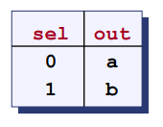
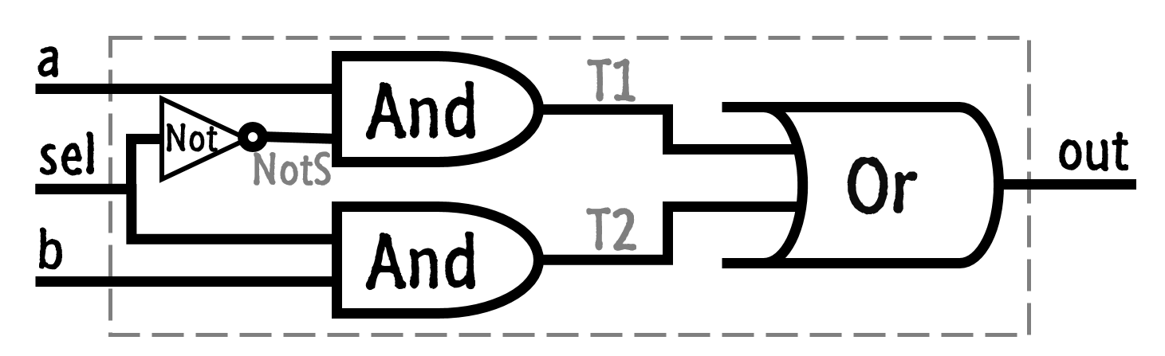
Mux(a,b,sel)=out
Мультиплексер
a
T1
And
sel
Not
Or
out
NotS
T2
b
And

Slide 12
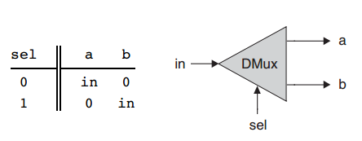
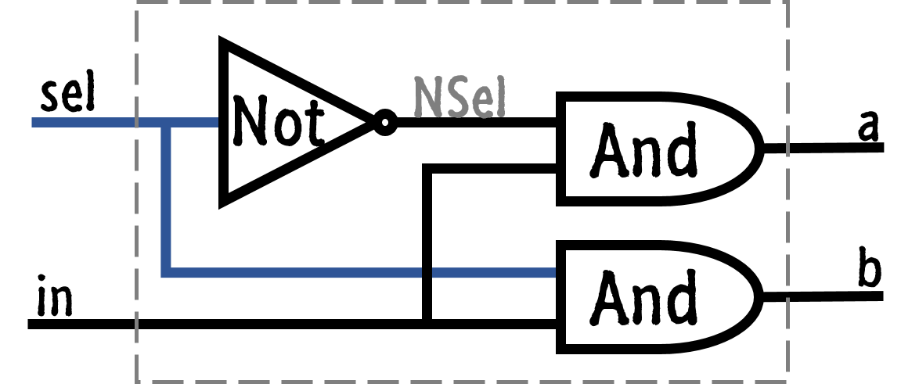
DMux(in,sel)=(a,b)
Демультиплексер
sel
NSel
Not
a
And
b
in
And

Slide 13
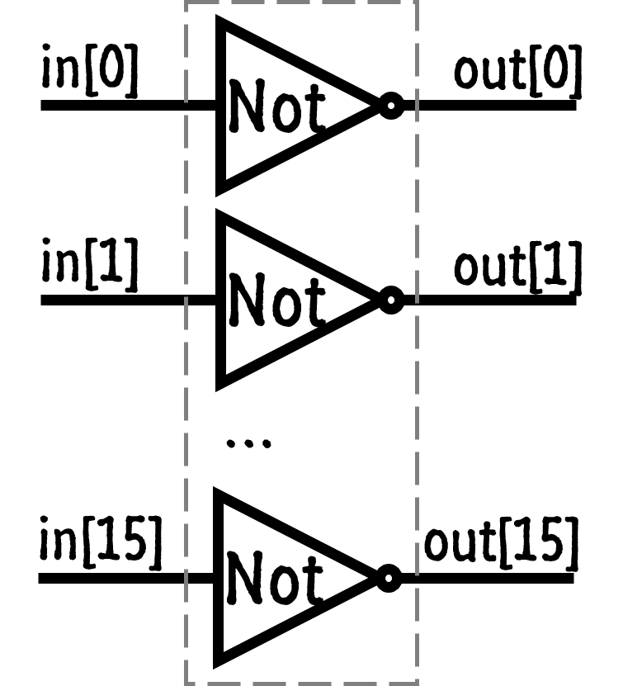
Not16(in[16])=out[16]
in[0]
out[0]
CHIP Not16 {
IN in[16];
OUT out[16];
PARTS:
Not(in=in[0],
out=out[0]);
Not(in=in[1],
out=out[1]);
…
Not(in=in[15],
out=out[15]);
}
Not
in[1]
out[1]
Not
…
in[15]
out[15]
Not

Slide 14
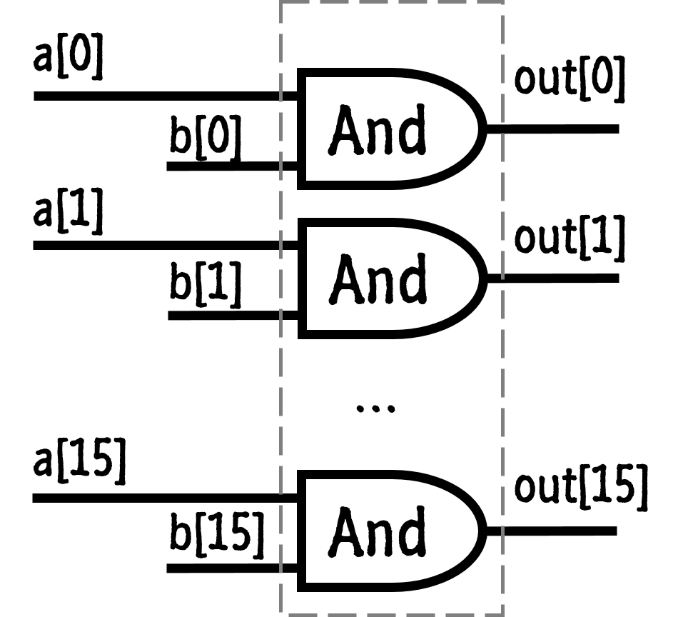
And16(a[16], b[16]) = out[16]
a[0]
out[0]
And
b[0]
a[1]
out[1]
And
b[1]
…
a[15]
out[15]
And
b[15]

Slide 15
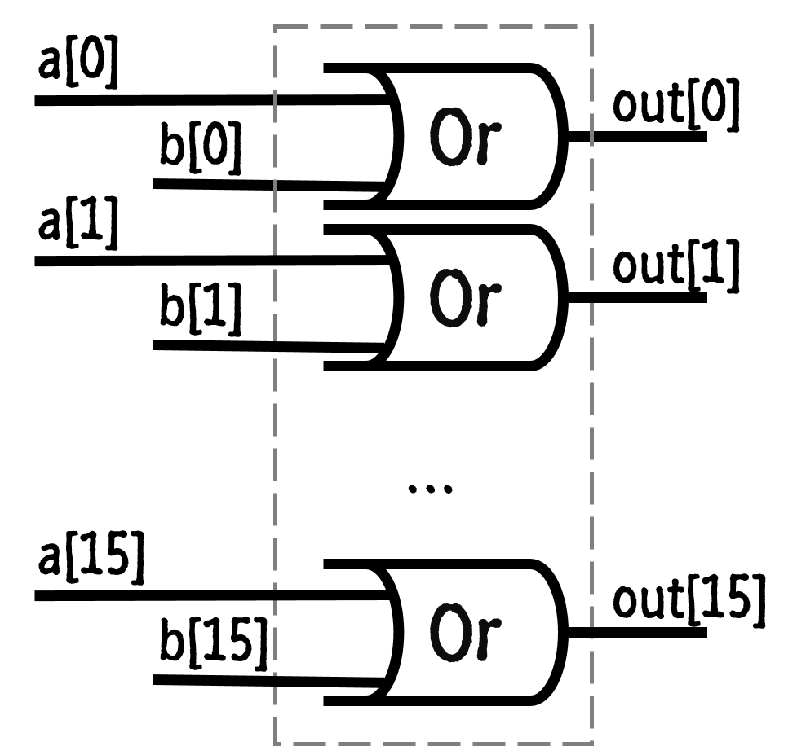
Or16(a[16], b[16]) = out[16]
a[0]
Or
out[0]
b[0]
a[1]
Or
out[1]
b[1]
…
a[15]
Or
out[15]
b[15]

Slide 16
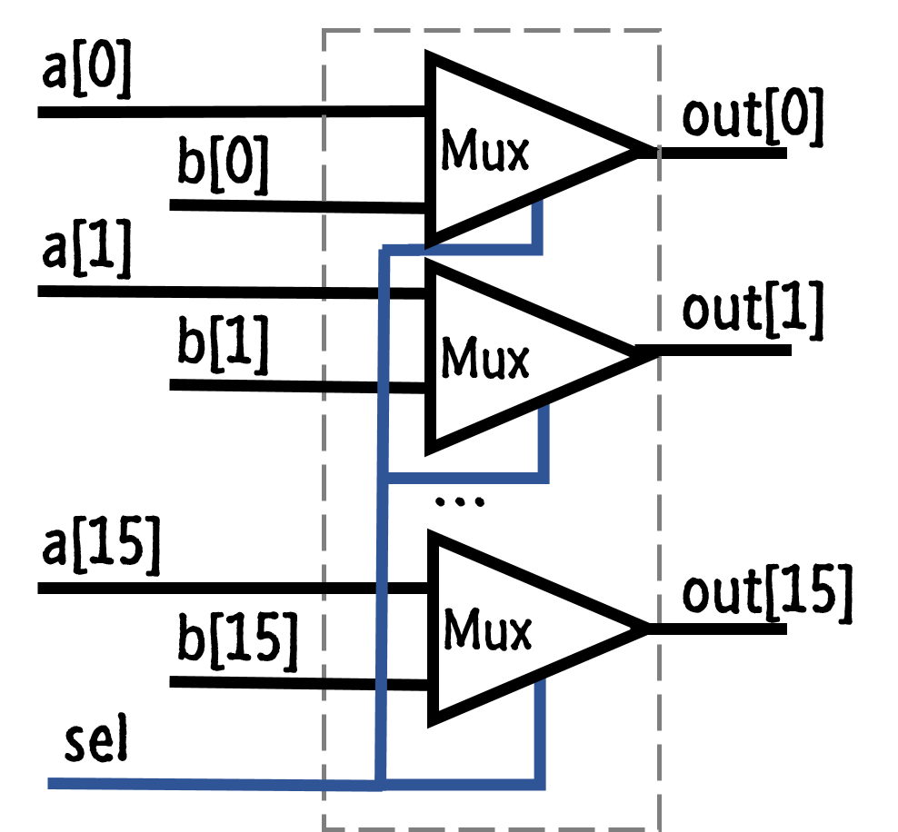
Mux16(a[16], b[16], sel) = out[16]
a[0]
Mux
out[0]
b[0]
a[1]
Mux
out[1]
b[1]
…
a[15]
Mux
out[15]
b[15]
sel

Slide 17
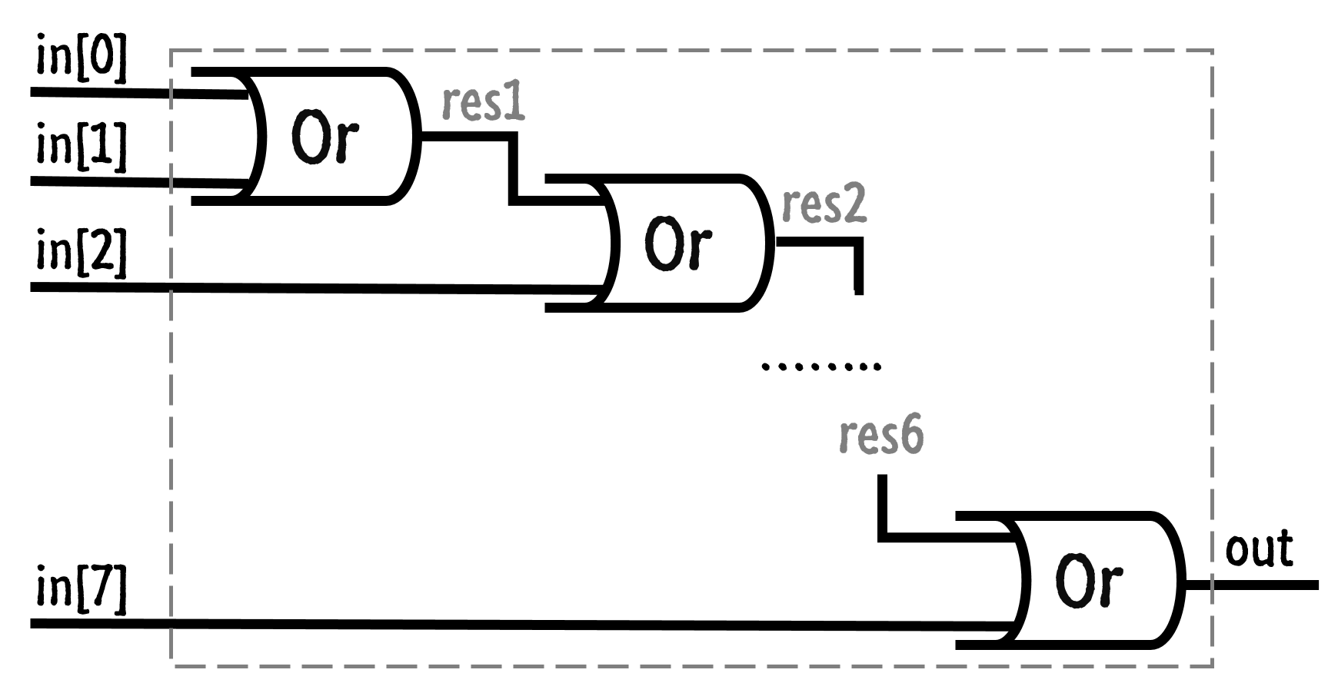
Or8Way(in[8]) = out
in[0]
Or
res1
in[1]
res2
Or
in[2]
……..
res6
Or
out
in[7]

Slide 18
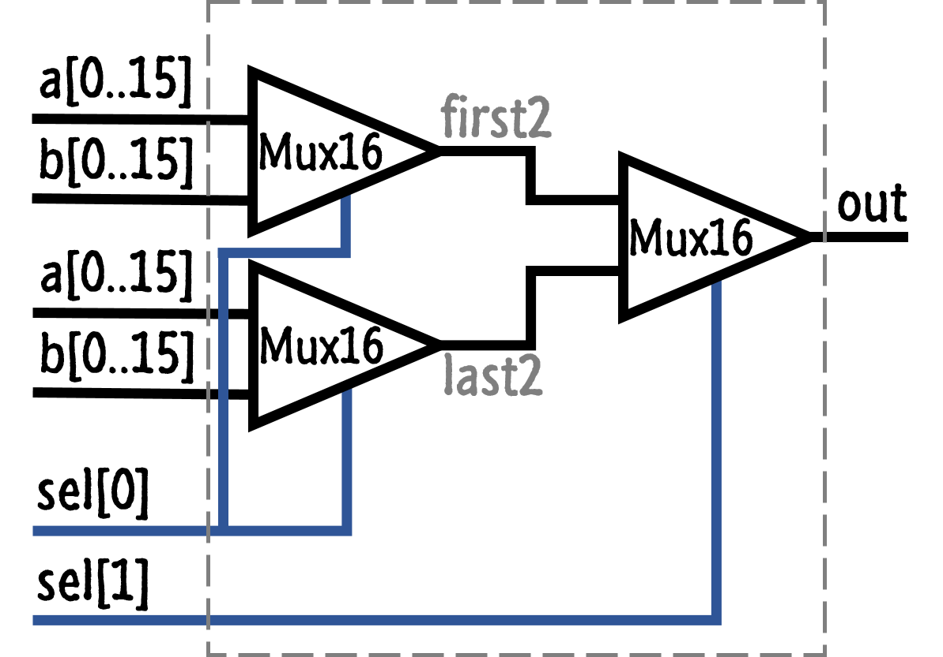
Mux4Way16(a[16], b[16], c[16], d[16], sel[2]) = out[16]
a[0..15]
CHIP Mux4Way16 { IN a[16], b[16], c[16], d[16], sel[2]; OUT out[16]; PARTS: Mux16(a[0..15]=a[0..15], b[0..15]=b[0..15], sel=sel[0], out[0..15]=first2); Mux16(a[0..15]=c[0..15], b[0..15]=d[0..15], sel=sel[0], out[0..15]=last2); Mux16(a[0..15]=first2, b[0..15]=last2, sel=sel[1], out[0..15]=out[0..15]); }
Mux16
first2
b[0..15]
Mux16
out
a[0..15]
Mux16
b[0..15]
last2
sel[0]
sel[1]

Slide 19
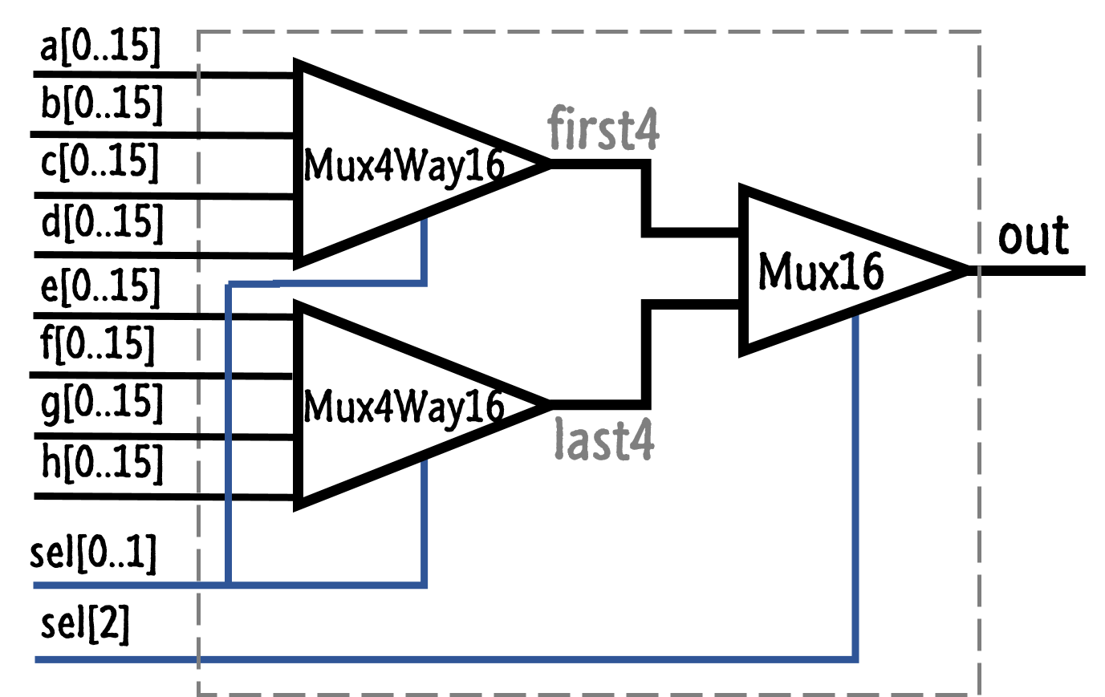
Mux8Way16(a[16], b[16], …, g[16], h[16], sel[3]) = out[16]
a[0..15]
Mux4Way16
b[0..15]
first4
c[0..15]
Mux16
d[0..15]
out
e[0..15]
Mux4Way16
f[0..15]
g[0..15]
last4
h[0..15]
sel[0..1]
sel[2]

Slide 20
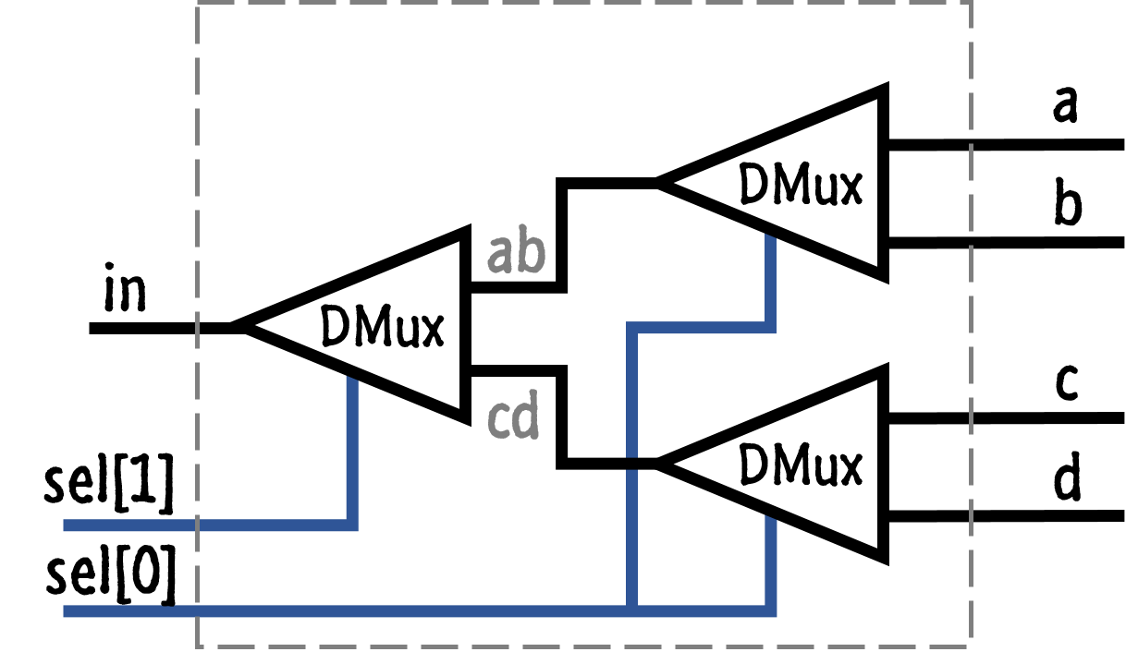
DMux4Way(in, sel[2]) = (a, b, c, d)
a
DMux
b
DMux
ab
in
c
cd
DMux
sel[1]
d
sel[0]

Slide 21
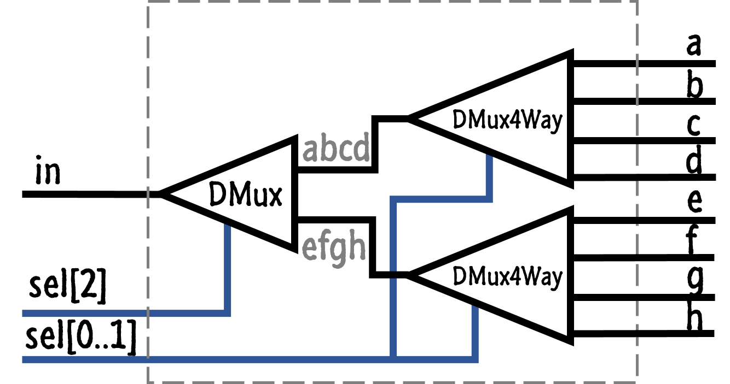
DMux8Way(in, sel[3]) = (a, b, c, d, e, f, g, h)
a
DMux4Way
b
c
DMux
abcd
in
d
e
DMux4Way
efgh
f
sel[2]
g
h
sel[0..1]

Slide 22
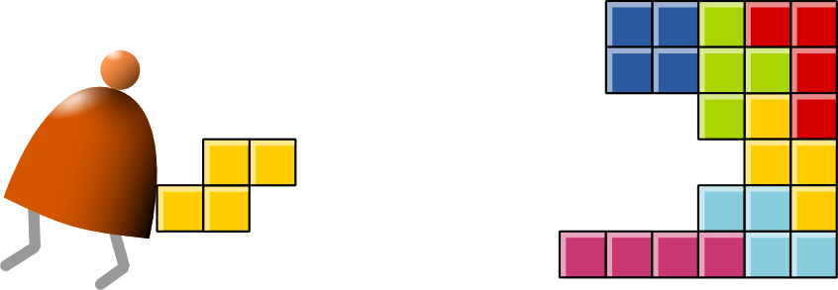

Спасибо за внимание
http://www.nand2tetris.org/
https://github.com/AndreySBer/nand2tetris

