Slide 1

Cloud HTTP Load Balancing By Andrey Semetchkov & Jenny Kapul Guided by Shay Vargaftik
Winter 2018

Slide 2
HTTP Load Balancing - Motivation
Optimize resource usage
Maximize throughput
Minimize latency
Avoid overload of any single resource
Notes:
Netflix example

Slide 3
Project Goals
Learn
Integrate Persistent Idle algorithm in open source load-balancer
POC system:
Implementation
Evaluation
Analyze results
Documentation
Notes:
HAproxy (prod level proxy)
Implementation – Client-Server

Slide 4
Outline
Intro
Load Balancing Algorithms
POC System
Implementation
Challenges
Results and Conclusions
Notes:
HAproxy (prod level proxy)
Implementation – Client-Server

Slide 5


HAProxy Project
Well documented
Very popular
Reliable
High Performance
Variety of implemented LB algorithms
Notes:
Description of haproxy
HAProxy is a free, very fast and reliable solution offering high availability, load balancing, and proxying for TCP and HTTP-based applications. It is particularly suited for very high traffic web sites and powers quite a number of the world's most visited ones. Over the years it has become the de-facto standard opensource load balancer, is now shipped with most mainstream Linux distributions, and is often deployed by default in cloud platforms. Since it does not advertise itself, we only know it's used when the admins report it :-)
HAPROXY wins because of its popularity : more solutions and documentation available
Also a major factor are the variety of implemented LB algorithms that otherwise we would need to implement.

Slide 6
Outline
Intro
Load Balancing Algorithms
POC System
Implementation
Challenges
Results and Conclusions
Notes:
HAproxy (prod level proxy)
Implementation – Client-Server

Slide 7
Load Balancing Algorithms
RR - Round Robin
Least connections (JSQ)
Persistent Idle (JIQ)
Notes:
JIQ - Join Idle Queue - The easiest to implement - Select empty queue else random queue.
JSQ(d) - Power of Choice
JSQ(d,m) - Power of Memory
RR - Round Robin - Weighted, Fair and Simple. Limited to 4095 servers.
SRR - Static RR - Similar to RR but changing RR weight in runtime have no affect. Less CPU. Unlimited servers.

Slide 8
Round Robin
1
2
3

Slide 9
Load Balancing Algorithms
RR - Round Robin
Least connections (JSQ)
Persistent Idle (JIQ)

Slide 10
Least Connections (JSQ)
1
2
3

Slide 11
Load Balancing Algorithms
RR - Round Robin
Least connections (JSQ)
Persistent Idle (JIQ)

Slide 12
Persistent Idle (JIQ)
1
2
3

Slide 13
Outline
Intro
Load Balancing Algorithms
POC System
Implementation
Challenges
Results and Conclusions

Slide 14



POC System

Slide 15

Software Stack
Python web.py framework
Linux How-to Manuals from developer's best friend :)
Notes:
Description of haproxy
HAProxy is a free, very fast and reliable solution offering high availability, load balancing, and proxying for TCP and HTTP-based applications. It is particularly suited for very high traffic web sites and powers quite a number of the world's most visited ones. Over the years it has become the de-facto standard opensource load balancer, is now shipped with most mainstream Linux distributions, and is often deployed by default in cloud platforms. Since it does not advertise itself, we only know it's used when the admins report it :-)
HAPROXY wins because of its popularity : more solutions and documentation available
Also a major factor are the variety of implemented LB algorithms that otherwise we would need to implement.

Slide 16
System Network Setup
Debug network
Configuration of 2 VMs
HAProxy Deployment from source
VMs topology definition:
Static IP requirements
Allowing servers one way access to the internet using NAT interfaces
Notes:
Challenges one slide, only explain network. Deciding on network topology and implementation adapters type. Started from bridged on all machines but this was not a secure and wasn’t suitable for our purposes. We needed static IP for all servers and proxy because of the HAproxy and apache config files that need to be reconfigured each time the IP changes.
Another problem was that the bridged connection couldn't have static IP because DHCP server could allocate the static address to another PC and they would crash
Thus we changed to:
For worker servers:
Servers have two interfaces one NAT and one LAN port. We changed the adapters in virtual box to Internal network and the NAT port to NAT. The LAN port has static IP.
For Proxy server:
The proxy server has three interfaces: NAT,LAN, host only adapter. NAT is meant for us to be able to use the internet but block external access for security. LAN (internal network adapter interface) port is to allow communication to servers. Host only adapter is for communication host to proxy.
The testing revealed many small issues with executing all the manuals and making everything work and connect.

Slide 17
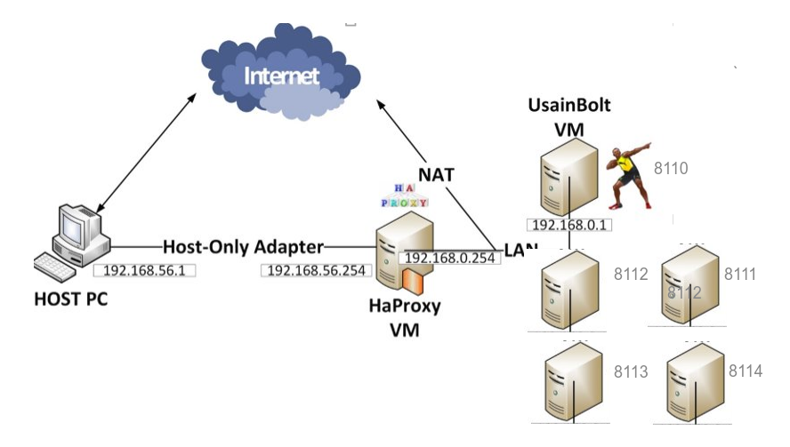
POC System
Network Scale Up
Network Scale Up
Notes:
Explain the networking
Networking challenges explained later Port difference one IP (using taskset)

Slide 18
Client
Load Generator
Many synchronous HTTP connections
HTTP JSON response
Results logging to CSV
Notes:
Webpy lightwight python web app for HTTP
Tell that used web pi and an app that recieves http get and added our code to that. Tell them what was ready and what we added
Last version client(synchronous threads) one for server talk about iterations and different versions of the code

Slide 19
Server
Using URL parameters: 192.168.56.254/isPrime/234355
Closest prime calculation
Semi-Heterogeneous servers
Taskset – each server process on different core
JSON response – request handling stats
2 | 3 | 4 | 3 | 5 | 5
Notes:
Webpy lightwight python web app for HTTP
Tell that used web pi and an app that recieves http get and added our code to that. Tell them what was ready and what we added

Slide 20
Outline
Intro
Load Balancing Algorithms
POC System
Implementation
Challenges
Results and Conclusions

Slide 21
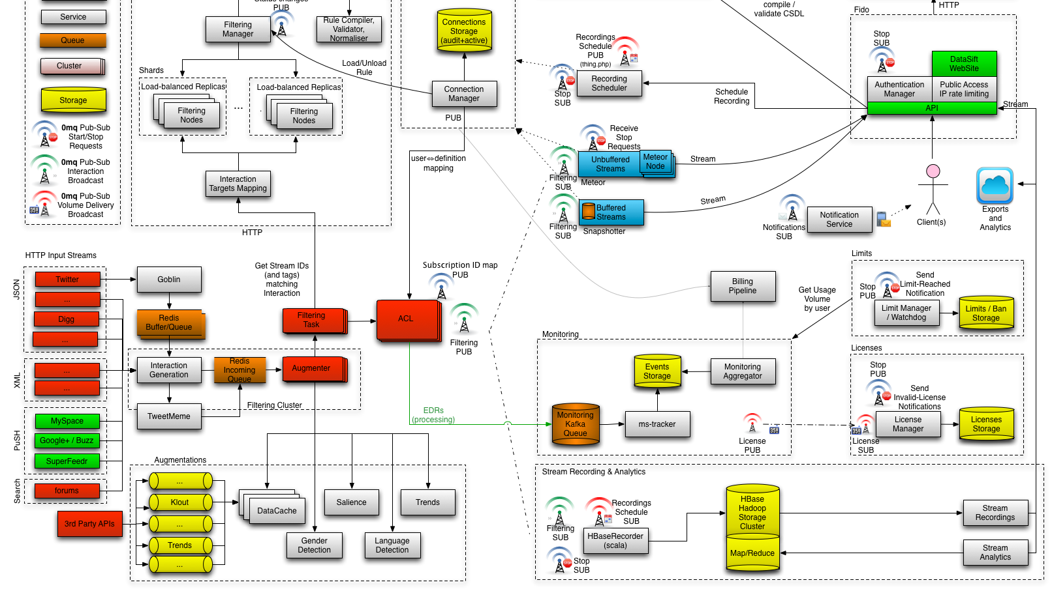
Just kidding XD

Slide 22
HAProxy Server PI Flow
Backend
Server
Proxy
Parser
Persistent Idle API
Elastic Binary Search Tree
HAProxy.cfg
Notes:
an elastic binary tree (or EB tree or EBtree) is a binary search tree specially optimized to very frequently store, retrieve and delete discrete integer or binary data without having to deal with memory allocation. It is particularly well suited for operating system schedulers where fast time-ordering and priority-ordering are strong requirements. Insertion and lookups are performed in O(log n) while removal is done in O(1). The tree is not balanced but its height is bound by the type of data to store in it. Ordered duplicate entries are also natively supported.
The hard part was the bitwise parsing and debug
using parsing of cfg the chosen algos API is called using the state obtained
Each eb32 node can be looked up in active or backup servers list node -> server
Compile from source, fight with linux to deploy HAPROXY the init script (deletion of unbacked config file and restoring it)
Debug of PI algorithm

Slide 23
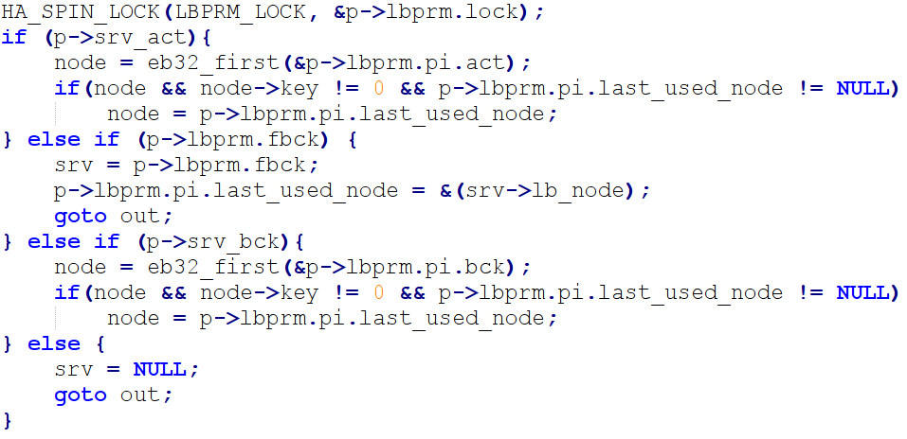
Persistent Idle API
Init functions
lb_pi.c
Next Server
Server down - Server up
Notes:
Each lb algo has a set API : init and next server func. Comparing nodes using EBT32 Next server- choosing server – node values as number of active HTTP connections Choosing server with 0 connections if none found keep sending to last idle server we saved in global state. All states that are not covered by PI are imitating least connections Node ->server and last server used saving in proxy struct backup servers
Debug of PI algorithm challenges ahead and printing to syslog ifs had {} bugs

Slide 24
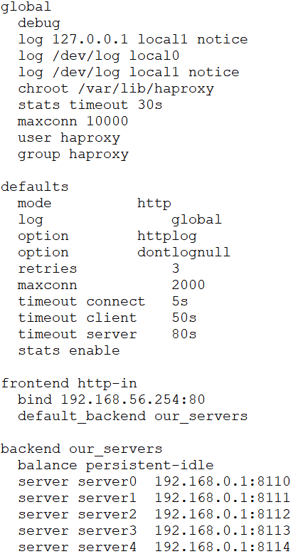
haproxy.cfg
Notes:
CFG deletion and debug challange

Slide 25
Outline
Intro
Load Balancing Algorithms
POC System
Implementation
Challenges
Results and Conclusions

Slide 26
Challenges
Requests timeouts – limits the level of the system's heterogeneity
Static IP on bridged connection – bad idea
Communication loss – servers would not respond to requests
Notes:
Timeouts of requests
Another problem was that the bridged connection couldn't have static IP because DHCP server could allocate the static address to another PC and they would crash
Static IP on bridged connection wasn’t an option – limitations of DHCP server

Slide 27
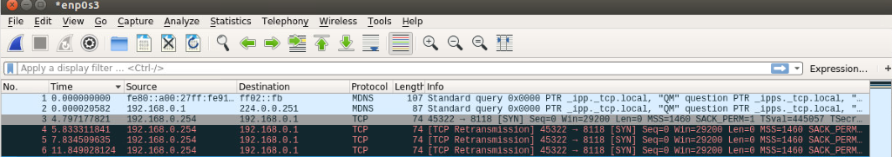
Networking Integration Challenges
Couldn’t establish TCP communication at scale up
Solution: disable linux firewall
Debug: Can't Print variables in order to debug Haproxy code
Notes:
Problem : We wanted to communicate to one ip of server to different tcp sockets.
Couldn’t do that .
After debug discovered
No tcp communication from proxy to server.
Http get from proxy sent , starting with forming tcp connection, no ACK from server
What happened:
At the server the firewall was blocking arbitrary tcp ports
Shays solution:
Disable firewall
sudo ufw disable
sudo iptables -L -n
Problem:
because HAproxy uses syslog process for stdout
Solution:
Found out how to read syslog using journal
fflush caused print!

Slide 28
Outline
Intro
Load Balancing Algorithms
POC System
Implementation
Challenges
Results and Conclusions

Slide 29
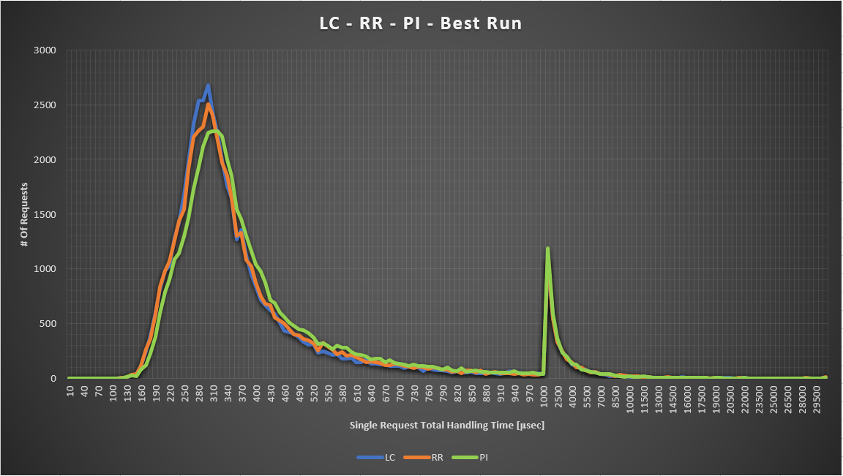

Slide 30
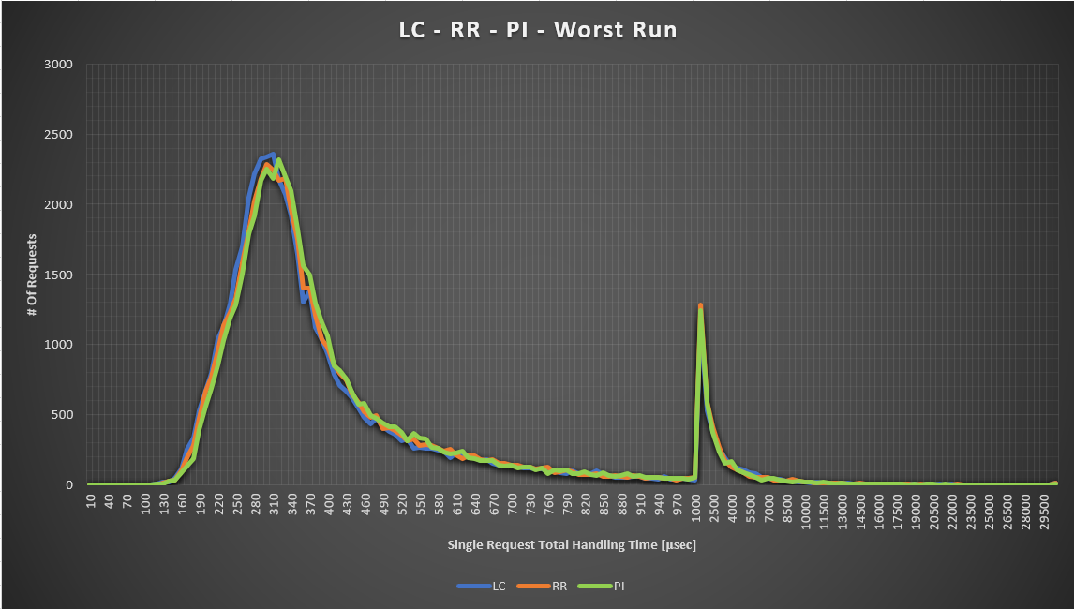
Results

Slide 31
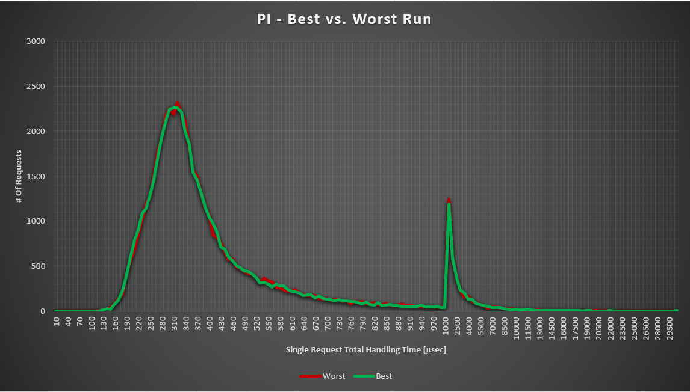

Slide 32

Conclusions
Servers heterogeneity importance
Algorithm vs. implementation
Setup defines the results

Slide 33

QUESTIONS?

