Slide 1
Stdio.h
http://www.cplusplus.com/reference/clibrary/cstdio/

Slide 2
Stdio.h
Stdio.h - #include <stdio.h>
  stands for "standard input-output header,"
    http://www.opengroup.org/onlinepubs/007908799/xsh/stdio.h.html
Functions declared in stdio.h are extremely popular, since as a part of the C standard library, they are guaranteed to work on any platform which supports C
  gets, puts, getchar, putchar
  fopen, fclose, fscanf, fprintf, scanf/printf
Notes:
http://www.digitalmars.com/rtl/stdio.html
http://en.wikipedia.org/wiki/Stdio.h

Slide 3
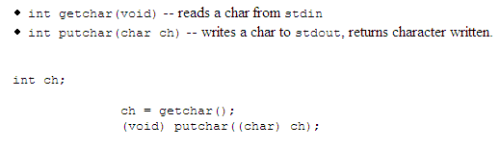
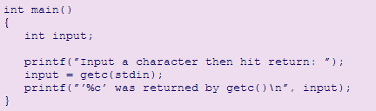
Basic I/O getchar / putchar
There are a couple of function that provide basic I/O facilities.
getchar() and putchar(). They are defined and used as follows:
Notes:
http://www.cs.cf.ac.uk/Dave/C/node18.html#SECTION001800000000000000000

Slide 4
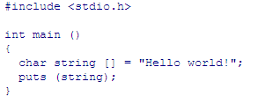
Basic I/O puts / fputs
The function fputs writes the string pointed to by str to the stream pointed to by stream.
The function puts writes the string str, and a terminating newline character, to the stream stdout.
#include <stdio.h>
  int fputs (const char *str, FILE *stream)
  int puts (const char *str)
Notes:
http://www.cs.cf.ac.uk/Dave/C/node18.html#SECTION001800000000000000000
http://www.cplusplus.com/ref/cstdio/puts.html

Slide 5
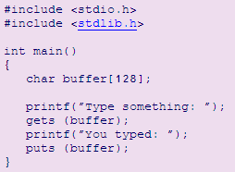
Basic I/O gets/puts
Read characters from stdin into the string str until a newline is read or an end-of-file is encountered.
Newlines are not written to the string. The string is terminated with a NULL character.
str must be large enough to hold the resulting string.
  gets – is very dangerous .Don't use it !!

Slide 6
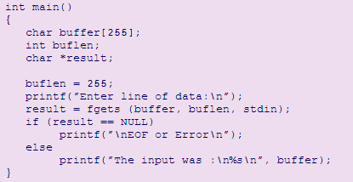
Basic I/O fgets
Reads characters from stream fp into the string pointed to by str.
The integer argument: n indicates the maximum number of characters that the buffer str can store.
Reading stops when: a newline is read, end-of-file is encountered, a read error occurs, or n-1 characters were read.
Newlines are included in the string. The string read is terminated with a 0

Slide 7
Basic I/O fprintf
Prototype
  int fprintf(FILE *fp, const char *format, arg0... argn);
  int printf(const char *format, arg0... argn);
Description
  fprintf writes formatted data to the file stream fp.
  printf writes formatted data to stdout.
Arguments are interpreted according to the null-terminated format string.
The format string is a sequence of characters with embedded conversion commands.
Characters that are not part of the conversion command are output
Notes:
http://http://www.digitalmars.com/rtl/stdio.html#fprintf

Slide 8

Basic I/O fscanf
Prototype
  int fscanf(FILE *fp, const char *format, ...);
  int scanf(char *format, ...);
Description
  fscanf reads characters from the input stream fp.
  scanf reads characters from the input stream stdin.
Characters read are converted according to the format string and the values created are stored through the argument pointers.
Note that the arguments are pointers to where values will be stored.
Notes:
http://www.digitalmars.com/rtl/stdio.html#fscanf

Slide 9
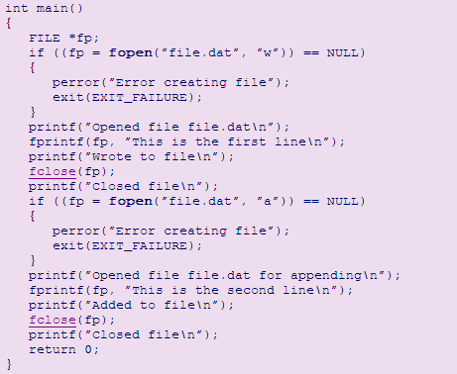

Basic I/O
Example
Notes:
http://http://www.digitalmars.com/rtl/stdio.html#fprintf

Slide 10
Stdlib.h
To use all functions in this library you must:
#include <stdlib.h>
There are three basic categories of functions:
  Arithmetic
  Random Numbers
  String Conversion
The use of all the functions is relatively straightforward.
Notes:
http://www.cs.cf.ac.uk/Dave/C/node16.html
http://www.digitalmars.com/rtl/stdlib.html

Slide 11
Stdlib.h
Arithmetic Functions
To use all functions in this library you must:
#include <stdlib.h>
There are three basic categories of functions:
    Arithmetic (abs , div … )
    Random Numbers
    String Conversion
The use of all the functions is relatively straightforward.
Notes:
http://www.cs.cf.ac.uk/Dave/C/node16.html

Slide 12
Malloc, Sizeof, and Free
In C++: long *pL = new long[128];
malloc is most commonly used to attempt to ``grab'' a continuous portion of memory.
  void *malloc(size_t number_of_bytes)
Void * is returned the C standard states that this pointer can be converted to any type.
The size_t argument type is defined in stdlib.h and is an unsigned type.
Notes:
http://en.wikipedia.org/wiki/Operator_new
http://www.cs.cf.ac.uk/Dave/C/node11.html#SECTION001110000000000000000

Slide 13
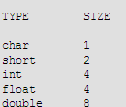
Malloc, Sizeof, and Free
sizeof will return the number of bytes reserved for a variable or data type.
int *ip;
ip = (int *) malloc(100*sizeof(int));
Heap (part of the adress space 4.14 )
Notes:
http://www.digitalmars.com/rtl/stdlib.html#malloc

Slide 14
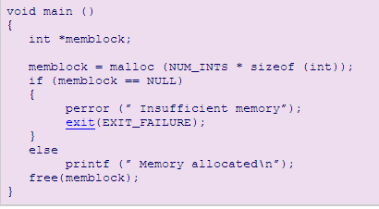
Malloc, Sizeof, and Free
Notes:
http://www.digitalmars.com/rtl/stdlib.html#malloc

