Slide 1
Smart Link Selection
הצגת הפרויקט
By
Andrey Shamis
And
Ilia Gaisinsky

Slide 2
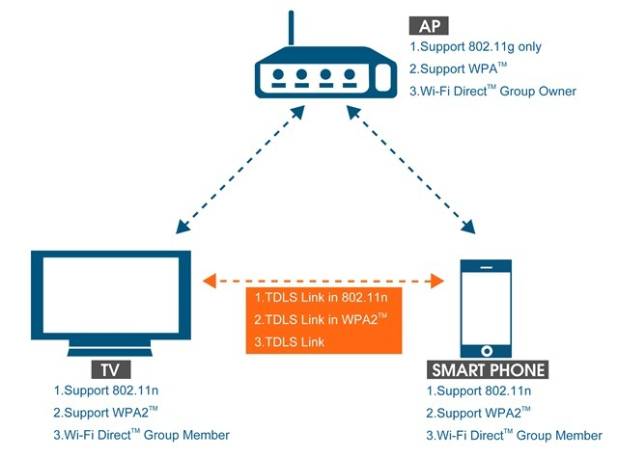
Project Goal
Creation of WiFi simulator in order to develop Smart Link Selection Algorithms

Slide 3
Project Overview
Simulator
Design
Supported Protocols
Used algorithms
Usability
SLS Algorithm
Algorithms flow
Statistic
Conclusion

Slide 4
Simulator - Design
Medium infrastructure.
RF devices
Packets
GUI
Support of two different data links:
BSS
TDLS

Slide 5
Rx/Tx emulation over Medium
Radius Calculation
Multiple Channel support
Dual Band support
RSSI Calculation
Transmission Data Rate
Noise Simulation
Tx opportunity
Acknowledgment
MAC resolution

Slide 6
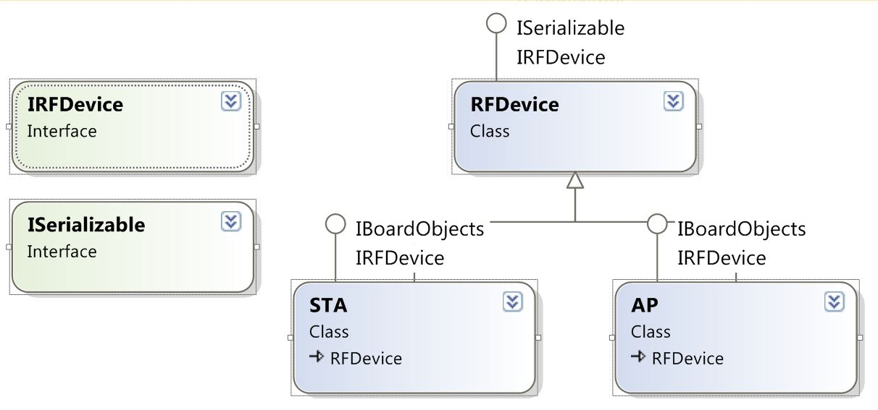
RF Devices UML

Slide 7
RF Devices
AP
Able to transfer any kind of packets without any code change
Buffers packet for each STA
STA
Preferred (best) Channel finding for TDLS
Stream handler / File to Packets division and restoration

Slide 8
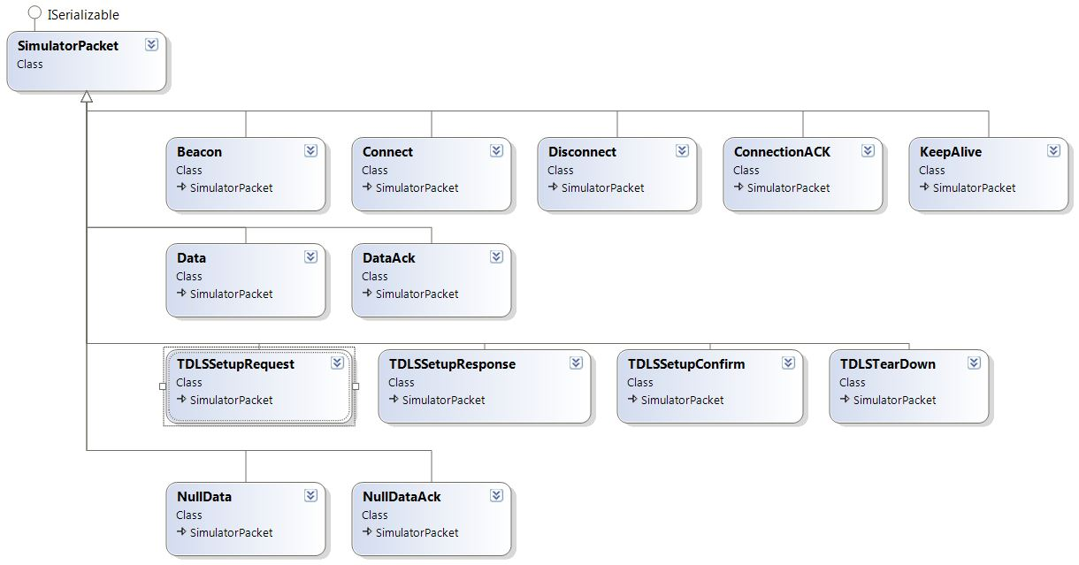
Packets UML

Slide 9
GUI
Easy access to get all simulated information
Ability to move objects on board - Drag & Drop
Creation of RF device
Random simulation
Static simulation
Station info form :
Statistic
Logs
Station configuration and overview
Configurable dump of STA object
AP info form – provide basic configuration
Saving and Load current simulation into file
Here we will show the bullets mentioned above on the real Program.

Slide 10
Supported Protocols
IEEE80211
Passive scan
Beacon sending
Acknowledgment
Connect/Disconnect flow
Keep Alive mechanism
Support of standards - Band A, Band N
Connection establishment negotiation
Base Service Set
Tunneled Direct Link Setup

Slide 11
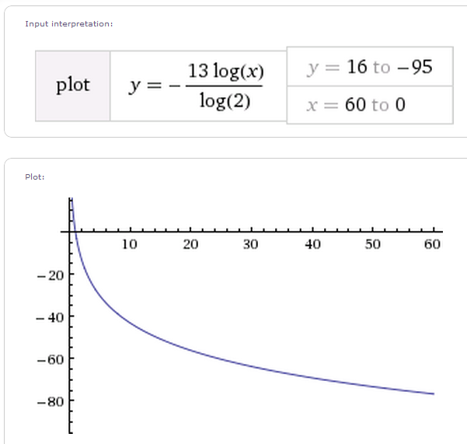
Used Algorithms
Calculation of Received Signal Strength Indication (RSSI)
Distance (meters)
(DBm)

Slide 12
Used Algorithms
Signal to Noise Ratio (SNR) – Packet Loss

Slide 13
Used Algorithms
Calculation of transmit rate regarding to RSSI
(DBm)
(Kbps)

Slide 14
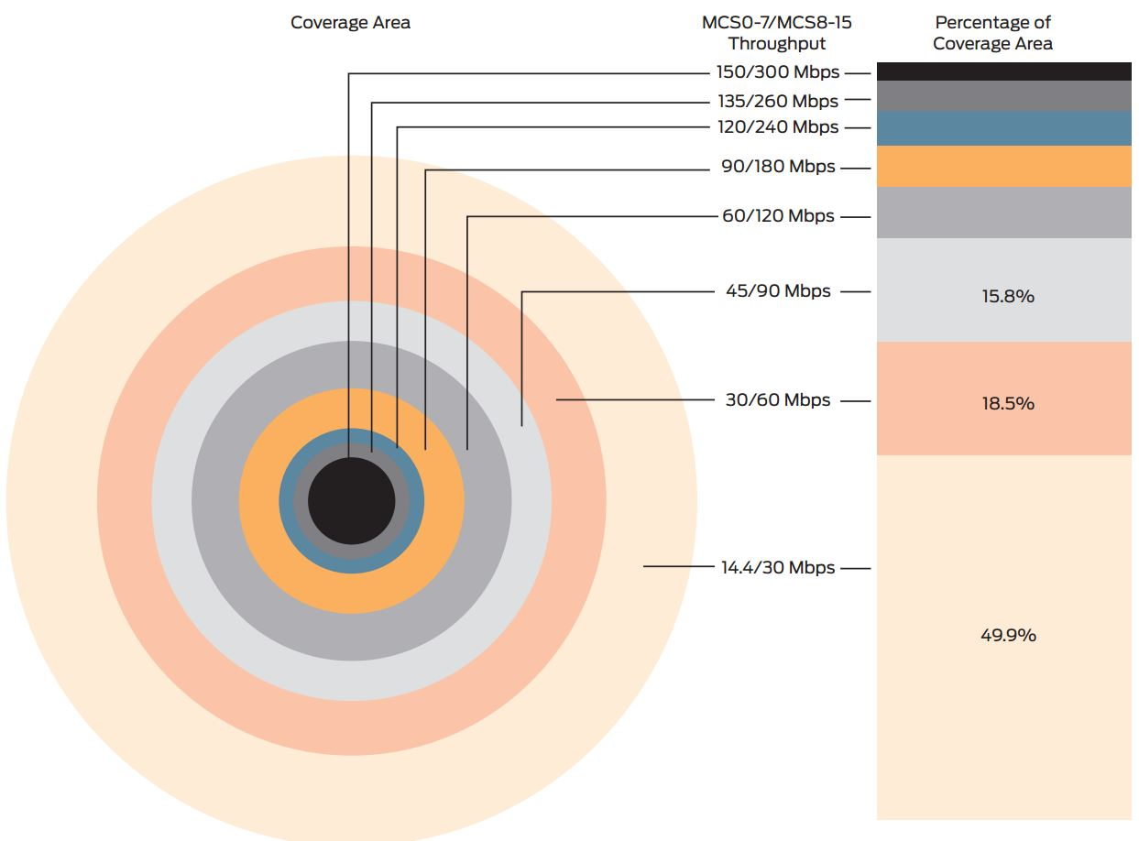
Used Algorithms
Calculation of transmit rate regarding to RSSI

Slide 15
Smart Link Selection
We have developed 2 different SLS algorithms:
Null Data Packet Based Algorithm
Window Based Algorithm

Slide 16
Null Data Packet
Sampling by sending packet on TDLS link and then on BSS link
Each channel is sent X packets
The sampling is performed every Y seconds
Sending packets are in parallel to sending data

Slide 18
Null Data Packet
Advantages
Small packet size – not overload the network
Simple
Independent on sending actual data
Disadvantages
While sampling, affects on sending actual data
Independent on sending actual data

Slide 19
Window Based Algorithm
Parameters
Cycle size (NUM of Packets)
Window Size (Percent of Cycle)
Window boundaries (MIN, MAX)

Slide 20
Window Based Algorithm

Slide 21
Window Based Algorithm

Slide 23
Window Based Algorithm
Advantages
Uses actual Data Packets for sampling – No Overhead
Dynamic increase/decrease samples window size
Can be integrated in the MAC layer (Wi-Fi Driver) or on the device it self (Firmware)
Samples count parameter might be controllable regarding traffic load.
Disadvantages
Not end-to-end estimation
On bad conditions, sample link may degrade throughput

Slide 24
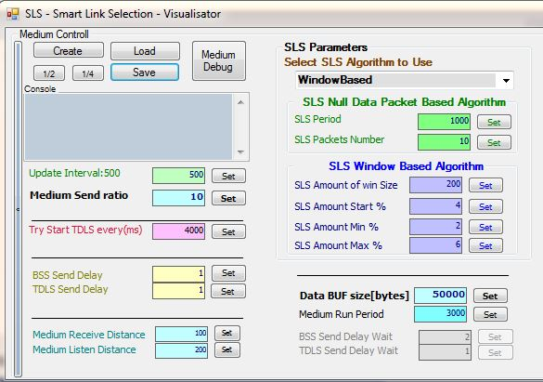
Start Simulation

Slide 25
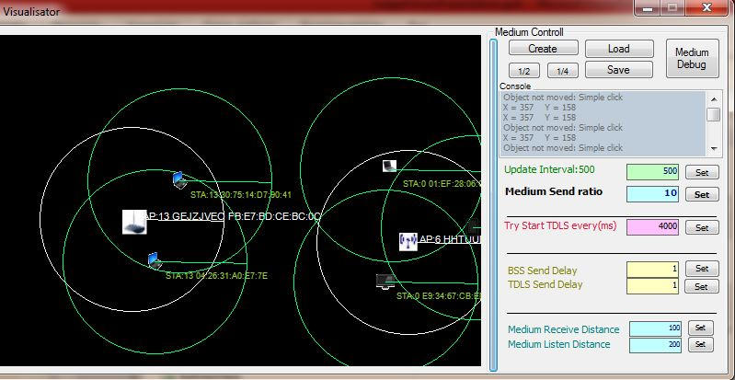
Simulator demo

Slide 26
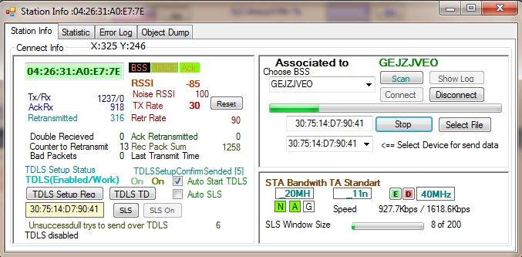
Simulator demo

Slide 27
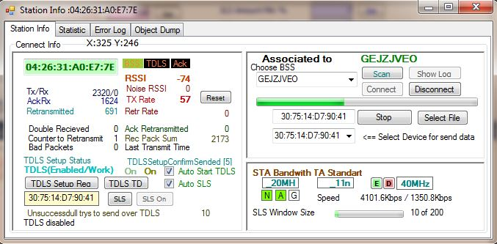
Simulator demo

Slide 28
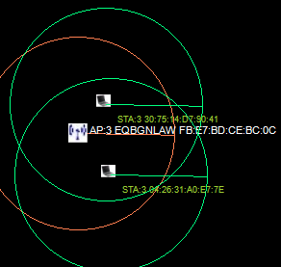
Conclusions
BSS better
Distance | AP | STA 1 | STA 2
AP | 0 | 50 | 55
STA 1 | 50 | 0 | 80
STA 2 | 55 | 80 | 0

Slide 29
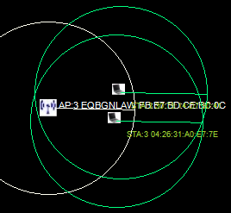
Conclusions
TDLS better
Distance (meters) | AP | STA 1 | STA 2
AP | 0 | 92 | 93
STA 1 | 92 | 0 | 5
STA 2 | 93 | 5 | 0

Slide 30


Management Tools
Repository
https://github.com/AndreyShamis/sls/
Auto compiler
http://jenkins.dhs01.com/

Slide 31

Questions

Slide 32
Bibliography
IEEE 802.11 SPEC - WiFi
IEEE 802.11z SPEC - TDLS
Wireless Rate Control Algorithms
DDRS
MAC rate control algorithm
WiFi Alliance
WiFi Direct - http://linuxwireless.org/
A Routing Algorithm for Wireless Ad Hoc Networks with Unidirectional Links
Wikipedia - Wireless network
http://wiki.dhs01.com/

