Slide 1
Smart Link Selection
הצגת הפרויקט
By
Andrey Shamis
And
Ilia Gaisinsky

Slide 2
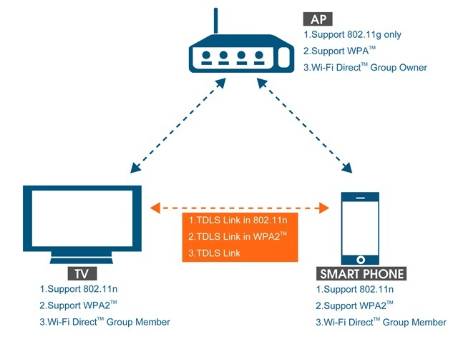
Project Overview

Slide 3
Project Overview - Goals
Simulator
Design
Protocols support
Used algorithms (RSSI,Noise,Rate)
Usability
SLS Algorithm
Algorithm flow
Statistic

Slide 4
Simulator - Design
Medium infrastructure.
RF devices - UML
Packets – UML
Support of two different data links:
BSS
TDLS
Selection between links:
BSS
TDLS

Slide 5
Protocols Support
IEEE80211
Passive scan
Beacon sending
Acknowledgment
BSS Connect/Disconnect flow
Keep Alive mechanism
Received Signal Strength Indication (RSSI)
Transmit Rate Calculation (SNR – adventeges/ disad
Support of standards Band A, Band N
Connection establishment negotiation
Packets Encapsulation /Headers /hierarchy

Slide 6
Used Algorithms
Preferred channel selection
Calculation of transmit rate regarding to RSSI
Calculation of RSSI regarding to Distance

Slide 7
GUI
Statistic and information
Easy access to get all simulated information
Ability to move objects on board
Drag & Drop
Creation of RF device
Random simulation
Static simulation
Station info form :
Statistic
Logs
Station configuration and overview
Configurable dump of STA object
AP info form – provide basic configuration
Saving and Load current simulation into file

Slide 8
Here insert graphs from wiki about standards
http://wiki.dhs01.com/
RSSI
Challenge – medium
Send data
Pars received packet
Medium registration
AP – support any kind of packets
Stream handler / File to Packet division and restoration

Slide 9
Notable Functions / Algorithms

Slide 10
Rx/Tx emulation over Medium
Radius Calculation
Multiple Channel support
Dual Band support
RSSI Calculation
Transmission Data Rate
Noise Simulation
Tx opportunity
Acknowledgment
MAC resolution

Slide 11
Why so radius important?

Slide 12
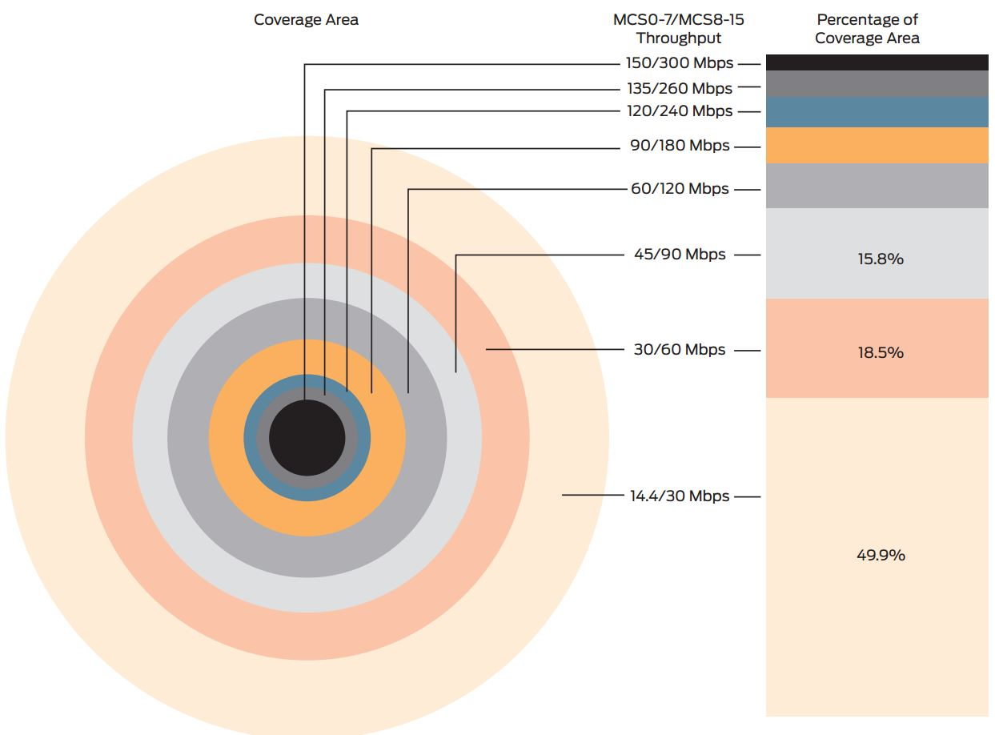
Low Rate Clients Degrade WLAN Performance

Slide 15
Rates used

Slide 16
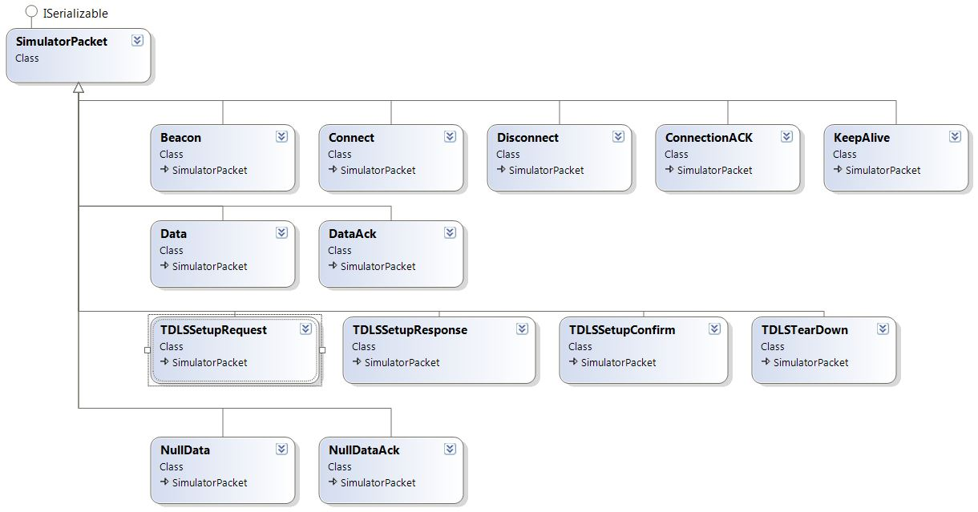
Packets UML

Slide 17
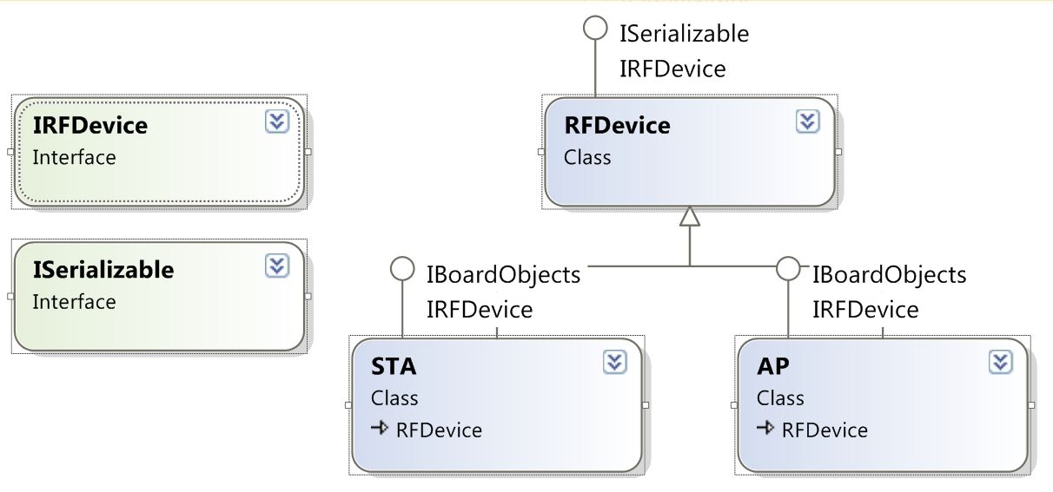
RF Devices UML

Slide 18
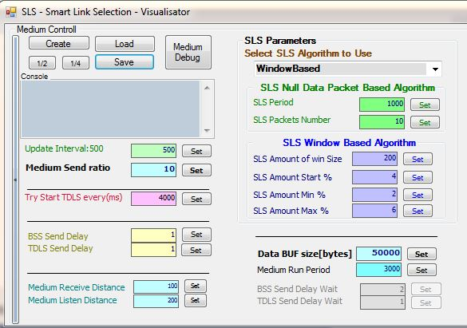
Start Simulation

Slide 19
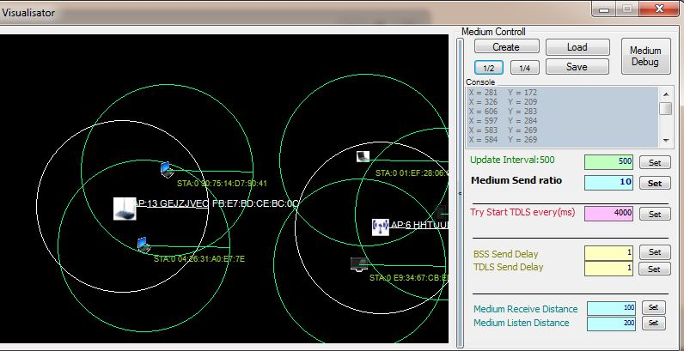
Simulation

Slide 20
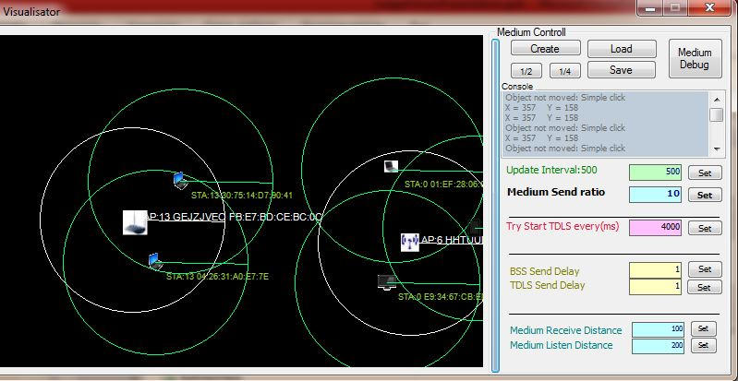
Simulator demo

Slide 21
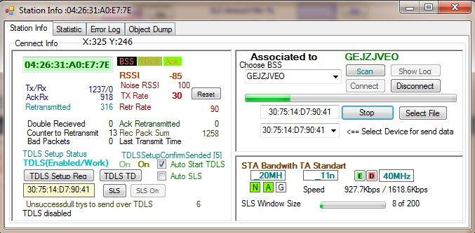
Simulator demo

Slide 22
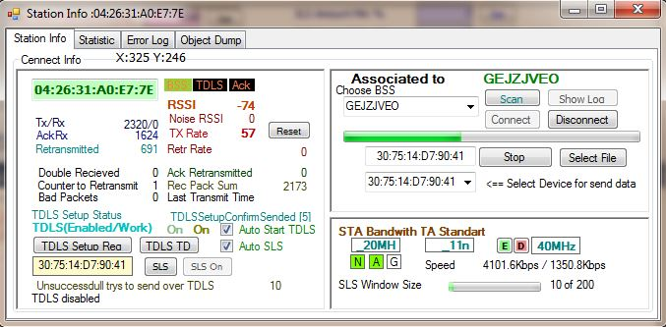
Simulator demo

Slide 23
Conclusions

Slide 24

Repository
https://github.com/AndreyShamis/sls/

Slide 25

Questions

