Slide 1
FLEXBOX

Slide 2
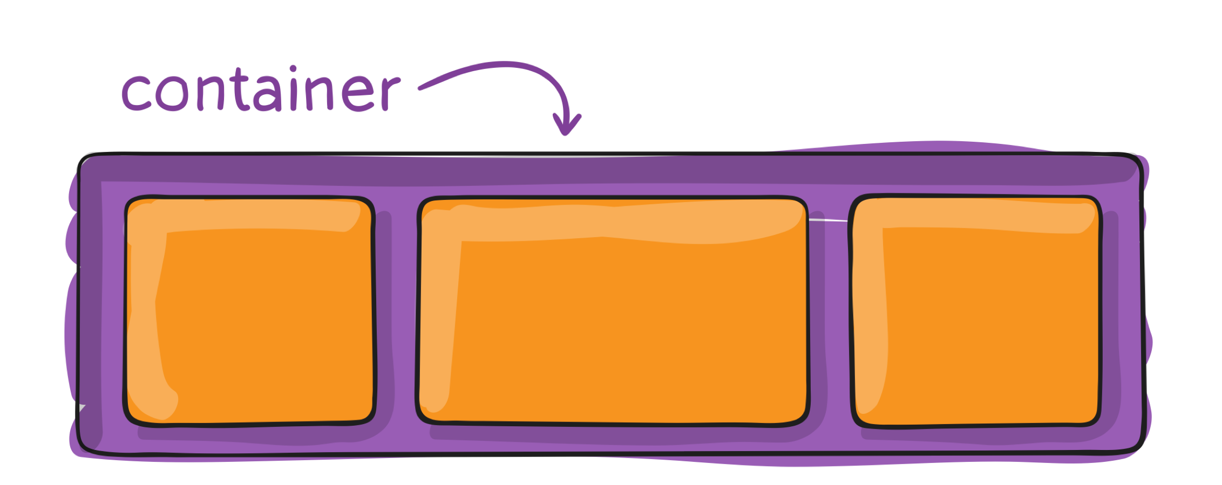
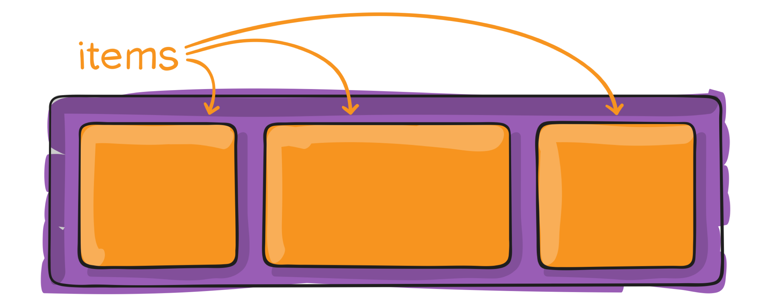
Flex container
Flex items

Slide 3
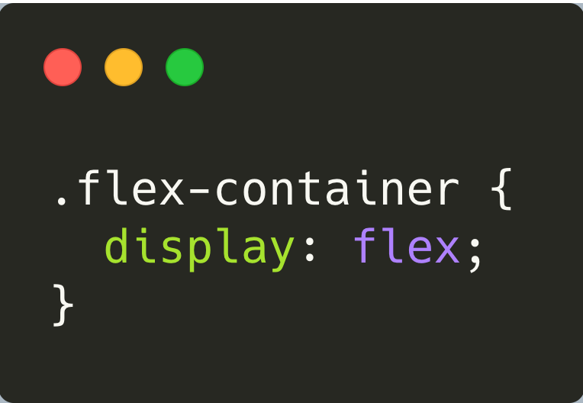
Flex container

Slide 4
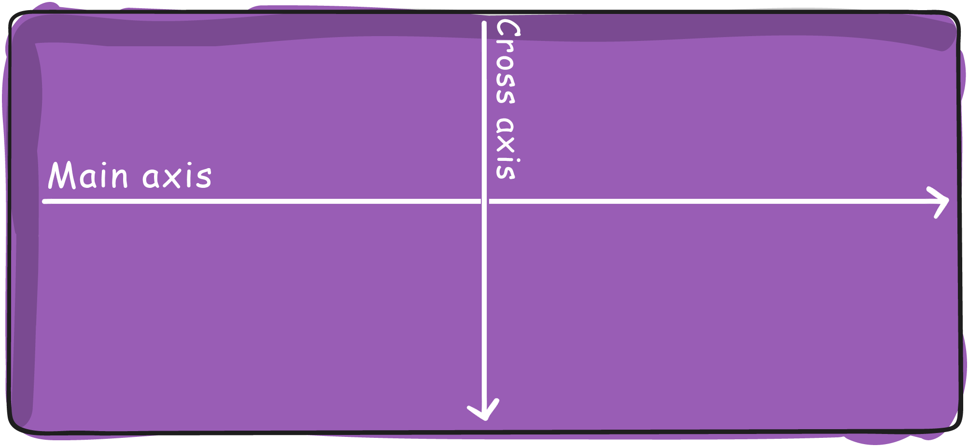
Flex container

Slide 5
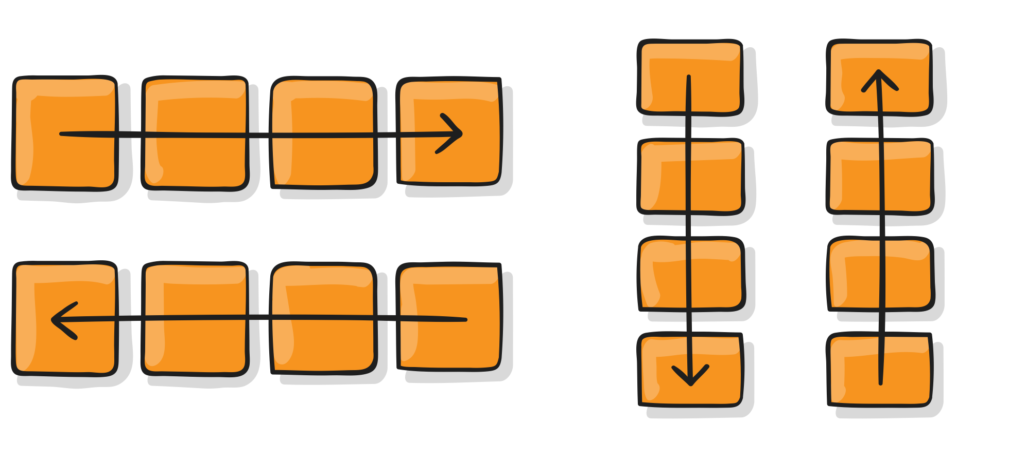
Flex container
flex-direction
column
column-reverse
row (default)
row-reverse

Slide 6
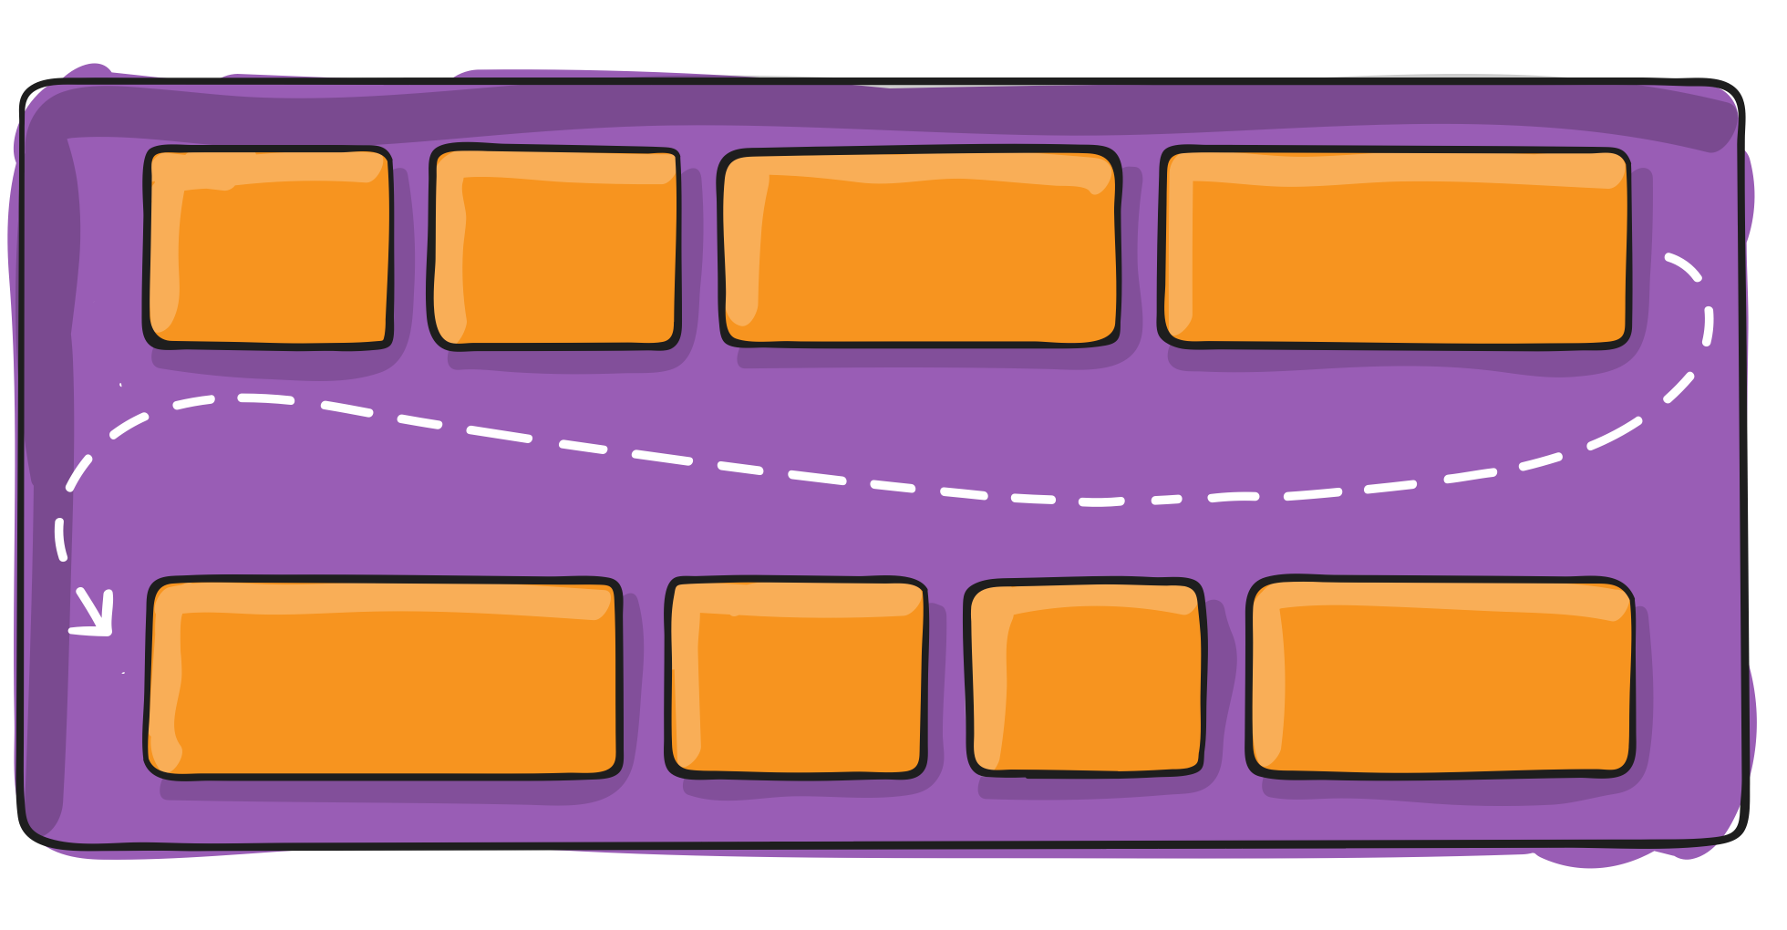
Flex container
flex-wrap
nowrap (default) | wrap | wrap-reverse

Slide 7
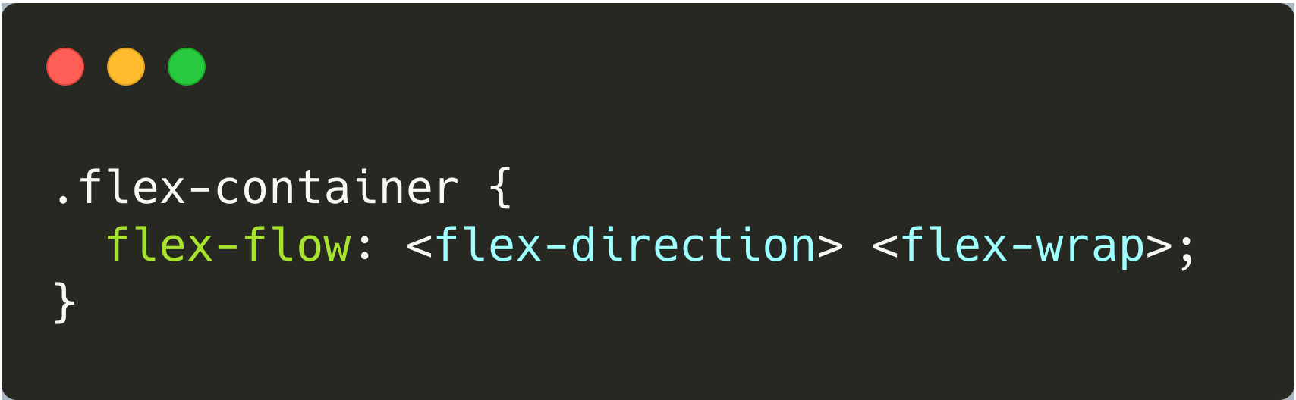
Flex container
Flex-flow

Slide 8
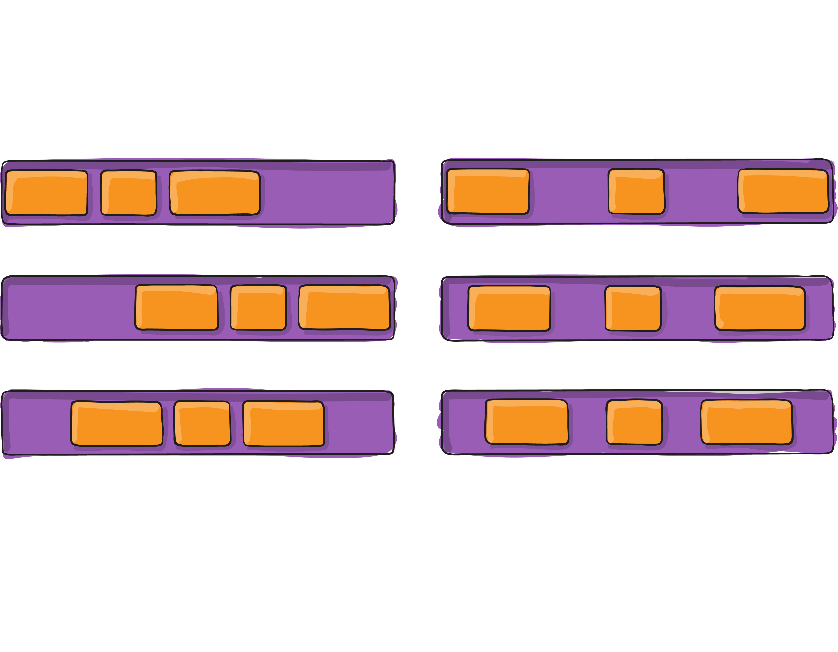
Flex container
justify-content
flex-start
space between
flex-end
space-around
center
space-evenly

Slide 9
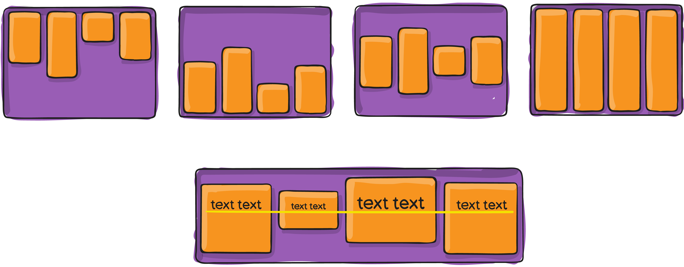
Flex container
align-items
flex-start
flex-end
center
stretch (default)
baseline

Slide 10
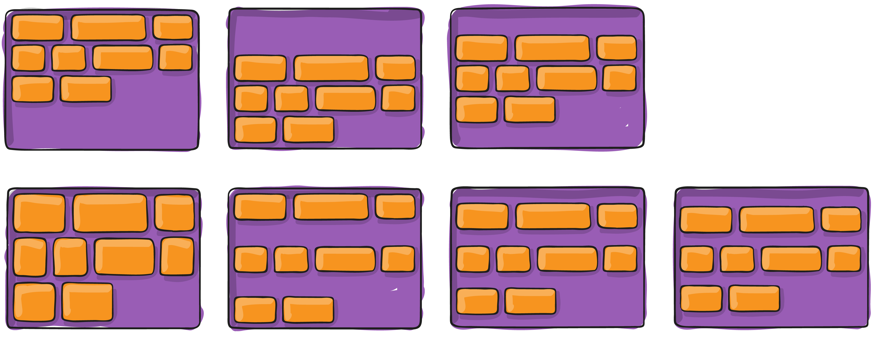
Flex container
align-content
flex-start
flex-end
center
stretch (default)
space-between
space-around
space-evenly

Slide 11
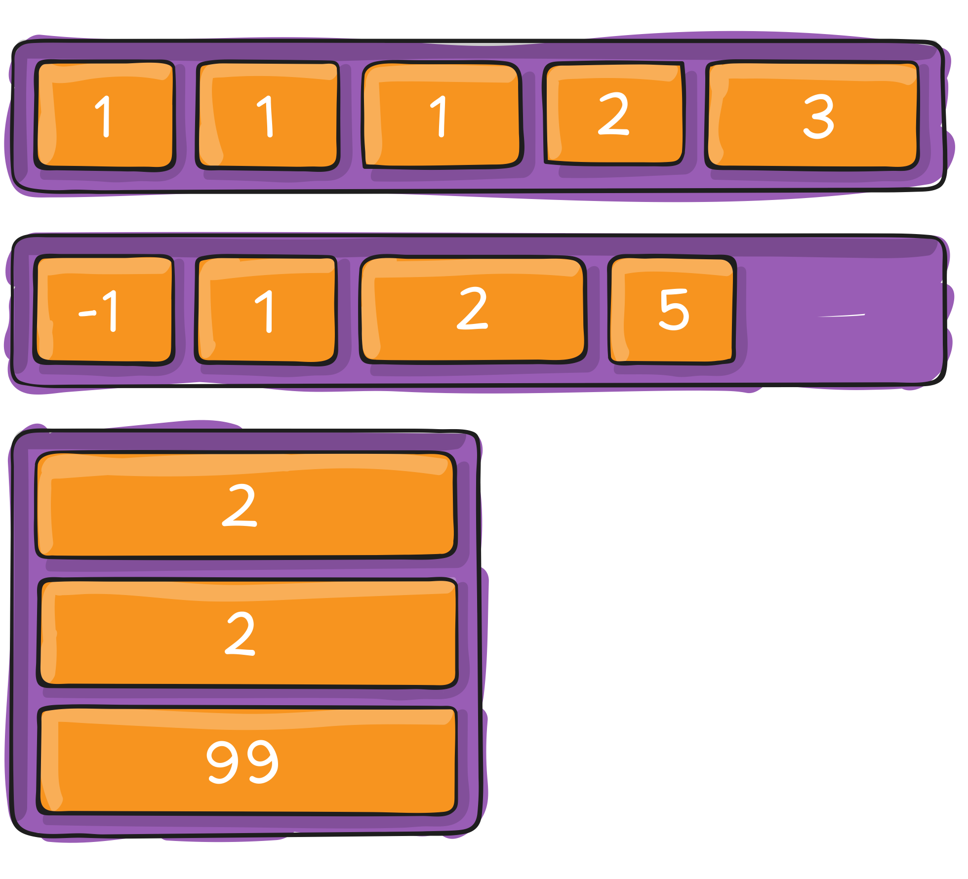
Flex item
order

Slide 12
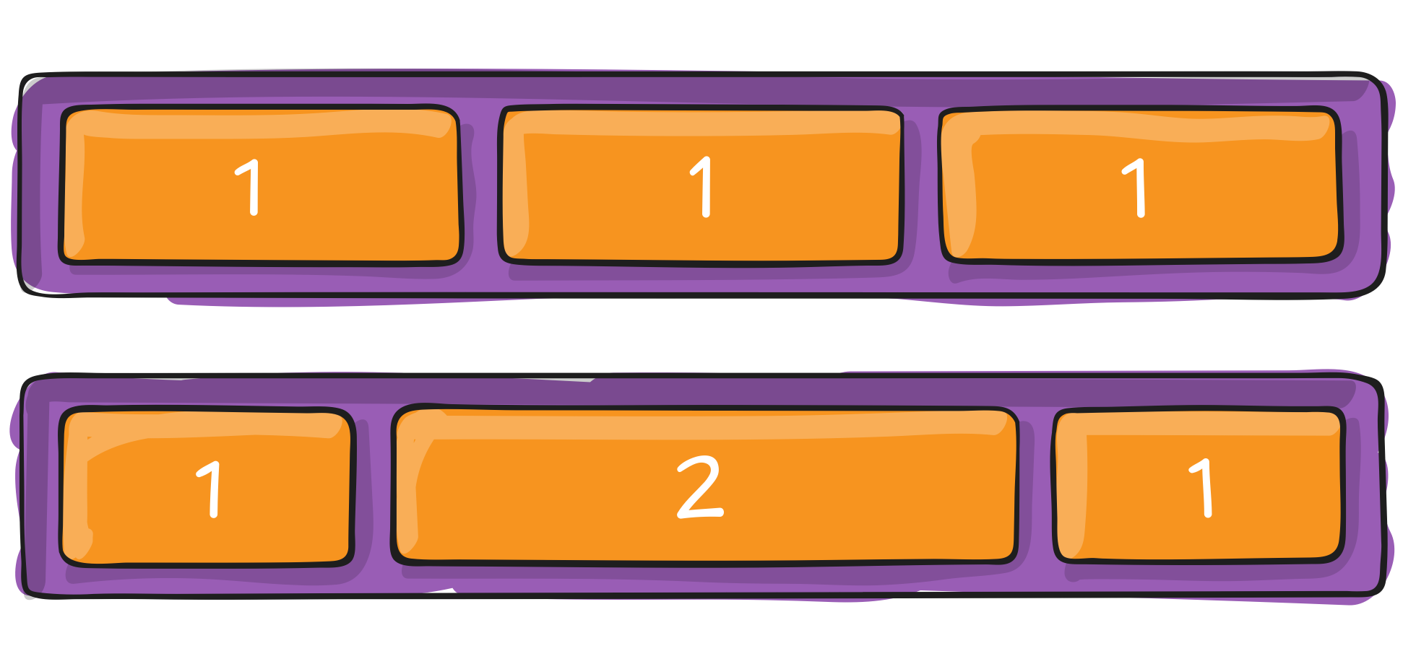
Flex item
flex-grow

Slide 13
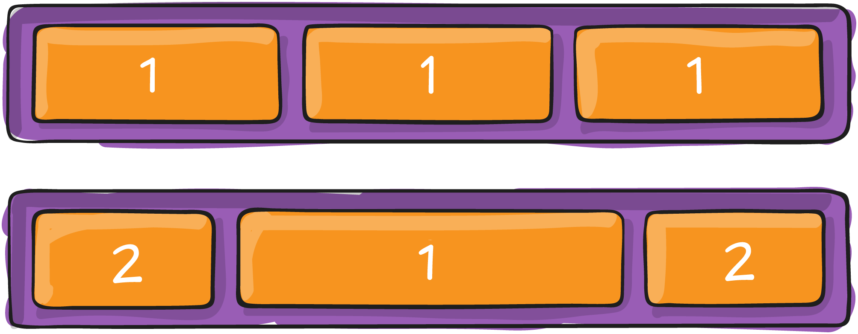
Flex item
flex-shrink

Slide 14
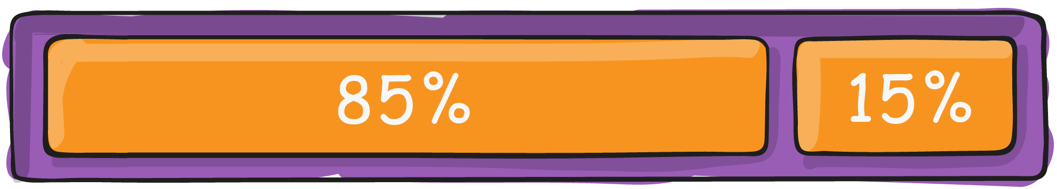
Flex item
flex-basis

Slide 15
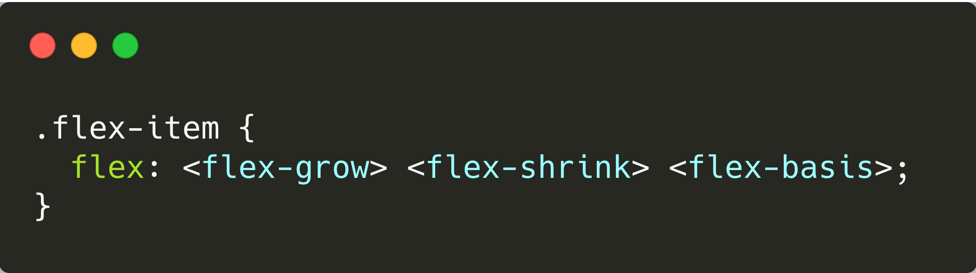
Flex item
flex

Slide 16
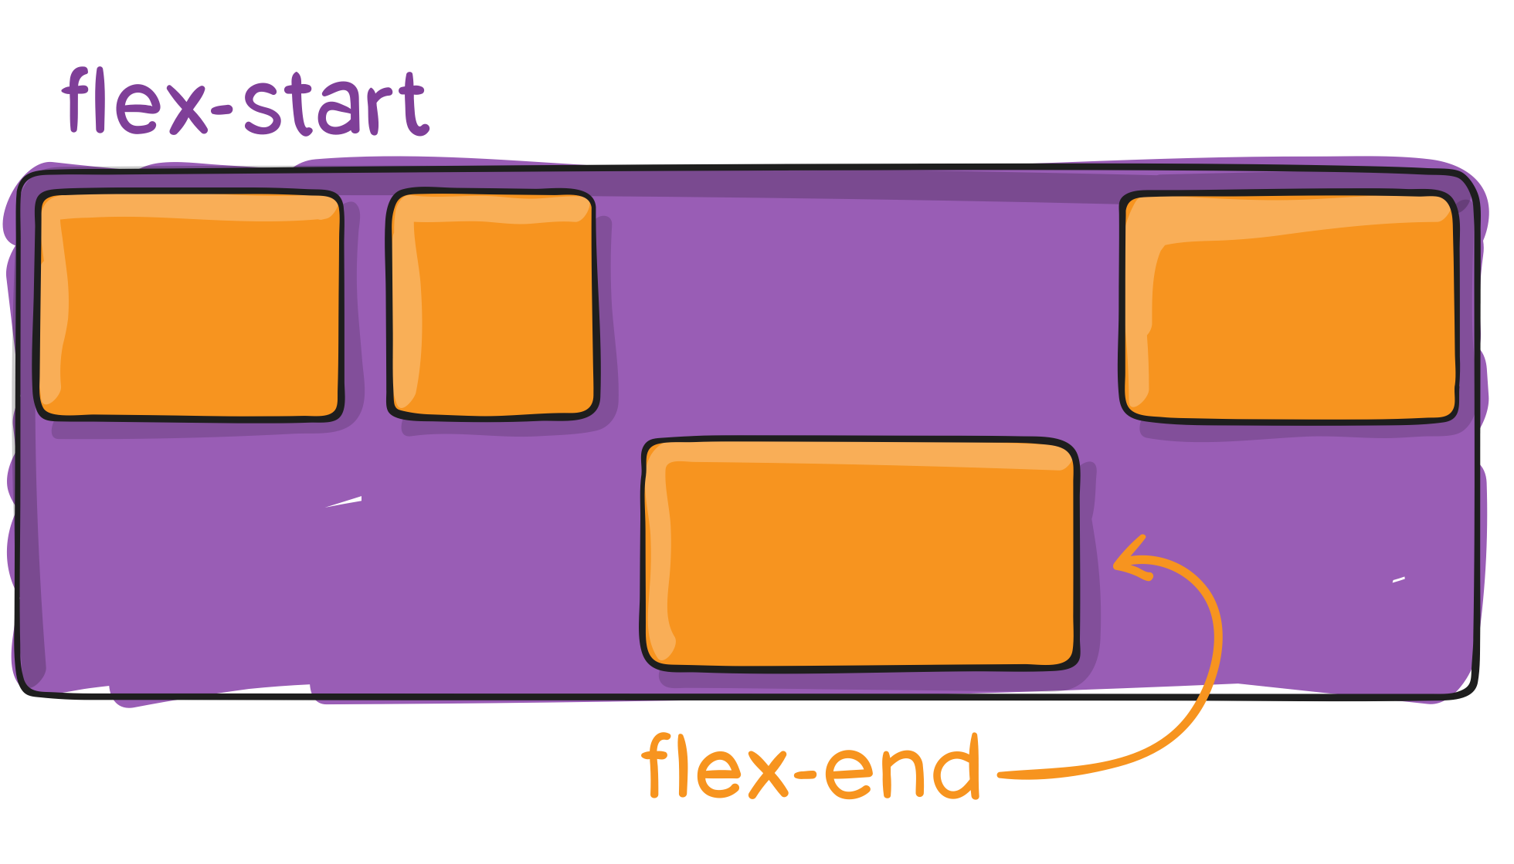
Flex item
align-self
auto | flex-start | flex-end | center | baseline | stretch

Slide 17

Практика
http://flexboxfroggy.com/ - ru

Slide 18
Спасибо!

