Slide 1
Проектирование мобильных приложений
Android: Ресурсы
Кузнецов
Андрей Николаевич
Санкт-Петербургский Государственный
Политехнический Университет

Slide 2
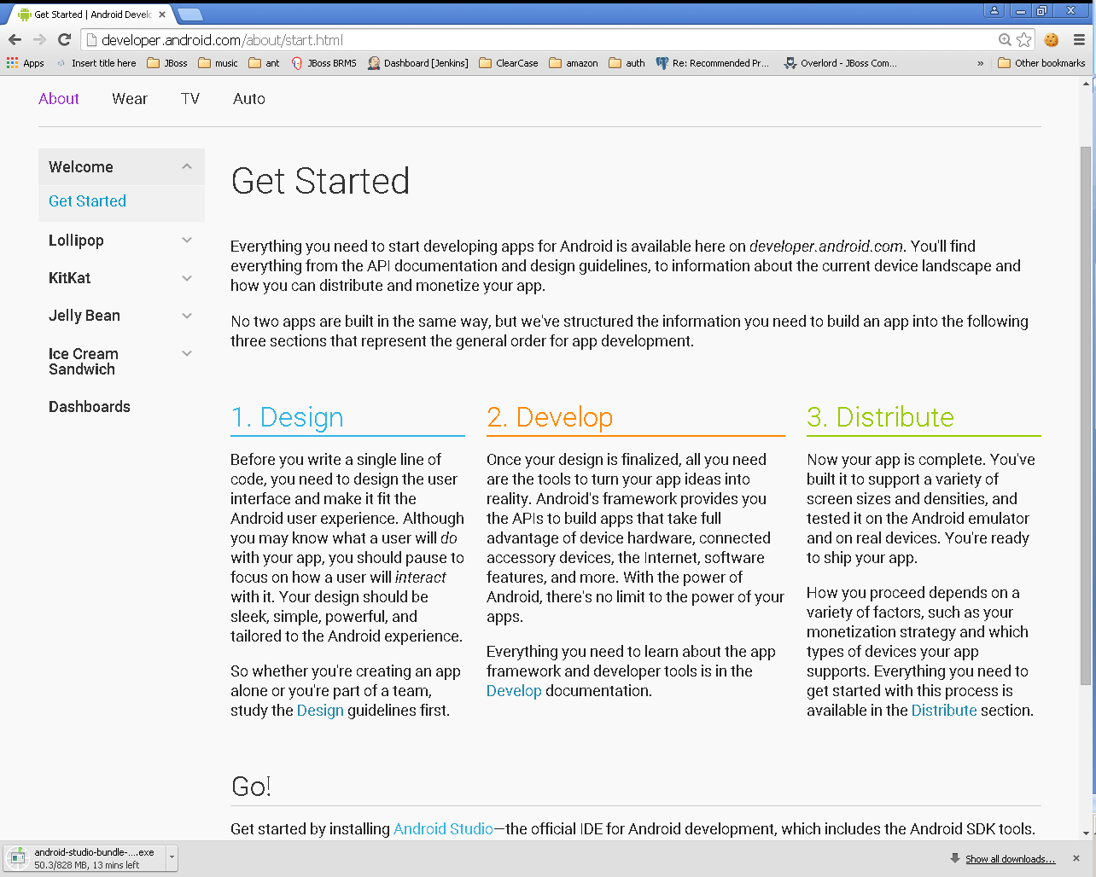

Slide 3
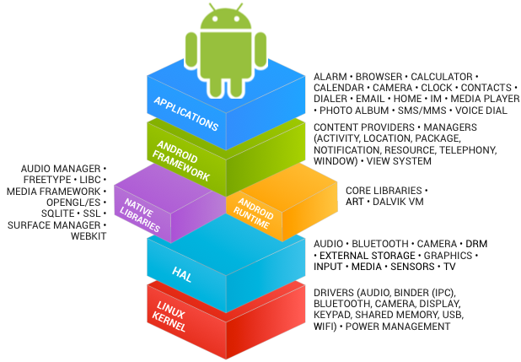
В предыдущих лекциях...
See https://source.android.com/source/index.html

Slide 4
В предыдущих лекциях...
Android Studio
Android SDK
http://developer.android.com/sdk/index.html
Eclipse IDE for Mobile Developers
http://eclipse.org/mobile/
ADT Plugin для Eclipse
https://dl-ssl.google.com/android/eclipse/
Java SE Development Kit 7
http://www.oracle.com/technetwork/java/javase/downloads/jdk7-downloads-1880260.html

Slide 5
В предыдущих лекциях...
Activities
Services
Content Providers
Broadcast Receivers
As a developer we need only to call and extend these already defined classes to use in our application.

Slide 6
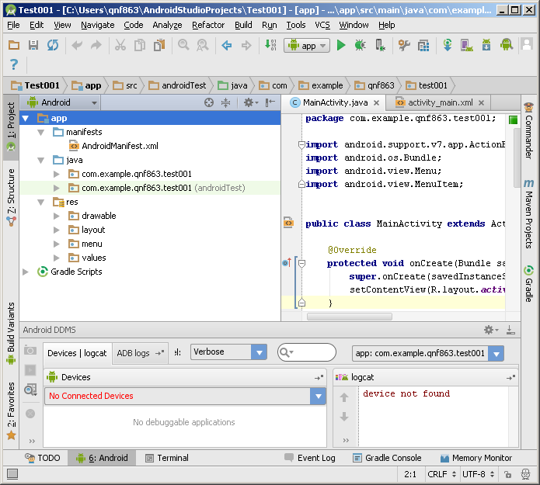
В предыдущих лекциях...

Slide 7
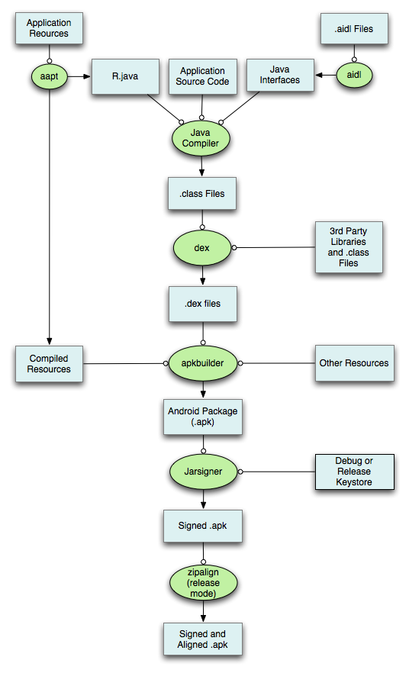

Slide 8
В предыдущих лекциях...
./animator/*
./anim/*
./xml/*
./drawable/*
Bitmap files (png, 9.png, jpg, gif)
State lists
Shapes
Other drawables

Slide 9
В предыдущих лекциях...
./layout/*
./menu/*
./raw/*
./values/*
arrays.xml
colors.xml
dimens.xml
strings.xml
styles.xml

Slide 10
Ресурсы: Обзор
Ресурсы Android

Slide 11
Важное замечание
В этой лекции мы узнаем только как определять различные ресурсы, но не использовать ☹

Slide 12
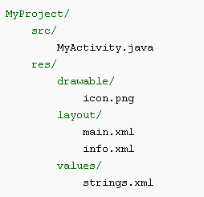
Типы ресурсов
Все ресурсы хранятся в каталоге “res”
Тип ресурса определяется именем подкаталога

Slide 13
Типы ресурсов
Имя ресурса | Доступ к ресурсу | Описание
layout/filename.xml | Java: R.layout.filename XML: @[package:]layout/filename | Верстка UI
drawable/filename.??? | Java: R.drawable.filename XML: @[package:]drawable/filename | Графические ресурсы
values/filename.xml | Java: R.<restype>.resname XML: @[package:]<restype>/resname | Значения
<restype> := “array” | “color” | “dimen” | “string” | “style” |
“bool” | “id” | “integer”
Рекомендуется (для удобства) хранить ресурсы разных типов в разных файлах (values/arrays.xml, values/strings.xml, и т.п.)

Slide 14
Типы ресурсов
Имя ресурса | Доступ к ресурсу | Описание
animator/filename.xml | Java: R.animator.filename XML: @[package:]animator/filename | XML файлы для property анимации
anim/filename.xml | Java: R.anim.filename XML: @[package:]anim/filename | XML файлы для tween анимации
color/filename.xml | Java: R.color.filename XML: @[package:]color/filename | XML файлы для color state list
raw/filename.??? | Java: R.raw.filename XML: @[package:]raw/filename | Неинтерпретируемый ресурс
menu/filename.xml | Java: R.menu.filename XML: @[package:]menu/filename | Меню
xml/filename.xml | Java: R.xml.filename XML: @[package:]xml/filename | XML файл произвольной природы

Slide 15
Layouts & Widgets
Ресурсы Android

Slide 16
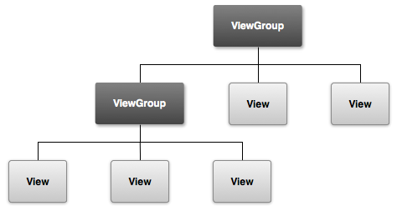
View Hierarchy
http://developer.android.com/guide/topics/ui/overview.html

Slide 17
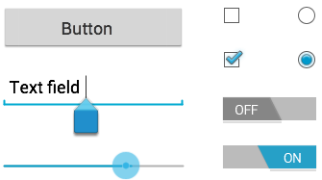
android.view.View
Known Direct Subclasses
AnalogClock, ImageView, KeyboardView, MediaRouteButton, ProgressBar, Space, SurfaceView, TextView, TextureView, ViewGroup, ViewStub
Known Indirect Subclasses
AbsListView, AbsSeekBar, AbsSpinner, AbsoluteLayout, AdapterView<T extends Adapter>, AdapterViewAnimator, AdapterViewFlipper, AppWidgetHostView, AutoCompleteTextView, Button, CalendarView, CheckBox, CheckedTextView, and 55 others.

Slide 18
android.view.ViewGroup
Known Direct Subclasses
AbsoluteLayout, AdapterView<T extends Adapter>, FragmentBreadCrumbs, FrameLayout, GridLayout, LinearLayout, PagerTitleStrip, RelativeLayout, SlidingDrawer, ViewPager
Known Indirect Subclasses
AbsListView, AbsSpinner, AdapterViewAnimator, AdapterViewFlipper, AppWidgetHostView, CalendarView, DatePicker, DialerFilter, ExpandableListView, FragmentTabHost, Gallery, GestureOverlayView, GridView, ListView and 21 others.

Slide 19
android.view.View & android.view.ViewGroup
java.lang.Object
↳android.view.View
↳android.view.ViewGroup

Slide 20
Layout resource (.xml)
<?xml version="1.0" encoding="utf-8"?> <ViewGroup xmlns:android="http://schemas.android.com/apk/res/android" android:id="@[+][package:]id/resource_name" android:layout_height=["dimension" | "fill_parent" | "wrap_content"] android:layout_width=["dimension" | "fill_parent" | "wrap_content"] [ViewGroup-specific attributes] > <View android:id="@[+][package:]id/resource_name" android:layout_height=["dimension" | "fill_parent" | "wrap_content"] android:layout_width=["dimension" | "fill_parent" | "wrap_content"] [View-specific attributes] > <requestFocus/> </View> <ViewGroup > <View /> </ViewGroup> <include layout="@layout/layout_resource"/> </ViewGroup>

Slide 21
Layout resource (.xml)
<?xml version="1.0" encoding="utf-8"?> <ViewGroup xmlns:android="http://schemas.android.com/apk/res/android" android:id="@[+][package:]id/resource_name" android:layout_height=["dimension" | "fill_parent" | "wrap_content"] android:layout_width=["dimension" | "fill_parent" | "wrap_content"] [ViewGroup-specific attributes] > <View android:id="@[+][package:]id/resource_name" android:layout_height=["dimension" | "fill_parent" | "wrap_content"] android:layout_width=["dimension" | "fill_parent" | "wrap_content"] [View-specific attributes] > <requestFocus/> </View> <ViewGroup > <View /> </ViewGroup> <include layout="@layout/layout_resource"/> </ViewGroup>

Slide 22
android:id
"@+id/<name>" – создать новый ресурс типа ID и сослаться на него
"@id/<name>" – ссылка на существующий ресурс типа ID

Slide 23
android:layout_height & android:layout_width
Value | Description
match_parent | Sets the dimension to match that of the parent element. Added in API Level 8 to deprecate fill_parent.
fill_parent | Sets the dimension to match that of the parent element.
wrap_content | Sets the dimension only to the size required to fit the content of this element.

Slide 24
Common Controls
Control Type | Description | Related Classes
Button | A push-button that can be pressed, or clicked, by the user to perform an action. | Button
Text field | An editable text field. You can use theAutoCompleteTextView widget to create a text entry widget that provides auto-complete suggestions | EditText, AutoCompleteTextView
Checkbox | An on/off switch that can be toggled by the user. You should use checkboxes when presenting users with a group of selectable options that are not mutually exclusive. | CheckBox
Radio button | Similar to checkboxes, except that only one option can be selected in the group. | RadioGroup RadioButton
http://developer.android.com/guide/topics/ui/controls.html

Slide 25
Common Controls
Control Type | Description | Related Classes
Toggle button | An on/off button with a light indicator. | ToggleButton
Spinner | A drop-down list that allows users to select one value from a set. | Spinner
Pickers | A dialog for users to select a single value for a set by using up/down buttons or via a swipe gesture. Use a DatePicker widget to enter the values for the date (month, day, year) or a TimePicker widget to enter the values for a time (hour, minute, AM/PM), which will be formatted automatically for the user's locale. | DatePicker, TimePicker
http://developer.android.com/guide/topics/ui/controls.html

Slide 26
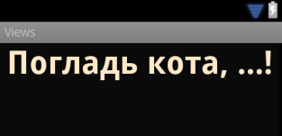
android.widget.TextView
<TextView android:id="@+id/pat_a_cat" android:layout_width="fill_parent" android:layout_height="wrap_content" android:text="@string/patacat" />

Slide 27

android.widget.Button android.widget.ImageButton
<Button android:layout_width="wrap_content" android:layout_height="wrap_content" android:text="@string/button_text” ... />
<ImageButton android:layout_width="wrap_content" android:layout_height="wrap_content" android:src="@drawable/button_icon”... />
<Button android:layout_width="wrap_content" android:layout_height="wrap_content" android:text="@string/button_text”
android:drawableLeft="@drawable/button_icon” ... />

Slide 28
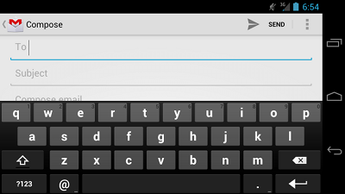
android.widget.EditText
<EditText android:id="@+id/email_address" android:layout_width="fill_parent" android:layout_height="wrap_content" android:hint="@string/email_hint" android:inputType="textEmailAddress" />
java.lang.Object
↳ android.view.View
↳ android.widget.TextView
↳ android.widget.EditText

Slide 29
android:inputType (1)
"text“
Normal text keyboard.
"textEmailAddress“
Normal text keyboard with the @ character.
"textUri“
Normal text keyboard with the / character.
"number“
Basic number keypad.
"phone“
Phone-style keypad.

Slide 30
android:inputType (2)
"textCapSentences“
Normal text keyboard that capitalizes the first letter for each new sentence.
"textCapWords“
Normal text keyboard that capitalizes every word. Good for titles or person names.
"textAutoCorrect“
Normal text keyboard that corrects commonly misspelled words.

Slide 31
android:inputType (3)
"textPassword“
Normal text keyboard, but the characters entered turn into dots.
"textMultiLine“
Normal text keyboard that allow users to input long strings of text that include line breaks (carriage returns).

Slide 32
android:inputType (4)
<EditText android:id="@+id/postal_address" android:layout_width="fill_parent" android:layout_height="wrap_content" android:hint="@string/postal_address_hint" android:inputType="textPostalAddress| textCapWords| textNoSuggestions" />

Slide 33

Keyboard Actions
<EditText android:id="@+id/search" android:layout_width="fill_parent" android:layout_height="wrap_content" android:hint="@string/search_hint" android:inputType="text" android:imeOptions="actionSend" />
http://developer.android.com/reference/android/widget/TextView.html#attr_android:imeOptions

Slide 34

android.widget.CheckBox
android.widget.Button
↳android.widget.CompoundButton
↳android.widget.CheckBox
<CheckBox android:id="@+id/checkbox_cheese" android:layout_width="wrap_content" android:layout_height="wrap_content" android:text="@string/cheese"/>

Slide 35

android.widget.RadioButton
android.widget.Button
↳android.widget.CompoundButton
↳android.widget.RadioButton
<RadioButton android:id="@+id/radio_ninjas" android:layout_width="wrap_content" android:layout_height="wrap_content" android:text="@string/ninjas"/>

Slide 36
android.widget.RadioGroup (1)
android.view.View
↳android.view.ViewGroup
↳android.widget.LinearLayout ↳android.widget.RadioGroup

Slide 37
android.widget.RadioGroup (2)
<?xml version="1.0" encoding="utf-8"?> <RadioGroup xmlns:android="http://schemas.android.com/apk/res/android" android:layout_width="fill_parent" android:layout_height="wrap_content" android:orientation="vertical"> <RadioButton android:id="@+id/radio_pirates" android:layout_width="wrap_content" android:layout_height="wrap_content" android:text="@string/pirates" android:onClick="onRadioButtonClicked"/> <RadioButton android:id="@+id/radio_ninjas" android:layout_width="wrap_content" android:layout_height="wrap_content" android:text="@string/ninjas" android:onClick="onRadioButtonClicked"/> </RadioGroup>

Slide 38

android.widget.ToggleButton
android.widget.Button
↳android.widget.CompoundButton
↳android.widget.ToggleButton
<ToggleButton android:id="@+id/togglebutton" android:layout_width="wrap_content" android:layout_height="wrap_content" android:textOn="On" android:textOff="off”/>

Slide 39
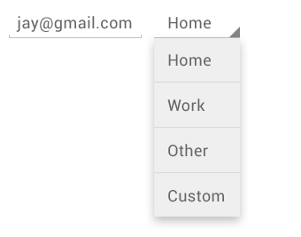
android.widget.Spinner
android.view.ViewGroup
↳android.widget.AdapterView<android.widget.SpinnerAdapter>
↳android.widget.AbsSpinner
↳android.widget.Spinner
<Spinner android:id="@+id/planets_spinner" android:layout_width="fill_parent" android:layout_height="wrap_content" />

Slide 40
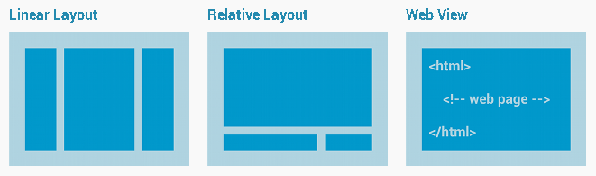
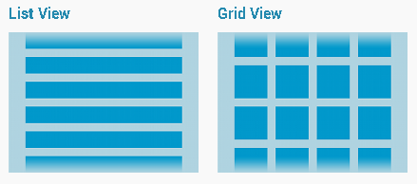
Layout Types
Common
Layouts
Building Layouts
with an Adapter

Slide 41
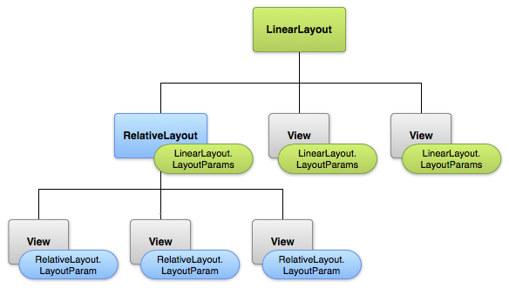
LayoutParams

Slide 42
Linear Layout
android.view.View
↳android.view.ViewGroup
↳android.widget.LinearLayout
XML Attributes:
android:orientation
android:gravity
android:layout_gravity
android:layout_weight
More: http://developer.android.com/reference/android/widget/LinearLayout.html

Slide 43
Relative Layout
android.view.View
↳android.view.ViewGroup
↳android.widget.RelativeLayout
XML Attributes:
android:gravity
android:layout_alignParentTop
android:layout_below
android:layout_toRightOf
More: http://developer.android.com/reference/android/widget/RelativeLayout.html

Slide 44
RelativeLayout.LayoutParams
Attribute Name | Description
android:layout_above | Positions the bottom edge of this view above the given anchor view ID.
android:layout_alignBaseline | Positions the baseline of this view on the baseline of the given anchor view ID.
android:layout_alignBottom | Makes the bottom edge of this view match the bottom edge of the given anchor view ID.
android:layout_alignEnd | Makes the end edge of this view match the end edge of the given anchor view ID.
android:layout_alignLeft | Makes the left edge of this view match the left edge of the given anchor view ID.
android:layout_alignParentBottom | If true, makes the bottom edge of this view match the bottom edge of the parent.
android:layout_alignParentEnd | If true, makes the end edge of this view match the end edge of the parent.
android:layout_alignParentLeft | If true, makes the left edge of this view match the left edge of the parent.
android:layout_alignParentRight | If true, makes the right edge of this view match the right edge of the parent.
android:layout_alignParentStart | If true, makes the start edge of this view match the start edge of the parent.
android:layout_alignParentTop | If true, makes the top edge of this view match the top edge of the parent.
android:layout_alignRight | Makes the right edge of this view match the right edge of the given anchor view ID.
android:layout_alignStart | Makes the start edge of this view match the start edge of the given anchor view ID.
android:layout_alignTop | Makes the top edge of this view match the top edge of the given anchor view ID.
android:layout_alignWithParentIfMissing | If set to true, the parent will be used as the anchor when the anchor cannot be be found for layout_toLeftOf, layout_toRightOf, etc.
android:layout_below | Positions the top edge of this view below the given anchor view ID.
android:layout_centerHorizontal | If true, centers this child horizontally within its parent.
android:layout_centerInParent | If true, centers this child horizontally and vertically within its parent.
android:layout_centerVertical | If true, centers this child vertically within its parent.
android:layout_toEndOf | Positions the start edge of this view to the end of the given anchor view ID.
android:layout_toLeftOf | Positions the right edge of this view to the left of the given anchor view ID.
android:layout_toRightOf | Positions the left edge of this view to the right of the given anchor view ID.
android:layout_toStartOf | Positions the end edge of this view to the start of the given anchor view ID.

Slide 45
Layout: Root Element
ViewGroup
LinearLayout, RelativeLayout, FrameLayout, etc.
View
TextView, Button, CheckBox, etc.
<merge>
An alternative root element that is not drawn in the layout hierarchy

Slide 46
<include>
<include layout="@layout/layout_resource“
android:id="@[+][package:]id/resource_name" android:layout_height=["dimension" | "fill_parent" | "wrap_content"] android:layout_width=["dimension" | "fill_parent" | "wrap_content"] />

Slide 47
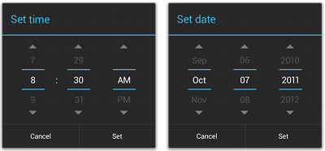
Pickers
android.app.Dialog
↳android.app.AlertDialog
↳android.app.TimePickerDialog
↳android.app.DatePickerDialog
See: http://developer.android.com/guide/topics/ui/controls/pickers.html

Slide 48
Drawables
Ресурсы Android

Slide 49
Drawable
Bitmap files (png, 9.png, jpg, gif)
See \Android\android-sdk\tools\draw9patch.bat
State lists
Shapes

Slide 50
Drawable: State Lists
Layer List
A Drawable that manages an array of other Drawables. These are drawn in array order, so the element with the largest index is be drawn on top.
State List
An XML file that references different bitmap graphics for different states (for example, to use a different image when a button is pressed)
Level List
An XML file that defines a drawable that manages a number of alternate Drawables, each assigned a maximum numerical value

Slide 51

Drawable: Layer List Определение
<?xml version="1.0" encoding="utf-8"?> <layer-list xmlns:android="http://schemas.android.com/apk/res/android" > <item android:drawable="@[package:]drawable/drawable_resource" android:id="@[+][package:]id/resource_name" android:top="dimension" android:right="dimension" android:bottom="dimension" android:left="dimension" /> </layer-list>

Slide 52



Drawable: State List Определение
<?xml version="1.0" encoding="utf-8"?> <selector xmlns:android="http://schemas.android.com/apk/res/android" android:constantSize=["true" | "false"] android:dither=["true" | "false"] android:variablePadding=["true" | "false"] > <item android:drawable="@[package:]drawable/drawable_resource" android:state_pressed=["true" | "false"] android:state_focused=["true" | "false"] android:state_hovered=["true" | "false"] android:state_selected=["true" | "false"] android:state_checkable=["true" | "false"] android:state_checked=["true" | "false"] android:state_enabled=["true" | "false"] android:state_activated=["true" | "false"] android:state_window_focused=["true" | "false"] /> </selector>

Slide 53
Drawable: State List Пример
<?xml version="1.0" encoding="utf-8"?> <selector xmlns:android="http://schemas.android.com/apk/res/android"> <item android:state_pressed="true" android:drawable="@drawable/button_pressed" /> <!-- pressed --> <item android:state_focused="true" android:drawable="@drawable/button_focused" /> <!-- focused --> <item android:state_hovered="true" android:drawable="@drawable/button_focused" /> <!-- hovered --> <item android:drawable="@drawable/button_normal" /> <!-- default --> </selector>

Slide 54
Drawable: Level List Определение
<?xml version="1.0" encoding="utf-8"?> <level-list xmlns:android="http://schemas.android.com/apk/res/android" > <item android:drawable="@drawable/drawable_resource" android:maxLevel="integer" android:minLevel="integer" /> </level-list>

Slide 55
Drawable: Level List Пример
<?xml version="1.0" encoding="utf-8"?> <level-list xmlns:android="http://schemas.android.com/apk/res/android" > <item android:drawable="@drawable/status_off" android:maxLevel="0" /> <item android:drawable="@drawable/status_on" android:maxLevel="1" /> </level-list>

Slide 56
Drawable: Other (1)
Transition Drawable
An XML file that defines a drawable that can cross-fade between two drawable resources
Inset Drawable
An XML file that defines a drawable that insets another drawable by a specified distance. This is useful when a View needs a background drawble that is smaller than the View's actual bounds.

Slide 57
Drawable: Other (2)
Clip Drawable
An XML file that defines a drawable that clips another Drawable based on this Drawable's current level value
Scale Drawable
An XML file that defines a drawable that changes the size of another Drawable based on its current level value

Slide 58
Drawable: Shape (1)
<?xml version="1.0" encoding="utf-8"?> <shape xmlns:android="http://schemas.android.com/apk/res/android" android:shape=["rectangle" | "oval" | "line" | "ring"] > <corners android:radius="integer" android:topLeftRadius="integer" android:topRightRadius="integer" android:bottomLeftRadius="integer" android:bottomRightRadius="integer" /> <gradient android:angle="integer" android:centerX="integer" android:centerY="integer" android:centerColor="integer" android:endColor="color" android:gradientRadius="integer" android:startColor="color" android:type=["linear" | "radial" | "sweep"] android:useLevel=["true" | "false"] />

Slide 59
Drawable: Shape (2)
<padding android:left="integer" android:top="integer" android:right="integer" android:bottom="integer" /> <size android:width="integer" android:height="integer" /> <solid android:color="color" /> <stroke android:width="integer" android:color="color" android:dashWidth="integer" android:dashGap="integer" /> </shape>

Slide 60
Drawable: Shape Пример
<?xml version="1.0" encoding="utf-8"?> <shape xmlns:android="http://schemas.android.com/apk/res/android" android:shape="rectangle"> <gradient android:startColor="#FFFF0000" android:endColor="#80FF00FF" android:angle="45"/> <padding android:left="7dp" android:top="7dp" android:right="7dp" android:bottom="7dp" /> <corners android:radius="8dp" /> </shape>

Slide 61
Values
Ресурсы Android

Slide 62
Values
String, String Array, Quantity Strings (Plurals)
Style
Bool
Color
Dimesion
ID
Integer
Integer Array
Typed Array

Slide 63
Values: String (1)
String
XML resource that provides a single string
String Array
XML resource that provides an array of strings
Quantity Strings (Plurals)
XML resource that carries different strings for pluralization

Slide 64
Values: String (2)
<?xml version="1.0" encoding="utf-8"?> <resources> <string name="string_name" >text_string</string> </resources>
<?xml version="1.0" encoding="utf-8"?> <resources> <string name="hello">Hello!</string> </resources>

Slide 65
Values: String Array Определение
<?xml version="1.0" encoding="utf-8"?> <resources> <string-array name="string_array_name"> <item >text_string</item> </string-array> </resources>

Slide 66
Values: String Array Пример
<?xml version="1.0" encoding="utf-8"?> <resources> <string-array name="planets_array"> <item>Mercury</item> <item>Venus</item> <item>Earth</item> <item>Mars</item> </string-array> </resources>

Slide 67
Values: Quantity Strings (Plurals) Определение
<?xml version="1.0" encoding="utf-8"?> <resources> <plurals name="plural_name"> <item quantity=["zero" | "one" | "two" | "few" | "many" | "other"] >text_string</item> </plurals> </resources>

Slide 68
Values: Quantity Strings (Plurals) Пример
<?xml version="1.0" encoding="utf-8"?> <resources> <plurals name="numberOfSongsAvailable"> <item quantity="one">One song found.</item> <item quantity="other">%d songs found.</item> </plurals> </resources>
<?xml version="1.0" encoding="utf-8"?> <resources> <plurals name="numberOfSongsAvailable"> <item quantity="one">Znaleziono jedną piosenkę.</item> <item quantity="few">Znaleziono %d piosenki.</item> <item quantity="other">Znaleziono %d piosenek.</item> </plurals> </resources>

Slide 69
Values (other)
<?xml version="1.0" encoding="utf-8"?> <resources> <bool name="screen_small">true</bool>
<color name="translucent_red">#80ff0000</color>
<item type="id" name="button_ok" />
<integer name="max_speed">75</integer>
<integer-array name="bits"> <item>4</item> <item>8</item> </integer-array>
<array name="icons"> <item>@drawable/home</item> <item>@drawable/settings</item> </array>
<array name="colors"> <item>#FFFF0000</item> <item>#FF00FF00</item> </array>
</resources>

Slide 70
Values: Dimension (1)
<?xml version="1.0" encoding="utf-8"?> <resources> <dimen name="textview_height">25dp</dimen> <dimen name="textview_width">150dp</dimen> <dimen name="ball_radius">30dp</dimen> <dimen name="font_size">16sp</dimen> </resources>

Slide 71
Values: Dimension (2)
“px”
Pixels
“mm”
Millimeters
“in”
Inches

Slide 72
Values: Dimension (3)
“dp”
Density-independent Pixels - An abstract unit that is based on the physical density of the screen.
“sp”
Scale-independent Pixels - This is like the dp unit, but it is also scaled by the user's font size preference.
“pt”
Points - 1/72 of an inch.

Slide 73
Демонстрация

