Slide 1
Проектирование мобильных приложений
Android: Content Providers
https://developer.android.com/guide/topics/providers/content-providers
Кузнецов
Андрей Николаевич
Санкт-Петербургский Государственный
Политехнический Университет

Slide 2
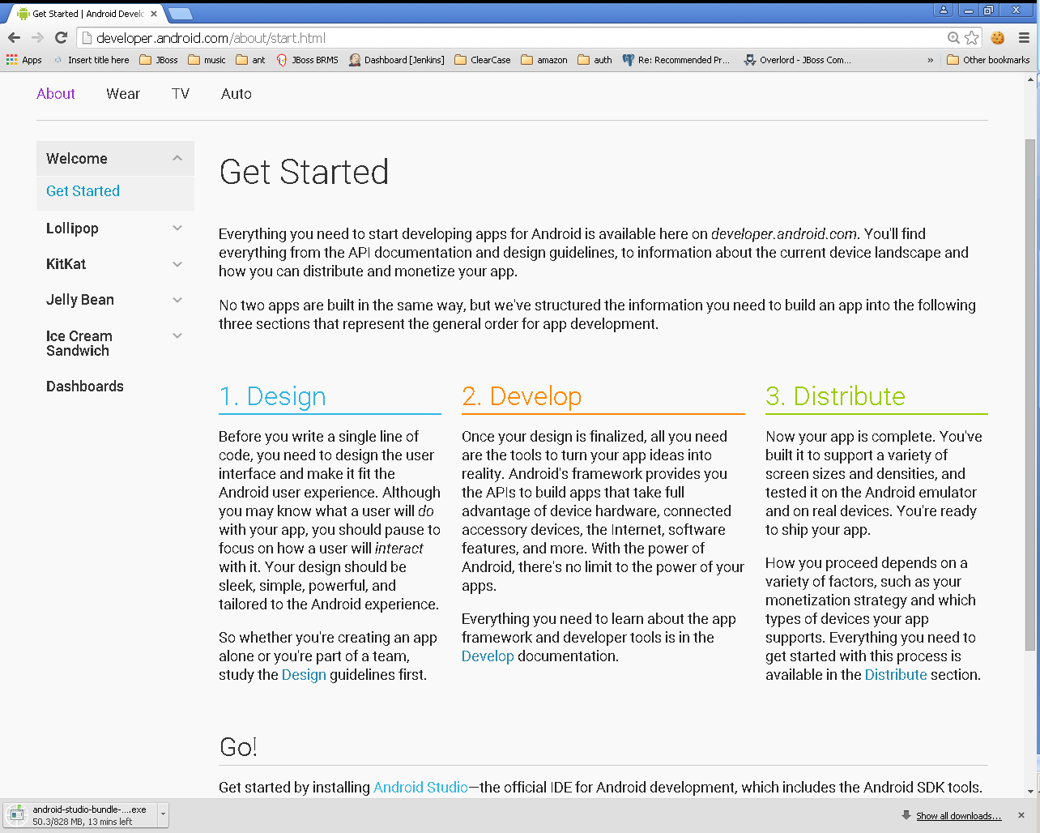

Slide 3
В предыдущих лекциях...
Activities
Services
Content Providers
Broadcast Receivers
Intents
As a developer we need only to call and extend these already defined classes to use in our application.

Slide 4
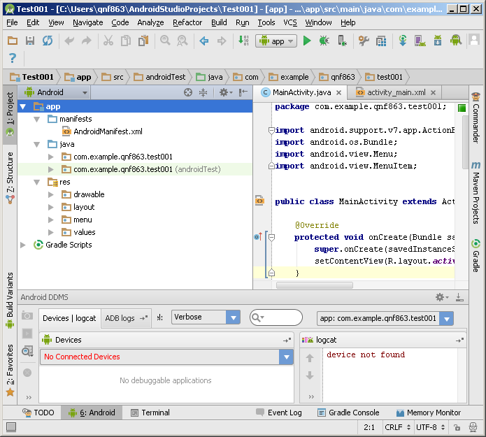
В предыдущих лекциях...

Slide 5
В предыдущих лекциях...
./animator/*
./anim/*
./xml/*
./drawable/*
Bitmap files (png, 9.png, jpg, gif)
State lists
Shapes
Other drawables
./layout/*
./menu/*
./raw/*
./values/*
arrays.xml
colors.xml
dimens.xml
strings.xml
styles.xml

Slide 6
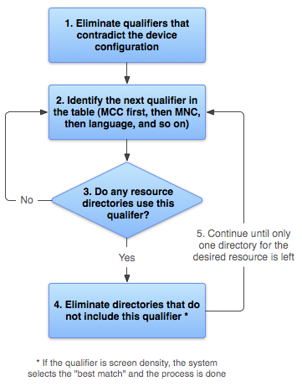
http://developer.android.com/guide/topics/resources/providing-resources.html

Slide 7
В предыдущих лекциях...
<?xml version="1.0" encoding="utf-8"?> <manifest> <uses-permission /> <permission /> <permission-tree /> <permission-group /> <instrumentation /> <uses-sdk /> <uses-configuration /> <uses-feature /> <supports-screens /> <compatible-screens /> <supports-gl-texture /> <application> <activity> <intent-filter> <action /> <category /> <data /> </intent-filter> <meta-data /> </activity>
<activity-alias> <intent-filter> . . . </intent-filter> <meta-data /> </activity-alias> <service> <intent-filter> . . . </intent-filter> <meta-data/> </service> <receiver> <intent-filter> . . . </intent-filter> <meta-data /> </receiver> <provider> <grant-uri-permission /> <meta-data /> <path-permission /> </provider> <uses-library /> </application> </manifest>

Slide 8
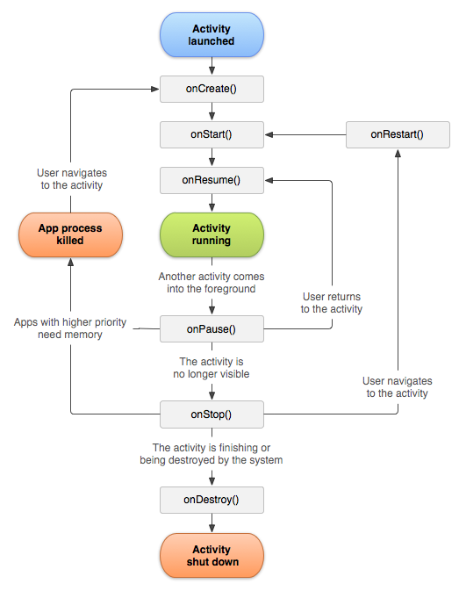
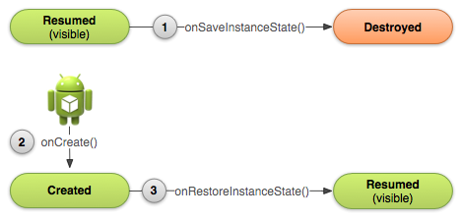
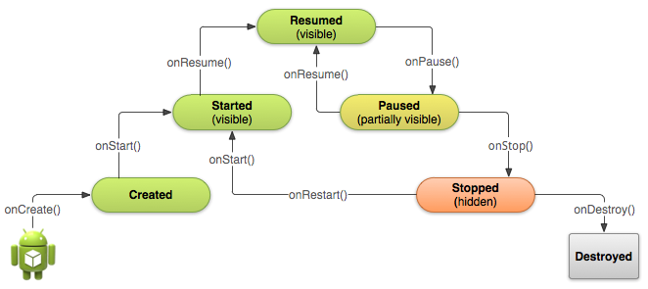

Slide 9
В предыдущих лекциях...
Explicit Intent
Implicit intent
Component
Extras
Flags
Action
Data
Category
Extras
Flags

Slide 10
В предыдущих лекциях...
Foreground process
Visible process
Service process
Background process
Empty process

Slide 11
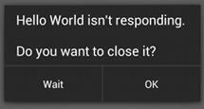
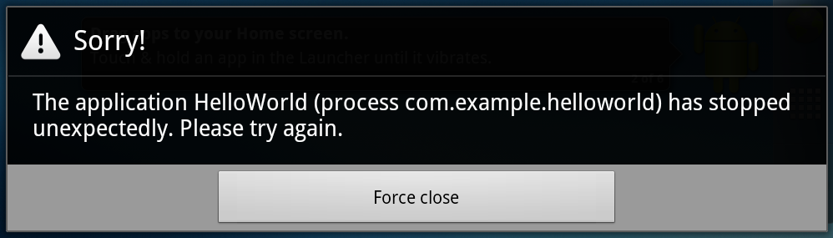
В предыдущих лекциях...
Do not block the UI thread
"application not responding" (ANR) dialog
Do not access the Android UI toolkit from outside the UI thread

Slide 12
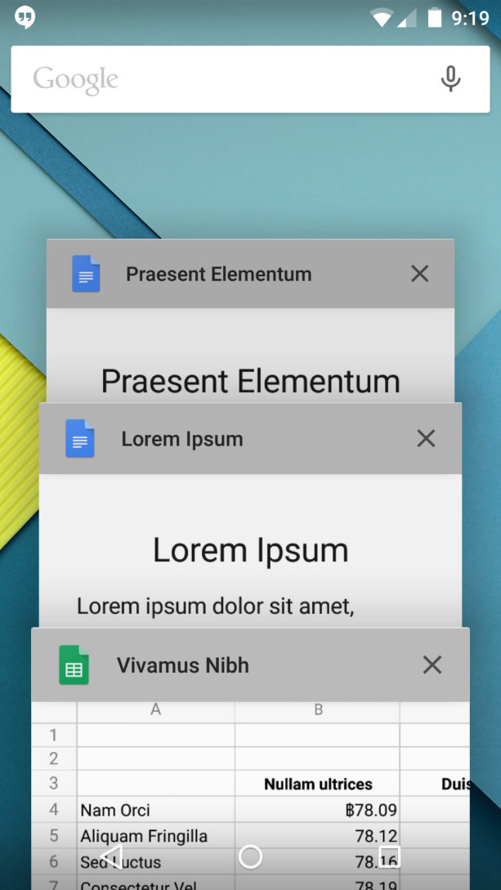
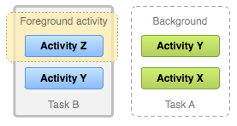
В предыдущих лекциях...

Slide 13
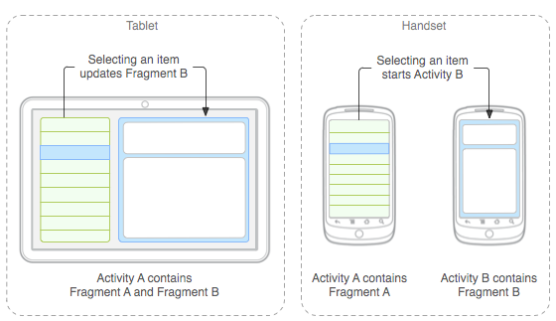
В предыдущих лекциях...

Slide 14
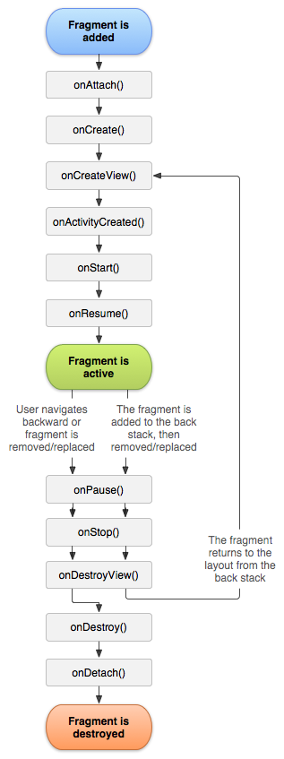
В предыдущих лекциях...

Slide 15
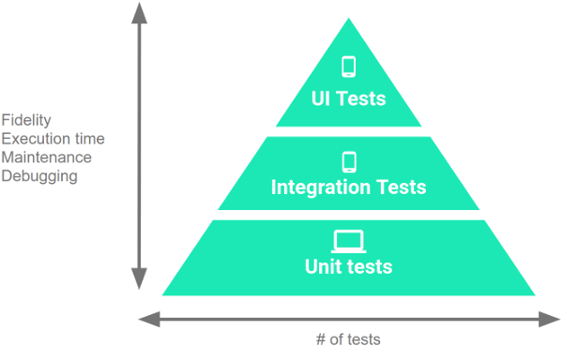
В предыдущих лекциях...
Instrumented
(device/emulator)
10%
20%
Local JVM
70%

Slide 16
Broadcast Receivers: Basics
pub-sub pattern
Publish/Subscribe
Android посылает Broadcast:
ACTION_POWER_CONNECTED
ACTION_TIMEZONE_CHANGED
https://developer.android.com/reference/android/content/Intent#standard-broadcast-actions – и т.п.
Приложение может:
Получать Broadcast
Посылать Broadcast

Slide 17
В предыдущих лекциях...
2 типа сервисов
Started
startService()
Сервис должен сам себя остановить
Non-IPC
Bound
bindService()
Будет остановлен, когда больше нет клиентов
IPC

Slide 18
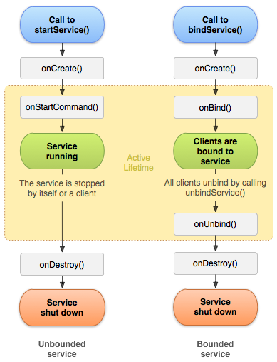
В предыдущих лекциях...

Slide 19
Content Providers
http://developer.android.com/guide/topics/providers/content-providers.html

Slide 20
Content Provider
Стандартный интерфейс для предоставления структурированных данных из одного приложения в другое
Secure IPC
Может иметь собственный UI
Встроенные провайдеры:
Calendar, Contacts, Media Store, User Dictionary, etc.

Slide 21
Content Provider & Resolver
Клиент работает с Content Resolver
android.content.ContentResolver
Content Resolver работает с Content Provider’ом
… extends android.content.ContentProvider
Content Provider получает запросы от клиента, обрабатывает и возвращает результат

Slide 22
"CRUD" (create, retrieve, update, and delete)
Content Resolver
Content Provider
query
insert
update
delete
query
insert
update
delete

Slide 23
Content Provider: Basics
Content Provider представляет данные в виде набора таблиц
Аналогично РБД
word | app id | frequency | locale | _ID
mapreduce | user1 | 100 | en_US | 1
precompiler | user14 | 200 | fr_FR | 2

Slide 24
Content Provider & Resolver Основные методы
Cursor query (Uri uri, String[] projection, String selection, String[] selectionArgs, String sortOrder)
Uri insert (Uri uri, ContentValues values)
int update (Uri uri, ContentValues values, String selection, String[] selectionArgs)
int delete (Uri uri, String selection, String[] selectionArgs)
String getType (Uri uri)
returns the MIME type of data in the content provider

Slide 25
Content Provider & Resolver (1)
По умолчанию все компоненты работают в UI-Thread процесса, в котором они определены, кроме Content Provider*
Разработчик провайдера предоставляет вспомогательные классы (Contract)
* query(), insert(),delete(), update(), and getType()—are called from a pool of threads in the content provider's process, not the UI thread for the process.

Slide 26
Content Provider Query & SQL
mCursor = getContentResolver().query( UserDictionary.Words.CONTENT_URI, // The content URI of the words table mProjection, // The columns to return for each row mSelectionClause // Selection criteria mSelectionArgs, // Selection criteria mSortOrder); // The sort order for the returned rows
Uri | FROM table_name | Uri maps to the table in the provider named table_name.
projection | col,col,col,... | projection is an array of columns that should be included for each row retrieved.
selection | WHERE col =value | selection specifies the criteria for selecting rows.
selectionArgs | (No exact equivalent. Selection arguments replace ? placeholders in the selection clause.)
sortOrder | ORDER BYcol,col,... | sortOrder specifies the order in which rows appear in the returned Cursor.

Slide 27
Content Provider. URI
URI= scheme://host:port/path
URI authority = host:port
URI authority идентифицирует провайдера
content://user_dictionary/
URI path идентифицирует
Таблицу
content://user_dictionary/words
Строку в таблице
content://user_dictionary/words/4

Slide 28
Content Provider: URI Замечание
Для работы с URI есть вспомогательные классы:
Uri
Uri.Builder
ContentUris
Uri singleUri = ContentUris.withAppendedId(UserDictionary.Words.CONTENT_URI,4);

Slide 29
query (provider)
public abstract Cursor query (Uri uri, String[] projection, String selection, String[] selectionArgs, String sortOrder[, CancellationSignal cancellationSigna])
Implement this to handle query requests from clients
[CancellationSignal cancellationSigna] добавлен в API 16

Slide 30
query (resolver)
public final Cursor query (Uri uri, String[] projection, String selection, String[] selectionArgs, String sortOrder [, CancellationSignal cancellationSigna])
Cursor mCursor = getContentResolver().query ( UserDictionary.Words.CONTENT_URI
mProjection, // Which columns to return. mSelectionClause, // WHERE clause. mSelectionArgs, // WHERE clause value substitution People.NAME + " ASC"); // Sort order.
// A "projection" defines the columns that will be returned for each row String[] mProjection = { UserDictionary.Words._ID, // Contract class constant for the _ID column name UserDictionary.Words.WORD, // Contract class constant for the word column name UserDictionary.Words.LOCALE // Contract class constant for the locale column name }; // Defines a string to contain the selection clause String mSelectionClause = UserDictionary.Words.WORD + " = ?"; // Initializes an array to contain selection arguments String[] mSelectionArgs = {“Search"};

Slide 31
android.database.Cursor
This interface provides random read-write access to the result set returned by a database query.
Некоторые методы:
int getColumnCount ()
String[] getColumnNames ()
double getDouble (int columnIndex)
String getString (int columnIndex)
int getType (int columnIndex)
boolean moveToNext ()
boolean moveToFirst ()
boolean requery ()
void close ()

Slide 32
Отображение данных с помощью адаптера
// Defines a list of columns to retrieve from the Cursor and load into an output row String[] mWordListColumns = { UserDictionary.Words.WORD, // Contract class constant containing the word column name UserDictionary.Words.LOCALE // Contract class constant containing the locale column name }; // Defines a list of View IDs that will receive the Cursor columns for each row int[] mWordListItems = { R.id.dictWord, R.id.locale}; // Creates a new SimpleCursorAdapter mCursorAdapter = new SimpleCursorAdapter( getApplicationContext(), // The application's Context object R.layout.wordlistrow, // A layout in XML for one row in the ListView mCursor, // The result from the query mWordListColumns, // A string array of column names in the cursor mWordListItems, // An integer array of view IDs in the row layout 0); // Flags (usually none are needed) // Sets the adapter for the ListView mWordList.setAdapter(mCursorAdapter);

Slide 33
insert (provider)
public abstract Uri insert (Uri uri, ContentValues values)
Implement this to handle requests to insert a new row.

Slide 34
insert (resolver)
public final Uri insert (Uri uri, ContentValues values)
mNewValues.put(UserDictionary.Words.APP_ID, "example.user"); mNewValues.put(UserDictionary.Words.LOCALE, "en_US"); mNewValues.put(UserDictionary.Words.WORD, "insert"); mNewValues.put(UserDictionary.Words.FREQUENCY, "100"); mNewUri = getContentResolver().insert( UserDictionary.Word.CONTENT_URI, // the user dictionary content URI mNewValues // the values to insert );

Slide 35
android.content.ContentValues
This class is used to store a set of values that the ContentResolver can process.
Некоторые методы
void put (String key, Byte value)
void put (String key, Integer value)
void put (String key, Float value)
void put (String key, Short value)
...

Slide 36
update (provider)
public abstract int update (Uri uri, ContentValues values, String selection, String[] selectionArgs)
Implement this to handle requests to update one or more rows.
The implementation should update all rows matching the selection to set the columns according to the provided values map.

Slide 37
update (resolver)
public final int update (Uri uri, ContentValues values, String selection, String[] selectionArgs)
ContentValues mUpdateValues = new ContentValues(); // Defines selection criteria for the rows you want to update String mSelectionClause = UserDictionary.Words.LOCALE + "LIKE ?"; String[] mSelectionArgs = {"en_%"}; // Defines a variable to contain the number of updated rows int mRowsUpdated = 0; /* * Sets the updated value and updates the selected words. */ mUpdateValues.putNull(UserDictionary.Words.LOCALE); mRowsUpdated = getContentResolver().update( UserDictionary.Words.CONTENT_URI, // the user dictionary content URI mUpdateValues // the columns to update mSelectionClause // the column to select on mSelectionArgs // the value to compare to );

Slide 38
delete (provider)
public abstract int delete (Uri uri, String selection, String[] selectionArgs)
Implement this to handle requests to delete one or more rows.
The implementation should apply the selection clause when performing deletion, allowing the operation to affect multiple rows in a directory.

Slide 39
delete (resolver)
public final int delete (Uri uri, String selection, String[] selectionArgs)
// Defines selection criteria for the rows you want to delete String mSelectionClause = UserDictionary.Words.APP_ID + " LIKE ?"; String[] mSelectionArgs = {"user"}; // Defines a variable to contain the number of rows deleted int mRowsDeleted = 0; ... // Deletes the words that match the selection criteria mRowsDeleted = getContentResolver().delete( UserDictionary.Words.CONTENT_URI, // the user dictionary content URI mSelectionClause // the column to select on mSelectionArgs // the value to compare to );

Slide 40
getType
public abstract String getType (Uri uri)
Implement this to handle requests for the MIME type of the data at the given URI. The returned MIME type should start with vnd.android.cursor.item for a single record, or vnd.android.cursor.dir for multiple items.
The subtype is provider-specific.
Note that there are no permissions needed for an application to access this information
vnd.android.cursor.item/phone_v2
vnd.android.cursor.dir/vnd.example.line1

Slide 41
Content Provider: Безопасность
Провайдер объявляет в AndroidManifest
android:readPermission="string"
android:writePermission="string"
android:exported=["true" | "false"]
android:grantUriPermissions=["true" | "false"]
<path-permission>
<grant-uri-permission>
Клиент объявляет в AndroidManifest
<uses-permission>

Slide 42
Permissions (provider)
<provider android:authorities="list" android:enabled=["true" | "false"] android:exported=["true" | "false"] android:grantUriPermissions=["true" | "false"] android:permission="string” android:readPermission="string” android:writePermission="string“
. . . > <path-permission>...</path-permission>
<grant-uri-permission android:path="string" android:pathPattern="string" android:pathPrefix="string" />
. . . </provider>
http://developer.android.com/guide/topics/manifest/provider-element.html

Slide 43
Permissions (provider)
“If a provider's application doesn't specify any permissions, then other applications have no access to the provider's data.” (https://developer.android.com/guide/topics/providers/content-provider-basics)
WAT?! “All applications can read from or write to your provider, even if the underlying data is private, because by default your provider does not have permissions set.” (https://developer.android.com/guide/topics/providers/content-provider-creating)
However, components in the provider's application always have full read and write access, regardless of the specified permissions.

Slide 44
Permissions (client)
<uses-permission> в AndroidManifest
Строка. Определяется разработчиком провайдера
Ex: android.permission.READ_USER_DICTIONARY
Имя permission надо искать в документации провайдера

Slide 45
Напоминание
void startActivityForResult (Intent intent, int requestCode)
void setResult (int resultCode)
void onActivityResult (int requestCode, int resultCode, Intent data)

Slide 46
Temporary URI Permission (via Intent)
Приложение, имеющее права на доступ, предоставляет временное разрешение на определенные URI с помощью Intent.flags:
FLAG_GRANT_READ_URI_PERMISSION
FLAG_GRANT_WRITE_URI_PERMISSION
См. http://developer.android.com/guide/topics/providers/content-provider-basics.html#Intents

Slide 47
Temporary URI Permission Пример (Contacts)
startActivityForResult().
ACTION_PICK and MIME=CONTENT_ITEM_TYPE
Открывается приложение «контакты»
Пользователь выбирает контакт
setResult(resultcode, intent)
The intent contains the content URI
"extras" flags FLAG_GRANT_READ_URI_PERMISSION.
onActivityResult()
Можно читать 1 (выбранный) контакт

Slide 48
Contract class
A contract class defines constants that help applications work with the content URIs, column names, intent actions, and other features of a content provider.
Contract classes are not included automatically with a provider; the provider's developer has to define them and then make them available to other developers.

Slide 49
Contract class Пример
android.provider.UserDictionary
http://grepcode.com/file_/repository.grepcode.com/java/ext/com.google.android/android/4.0.1_r1/android/provider/UserDictionary.java/?v=source
// Deletes the words that match the selection criteria mRowsDeleted = getContentResolver().delete( UserDictionary.Words.CONTENT_URI, // the user dictionary content URI mSelectionClause // the column to select on mSelectionArgs // the value to compare to );

Slide 50
Creating a Content Provider (1)
java.lang.Object
↳android.content.ContentProvider

Slide 51
Creating a Content Provider (2)
onCreate() - called to initialize the provider
query(Uri, String[], String, String[], String) which returns data to the caller
insert(Uri, ContentValues) which inserts new data into the content provider
update(Uri, ContentValues, String, String[]) which updates existing data in the content provider
delete(Uri, String, String[]) which deletes data from the content provider
getType(Uri) which returns the MIME type of data in the content provider

Slide 52
Storage Access Framework Android 4.4 (API 19+)
Специальный тип Content Provideer’а
http://developer.android.com/guide/topics/providers/document-provider.html

Slide 53
Storage Access Framework (SAF) Android 4.4 (API 19+)
SAF делает проще для пользователя доступ к файлам (документам, картинкам и т.п.), хранящимся в разных хранилищах (Google Drive, SD card, и т.п.)
Сетевые и локальные хранилища могут предоставить SAF доступ к своим сервисам с помощью класса DocumentsProvider .

Slide 54
Доступ к контенту (до SAF)
On Android 4.3 and lower, if you want your app to retrieve a file from another app, it must invoke an intent such as ACTION_PICK or ACTION_GET_CONTENT. The user must then select a single app from which to pick a file and the selected app must provide a user interface for the user to browse and pick from the available files.

Slide 55
Доступ к контенту (SAF)
On Android 4.4 and higher, you have the additional option of using the ACTION_OPEN_DOCUMENT intent, which displays a picker UI controlled by the system that allows the user to browse all files that other apps have made available. From this single UI, the user can pick a file from any of the supported apps.

Slide 56
Доступ к контенту (SAF)
ACTION_OPEN_DOCUMENT не призван заменить собой ACTION_GET_CONTENT.
Actions преследуют разные цели

Slide 57
ACTION_OPEN_DOCUMENT vs. ACTION_GET_CONTENT
ACTION_GET_CONTENT
ACTION_OPEN_DOCUMENT
Use ACTION_GET_CONTENT if you want your app to simply read/import data. With this approach, the app imports a copy of the data, such as an image file.
Use ACTION_OPEN_DOCUMENT if you want your app to have long term, persistent access to documents owned by a document provider
Пример: a photo-editing app that lets users edit images stored in a document provider.

Slide 58
Элементы SAF
Document provider—Content provider.
Client app—A custom app that invokes the ACTION_OPEN_DOCUMENTand/or ACTION_CREATE_DOCUMENT intent and receives the files returned by document providers.
Picker—A system UI that lets users access documents from all document providers that satisfy the client app's search criteria.

Slide 59
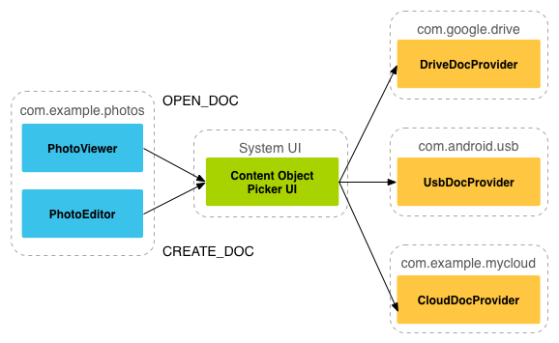
Storage Access Framework Flow
https://developer.android.com/images/providers/storage_dataflow.png

Slide 60
Элементы SAF Document provider
java.lang.Object
↳android.content.ContentProvider
↳android.provider.DocumentsProvider
Built-in document providers
Downloads, Images, Videos

Slide 61

Элементы SAF Document provider
The document-provider schema is based on a traditional file hierarchy
though how your document provider physically stores data is up to you.

Slide 62
Элементы SAF Client app
Client app—A custom app that invokes the ACTION_OPEN_DOCUMENTand/or ACTION_CREATE_DOCUMENT intent and receives the files returned by document providers.

Slide 63
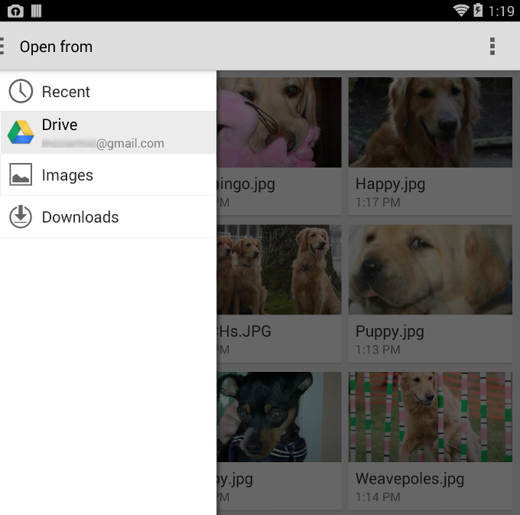
Элементы SAF Picker
Picker—A system UI that lets users access documents from all document providers that satisfy the client app's search criteria.

Slide 64
Поиск документа (пример)
private static final int READ_REQUEST_CODE = 42; ... /** * Fires an intent to spin up the "file chooser" UI and select an image. */ public void performFileSearch() { // ACTION_OPEN_DOCUMENT is the intent to choose a file via the system's file // browser. Intent intent = new Intent(Intent.ACTION_OPEN_DOCUMENT); // Filter to only show results that can be "opened", such as a // file (as opposed to a list of contacts or timezones) intent.addCategory(Intent.CATEGORY_OPENABLE); // Filter to show only images, using the image MIME data type. // If one wanted to search for ogg vorbis files, the type would be "audio/ogg". // To search for all documents available via installed storage providers, // it would be "*/*". intent.setType("image/*"); startActivityForResult(intent, READ_REQUEST_CODE); }

Slide 65
Обработка результатов (пример)
@Override public void onActivityResult(int requestCode, int resultCode, Intent resultData) { // The ACTION_OPEN_DOCUMENT intent was sent with the request code // READ_REQUEST_CODE. If the request code seen here doesn't match, it's the // response to some other intent, and the code below shouldn't run at all. if (requestCode == READ_REQUEST_CODE && resultCode == Activity.RESULT_OK) { // The document selected by the user won't be returned in the intent. // Instead, a URI to that document will be contained in the return intent // provided to this method as a parameter. // Pull that URI using resultData.getData(). Uri uri = null; if (resultData != null) { uri = resultData.getData(); Log.i(TAG, "Uri: " + uri.toString()); showImage(uri); } } }

Slide 66
Обработка метаданных (пример)
public void dumpImageMetaData(Uri uri) { // The query, since it only applies to a single document, will only return // one row. There's no need to filter, sort, or select fields, since we want // all fields for one document. Cursor cursor = getActivity().getContentResolver() .query(uri, null, null, null, null, null); try { // moveToFirst() returns false if the cursor has 0 rows. Very handy for // "if there's anything to look at, look at it" conditionals. if (cursor != null && cursor.moveToFirst()) { // Note it's called "Display Name". This is // provider-specific, and might not necessarily be the file name. String displayName = cursor.getString(
cursor.getColumnIndex(OpenableColumns.DISPLAY_NAME)); Log.i(TAG, "Display Name: " + displayName); int sizeIndex = cursor.getColumnIndex(OpenableColumns.SIZE); String size = null; if (!cursor.isNull(sizeIndex)) { // Technically the column stores an int, but cursor.getString() // will do the conversion automatically. size = cursor.getString(sizeIndex); } else { size = "Unknown"; } Log.i(TAG, "Size: " + size); } } finally { cursor.close(); } }

Slide 67
Обработка метаданных (пример)
public void dumpImageMetaData(Uri uri) { // The query, since it only applies to a single document, will only return // one row. There's no need to filter, sort, or select fields, since we want // all fields for one document. Cursor cursor = getActivity().getContentResolver() .query(uri, null, null, null, null, null); try { // moveToFirst() returns false if the cursor has 0 rows. Very handy for // "if there's anything to look at, look at it" conditionals. if (cursor != null && cursor.moveToFirst()) { // Note it's called "Display Name". This is // provider-specific, and might not necessarily be the file name. String displayName = cursor.getString(
cursor.getColumnIndex(OpenableColumns.DISPLAY_NAME)); Log.i(TAG, "Display Name: " + displayName); int sizeIndex = cursor.getColumnIndex(OpenableColumns.SIZE); String size = null; if (!cursor.isNull(sizeIndex)) { // Technically the column stores an int, but cursor.getString() // will do the conversion automatically. size = cursor.getString(sizeIndex); } else { size = "Unknown"; } Log.i(TAG, "Size: " + size); } } finally { cursor.close(); } }

Slide 68
Доступ к содержимому (пример FileDescriptor)
private Bitmap getBitmapFromUri(Uri uri) throws IOException { ParcelFileDescriptor parcelFileDescriptor = getContentResolver().openFileDescriptor(uri, "r"); FileDescriptor fileDescriptor = parcelFileDescriptor.getFileDescriptor(); Bitmap image = BitmapFactory.decodeFileDescriptor(fileDescriptor); parcelFileDescriptor.close(); return image; }

Slide 69
Доступ к содержимому (пример InputStream)
private String readTextFromUri(Uri uri) throws IOException { InputStream inputStream = getContentResolver().openInputStream(uri); BufferedReader reader = new BufferedReader(new InputStreamReader( inputStream)); StringBuilder stringBuilder = new StringBuilder(); String line; while ((line = reader.readLine()) != null) { stringBuilder.append(line); } fileInputStream.close(); return stringBuilder.toString(); }

Slide 70
Доступ к содержимому (пример OutputStream)
private void alterDocument(Uri uri) { try { ParcelFileDescriptor pfd = getActivity().getContentResolver(). openFileDescriptor(uri, "w"); FileOutputStream fileOutputStream = new FileOutputStream(pfd.getFileDescriptor()); fileOutputStream.write(("Overwritten by MyCloud at " + System.currentTimeMillis() + "\n").getBytes()); // Let the document provider know you're done by closing the stream. fileOutputStream.close(); pfd.close(); } catch (FileNotFoundException e) { e.printStackTrace(); } catch (IOException e) { e.printStackTrace(); } }

Slide 71
Больше примеров и указания для разработчиков
http://developer.android.com/guide/topics/providers/document-provider.html
Contract classes (разрабатывать не нужно)
DocumentsContract.Document
DocumentsContract.Root

