Slide 1
Алгоритмы и структуры данных
Android: Activity & Intent
Кузнецов
Андрей Николаевич
Санкт-Петербургский Государственный
Политехнический Университет

Slide 2
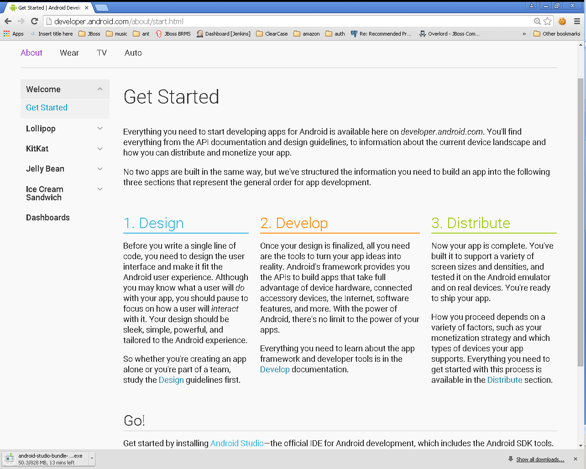

Slide 3
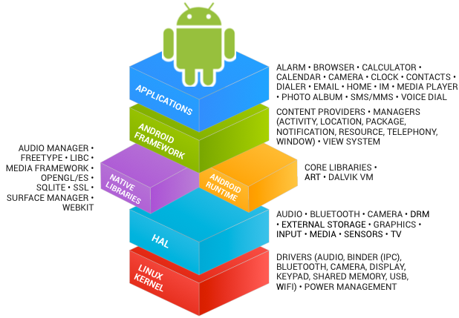
В предыдущих лекциях...
See https://source.android.com/source/index.html

Slide 4
В предыдущих лекциях...
Android Studio
Android SDK
http://developer.android.com/sdk/index.html
Eclipse IDE for Mobile Developers
http://eclipse.org/mobile/
ADT Plugin для Eclipse
https://dl-ssl.google.com/android/eclipse/
Java SE Development Kit 7
http://www.oracle.com/technetwork/java/javase/downloads/jdk7-downloads-1880260.html

Slide 5
В предыдущих лекциях...
Activities
Services
Content Providers
Broadcast Receivers
Intents
As a developer we need only to call and extend these already defined classes to use in our application.

Slide 6
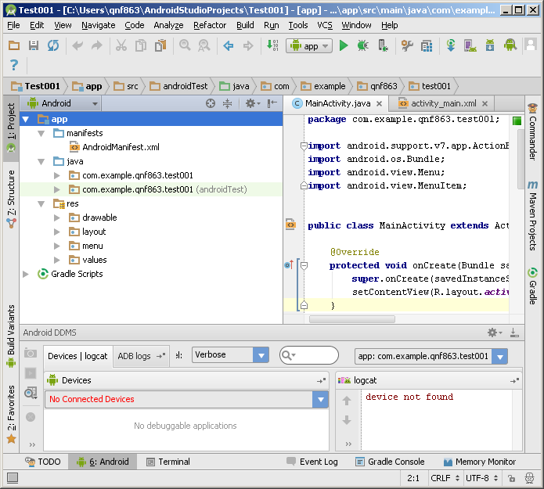
В предыдущих лекциях...

Slide 7
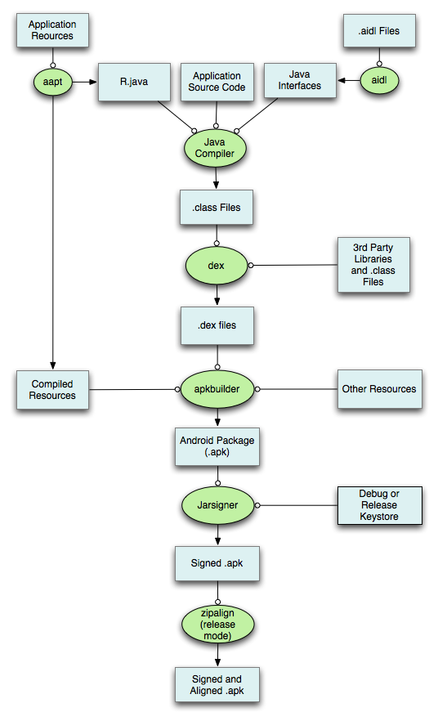

Slide 8
В предыдущих лекциях...
./animator/*
./anim/*
./xml/*
./drawable/*
Bitmap files (png, 9.png, jpg, gif)
State lists
Shapes
Other drawables

Slide 9
В предыдущих лекциях...
./layout/*
./menu/*
./raw/*
./values/*
arrays.xml
colors.xml
dimens.xml
strings.xml
styles.xml

Slide 10
В предыдущих лекциях...
<resources_name>-<config_qualifier>
resources_name := anim, drawable, layout, menu, raw, value, xml
config_qualifier := qualifier1[-qualifier2[…]]
Примеры:
drawable-ldpi
drawable-en-notouch-12key
values-land-mdpi-v11

Slide 11
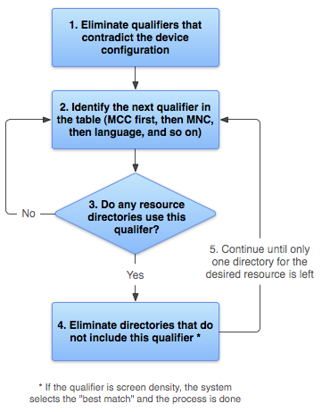
http://developer.android.com/guide/topics/resources/providing-resources.html

Slide 12
В предыдущих лекциях...
<?xml version="1.0" encoding="utf-8"?> <manifest> <uses-permission /> <permission /> <permission-tree /> <permission-group /> <instrumentation /> <uses-sdk /> <uses-configuration /> <uses-feature /> <supports-screens /> <compatible-screens /> <supports-gl-texture /> <application> <activity> <intent-filter> <action /> <category /> <data /> </intent-filter> <meta-data /> </activity>
<activity-alias> <intent-filter> . . . </intent-filter> <meta-data /> </activity-alias> <service> <intent-filter> . . . </intent-filter> <meta-data/> </service> <receiver> <intent-filter> . . . </intent-filter> <meta-data /> </receiver> <provider> <grant-uri-permission /> <meta-data /> <path-permission /> </provider> <uses-library /> </application> </manifest>

Slide 13
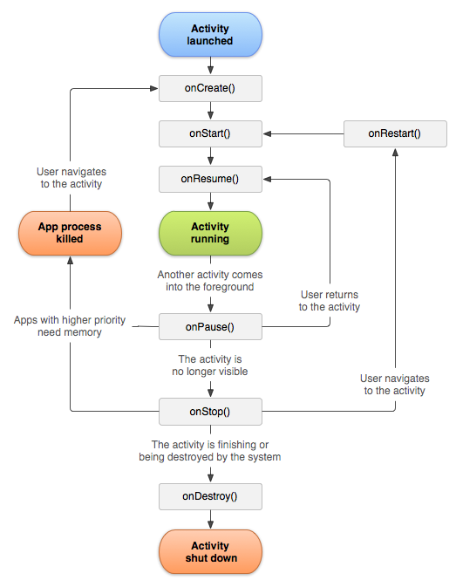
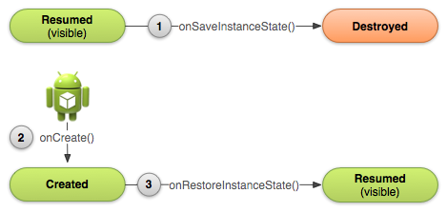
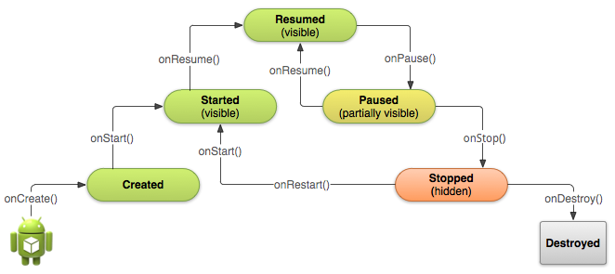

Slide 14
Activity: API Overview

Slide 15
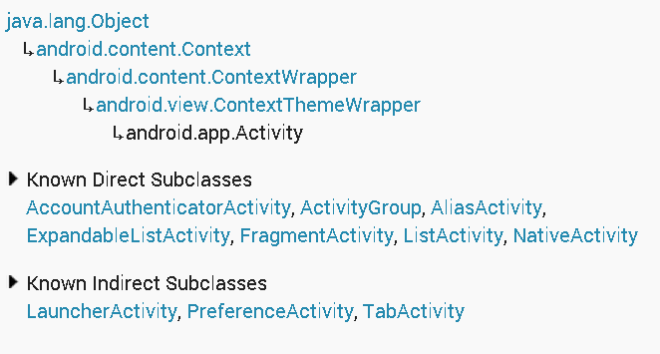
Activity: API Overview (1)

Slide 16
Activity: Lifecycle Callbacks
protected void onCreate (Bundle savedInstanceState)
protected void onStart ()
protected void onPause ()
protected void onResume ()
protected void onRestart ()
protected void onStop ()
protected void onDestroy ()

Slide 17
Activity: State Callbacks
protected void onSaveInstanceState (Bundle outState)
protected void onRestoreInstanceState (Bundle savedInstanceState)

Slide 18
Activity: Content
public void setContentView (int layoutResID)
Вспомните R.layout.my_layout
public void setContentView (View view)
public View findViewById (int id)
Вспомните android:id=“@+id/my_id”

Slide 19
Button Обработка событий (В1)
<Button xmlns:android="http://schemas.android.com/apk/res/android" android:id="@+id/button_send" android:layout_width="wrap_content" android:layout_height="wrap_content" android:text="@string/button_send“ />
Button button = (Button) findViewById(R.id.button_send); button.setOnClickListener(new View.OnClickListener() { public void onClick(View v) { // Do something in response to button click } });

Slide 20
Button Обработка событий (В2)
<Button xmlns:android="http://schemas.android.com/apk/res/android" android:id="@+id/button_send" android:layout_width="wrap_content" android:layout_height="wrap_content" android:text="@string/button_send" android:onClick="onButtonClicked" />
public class MyActivity extends Activity {
// . . .
public void onButtonClicked(View view) { // Какая кнопка была нажата? switch(view.getId()) { case R.id.button_send: // . . . break; case R.id.button_forward: // . . . } }
}

Slide 21
CheckBox Обработка событий
public void setOnCheckedChangeListener (CompoundButton.OnCheckedChangeListener listener)
public void setOnClickListener (View.OnClickListener l)
<CheckBox android:id="@+id/checkbox_meat“ android:layout_width="wrap_content“ android:layout_height="wrap_content“ android:text="@string/meat“ android:onClick="onCheckboxClicked"/>

Slide 22
CheckBox Обработка событий
<?xml version="1.0" encoding="utf-8"?> <LinearLayout xmlns:android="http://schemas.android.com/apk/res/android" android:orientation="vertical" android:layout_width="fill_parent" android:layout_height="fill_parent"> <CheckBox android:id="@+id/checkbox_meat" android:layout_width="wrap_content" android:layout_height="wrap_content" android:text="@string/meat" android:onClick="onCheckboxClicked"/> <CheckBox android:id="@+id/checkbox_cheese" android:layout_width="wrap_content" android:layout_height="wrap_content" android:text="@string/cheese" android:onClick="onCheckboxClicked"/> </LinearLayout>

Slide 23
CheckBox Обработка событий
public void onCheckboxClicked(View view) { // Is the view now checked? boolean checked = ((CheckBox) view).isChecked(); // Check which checkbox was clicked switch(view.getId()) { case R.id.checkbox_meat: if (checked) // Put some meat on the sandwich else // Remove the meat break; case R.id.checkbox_cheese: if (checked) // Cheese me else // I'm lactose intolerant break; // TODO: Veggie sandwich } }

Slide 24
ToggleButton Обработка событий
public void setOnCheckedChangeListener (CompoundButton.OnCheckedChangeListener listener)
public void setOnClickListener (View.OnClickListener l)
<ToggleButton android:id="@+id/togglebutton" android:layout_width="wrap_content" android:layout_height="wrap_content" android:textOn="Vibrate on" android:textOff="Vibrate off" android:onClick="onToggleClicked"/>

Slide 25
RadioButton Обработка событий
public void setOnCheckedChangeListener (RadioGroup.OnCheckedChangeListener listener)
public void setOnClickListener (View.OnClickListener l)
<RadioButton android:id="@+id/radio_ninjas" android:layout_width="wrap_content" android:layout_height="wrap_content" android:text="@string/ninjas" android:onClick="onRadioButtonClicked"/>

Slide 26
Activity: Inflaters (инстанциирование layout)
public LayoutInflater getLayoutInflater ()
public View inflate (int resource, ViewGroup root)
public MenuInflater getMenuInflater ()
public void inflate (int menuRes, Menu menu)

Slide 27
Activity доступ к ресурсам
public Resources getResources ()
public boolean getBoolean (int id)
public int getColor (int id)
public float getDimension (int id)
public Drawable getDrawable (int id)
public int getInteger (int id)
public String getQuantityString (int id, int quantity, Object... formatArgs)
public String getString (int id)
public String getString (int id, Object... formatArgs)
public String[] getStringArray (int id)
public XmlResourceParser getLayout (int id)
http://developer.android.com/reference/android/content/res/Resources.html

Slide 28
Activity: Preferences
public SharedPreferences getPreferences (int mode)
Use this if you need only one preferences file for your Activity
public abstract SharedPreferences getSharedPreferences (String name, int mode)
Use this if you need multiple preferences files identified by name.

Slide 29
SharedPreferences
To write values:
Call edit() to get a SharedPreferences.Editor.
Add values with methods such as putBoolean() andputString().
Commit the new values with commit()
To read values
use SharedPreferences methods such as getBoolean() and getString().

Slide 30
Activity: Dialog
Deprecated:
protected Dialog onCreateDialog (int id, Bundle args)
protected void onPrepareDialog (int id, Dialog dialog, Bundle args)
public final void showDialog (int id)
public final void dismissDialog (int id)

Slide 31
Activity: API Overview
И многое другое!
http://developer.android.com/reference/android/app/Activity.html

Slide 32
Android: Threads and Processes
http://developer.android.com/guide/components/processes-and-threads.html

Slide 33
Процессы и Потоки
По умолчанию все компоненты одного приложения работают в одном процессе
М.б. изменено с помощью AndroidManifest.xml
android:process
По умолчанию все компоненты одного приложения работают в одном потоке
В т.ч. сервисы!
UI-Thread = Main-Thread
М.б. изменено с помощью Worker Threads

Slide 34
Жизненный Цикл Процесса
ОС создает 1 процесс с 1 потоком при первом запуске любого из компонентов приложения
ОС выстраивает “importance hierarchy” процессов
В случае нехватки ресурсов (памяти) ОС убивает наименее важные процессы

Slide 35
Типы Процессов (1)
Foreground process – A process that is required for what the user is currently doing.
It hosts an Activity that the user is interacting with (the Activity's onResume() method has been called).
It hosts a Service that's bound to the activity that the user is interacting with.
It hosts a Service that's running "in the foreground"—the service has called startForeground().
It hosts a Service that's executing one of its lifecycle callbacks (onCreate(), onStart(), or onDestroy()).
It hosts a BroadcastReceiver that's executing its onReceive() method.

Slide 36
Типы Процессов (2)
Visible process – A process that doesn't have any foreground components, but still can affect what the user sees on screen. A process is considered to be visible if either of the following conditions are true:
It hosts an Activity that is not in the foreground, but is still visible to the user (its onPause() method has been called). This might occur, for example, if the foreground activity started a dialog, which allows the previous activity to be seen behind it.
It hosts a Service that's bound to a visible (or foreground) activity.

Slide 37
Типы Процессов (3)
Service process – A process that is running a service that has been started with the startService() method and does not fall into either of the two higher categories. Although service processes are not directly tied to anything the user sees, they are generally doing things that the user cares about (such as playing music in the background or downloading data on the network), so the system keeps them running unless there's not enough memory to retain them along with all foreground and visible processes.

Slide 38
Типы Процессов (4)
Background process – A process holding an activity that's not currently visible to the user (the activity's onStop() method has been called).
These processes have no direct impact on the user experience, and the system can kill them at any time to reclaim memory for a foreground, visible, or service process.
Background process are kept in an LRU (least recently used).
If an activity implements its lifecycle methods correctly, and saves its current state, killing its process will not have a visible effect on the user experience.

Slide 39
Типы Процессов (5)
Empty process – A process that doesn't hold any active application components.
caching purposes, to improve startup time the next time a component needs to run in it.
The system often kills these processes in order to balance overall system resources between process caches and the underlying kernel caches.

Slide 40
Значимость процессов
Foreground process
Visible process
Service process
Background process
Empty process

Slide 41
Потоки в Приложении
По умолчанию все компоненты одного приложения работают в одном потоке (Main Thread)
При запуске приложения создается main looper (android.os.Looper)
http://developer.android.com/reference/android/os/Looper.html
main looper перенаправляет (dispatch) сообщения другим компонентам:
Activity, Widget, пр.

Slide 42
Потоки и Android UI Toolkit (1)
UI toolkit
android.widget.*, android.view.*
НЕ thread-safe
Все взаимодействия с UI только из UI Thread
Все callback происходят в UI Thread

Slide 43
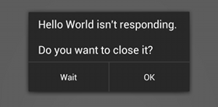
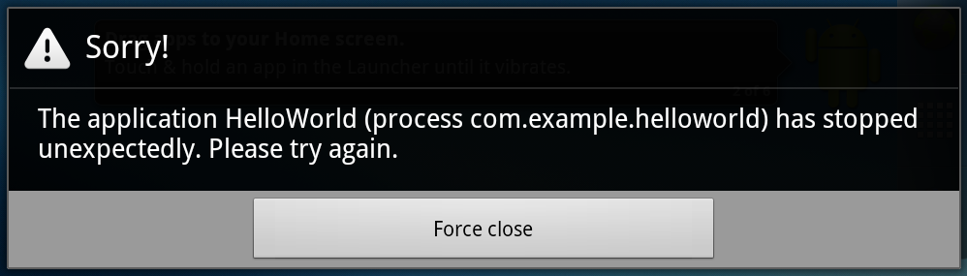
Потоки и Android UI Toolkit (2)
Do not block the UI thread
"application not responding" (ANR) dialog
Do not access the Android UI toolkit from outside the UI thread

Slide 44
Worker Threads (1)
public void onClick(View v) { Bitmap b = loadImageFromNetwork("http://example.com/image.png"); mImageView.setImageBitmap(b); }

Slide 45
Worker Threads (1)
public void onClick(View v) { Bitmap b = loadImageFromNetwork("http://example.com/image.png"); mImageView.setImageBitmap(b); }

Slide 46
Worker Threads (2)
public void onClick(View v) { new Thread(new Runnable() { public void run() { Bitmap b = loadImageFromNetwork("http://example.com/image.png"); mImageView.setImageBitmap(b); } }).start(); }

Slide 47
Worker Threads (2)
public void onClick(View v) { new Thread(new Runnable() { public void run() { Bitmap b = loadImageFromNetwork("http://example.com/image.png"); mImageView.setImageBitmap(b); } }).start(); }

Slide 48
Способы Доступа к UI Thread (1)
Activity.runOnUiThread(Runnable)
View.post(Runnable)
View.postDelayed(Runnable, long)

Slide 49
Способы Доступа к UI Thread (2)
public void onClick(View v) { new Thread(new Runnable() { public void run() { final Bitmap bitmap =
loadImageFromNetwork("http://example.com/image.png"); mImageView.post(new Runnable() { public void run() { mImageView.setImageBitmap(bitmap); } }); } }).start(); }

Slide 50
Способы Доступа к UI Thread: AsyncTask
private class MyTask extends AsyncTask<Params, Progress, Result> { ... }
http://developer.android.com/reference/android/os/AsyncTask.html

Slide 51
AsyncTask: 3 Types
android.os.AsyncTask<Params, Progress, Result>
Params
parameters sent to the task upon execution.
Progress
progress units published during the background computation.
Result
result of the background computation.

Slide 52
AsyncTask 4 Шага исполнения
void onPreExecute()
invoked on the UI thread
Result doInBackground(Params...)
invoked on the background
void publishProgress(Progress...)
void onProgressUpdate(Progress...)
invoked on the UI thread
void onPostExecute(Result)
invoked on the UI thread

Slide 53
AsyncTask Пример
public void onClick(View v) { new DownloadImageTask().execute("http://example.com/image.png"); } private class DownloadImageTask extends AsyncTask<String, Void, Bitmap> { /** The system calls this to perform work in a worker thread and * delivers it the parameters given to AsyncTask.execute() */ protected Bitmap doInBackground(String... urls) { return loadImageFromNetwork(urls[0]);
// publishProgress(...); } /** The system calls this to perform work in the UI thread and delivers * the result from doInBackground() */ protected void onPostExecute(Bitmap result) { mImageView.setImageBitmap(result); } }

Slide 54
Некоторые полезные методы AsyncTask
final AsyncTask<Params, Progress, Result> execute(Params... params)
final boolean cancel (boolean mayInterruptIfRunning)
final AsyncTask<Params, Progress, Result> execute (Params... params)
final Result get (long timeout, TimeUnit unit)
final Result get ()
final AsyncTask.Status getStatus ()

Slide 55
Общие правила использования AsyncTask
Экземпляр объекта должен быть создан в UI потоке.
execute(Params...) должен быть вызван в UI потоке.
Не вызывать вручную onPreExecute(), onPostExecute(Result), doInBackground(Params...), onProgressUpdate(Progress...).
AsyncTask может быть запущен только один раз (при повторном использовании возникнет исключение)

