Slide 1
Проектирование мобильных приложений
Кузнецов
Андрей Николаевич
Санкт-Петербургский Государственный
Политехнический Университет

Slide 2
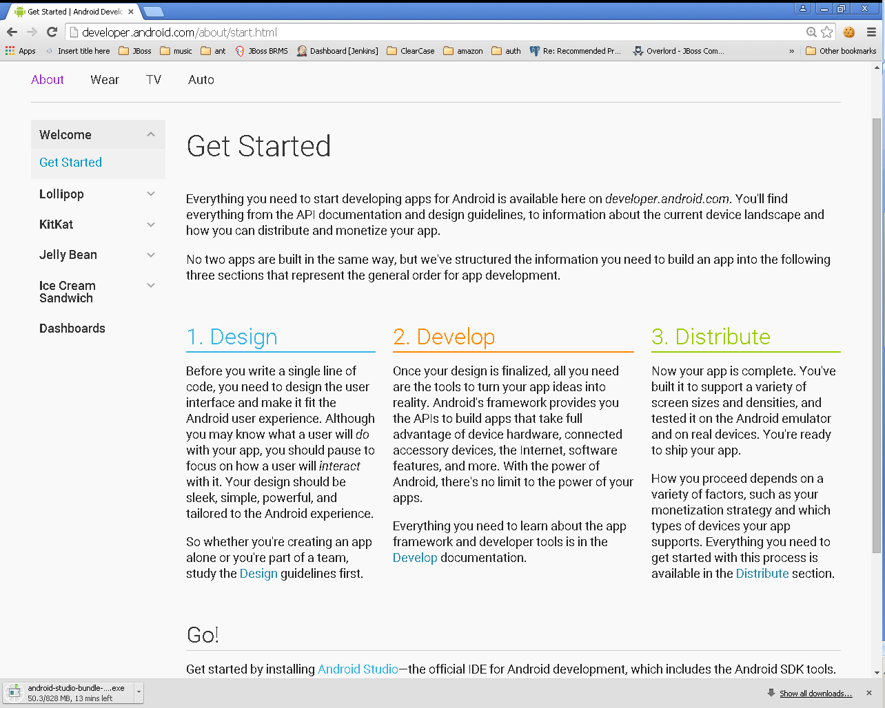

Slide 3
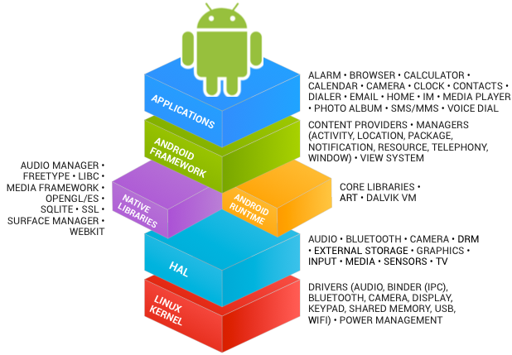
В предыдущих лекциях...
See https://source.android.com/source/index.html

Slide 4
В предыдущих лекциях...
Activities
Services
Content Providers
Broadcast Receivers
Intents
As a developer we need only to call and extend these already defined classes to use in our application.

Slide 5
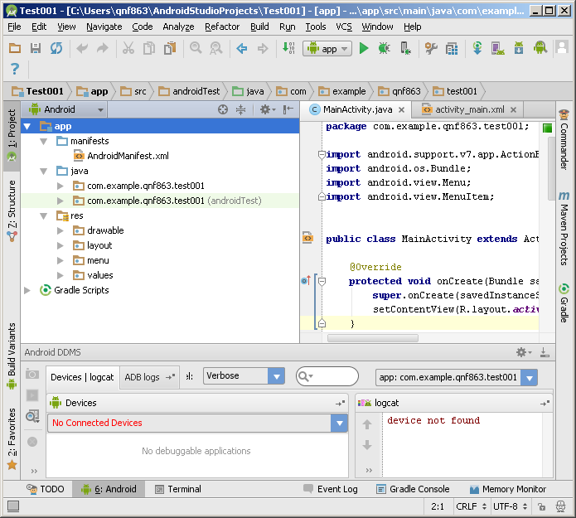
В предыдущих лекциях...

Slide 6
В предыдущих лекциях...
./animator/*
./anim/*
./xml/*
./drawable/*
Bitmap files (png, 9.png, jpg, gif)
State lists
Shapes
Other drawables
./layout/*
./menu/*
./raw/*
./values/*
arrays.xml
colors.xml
dimens.xml
strings.xml
styles.xml

Slide 7
В предыдущих лекциях...
<resources_name>-<config_qualifier>
resources_name := anim, drawable, layout, menu, raw, value, xml
config_qualifier := qualifier1[-qualifier2[…]]
Примеры:
drawable-ldpi
drawable-en-notouch-12key
values-land-mdpi-v11

Slide 8
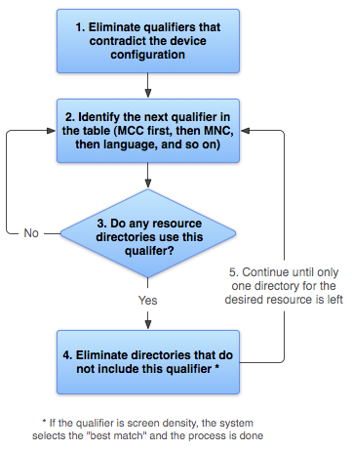
http://developer.android.com/guide/topics/resources/providing-resources.html

Slide 9
В предыдущих лекциях...
<?xml version="1.0" encoding="utf-8"?> <manifest> <uses-permission /> <permission /> <permission-tree /> <permission-group /> <instrumentation /> <uses-sdk /> <uses-configuration /> <uses-feature /> <supports-screens /> <compatible-screens /> <supports-gl-texture /> <application> <activity> <intent-filter> <action /> <category /> <data /> </intent-filter> <meta-data /> </activity>
<activity-alias> <intent-filter> . . . </intent-filter> <meta-data /> </activity-alias> <service> <intent-filter> . . . </intent-filter> <meta-data/> </service> <receiver> <intent-filter> . . . </intent-filter> <meta-data /> </receiver> <provider> <grant-uri-permission /> <meta-data /> <path-permission /> </provider> <uses-library /> </application> </manifest>

Slide 10
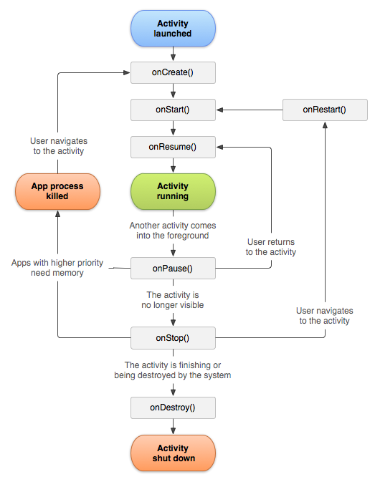
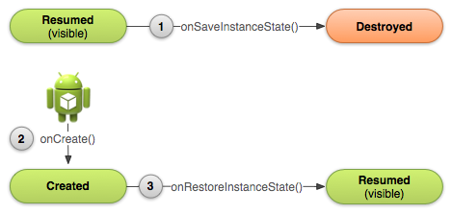
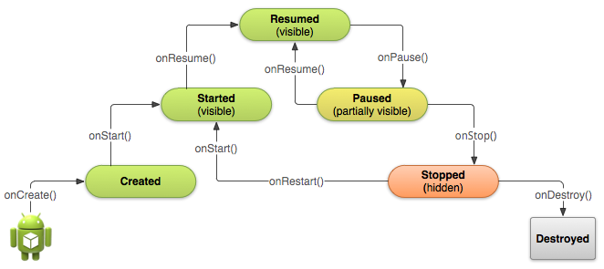

Slide 11
В предыдущих лекциях...
kotlin-android-extensions
Позволяет не писать findViewById
DatabindingLibrary
android:text="@{user.firstName}"
ViewModel
Gозволяет данным переживать Configuration Change
LiveData
Объект с состоянием, который можно безопасно наблюдать (Observe) из объекта с Lifecycle

Slide 12
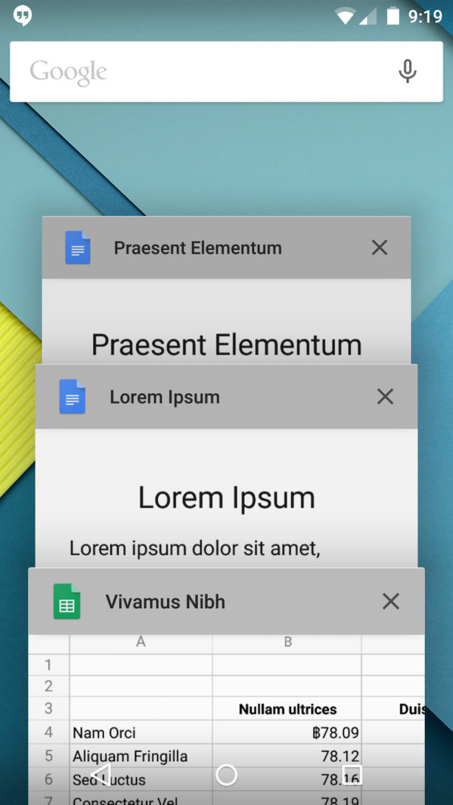
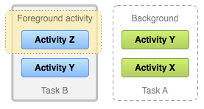
В предыдущих лекциях...

Slide 13
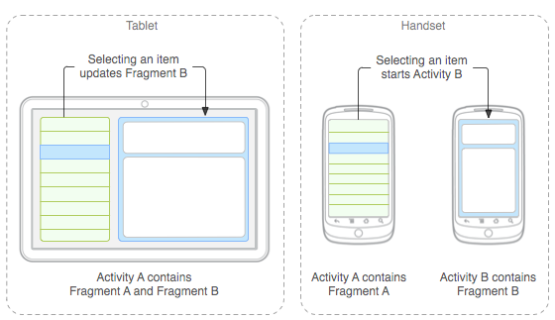
В предыдущих лекциях...

Slide 14
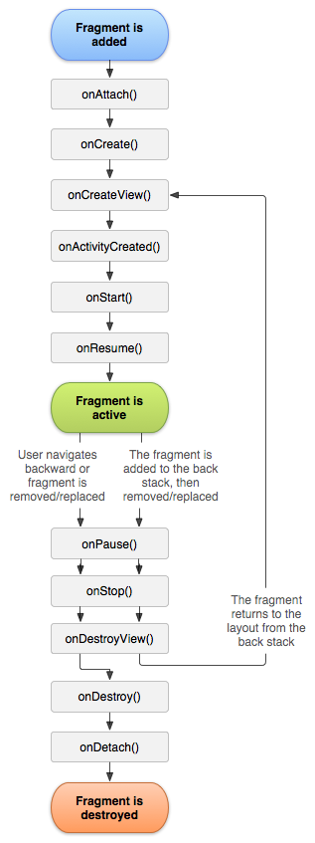
В предыдущих лекциях...

Slide 15
В предыдущих лекциях...
Explicit Intent
Implicit intent
Component
Extras
Flags
Action
Data
Category
Extras
Flags

Slide 16
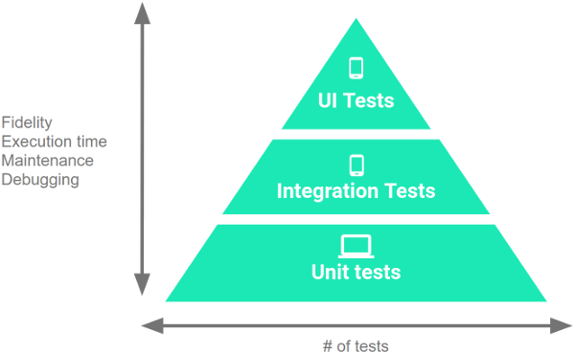
В предыдущих лекциях...
Instrumented
(device/emulator)
10%
20%
Local JVM
70%

Slide 17
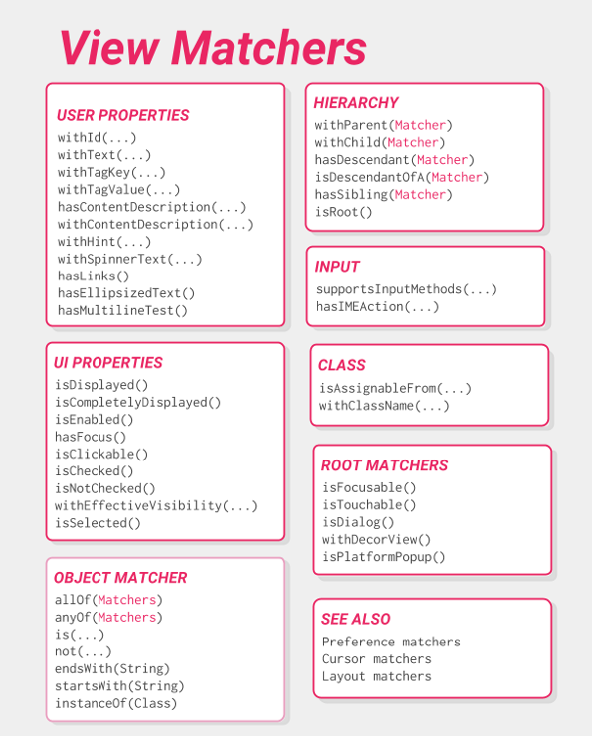

https://developer.android.com/training/testing/espresso/cheat-sheet

Slide 18
Android: Threads and Processes
http://developer.android.com/guide/components/processes-and-threads.html

Slide 19
Процессы и Потоки
По умолчанию все компоненты одного приложения работают в одном процессе
М.б. изменено с помощью AndroidManifest.xml
android:process
По умолчанию все компоненты одного приложения работают в одном потоке
В т.ч. сервисы!
UI-Thread = Main-Thread
М.б. изменено с помощью Worker Threads

Slide 20
Жизненный Цикл Процесса
ОС создает 1 процесс с 1 потоком при первом запуске любого из компонентов приложения
ОС выстраивает “importance hierarchy” процессов
В случае нехватки ресурсов (памяти) ОС убивает наименее важные процессы

Slide 21
Типы Процессов (1)
Foreground process – A process that is required for what the user is currently doing.
It hosts an Activity that the user is interacting with (the Activity's onResume() method has been called).
It hosts a Service that's bound to the activity that the user is interacting with.
It hosts a Service that's running "in the foreground"—the service has called startForeground().
It hosts a Service that's executing one of its lifecycle callbacks (onCreate(), onStart(), or onDestroy()).
It hosts a BroadcastReceiver that's executing its onReceive() method.

Slide 22
Типы Процессов (2)
Visible process – A process that doesn't have any foreground components, but still can affect what the user sees on screen. A process is considered to be visible if either of the following conditions are true:
It hosts an Activity that is not in the foreground, but is still visible to the user (its onPause() method has been called). This might occur, for example, if the foreground activity started a dialog, which allows the previous activity to be seen behind it.
It hosts a Service that's bound to a visible (or foreground) activity.

Slide 23
Типы Процессов (3)
Service process – A process that is running a service that has been started with the startService() method and does not fall into either of the two higher categories. Although service processes are not directly tied to anything the user sees, they are generally doing things that the user cares about (such as playing music in the background or downloading data on the network), so the system keeps them running unless there's not enough memory to retain them along with all foreground and visible processes.

Slide 24
Типы Процессов (4)
Background process – A process holding an activity that's not currently visible to the user (the activity's onStop() method has been called).
These processes have no direct impact on the user experience, and the system can kill them at any time to reclaim memory for a foreground, visible, or service process.
Background process are kept in an LRU (least recently used).
If an activity implements its lifecycle methods correctly, and saves its current state, killing its process will not have a visible effect on the user experience.

Slide 25
Типы Процессов (5)
Empty process – A process that doesn't hold any active application components.
caching purposes, to improve startup time the next time a component needs to run in it.
The system often kills these processes in order to balance overall system resources between process caches and the underlying kernel caches.

Slide 26
Значимость процессов
Foreground process
Visible process
Service process
Background process
Empty process

Slide 27
Потоки в Приложении
По умолчанию все компоненты одного приложения работают в одном потоке (Main Thread)
При запуске приложения создается main looper (android.os.Looper)
http://developer.android.com/reference/android/os/Looper.html
main looper перенаправляет (dispatch) сообщения другим компонентам:
Activity, Widget, пр.

Slide 28
Потоки и Android UI Toolkit (1)
UI toolkit
android.widget.*, android.view.*
НЕ thread-safe
Все взаимодействия с UI только из UI Thread
Все callback происходят в UI Thread

Slide 29
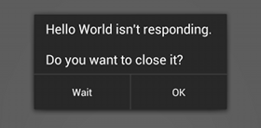
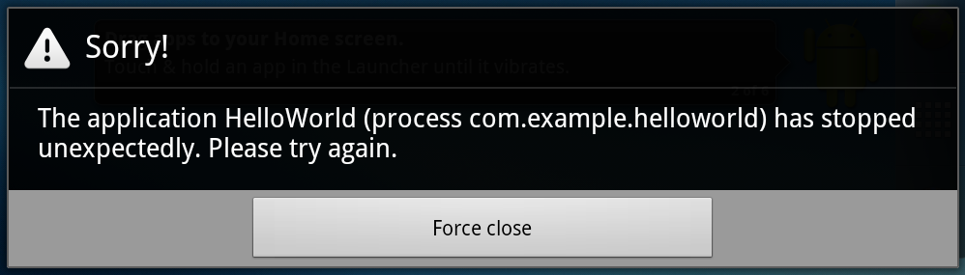
Потоки и Android UI Toolkit (2)
Do not block the UI thread
"application not responding" (ANR) dialog
Do not access the Android UI toolkit from outside the UI thread

Slide 30
Worker Threads (1)
public void onClick(View v) { Bitmap b = loadImageFromNetwork("http://example.com/image.png"); mImageView.setImageBitmap(b); }

Slide 31
Worker Threads (1)
public void onClick(View v) { Bitmap b = loadImageFromNetwork("http://example.com/image.png"); mImageView.setImageBitmap(b); }

Slide 32
Worker Threads (2)
public void onClick(View v) { new Thread(new Runnable() { public void run() { Bitmap b = loadImageFromNetwork("http://example.com/image.png"); mImageView.setImageBitmap(b); } }).start(); }

Slide 33
Worker Threads (2)
public void onClick(View v) { new Thread(new Runnable() { public void run() { Bitmap b = loadImageFromNetwork("http://example.com/image.png"); mImageView.setImageBitmap(b); } }).start(); }

Slide 34
Способы Доступа к UI Thread (1)
Activity.runOnUiThread(Runnable)
View.post(Runnable)
View.postDelayed(Runnable, long)

Slide 35
Способы Доступа к UI Thread (2)
public void onClick(View v) { new Thread(new Runnable() { public void run() { final Bitmap bitmap =
loadImageFromNetwork("http://example.com/image.png"); mImageView.post(new Runnable() { public void run() { mImageView.setImageBitmap(bitmap); } }); } }).start(); }

Slide 36
Способы Доступа к UI Thread: AsyncTask
private class MyTask extends AsyncTask<Params, Progress, Result> { ... }
http://developer.android.com/reference/android/os/AsyncTask.html

Slide 37
AsyncTask: 3 Types
android.os.AsyncTask<Params, Progress, Result>
Params
parameters sent to the task upon execution.
Progress
progress units published during the background computation.
Result
result of the background computation.

Slide 38
AsyncTask 4 Шага исполнения
void onPreExecute()
invoked on the UI thread
Result doInBackground(Params...)
invoked on the background
void publishProgress(Progress...)
void onProgressUpdate(Progress...)
invoked on the UI thread
void onPostExecute(Result)
invoked on the UI thread

Slide 39
AsyncTask Пример
public void onClick(View v) { new DownloadImageTask().execute("http://example.com/image.png"); } private class DownloadImageTask extends AsyncTask<String, Void, Bitmap> { /** The system calls this to perform work in a worker thread and * delivers it the parameters given to AsyncTask.execute() */ protected Bitmap doInBackground(String... urls) { return loadImageFromNetwork(urls[0]);
// publishProgress(...); } /** The system calls this to perform work in the UI thread and delivers * the result from doInBackground() */ protected void onPostExecute(Bitmap result) { mImageView.setImageBitmap(result); } }

Slide 40
Некоторые полезные методы AsyncTask
final AsyncTask<Params, Progress, Result> execute(Params... params)
final boolean cancel (boolean mayInterruptIfRunning)
final Result get (long timeout, TimeUnit unit)
final Result get ()
final AsyncTask.Status getStatus ()

Slide 41
Общие правила использования AsyncTask
Экземпляр объекта должен быть создан в UI потоке.
execute(Params...) должен быть вызван в UI потоке.
Не вызывать вручную onPreExecute(), onPostExecute(Result), doInBackground(Params...), onProgressUpdate(Progress...).
AsyncTask может быть запущен только один раз (при повторном использовании возникнет исключение)

Slide 42
Kotlin coroutines
https://github.com/Kotlin/KEEP/blob/master/proposals/coroutines.md
https://developer.android.com/kotlin/coroutines

Slide 43
Основные сценарии при Android разработке
Manage long-running tasks that might otherwise block the main thread and cause your app to freeze.
Providing main-safety, or safely calling network or disk operations from the main thread.
https://developer.android.com/kotlin/coroutines

Slide 44
Основные концепции
A coroutine — is an instance of suspendable computation.
A suspending function — a function that is marked with suspend modifier.
A suspending lambda — a block of code that have to run in a coroutine.
A coroutine builder — a function that takes some suspending lambda as an argument, creates a coroutine, and, optionally, gives access to its result in some form.
https://github.com/Kotlin/KEEP/blob/master/proposals/coroutines.md#terminology

Slide 45
Dispatchers
Dispatchers.Main - Use this dispatcher to run a coroutine on the main Android thread.
Dispatchers.IO - This dispatcher is optimized to perform disk or network I/O outside of the main thread.
Dispatchers.Default - This dispatcher is optimized to perform CPU-intensive work outside of the main thread.
https://developer.android.com/kotlin/coroutines#main-safety

Slide 46
Dispatchers. Пример.
suspend fun fetchDocs() { // Dispatchers.Main val result = get("developer.android.com") // Dispatchers.Main show(result) // Dispatchers.Main } suspend fun get(url: String) = // Dispatchers.Main withContext(Dispatchers.IO) { // Dispatchers.IO (main-safety block) /* perform network IO here */ // Dispatchers.IO (main-safety block) } // Dispatchers.Main }

Slide 47
Создание coroutine (coroutine builder)
launch starts a new coroutine and doesn't return the result to the caller. Any work that is considered "fire and forget" can be started using launch.
async starts a new coroutine and allows you to return a result with a suspend function called await.
https://developer.android.com/kotlin/coroutines#start

Slide 48
Создание coroutine. CoroutineScope.
private val coroutineJob = Job() private val uiScope = CoroutineScope(Dispatchers.Main + coroutineJob) uiScope.launch { … }
... uiScope.cancel()
https://codelabs.developers.google.com/codelabs/kotlin-coroutines

