Slide 2
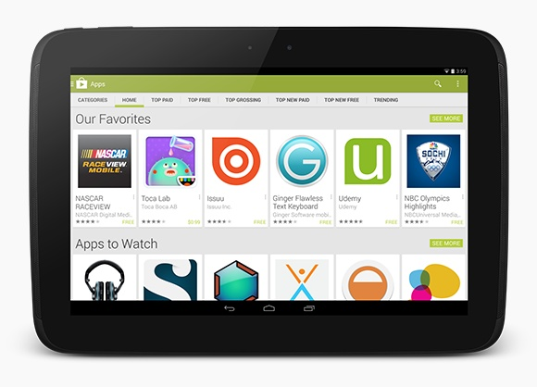
Google Play
Google Play is designed to connect users with great apps and games.
http://developer.android.com/distribute/googleplay/about.html

Slide 3
Возможности Play Market
Приложение и веб-сайт
Поиск
In results, users find the most relevant, most popular apps at the top.
Рейтинг
Top Charts and Lists
Top charts keep users in touch with what’s popular and trending with Android users, right from
country-specific in Google Play's most popular countries
Featured, Staff Picks, Collections, and Badges
The Google Play editorial team promotes great apps in the Featured, Staff Picks, and other collections.

Slide 4
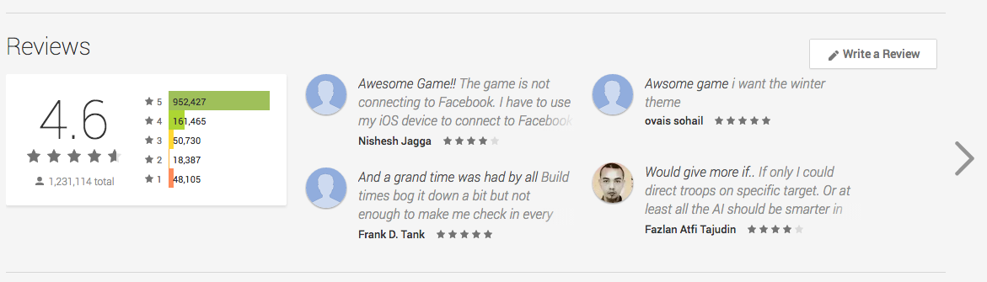
User Ratings and Reviews
Рейтинг влияет на позицию приложения в результатах поиска
Используется редакторами Play Market для продвижения приложений

Slide 5
Top Charts and Lists
Top Free | Free apps and free games lists
Top Paid | Paid apps and paid games lists
Top Grossing | Gross proceeds, free or paid
Top New Free | Less than 30 days old
Top New Paid | Less than 30 days old
Trending | New arrivals growing quickly in installs

Slide 6
Featured and Staff Picks collections
Еженедельное обновление редакторами магазина.
Цель: продвижение хороших приложений
The Featured (новинки) collections highlight the latest and greatest app
Staff Picks collects all recently featured apps and games on Google Play for Android tablets (?)

Slide 7
Badges
Editors’ Choice is a curated collection of apps that highlights some of the very best apps available on Android. Editors choose these apps for quality and great user interface, long-term popularity and innovative use of Android features.
Top Developer is a badge recognizing established, respected developers for their commitment to launching high-quality and innovative apps on Android.
http://developer.android.com/distribute/tools/promote/badges.html

Slide 8
Атрибуты приложения
Страна
190 стран
Рейтинг
Категория
Inside each category, apps are ranked based on a combination of ratings, reviews, downloads, country, and other factors.
Ссылка на приложение в Play Market
Store Listing Pages
http://developer.android.com/distribute/tools/promote/linking.html

Slide 9
Подготовка публикации приложения
http://developer.android.com/distribute/tools/launch-checklist.html
DEMO

Slide 10
Публикации приложения
http://developer.android.com/distribute/googleplay/developer-console.html
DEMO

