Slide 1
Workload Runtime And Placement (WRAP)
NGRM High-Level Review
March 4 2013
Dong H. Ahn

Slide 2
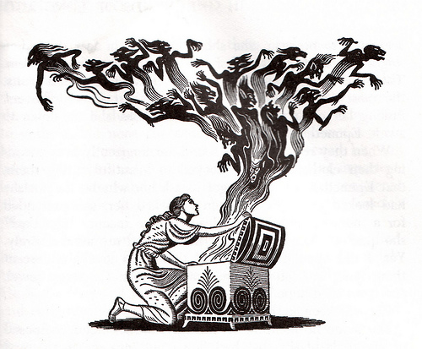
WRAP concerns all aspects of executing transactions of a job in the new paradigm.
Scheduler sets the overall bound for resources and the duration for a job, and now what?
Opening the job will let loose various transactions on this bound to execute.
WRAP must provide run-time services to execute them most effectively and efficiently under the new RM paradigm.
Notes:
The new paradigm’s fundamental characteristics: the global view, generalized compute resources, elasticity. Plus, lightweight virtualization, integration of productivity tools, etc.

Slide 3
The new paradigm needs new ways to organize/group processes a job executes.
The traditional approach models transactions as a set of compute steps (e.g., job steps).
Limits the ability to seamlessly integrate various transactions beyond compute transactions (e.g., tools).
Limits the ability to relate one group of processes to another.
Limits the ability to enable resource elasticity.
Designing the WRAP services after this traditional model would be an under-design.
Notes:
- traditional approach: each parallel launch is a step and effectively all processes in a step form a group

Slide 4
LWJ is our model to group processes executed by a job in many meaningful way.
R
R1
R2

Slide 5
WRAP uses LWJs to express run-time services concisely.
LWJ serves as group identifiers for WRAP services to relate each LWJ to diverse resources and other LWJs.
Resource allocation and elasticity: alloc(lwj, c), realloc(lwj,c), and release(lwj, r).
Process management/confinement: launch(lwj), destroy(ljw), etc.
Synchronization: sync(lwj(i), lwj(k)).
Resource discovery and provenance: query(lwj) and record(lwj).
Notes:
alloc, realloc, realloc
Launch,
sync
query

Slide 6
We can compose the primitives to enable high-level services of the new paradigm.
grow and shrink for elasticity on any resource
launch/bootrap
alloc()
alloc()
realloc()
alloc()
realloc()
alloc()
release()
CNs as resource
Power as resource
Power as resource

Slide 7

The base architecture builds on comms. framework and distributed key-value store.
alloc($lwj$)
d
Parent’s overlay network
d
d
lwj’s overlay network
d
d
d
d
d
Dist KVS
p
p
Process mgr
Bootstrap APIs

Slide 8
DKVS is scalable distributed shared memory for an LWJ and its descendants.
key
in-memory DB
rank(i)
Hash function
lwj’s overlay network
Home DB1
rank(j)
Home DB2
rank(k)
Home DBn
Get/put for data access
Collective Fence for memory consistency
lwj(1)::resource | cores (128) | power(10KW) | lic (10 tokens) | …
lwj(1)::rank(10) | host(1) | pid(345) | port(445)
lwj(1)::record | info1 | info2 | … | …
lwj(1)::lwj(2)::resource | cores(64) | power(4KW) | lic (2 tokens)
Notes:
- Conceptually shared memory
- Store info in key-value pair format and uses the key for retrieval
- Distributed for extreme scalability; uses a technique similar to distributed hash table that p2p has been using.

Slide 9
All process management operations must be scalable.
Environment propagation: Bcast problem O(log(N))
stdin/signal: Bcast problem, O(log(N))
stderr/stdout handling: Reduction problem, O(log(N)) with an ability to reduce the outputs on the fly
Process termination detection/analysis: Reduction problem: O(log(N)) with an ability to reduce the outputs on the fly
d
d
d
lwj’s overlay network
d
d
d
d
d
Dist KVS
p
p
Process mgr
Bootstrap APIs

Slide 10
DKVS allows ease integration with various types of LWJs beyond MPI
PMI 1, 2 will be a very thin layer on top of DKVS.
PMGR, PMGR Collective, COBO, LaunchMON, and LIBI use essentially the same bootstrapping technique: launched processes discover open TCP ports of their children processes or parent process in the binomial tree.
Our plug-ins for these well-known bootstrappers will serve as the reference implementation.
Other types of LWJs can write their own plug-ins for ease integration into WRAP.

Slide 11
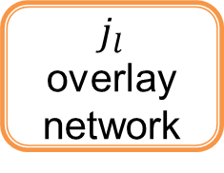
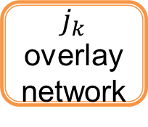

We can easily extend the base architecture to implement sync.
d
Parent’s overlay network
d
d
$j_{k}$ overlay network
d
d
Bridge
alloc ($j_{l}$)
Sync
p
d
d
p
d
d
d
d
Dist KVS
$j_{l}$ overlay network
d
d
d
d
d

Slide 12
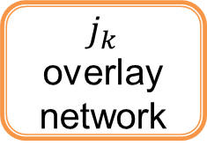


We can easily extend the base architecture to implement realloc w/ respect to CNs.
d
Parent’s overlay network
d
d
$j_{k}$ overlay network
d
d
Bridge
realloc ($j_{k}$)
d
d
d
d
d
d
Dist KVS
$j_{k}$ overlay network
d
d
p
d
p
d
d

Slide 13
We devised a WRAP architecture that will allow us to create an effective development plan.
WRAP has analyzed the requirements and use cases to conceive novel models as well as run-time services.
WRAP devised a high-level architecture that can the services scalably.
WRAP’s architecture allowed us to identify the major components and their subsystems to develop (Unsolicited section).
WRAP plans to use a phased approach to mitigate the risk of developing these components (Unsolicited section).
WRAP work items will need to be considered in the context of the global Work Breakdown Structure (WBS).

