Slide 1
Work In Progress: FLUX Runtime Environment
FLUX Meeting
Sep 17 2013
Dong H. Ahn

Slide 2
Work in progress on two initial phases on run-time areas
Phase I – conceptualized next-generation resource management challenges and design space
Phase II – gaining experiences and insights by producing prototype software
Today, an interim report on the runtime system
Highlight key concepts in runtime (Phase I)
Experiences with early prototyping efforts (Phase II)

Slide 3
A scalable run-time to execute various transactions in a job in the new paradigm
A paradigm shift in resource management
Capable of imposing complex resource bound
Highest operational efficiency at any level across the computing facility
Scheduler sets the overall bound for resources and the duration for a job—now what?
Workload Runtime And Placement (WRAP) thrust area
A job consists of various transactions
Need a powerful run-time system to execute a wide range of transactions of a job efficiently while under the overall bound
Notes:
Extreme-scalability, treating vary transaction types as first-class citizens, elasticity for resources and jobs , etc

Slide 4
The new paradigm needs new ways to organize and group processes of a job
The traditional approach models transactions of a job as a set of compute steps (e.g., job steps)
Limits next-generation computing in many ways
Designing WRAP after this model would be an under-design
Notes:
Limits the ability to seamlessly integrate various transactions beyond compute transactions (e.g., tools and middleware).
Limits the ability to relate one group of processes to another.
Limits the ability to enable resource elasticity.

Slide 5
Lightweight job (LWJ) as our model to capture a transaction—i.e., grouping processes
R
R1
R2

Slide 6
LWJ enables us to express various run-time services concisely under the new paradigm
Serves as group identifiers to relate a group of processes to resources as well as to other groups of processes
Resource allocation and elasticity: alloc(lwj, c), realloc(lwj,c), and release(lwj, c)
Process management/confinement: launch(lwj), destroy(ljw)
Synchronization: sync(lwj(i), lwj(k))
Resource discovery and provenance: query(lwj), record(lwj)

Slide 7

The base WRAP architecture builds on comms. framework and distributed key-value store
alloc($lwj$)
d
Parent’s overlay network
d
d
lwj’s overlay network
d
d
d
d
d
Dist KVS
p
p
Process mgr
Bootstrap APIs

Slide 8
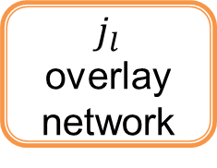
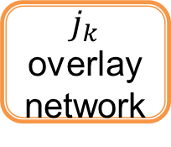

We can easily extend the base architecture to implement sync
d
Parent’s overlay network
d
d
$j_{k}$ overlay network
d
d
Bridge
alloc ($j_{l}$)
Sync
p
d
d
p
d
d
d
d
Dist KVS
$j_{l}$ overlay network
d
d
d
d
d

Slide 9
DKVS is scalable distributed shared memory for an LWJ and its descendants
key
in-memory DB
rank(i)
Hash function
lwj’s overlay network
Home DB1
rank(j)
Home DB2
rank(k)
Home DBn
Get/put for data access
Collective Fence for memory consistency
lwj(1)::resource | cores (128) | power(10KW) | lic (10 tokens) | …
lwj(1)::rank(10) | host(1) | pid(345) | port(445)
lwj(1)::record | info1 | info2 | … | …
lwj(1)::lwj(2)::resource | cores(64) | power(4KW) | lic (2 tokens)
Notes:
- Conceptually shared memory
- Store info in key-value pair format and uses the key for retrieval
- Distributed for extreme scalability; uses a technique similar to distributed hash table that p2p has been using.

Slide 10
Scalable KVS allows ease integration with various types of LWJs beyond MPI
PMI 1, 2 will be a very thin layer on top of KVS
PMGR, PMGR Collective, COBO, LaunchMON, and LIBI use essentially the same bootstrapping technique that KVS can easily enable
Our plug-ins for these well-known bootstrappers will serve as the reference implementation
Other types of LWJs can write their own plug-ins for ease integration into WRAP

Slide 11
Phase II aims to strategic prototyping to gain insight into the detailed design
Goal
Gain experiences for the final design
Prove that FLUX’s rich run-time will significantly boost user productivity
Plan
Bring up COBO on top of KVS
Native LaunchMON API Support
Bring up MRNet by porting the LIBI interface
Bring up STAT on top of LaunchMON and MRNet
Bring up and enhance SPINDLE
Show FLUX can bring in rich sets of scalable productivity tools
Show FLUX can start up massive applications
By enabling seamless integration with a specialize software system

Slide 12
KVS service via CMB solved a notorious chicken-and-egg problem for bootstrapping
COBO: a bootsrapper used in scalable tools infrastructure
A simple TCP-based tree-based overlay network
Chicken-and-egg problem: no common mechanism exists to bootstrap this bootstrapper!
Initial version used all-send-to-one algorithm—not scalable
Current version uses ad hoc port-range scheme—scalable but not ideal
Use CMB’s KVS service to address this problem

Slide 13
CMB/KVS-based COBO Connection algorithm and implementation
Extended its tree open call in pmgr_collective_client_tree.c
#include "cmb.h”
int pmgr_tree_open_cmb (pmgr_tree_t *t, …
Each spawned process creates a key-value tuple (key=its rank, value= ip:port) and push it to KVS
cmb_kvs_put (cmb_cxt, keystr, valstr) /* keystr=rank, valstr=ip:port */
cmb_kvs_commit (cmb_cxt, &error_cnt, &put_cnt)
cmb_barrier (cmb_cxt, "topen-cmb", ranks) /* named barrier */
Each process computes its position in the binary tree based on it rank and size and fetch ip/port of its parent and children:
res_val = cmb_kvs_get (cmb_cxt, (const char *) keystr)
Then, a simple two-step connection algorithm

Slide 14
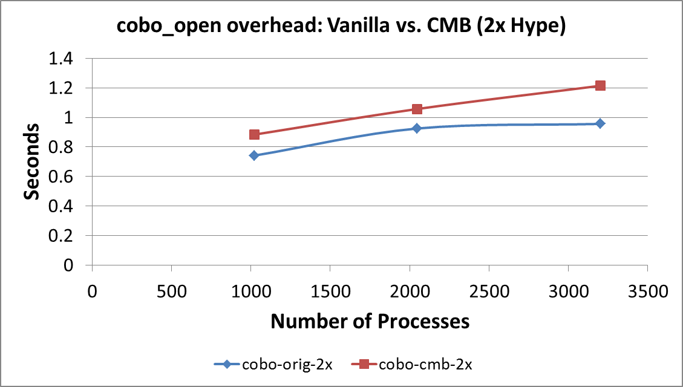
Initial performance under a single KVS server (no KVS optimization)
Code at the cobo-tester directory in git@github.com:chaos/ngrm.git

Slide 15
Native LaunchMON API support under FLUX
LaunchMON: tool daemon launching infrastructure
Used by many scalable tools
For high portability, it uses the MPIR process acquisition interface (a de factor standard RM interface for debuggers)
Requires tracing a MPI starter process and this makes it difficult to compose multiple tools
Many problems can be addressed when LaunchMON is more deeply into the resource manager

Slide 16
Adding a new LaunchMON engine that interacts with RM through its API
Node 1
Node 2
Node N-1
Node N
Efficient
Tool
daemon
launch
Task
Task
Task
Task
Application
Partition
…
…
Tool Daemon
Tool Daemon
Tool Daemon
Tool Daemon
LMON BE API
BE API
BE API
BE API
Master
COBO
LMONP
Efficient
MW
daemon
launch
Node 1
Node M
Middleware Support
Partition
LMON
MW API
MW
Daemon
…
LMON
MW API
MW
Daemon
Master
LMONP
MW Protocol
OS, Comp., Arch, ABI
MPI Starter
LMON
FE API
Tool FE
LaunchMON Engine
LMONP
User Interface
Front-End Node
OO constructs abstracts out concepts from details

Slide 17
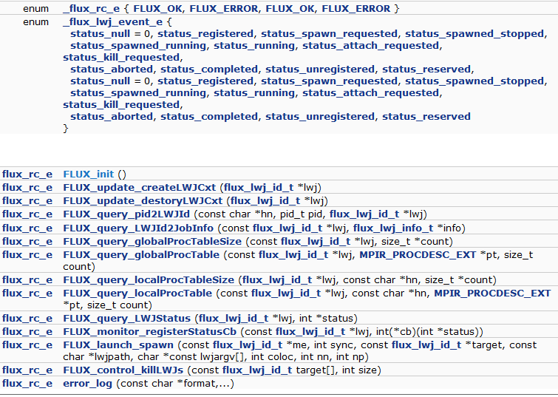
FLUX API mockup committed

Slide 18
Good progress made in new LaunchMON engine implementation
Event-based system
Many of the actions on LWJ state changes implemented
Need to complete all of the actions and wire-up with FEN API through LMONP
Mostly importantly, bring this up when the real FLUX API is in place
Notes:
Mostly event-based system.

Slide 19
Phase II aims to strategic prototyping to gain insight into the detailed design
Goal
Gain experiences for the final design
Prove that FLUX’s rich run-time will significantly boost user productivity
Plan
Bring up COBO on top of KVS
Native LaunchMON API Support
Bring up MRNet by porting the LIBI interface
Bring up STAT on top of LaunchMON and MRNet
Bring up and enhance SPINDLE
Show that FLUX can bring in rich sets of scalable productivity tools like STAT
Show that FLUX can start up massive applications
By enabling seamless integration with middleware software like SPINDLE

Slide 20
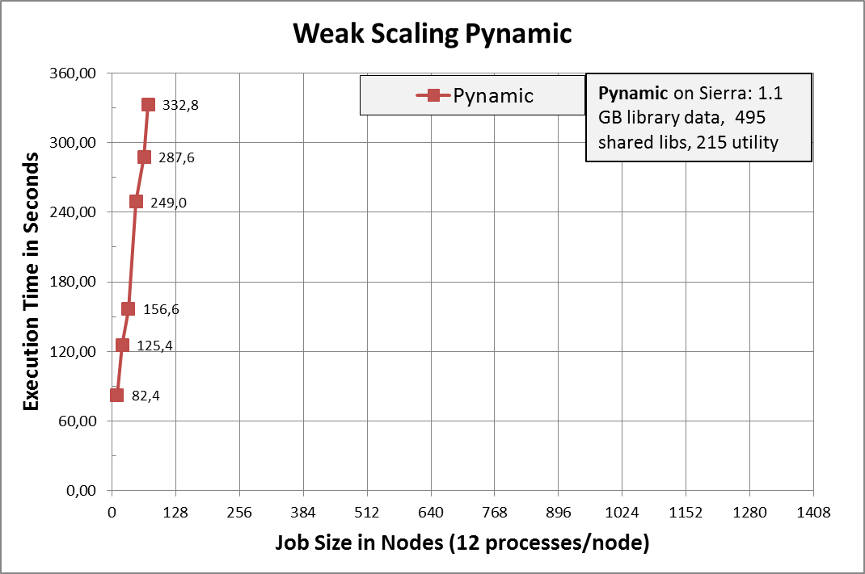
Dynamic linking and loading causes major disruption at large scale
Multi-physics applications at LLNL
848 shared library files
Load time on BG/P:
2k tasks → 1 hour
16k tasks → 10 hours
Pynamic
LLNL Benchmark
Loads shared libraries and python files
495 shared objects → 1.1 GB
Pynamic running on LLNL Sierra Cluster
1944 nodes, 12 tasks/node, NFS and Lustre file system

Slide 21
File Access is uncoordinated!
Loading is nearly unchanged since 1964 (MULTICS)
ld-linux.so uses serial POSIX file operations that are not coordinated among process.
dynamic linker
Process
lib
lib
…
dynamic linker
Process
lib
lib
lib
lib
lib
lib
…
lib
lib
lib
dynamic linker
lib
Process
lib
lib
…
dynamic linker
Process
lib
lib

Slide 22
SPINDLE server components will be supported as a LWJ (i.e., performance booster subsystem lwj)
SPINDLE Client
SPINDLE Server
dynamic linker
Process
SPINDLE Server
SPINDLE Server
SPINDLE Server
…
SPINDLE Client
dynamic linker
Process
SPINDLE Server
SPINDLE Server
…
SPINDLE Client
SPINDLE Server
SPINDLE Server
dynamic linker
Process
SPINDLE Client
…
dynamic linker
Process

Slide 23
Concluding remarks
Interim report on the first two phases in our effort to provide a rich and scalable run-time system for FLUX
Phase I: conceptualized our run-time system around the notion of LWJ
Phase II: made good process with strategic prototyping
To prove rich FLUX run-time can solve many next-generation computing challenges by leveraging other technologies through easy integration

Slide 24
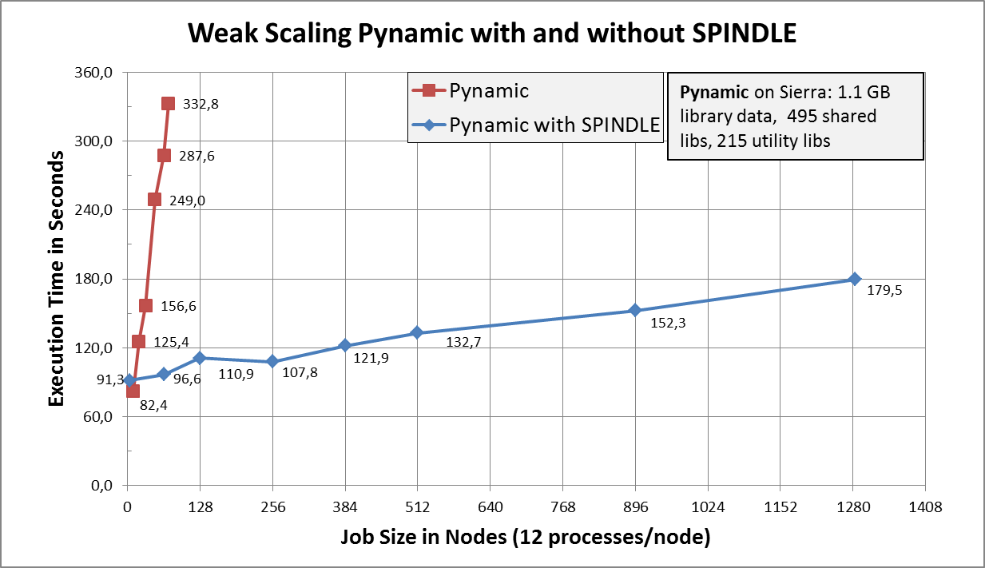
Back-up: SPINDLE’s Performance

Slide 25
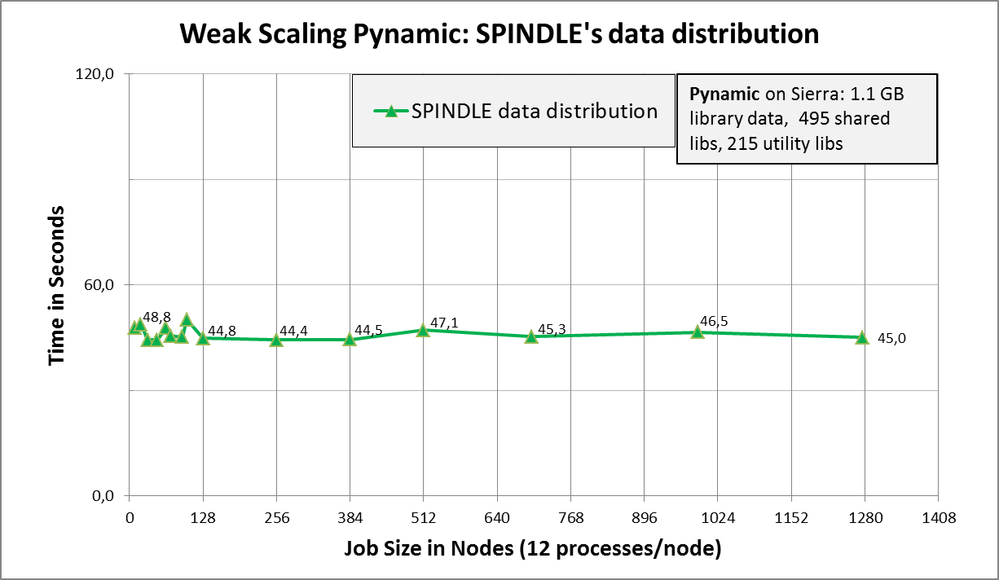
Back-up: Constant Overhead of SPINDLE’s Data Distribution

