Slide 1
NRGM Scheduling
NGRM High Level Review
March 4, 2013

Slide 2
Goals of the presentation
To present the terrain of the resource scheduling problem
To introduce potential design directions

Slide 3
Job Scheduling
Selecting and allocating computing resources to a job over the course of time.
Selecting a set of resources on which to launch a job
Single task
Parallel (MPI) job.

Slide 4
Fundamental Scheduling Choice
Schedule jobs to resources
The scheduler cycles through a prioritized list of jobs
Pick off each top priority job and find resources for it.
Schedule resources to jobs
The scheduler cycles through a collection of resources and finds jobs which can run on them

Slide 5
Scheduling Activities
Job Prioritization
Plugins that implement prioritization algorithms
Submission Order, Fair-share, Job Size, custom
Resource Scheduling (aka, the Scheduling Loop)
Selects the resources for each job over the course of time
Plugins that implement resource selection algorithms
First Fit, Best Fit, Backfill, network topology, custom
Must support shared and exclusive resource allocations
Job Preemption
Targeting running jobs for removal as part of the resource scheduling activities
NOTE 1: FIFO scheduling implies job prioritization based on submission order + first fit scheduling
NOTE 2: While a “simple” scheduler can have a simple job prioritization algorithm (submission order), the resource scheduling algorithm will rarely be “simple”.

Slide 6
Job Prioritization Factors
Submission Order
Job Size
Job Time Limit
(Size * Time Limit)
Quality of Service
Queue
Fair-share
A blend of all the above

Slide 7
Scheduling Plugins
Support complex job dependencies, e.g. as in scientific workflows
Backfill lower priority jobs
Support for dynamic job growth and reduction
Preempt running jobs to free up resources needed by more important jobs
Calculate estimates of when each job will begin
Provide scheduling answers to hypothetical scenarios
When would a job needing x resources run?
What if I asked for fewer resources for a longer time?
Scheduling different resources to a job over time
Gang scheduling

Slide 8
Resource Scheduling
The NGRM model calls for resource scheduling services to be associated with the job.
Allows for hierarchical scheduling decisions. E.g., job 0.1 runs on 16 nodes, but scheduling jobs 0.1.1 and 0.1.2 is an independent activity localized to job 0.1’s instance.
This model works to relieve the work of scheduling all jobs in the system by a single agent.

Slide 9
Worst Case Scheduling
Even with hierarchical scheduling, scheduling lots of small (single core), short duration jobs submitted to job 0 presents a scaling challenge.
The following slides review basic scheduling algorithms and end with suggestions for shortcuts.

Slide 10
Scheduling Marbles
Job 1 wants 1 red, 2 blue, and 3 yellow marbles for 10 minutes
Job 2 wants 5 red, 5 blue, and 5 yellow marbles for 10 minutes

Slide 11
Scheduling Marbles
6
Job 1
Job 1
Job 1
1

Slide 12
Job 2 is Scheduled
6
Job 1
Job 2
Job 1
Job 2
Job 1
Job 2

Slide 13

Scheduling Russian Dolls

Slide 14
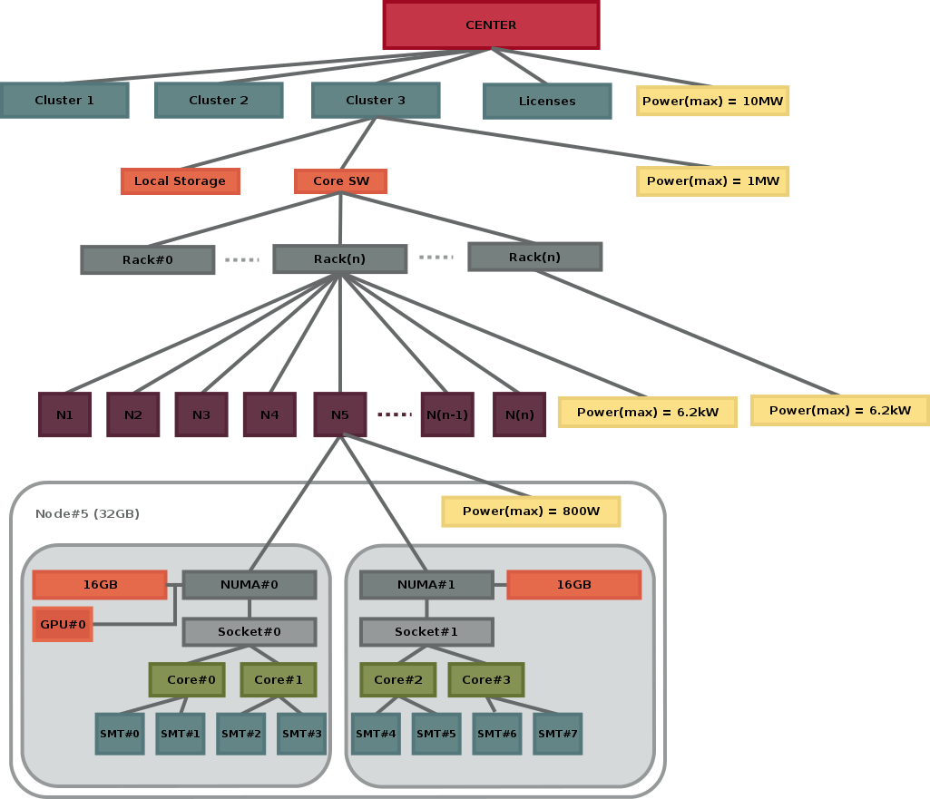
More Specifically…

Slide 15
Scheduling - First Pass
The scheduler at the highest level must have visibility into all the resources down to the core level to schedule jobs submitted to job.0
How all the center’s resources are represented in memory (or the repository) is an implementation detail
Job 0’s scheduler could have a big task of scheduling short, single core jobs across every resource in the center (worst case scenario).

Slide 16
Scheduling Shortcuts to Better Performance
Always push the scheduling decisions down to the child job whenever possible (e.g., DATs)
Establish running job “queues”
A job for the traditional batch and debug partitions
A job for all the core-scheduled nodes (aztec)
Commit to first scheduling decision and only occasionally (if ever) reconsider that decision
Begin the scheduling loop with the highest priority newly submitted job

Slide 17
Scheduling Resources to a Job that Change over Time
Scheduling a series of resource requirements as one job (without relying on a series of dependent jobs)
File staging - lots of I/O for 30 minutes, then
A bunch of compute nodes for 8 hours, then
File storage - I/O bandwidth for 30 minutes
nodes
time

Slide 18
Reactive vs. Proactive Scheduling
All (known) batch schedulers to date can be considered reactive. They schedule in reaction to state changes: newly submitted jobs, newly completed jobs, etc.
There could be a scheduler that is proactive. It monitors the status of all its jobs and makes adjustments dynamically to optimize performance.
Moving a task from a core that appears to be failing
Balancing load dynamically
Growing a job to make use of idle resources
Reducing monitoring/logging when bandwidth is suffering

