Slide 1
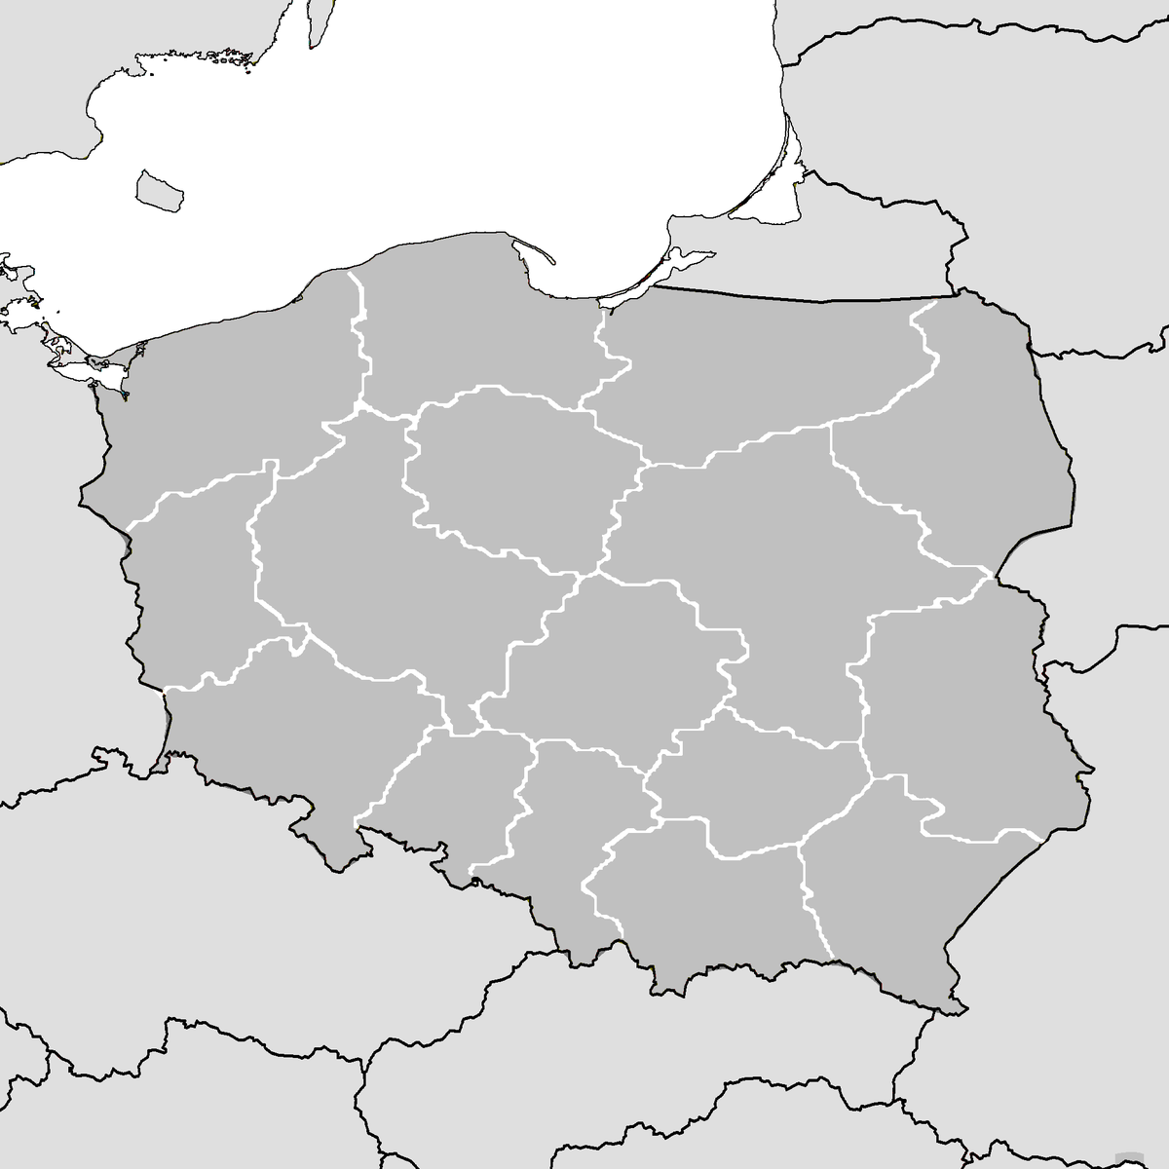
Analysis of Unemployment in Poland
Unemployment by Gender and Place of Residence Comparison of National and Regional Unemployment Trends

Slide 2
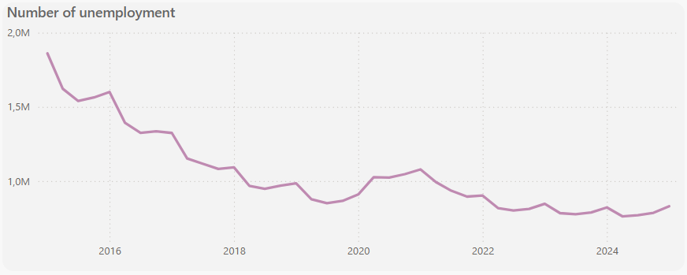
Changing the amount of unemployment in 2015-2025
2015 – 1,8M of unemployment
2025 – 0,8M of unemployment

Slide 3
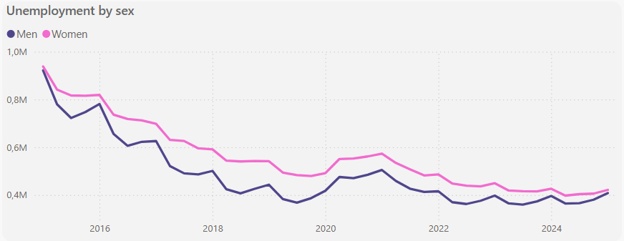
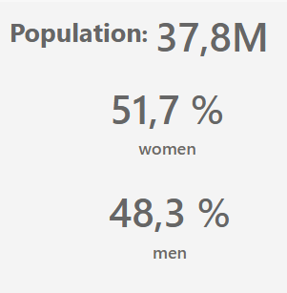
Distribution by sex
On average, each year the number of unemployed women exceeds the number of unemployed men by 70,000 individuals

Slide 4
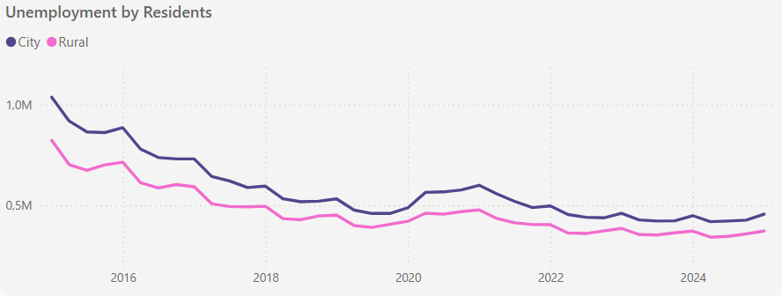
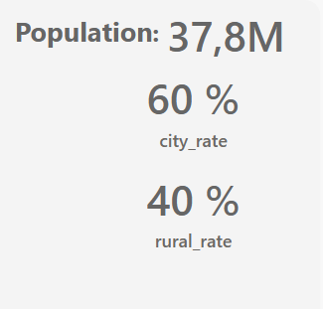
Distribution by residents
The gap between the number of unemployed people in rural and urban areas has halved – from 200,000 in 2015 to 100,000 in 2025.

Slide 5
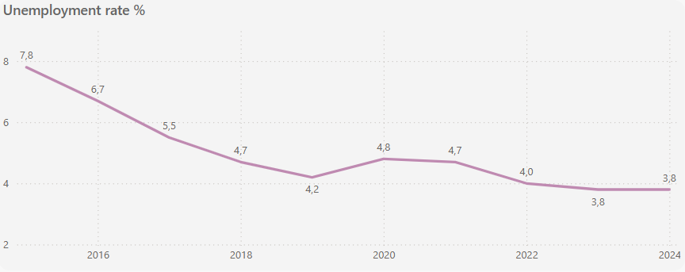
Unemployment rate dynamics: 2015 to 2025
2015 – 7,8%
2025 – 3,8%

Slide 6
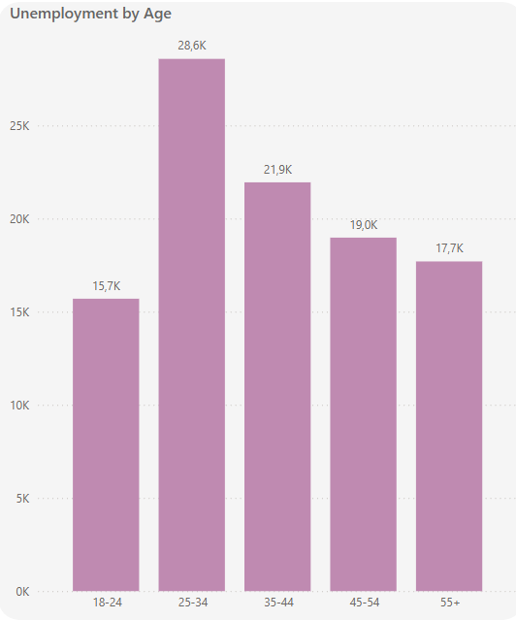
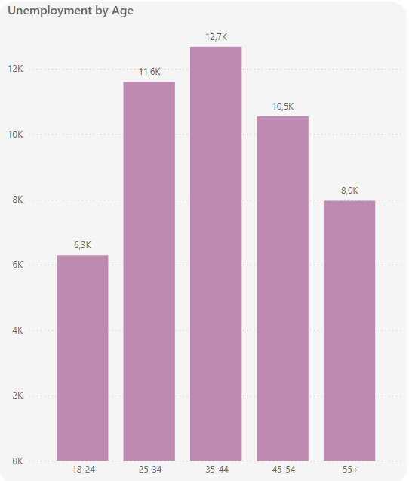
Distribution of unemployment by age groups
2015
2025

Slide 7
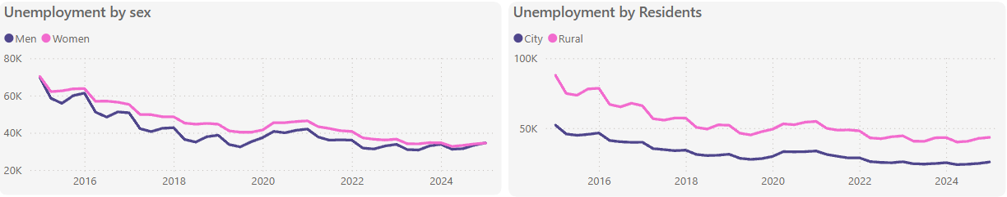
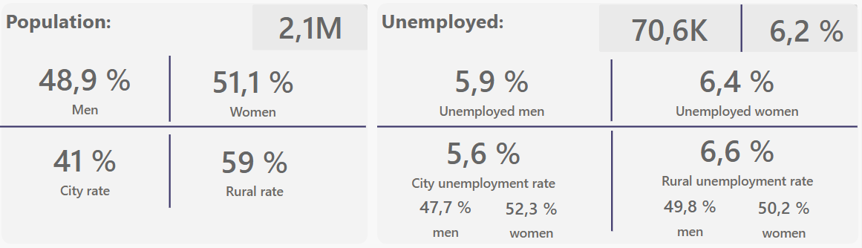
Podkarpackie Voivodeship has the highest unemployment rate

Slide 8
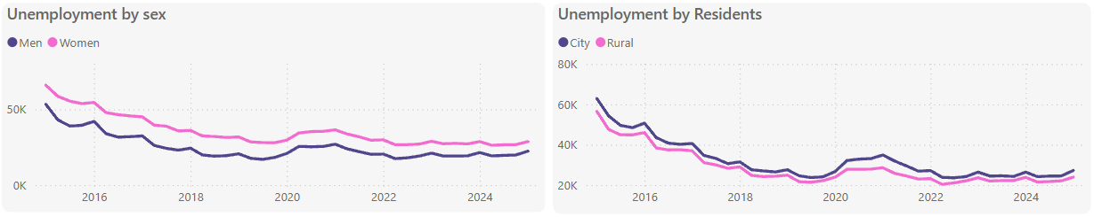
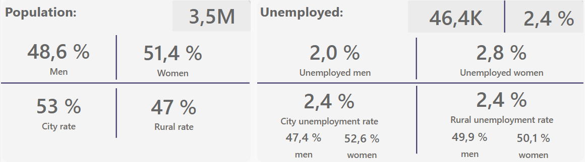
Wielkopolskie Voivodeship has the lowest unemployment rate

Slide 9
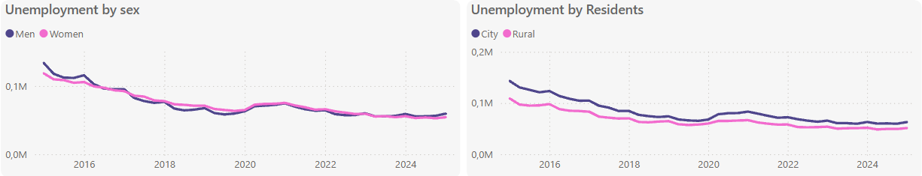
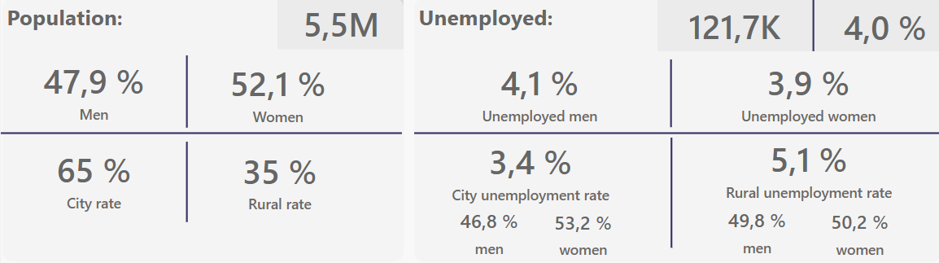
Mazowieckie Voivodeship has the highest number of unemployed people

Slide 10
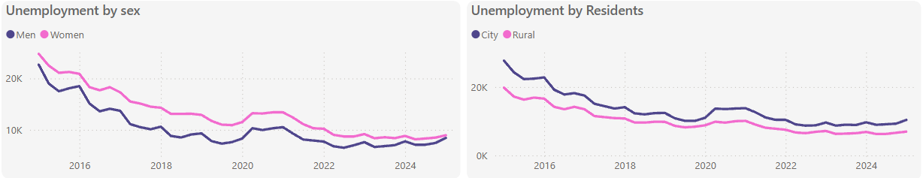
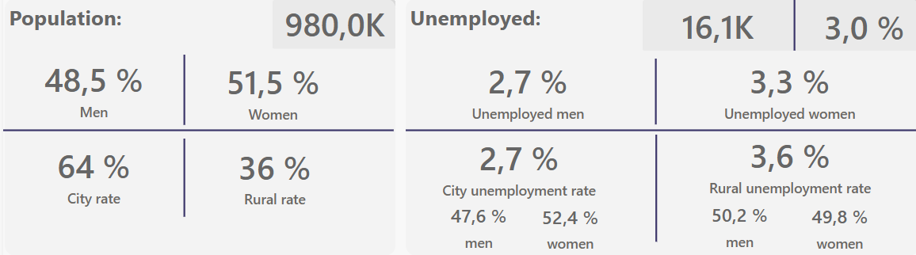
Lubuskie Voivodeship has the lowest number of unemployed people

Slide 11
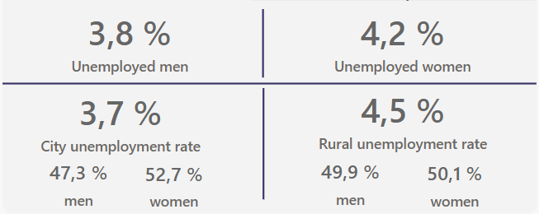
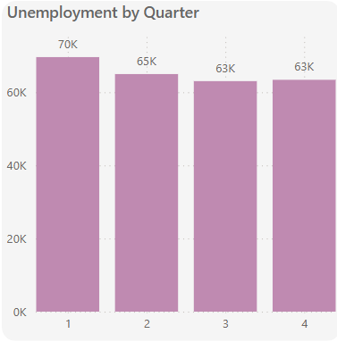
Interesting facts about unemployment in Poland
A disparity between male and female unemployment exists exclusively in urban areas
Each year, unemployment tends to be higher at the beginning of the year than in the following months

Slide 12
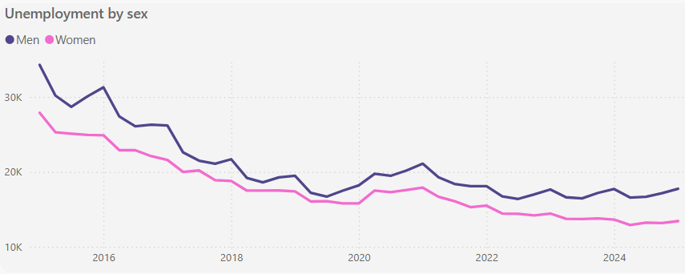
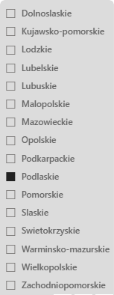
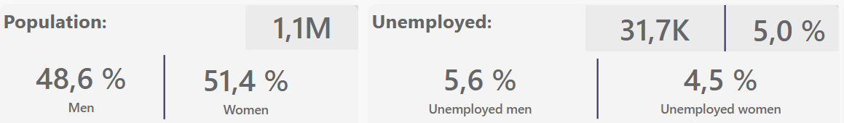
Podlaskie voivodeship has more unemployed men than women

Slide 13
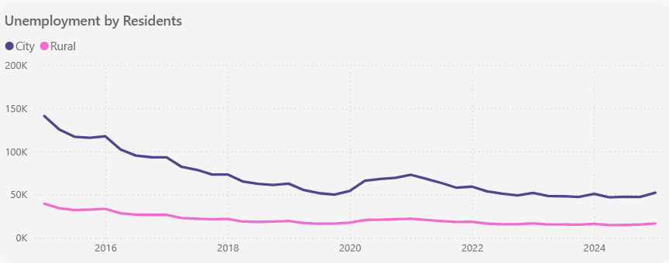
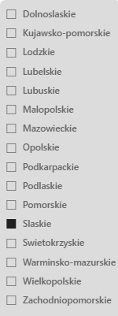
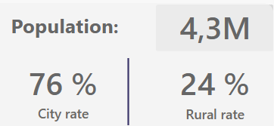
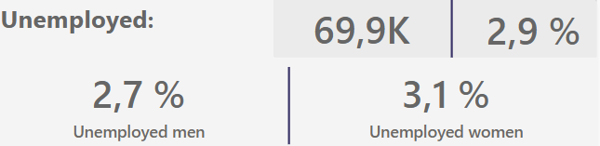
Silesian Voivodeship has the largest difference between urban and rural unemployment

Slide 14
THANK YOU!
Data sources: https://drive.google.com/drive/folders/122fZJujlE88uGsvdWn8cVnxo429z48Kh?usp=sharing

