Slide 1
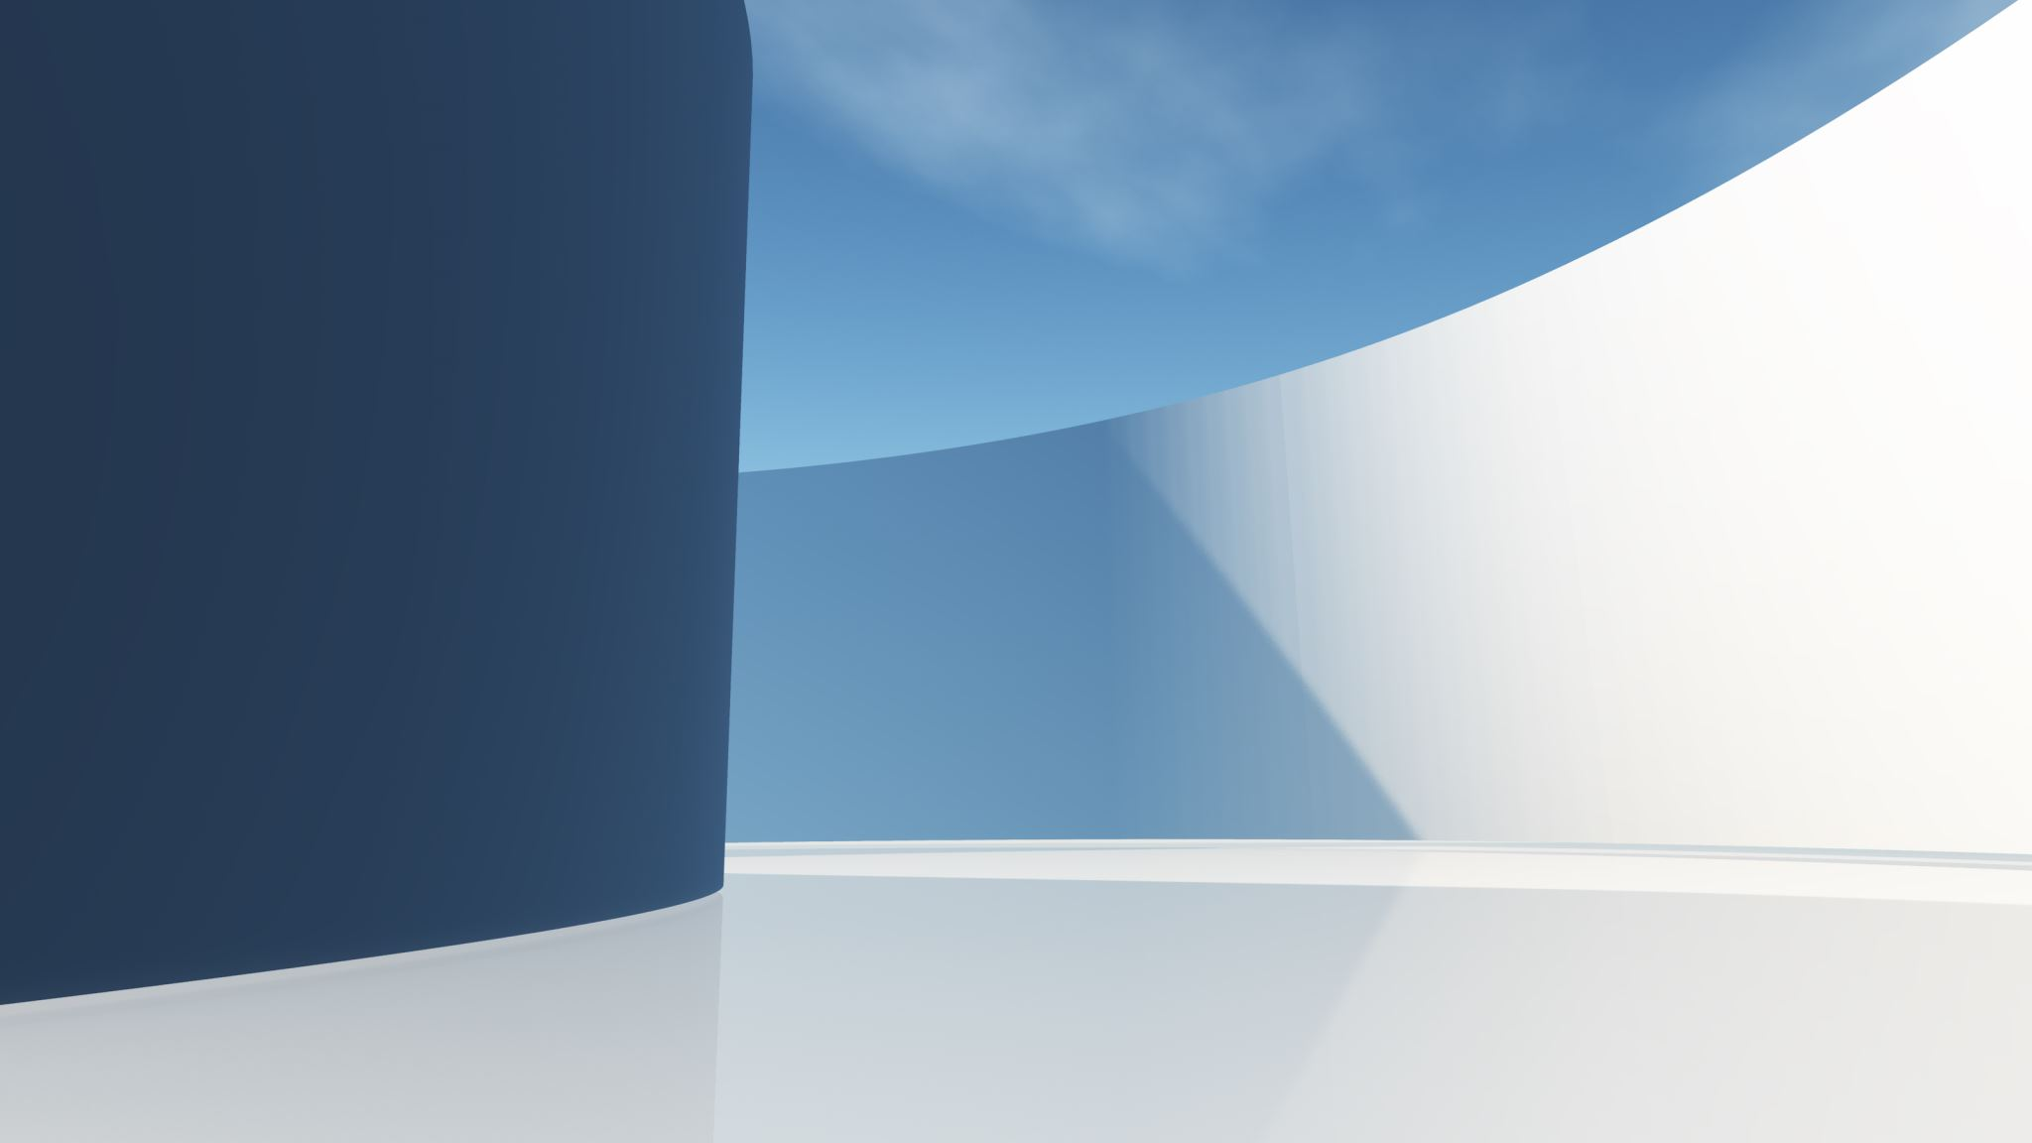
Semantic WEB LINKED

Slide 2
COMPONENTES DEL GRUPO
Victor campos sánchez 210397
Nerea romero peinado 200265
RUBEN CHALA MEDIERO 200120
CARLOS HERNÁNDEZ HERRERO 200095

Slide 3

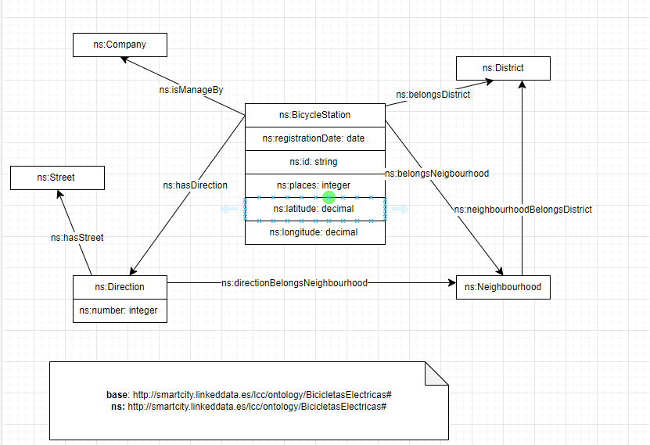

ONTOLOGIA

Slide 4
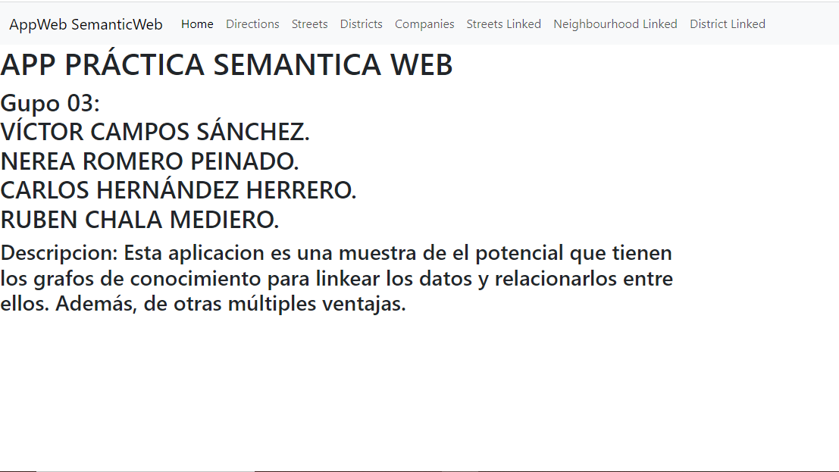

Slide 5
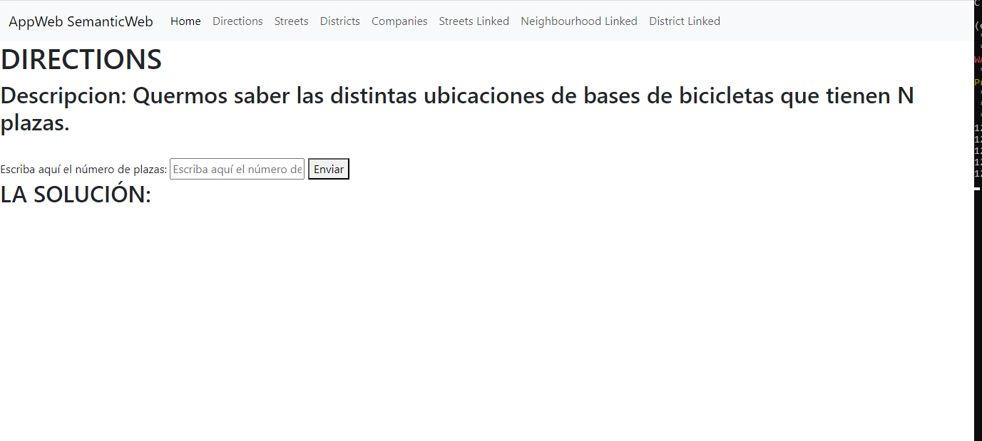

Slide 6
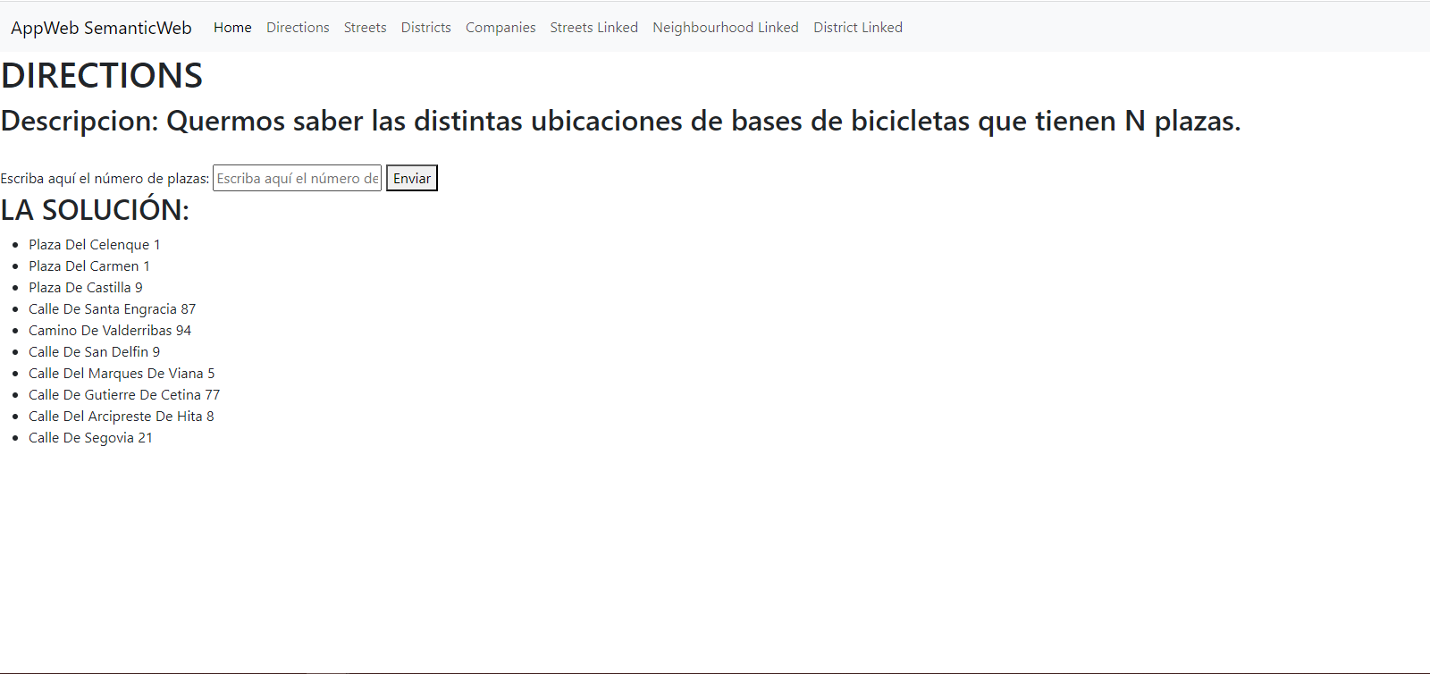

Slide 7
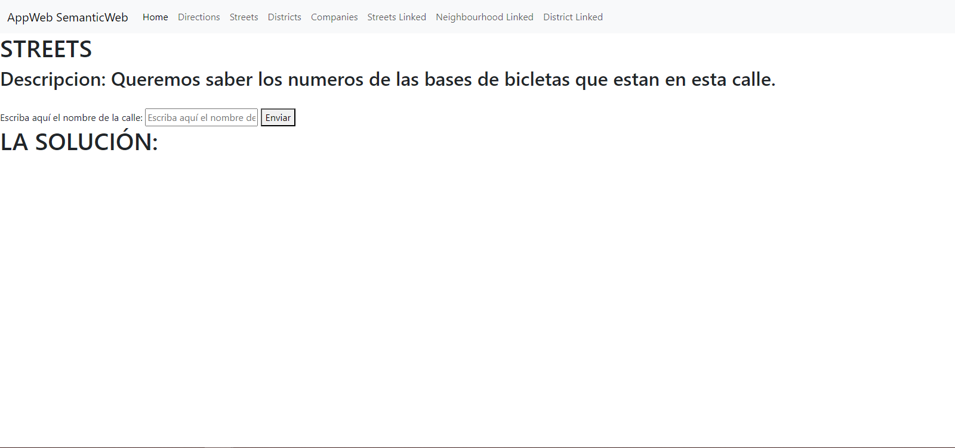

Slide 8
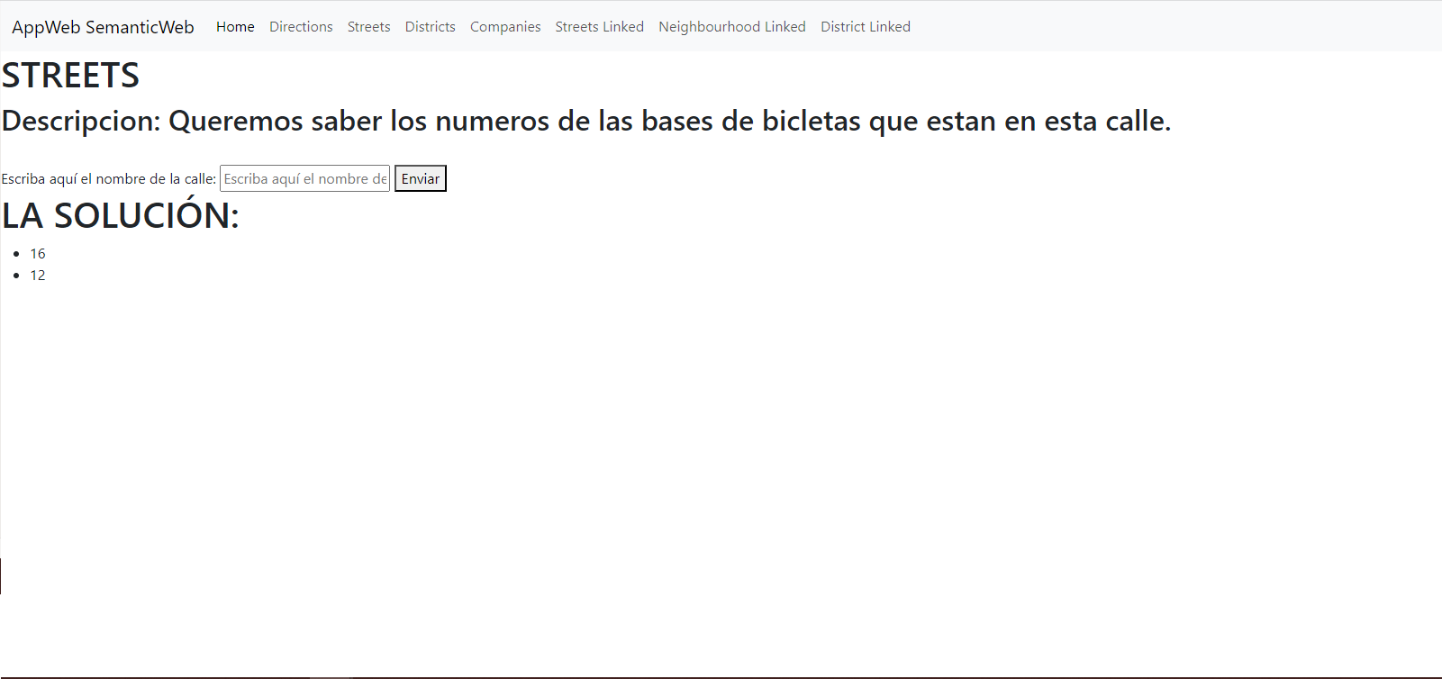

Slide 9
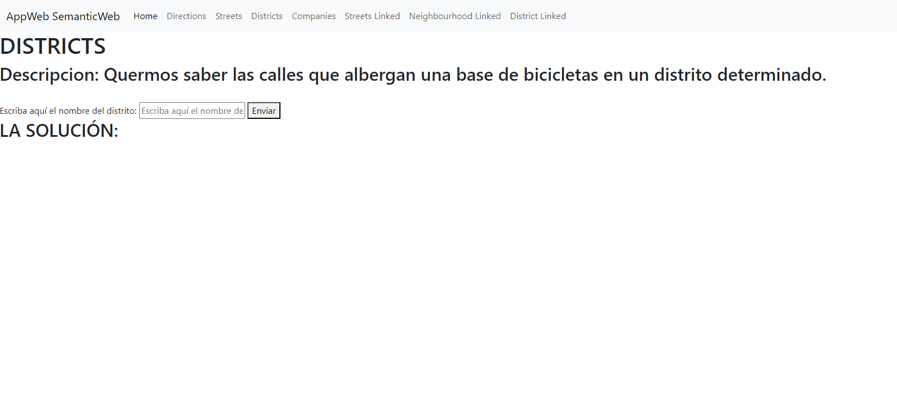

Slide 10
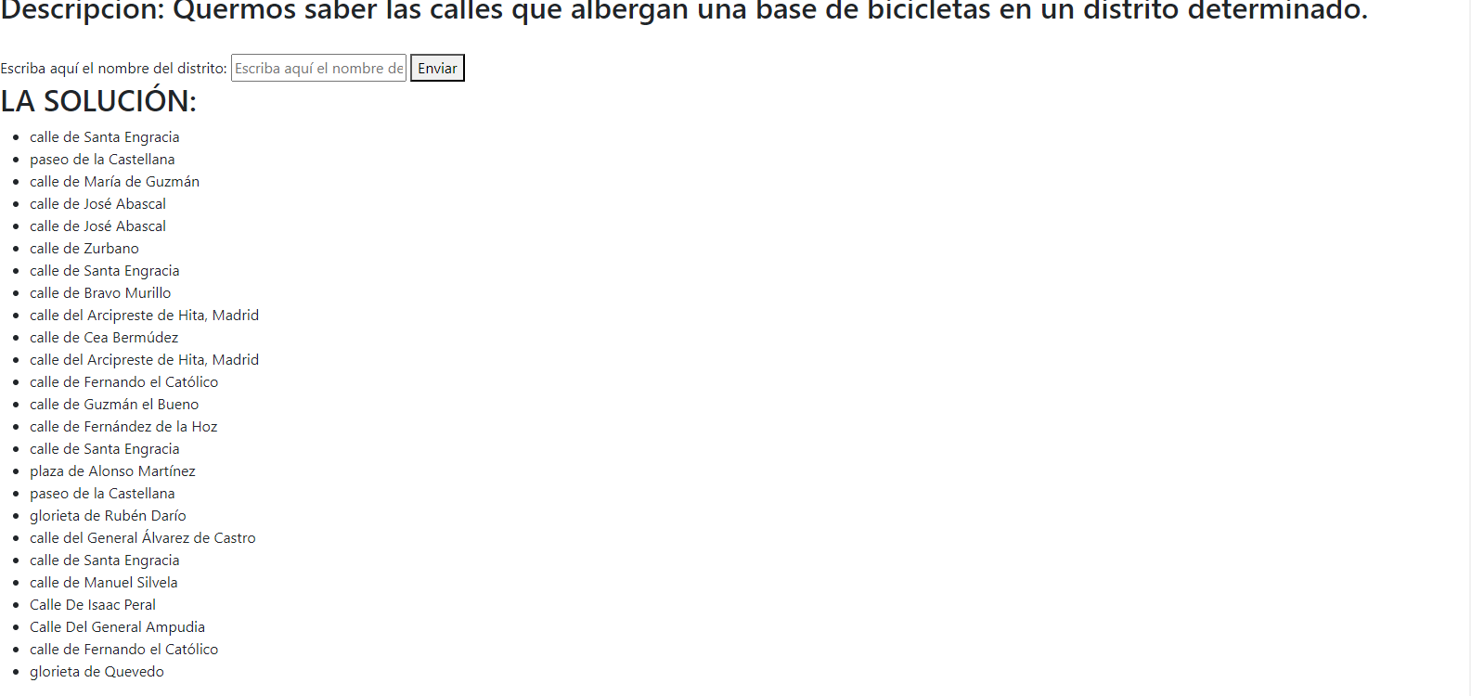

Slide 11
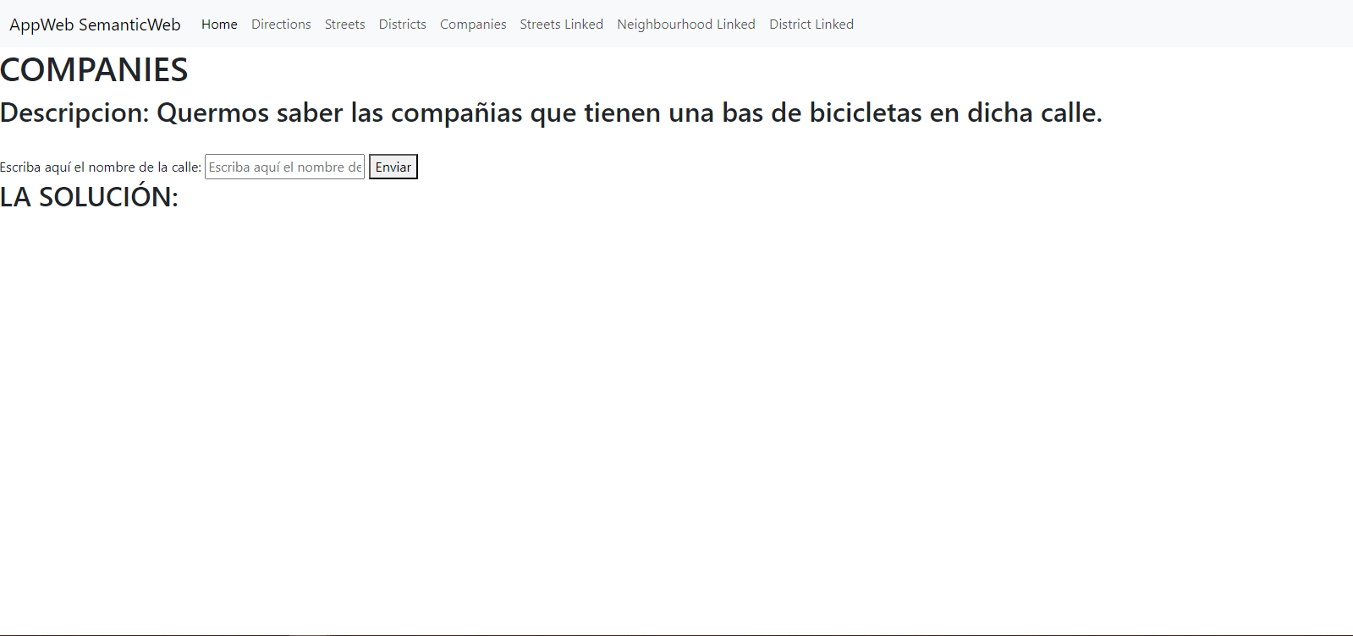

Slide 12
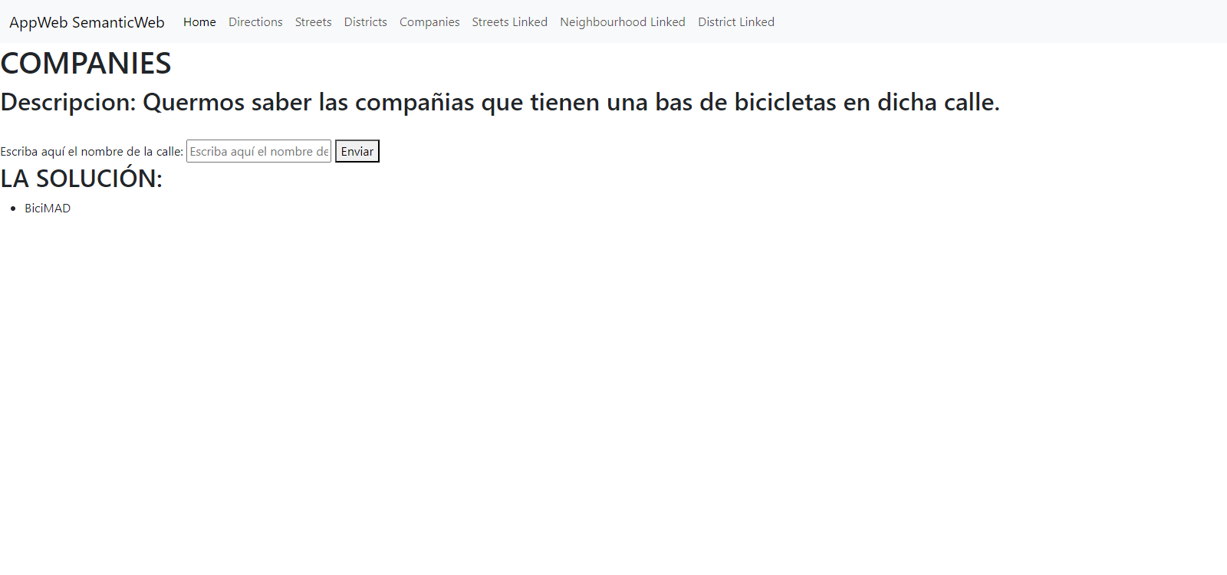

Slide 13
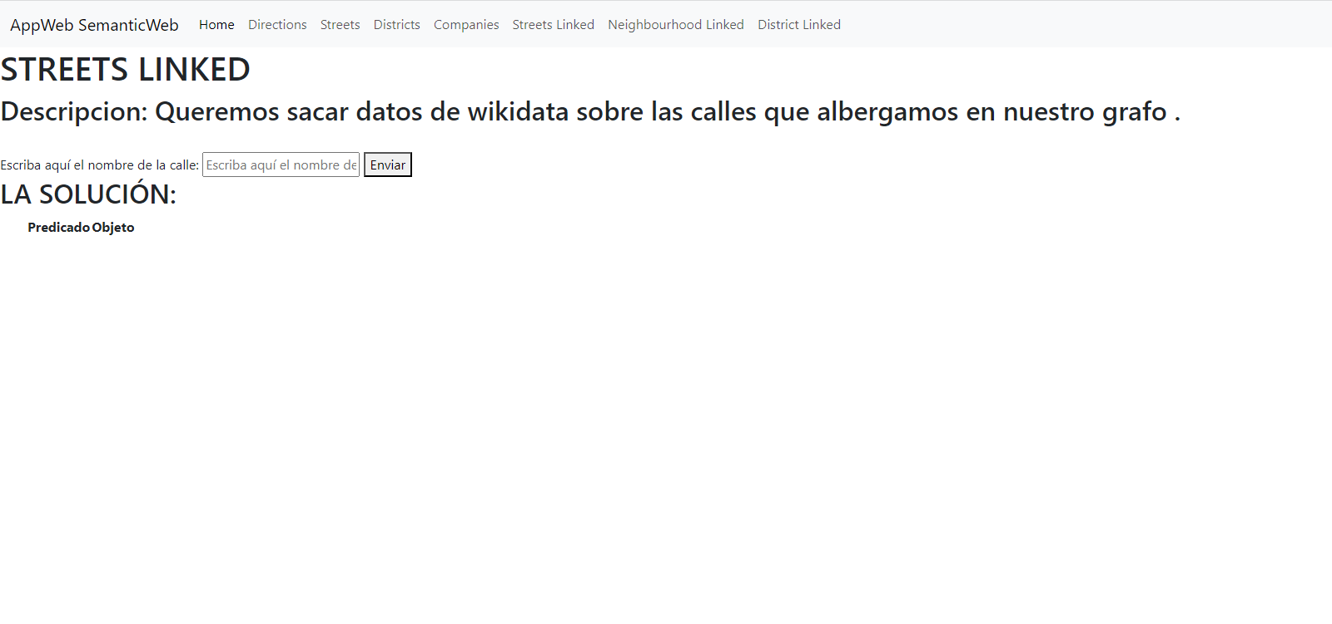

Slide 14
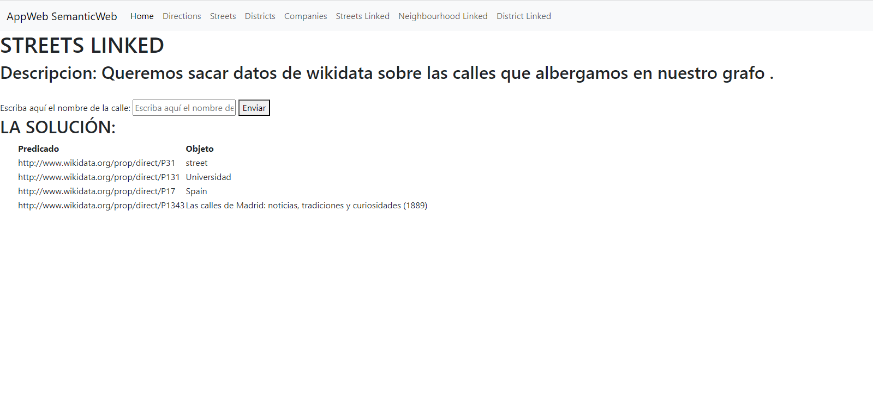
https://wikidata.org/prop/direct/P31
https://wikidata.org/prop/direct/P131
https://wikidata.org/prop/direct/P17
https://wikidata.org/prop/direct/P1343

Slide 15
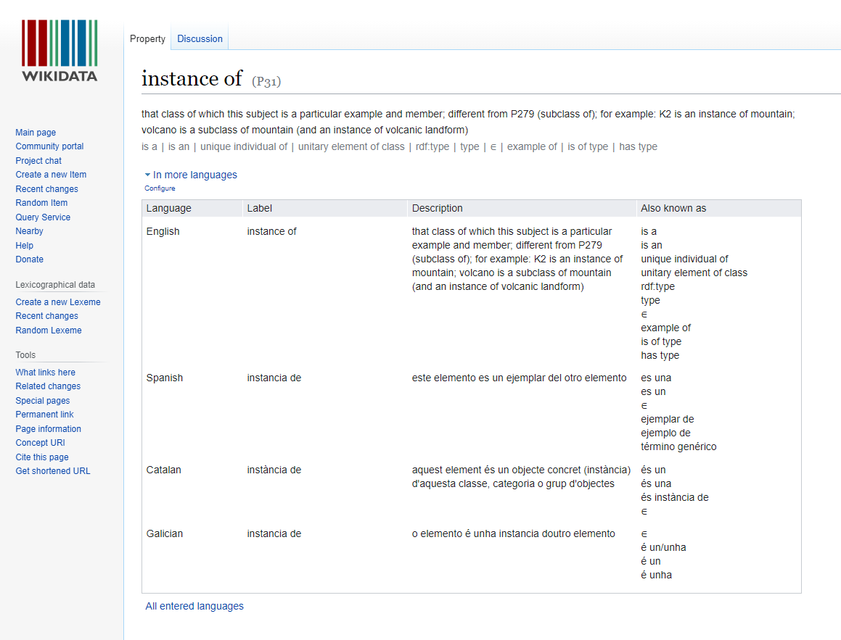
https://wikidata.org/prop/direct/P31

Slide 16
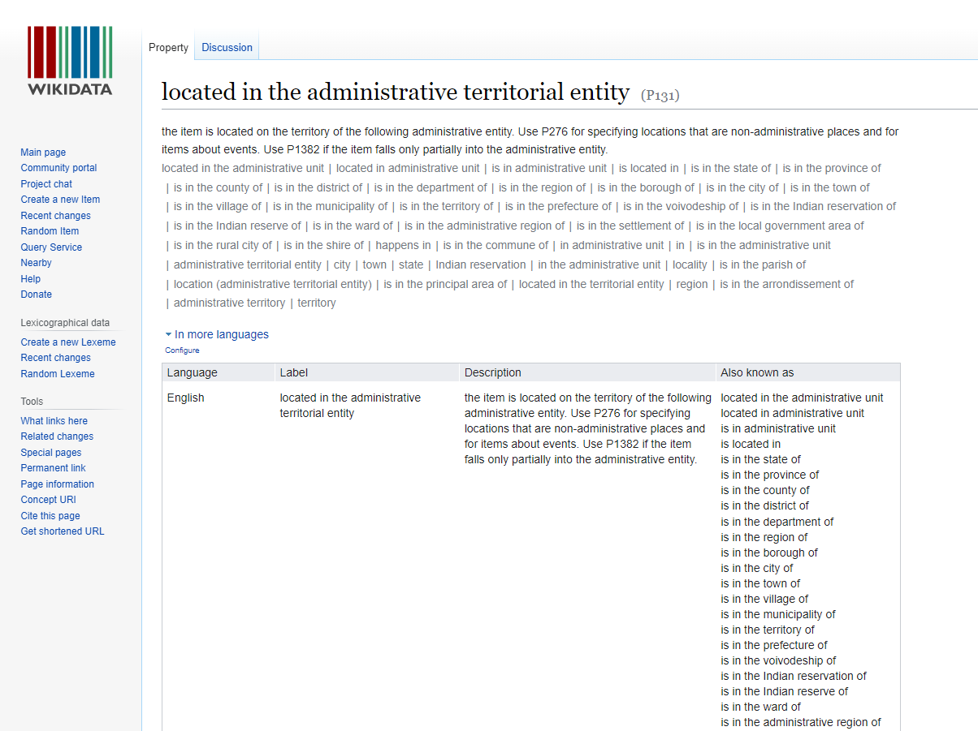
https://wikidata.org/prop/direct/P131

Slide 17
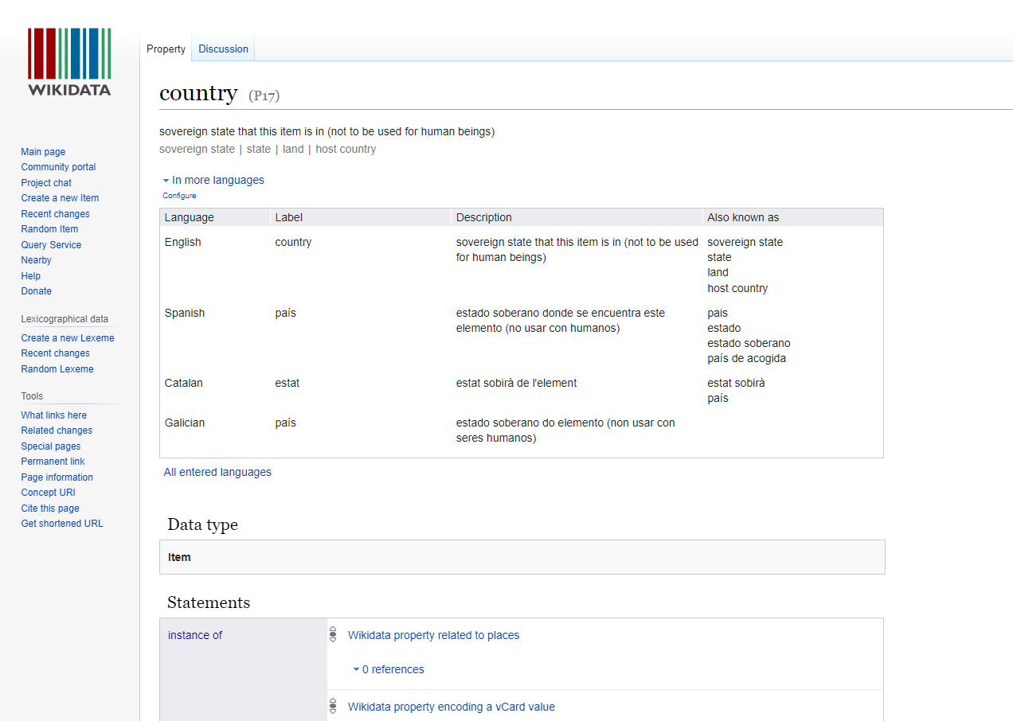
https://wikidata.org/prop/direct/P17

Slide 18
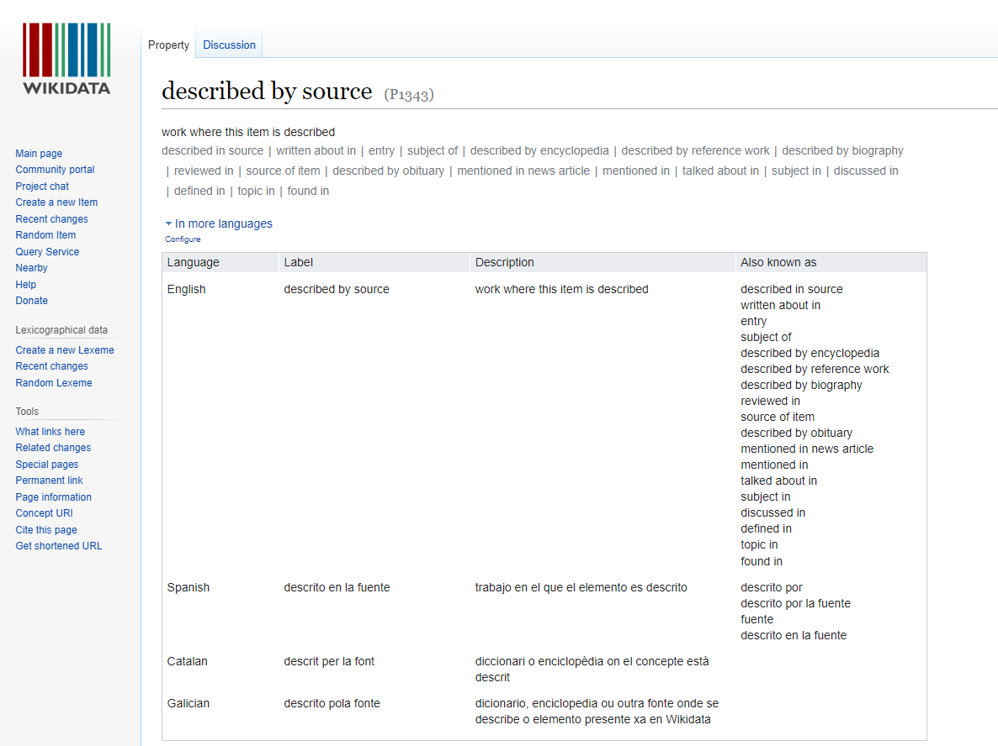
https://wikidata.org/prop/direct/P1343

Slide 19
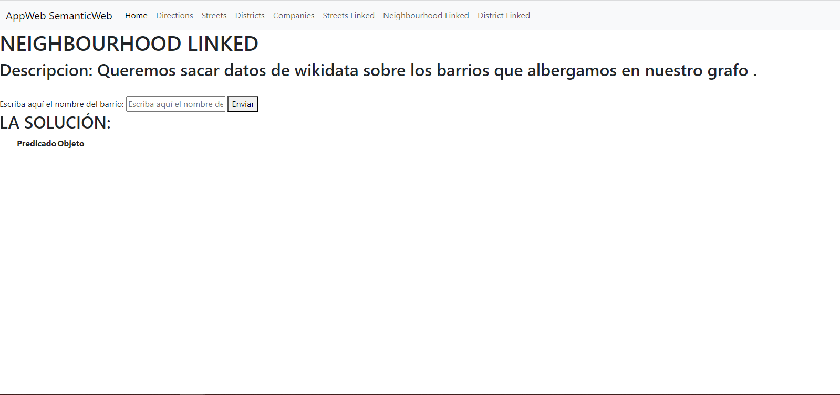

Slide 20
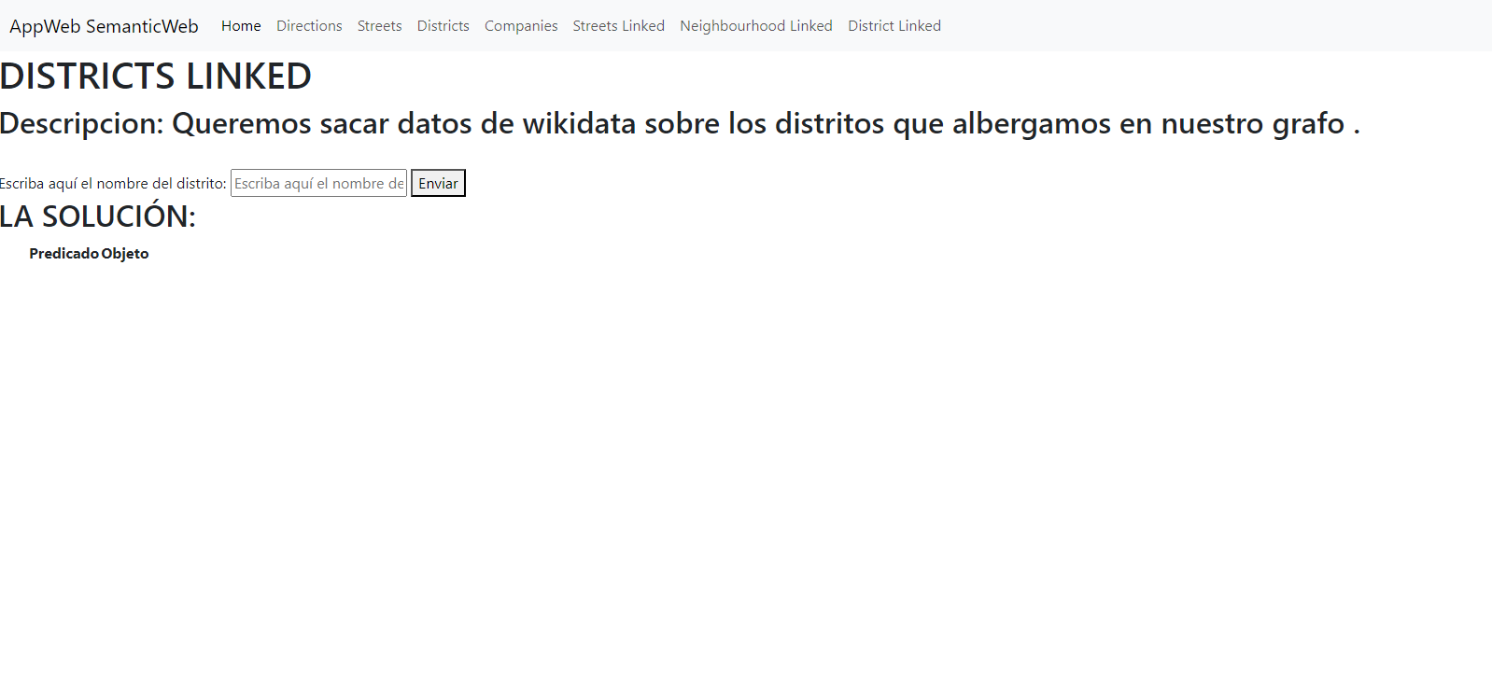

Slide 21
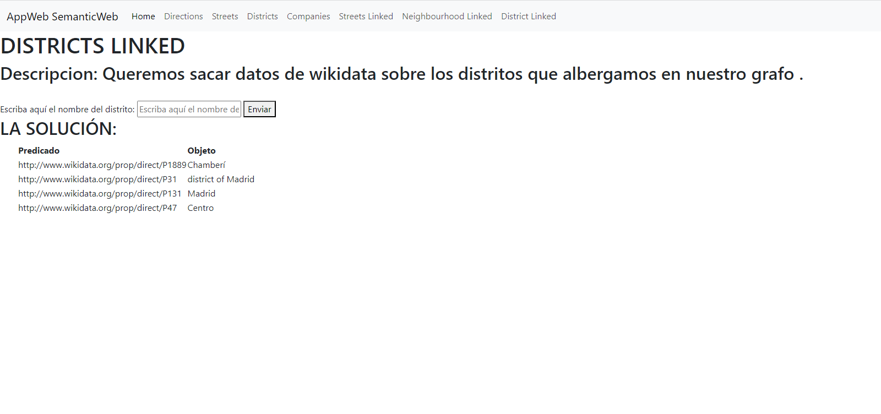

Slide 22
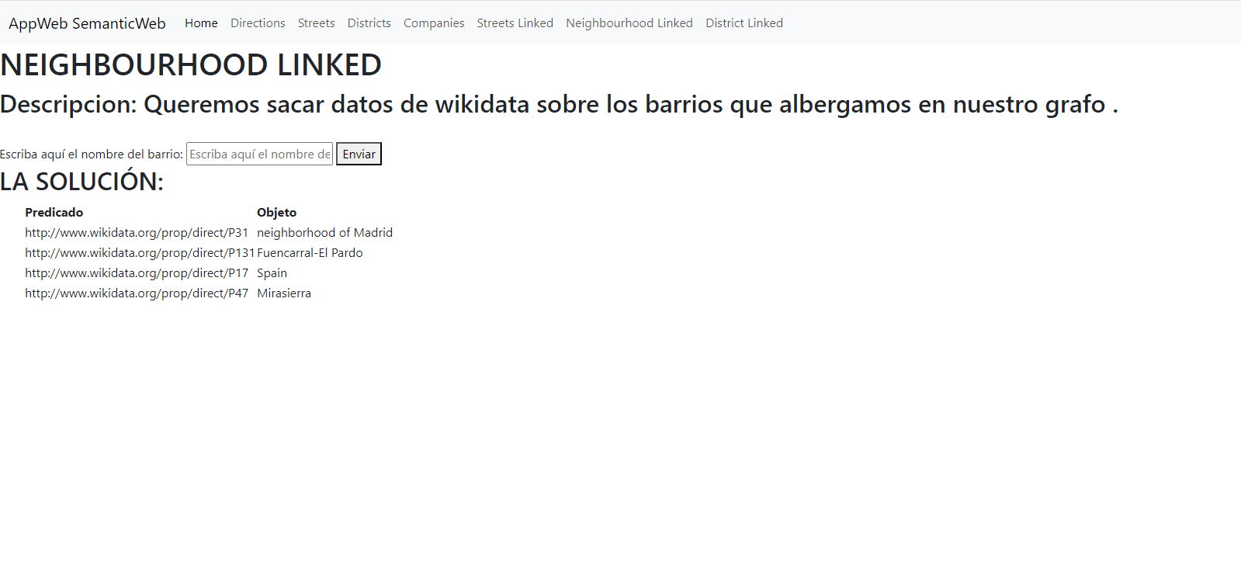

Slide 23
https://wikidata.org/prop/direct/P31

Slide 24
https://wikidata.org/prop/direct/P131

Slide 25
https://wikidata.org/prop/direct/P17

Slide 26
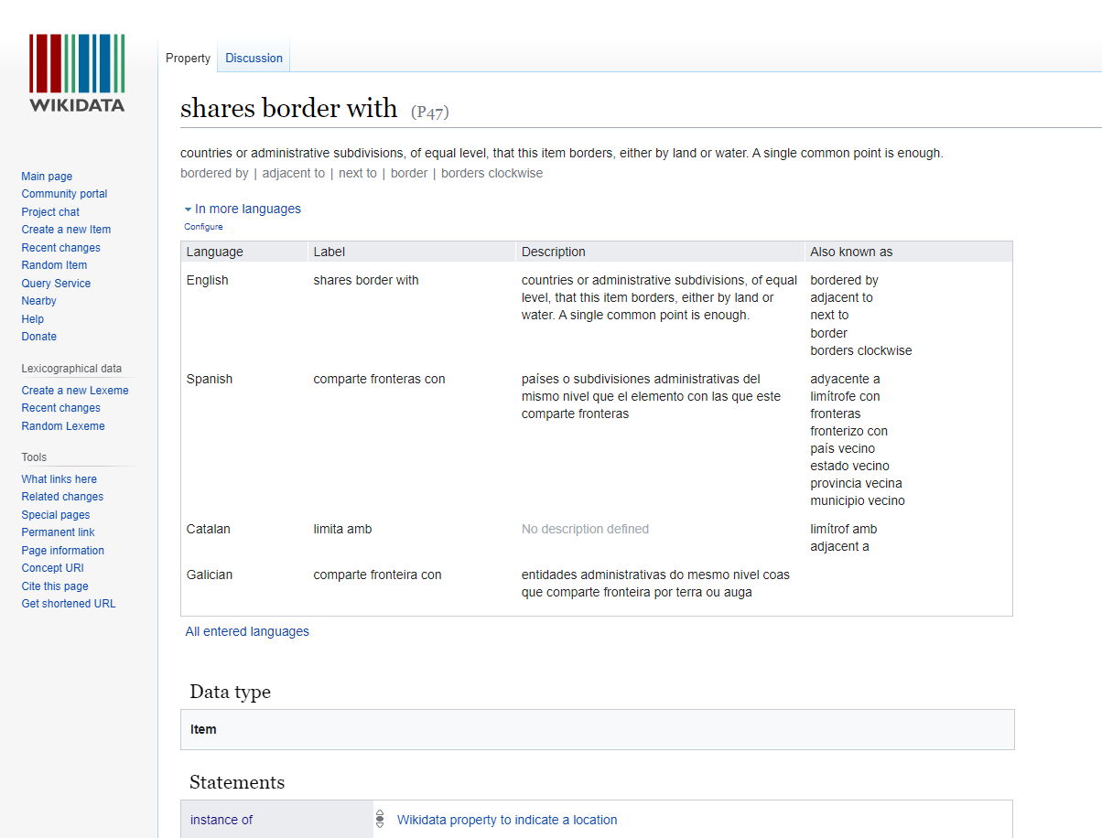
https://wikidata.org/prop/direct/P47

